Slide 1
WHO ARE HERS RATERS?
RESNET & You: The Future of Energy Ratings

Slide 2
2,000,000+
Over two million homes have been HERS rated in the United States, and that number is continuing to grow.
Notes:
We all talk about saving energy and here’s a chance to talk about/introduce you to a job that has helped more than 2 million homes across the country be more energy efficient, lowering energy costs and reducing carbon dioxide emissions by 4 million tons (equal to taking 766,000 cars off the road each year)

Slide 3
How is A Home Impacted by Energy Efficiency and Air Quality?
Are some rooms too hot or too cold?
Is the house hot upstairs in the summer?
Do doors slam when AC comes on?
Is it dusty/constantly wiping dust?
Notes:
How are homes impacted by energy efficiency?
Talk about some of the effects in a house that may not be energy efficient.

Slide 4
Who Are HERS Raters?
Did you know that the new homes HERS Raters work on don’t have those problems?
The work of HERS raters helps improve the comfort, health, and efficiency of homes = lower cost & better for the environment
Helps to conserve resources
Building high-performance homes that are good for your family, your bank account, and the environment.
Notes:
Introduce HERS raters as the individuals behind improving a homes’ comfort and efficiency
They work to make sure a home doesn’t waste resources, resulting in better homes that are good for everyone

Slide 5
What do HERS Raters do?
A day on the job

Slide 6
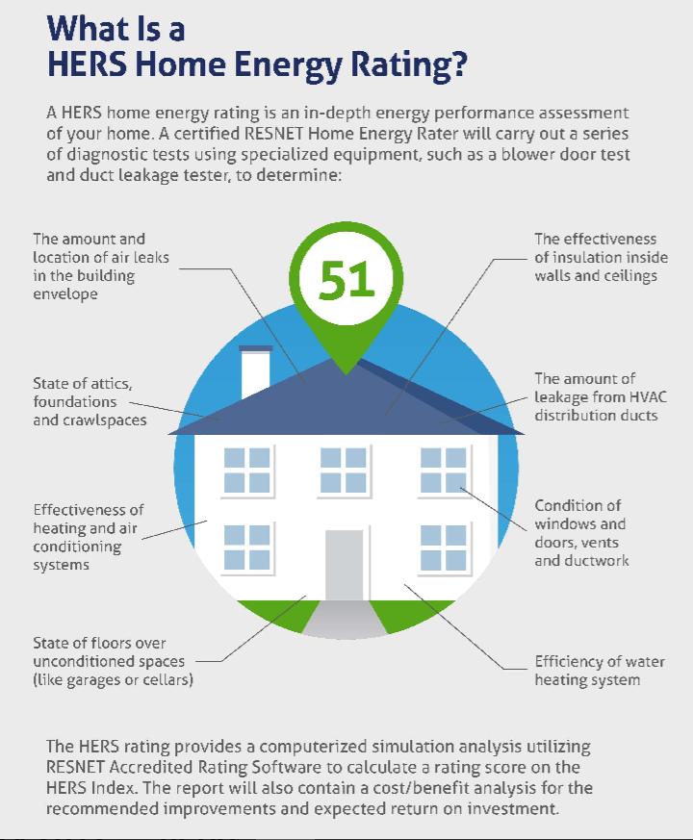
Home
Energy Rating System (HERS)
Notes:
To understand the work of a HERS rater, let’s first talk a bit about HERS
Think of the HERS rating as an energy efficiency version of a MPG (like for cars) for your home
Depending on knowledge of the audience, the speaker should keep the details at a high level, about the things that are tested to determine the score.

Slide 7
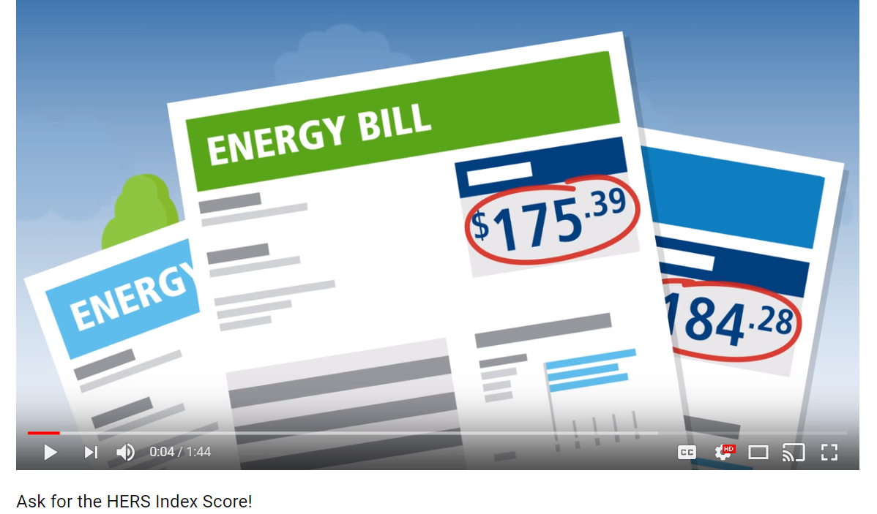
Examples
Short video https://www.youtube.com/watch?v=klGa1rUdydo&feature=youtu.be
Notes:
If there is enough time, you could play this short video on What is HERS?
If not enough time allotted, then skip to next slide

Slide 8
Competencies/Knowledge
Building science—how buildings work
Drafting/plan reading
Spatial awareness
Math, science, physics
Notes:
What kind of competencies are needed?
Talk about the subjects you have to study, things you have to learn, again at a high level.
Talk about the physicality of the work, if asked.
You want to encourage interest, but not discourage them with too much complexity .

Slide 9
BENEFITS
Set your own schedule
Make a difference for homeowners
Mix of work in office and out in the “field”-- Not behind a desk all day
Flexibility
What are the personal benefits of becoming a HERS Rater?
Notes:
Talk about benefits of the job—and why you chose to get into field
Talk about the a day in the life of and the flexibility of the work—you go from office to building site, interact with contractors, sales staff, potential buyers, etc…
And on a personal note, being a HERS rater makes you better able to troubleshoot issues in your own home and others’

Slide 10
In many ways, being a HERS rater is like being a teacher; having the opportunity to teach people on all sides of the industry how to build and live better.
At the same time, being a HERS rater means being a lifetime student; constantly learning as industry and best building practices evolve and improve.
- C. Pratt, HERS Rater
Notes:
Talk about how HERS raters are they type of people who are constantly learning the latest and ow they teach others about better building scieince.

Slide 11
How HERS Raters make a difference
HOMEOWNERS
Agents of change—working to make changes in the homebuilding industry
Value-add to homeowners; helping them to save money on utility costs, mortgage
Improving resale value of home
Preventing problems before they happen; making home more comfortable
ENVIRONMENT
Agents of change—working to make changes in the homebuilding industry
Carbon dioxide emission reductions
Climate change
Utility loads
Reducing fossil fuels
Notes:
Many people want to feel their work makes a difference.
On this slide, you can highlight how the work of a rater helps homeowners, and the environment

Slide 12
Career Path for HERS Raters
Owner of rating company
Employed by
Homebuilder
Design/architect
Engineering
Utility provider
Product manufacturer
Work as a code official
Multiple potential lines of business/income
Flexibility—can work anywhere
Notes:
Talk about jobs you’ve had, roles of HERS raters employed, etc.

Slide 13
$52,000*
1,900 HERS Raters
1 in 4 Homes HERS Rated
Estimated Annual Salary
Current RESNET certified Raters
Growing demand!
*https://www.payscale.com/research/US/Certification=HERS_Rater_Certification/Salary
Notes:
According to Payscale.com, the average salary of a HERS Rater is $52k a year, which could vary based on experience, certifications, location, etc.
As a presenter, if you want to share estimates more local to your area, feel free, but it is always helpful to cite a 3rd party source when available.
Note it may not be appropriate to share fees your earn per rating, but instead talk about a range.

Slide 14
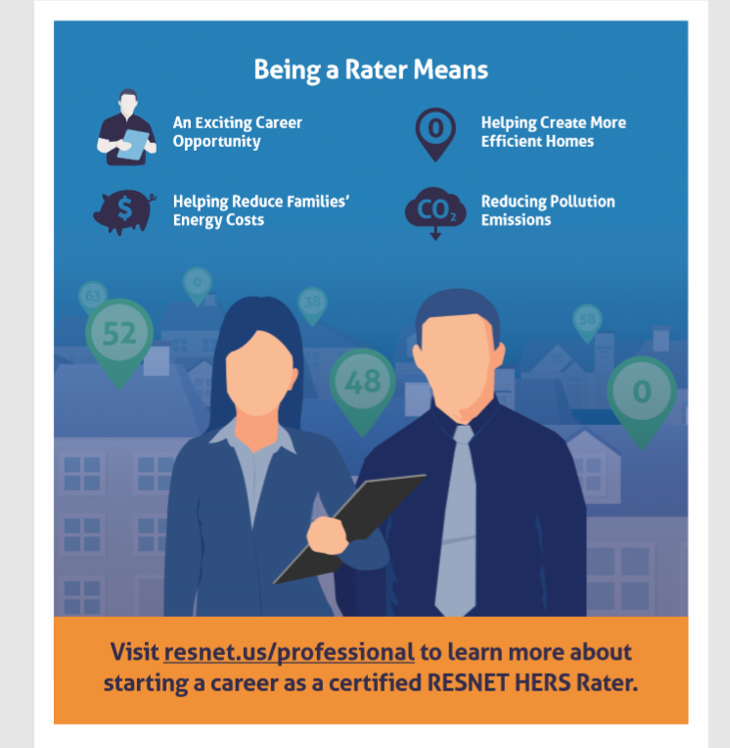
Notes:
To close, being a HERS raters represents
An exciting career opportunity
Helping create more energy efficient homes
Helping to reduce families’ energy costs
And reduce pollution emissions

Slide 15
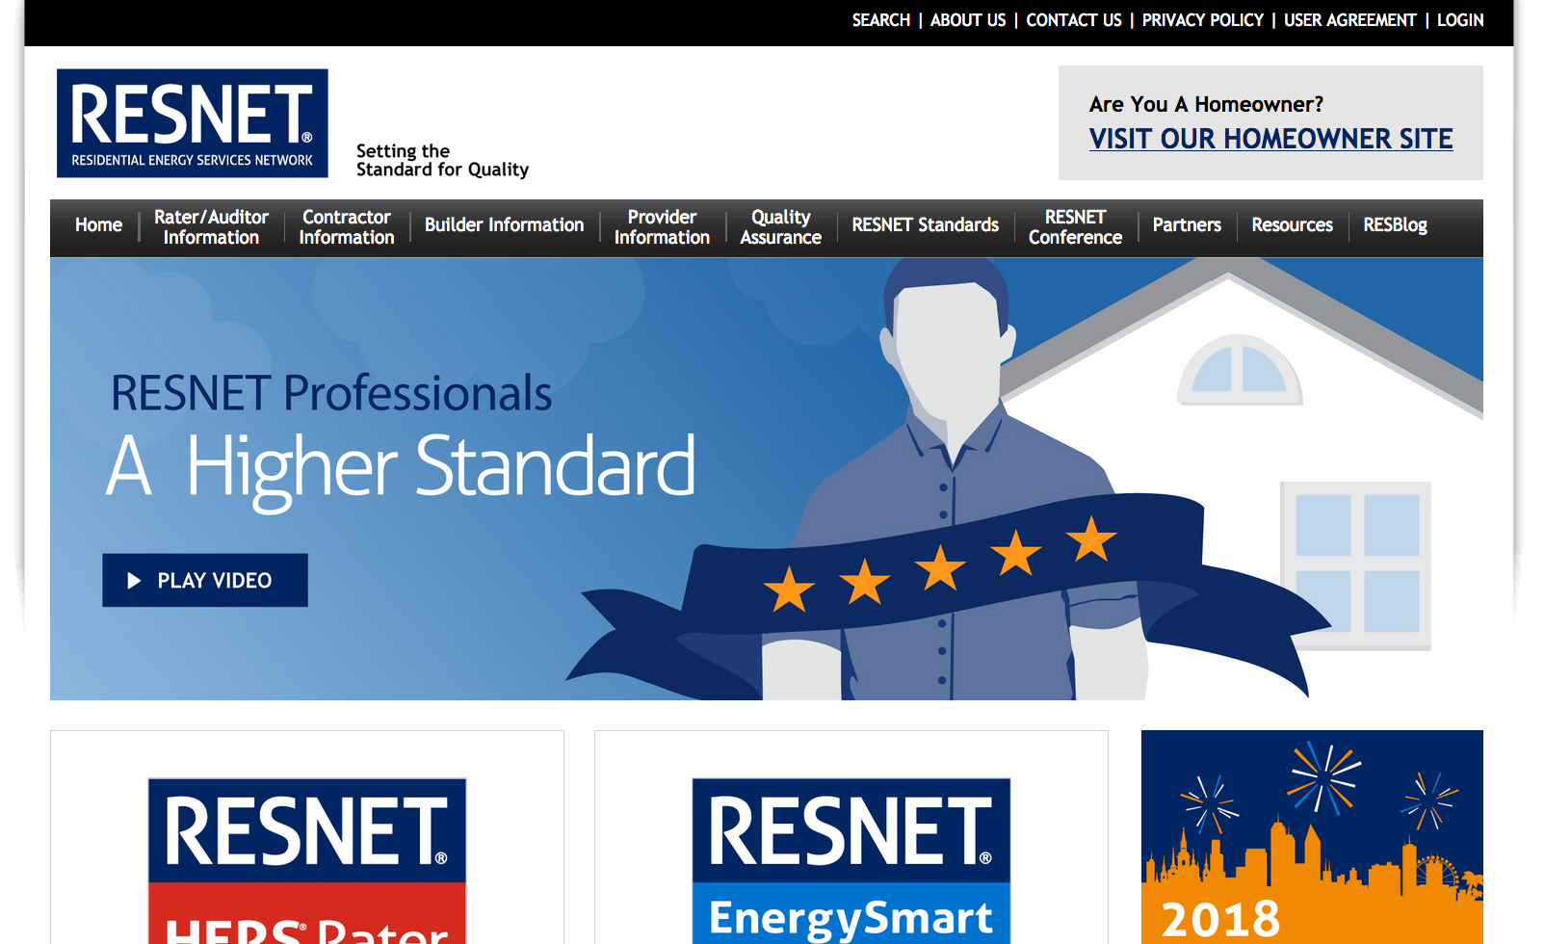
FOR MORE INFO
Visit our RESNET Professional Site for more information.
Place your screenshot here
Notes:
Direct them to our website to learn more about HERS

Slide 16
THANKS!
Questions:
info@resnet.us
www.resnet.us

