Slide 1
2025 Modeling Enhancements Update
Formally known as the “Software Consistency Update”
Neal Kruis, PhD Big Ladder Software, Vice President
RESNET, Energy Modeling Director
Nathan Oliver Big Ladder Software

Slide 2
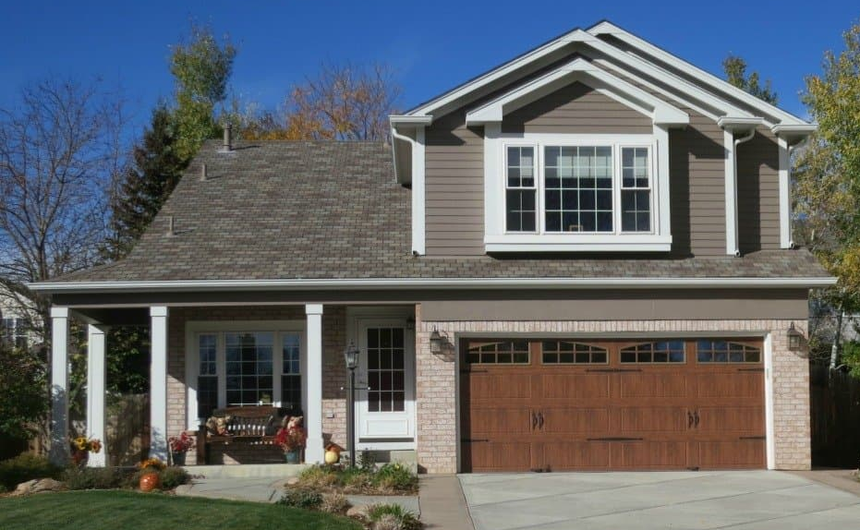
HERS® Rating Consistency
63
Modeler A
Software A
Modeler B
Software B
Notes:
Consistency is a critical component of quality standard RESNET sets for itself.
This means that a home rating should be the same regardless of who models it and what software they use
RESNET does this through standardizing inspection procedures and requiring training and professional development for RESNETcertified raters or modelers
And by through standardized calculations and testing procedures for RESNET accredited software

Slide 3
HERS® Rating Consistency
67
Modeler A
Software A
59
Modeler B
Software B
Notes:
However, modelers sometimes make mistakes that result in inconsistent results
but those mistakes can be mitigated and corrected through RESNET’s quality assurance process
Software developers also make mistakes, but there aren’t QADs for software development.

Slide 4
RESNET Software Consistency Committee
Subject Matter Experts:
Neal Kruis
Rob Salcido
Scott Criswell
Brian Christensen
Residential Energy Management Systems
RESNET HERS Software Providers:
Tim
Leslie
Philip Fairey
Cy
Kilbourn
Steven Klass
Pivotal Energy Solutions
APEX
Notes:
So in 2018, the RESNET board formed the Software Consistency Committee.
Some faces have changed, but the idea remains the same: A balance between software providers and subject matter experts.
SMEs include me (chair of the committee)

Slide 5
Other SCC Participants
Scott Horowitz* (NREL)
Robin Viera* (FSEC – EnergyGauge)
David Reddy* (O’Brien360 – CBECC-Res)
Robert Burns (Pivotal Energy Solutions – APEX)
Gayathri Vijayakumar (Steven Winter – SDC 300 Chair)
Nathan Oliver (Big Ladder Software)
Laurel Elam (RESNET – Director of QA Administration and Standards)

Slide 6
HERS® Software Consistency
65
Software A
61
Modeler
Software B
Notes:
The Software Consistency Committee was tasked with resolving cases where two or more software tools were giving different HERS Index results even when they were run by the same modeler.
When the Software Consistency Committee started. The software landscape was quite different:
The accreditation testing criteria was outdated and relatively lax and forgiving (I’ll come back to this in a moment).
Some of the underlying calculations were so fundamentally different (some tools used seasonal calculations, others used hourly calculations).
Comparing software was not apples-to-apples

Slide 7
SCC Charter
Transition to hourly calculations
Revise accreditation testing criteria
Investigate consistency inquiries
Enhance software tests
Recommend standards updates
Notes:
Two important tasks were set for the SCC:
Shepherd the industry through the required transition to only hourly (or better) calculations
Revise the testing criteria to reflect modern best simulation practices
This is followed by three ongoing tasks to support software consistency:
Inquiries
Enhanced tests
Update standards to include clearer modeling guidelines
As a committee appointed by the board, SCC does not formally have any role in the standards development process
That job is assigned to SDC 300 and its subcommittees

Slide 8
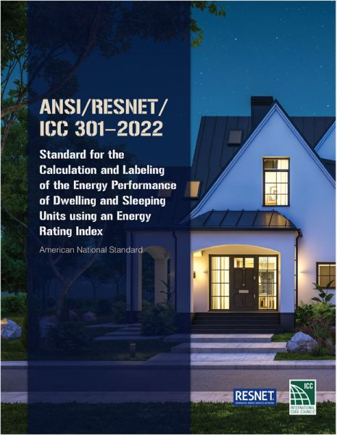
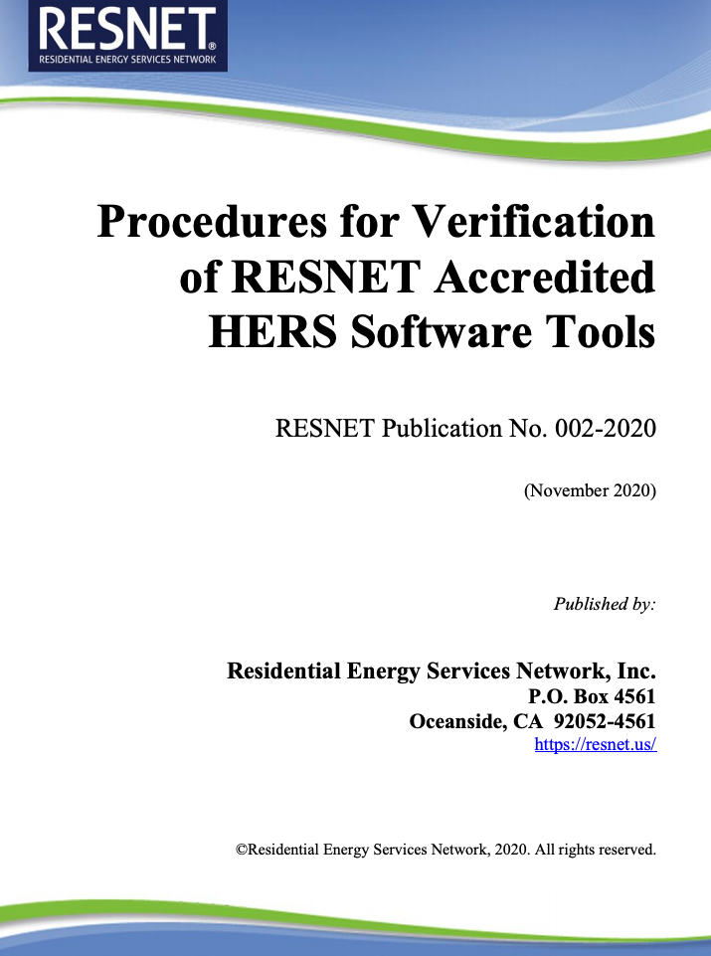
Software Consistency Documents
Calculation Standard
Testing Procedures
Notes:
Basically, the only way to enforce anything coming out of the SCC is to draft changes to either of these two documents

Slide 9
SCC Charter
Transition to hourly calculations
Revise accreditation testing criteria
Investigate consistency inquiries
Enhance software tests
Recommend standards updates
✅

Slide 10
Acceptance
Criteria
Notes:
Publication 002 describes several tests that evaluate software’s ability to model building physics.
Includes: Heating load calculations, cooling load calculations, HVAC performance, Hot Water system performance, and distribution system efficiency
Each set of tests has acceptance criteria for the test results…

Slide 11
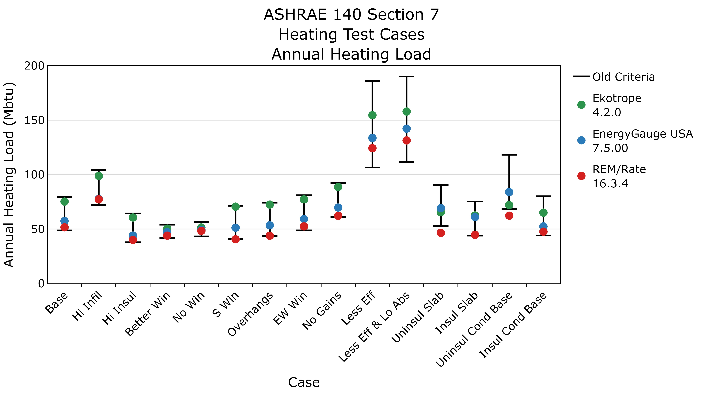
Notes:
This is an example of the heating load test case results
On the bottom axis, you have the different cases starting from a base case and changing infiltration…
You can see results of recent versions of each of three software tools (this was before APEX accreditation)
The black bars show the old criteria for accreditation. You had to be somewhere within this range to pass.
But these ranges are based on simulation tools that were considered state-of-the art in the mid 90s. And simulation technology has come a long way since then.

Slide 12
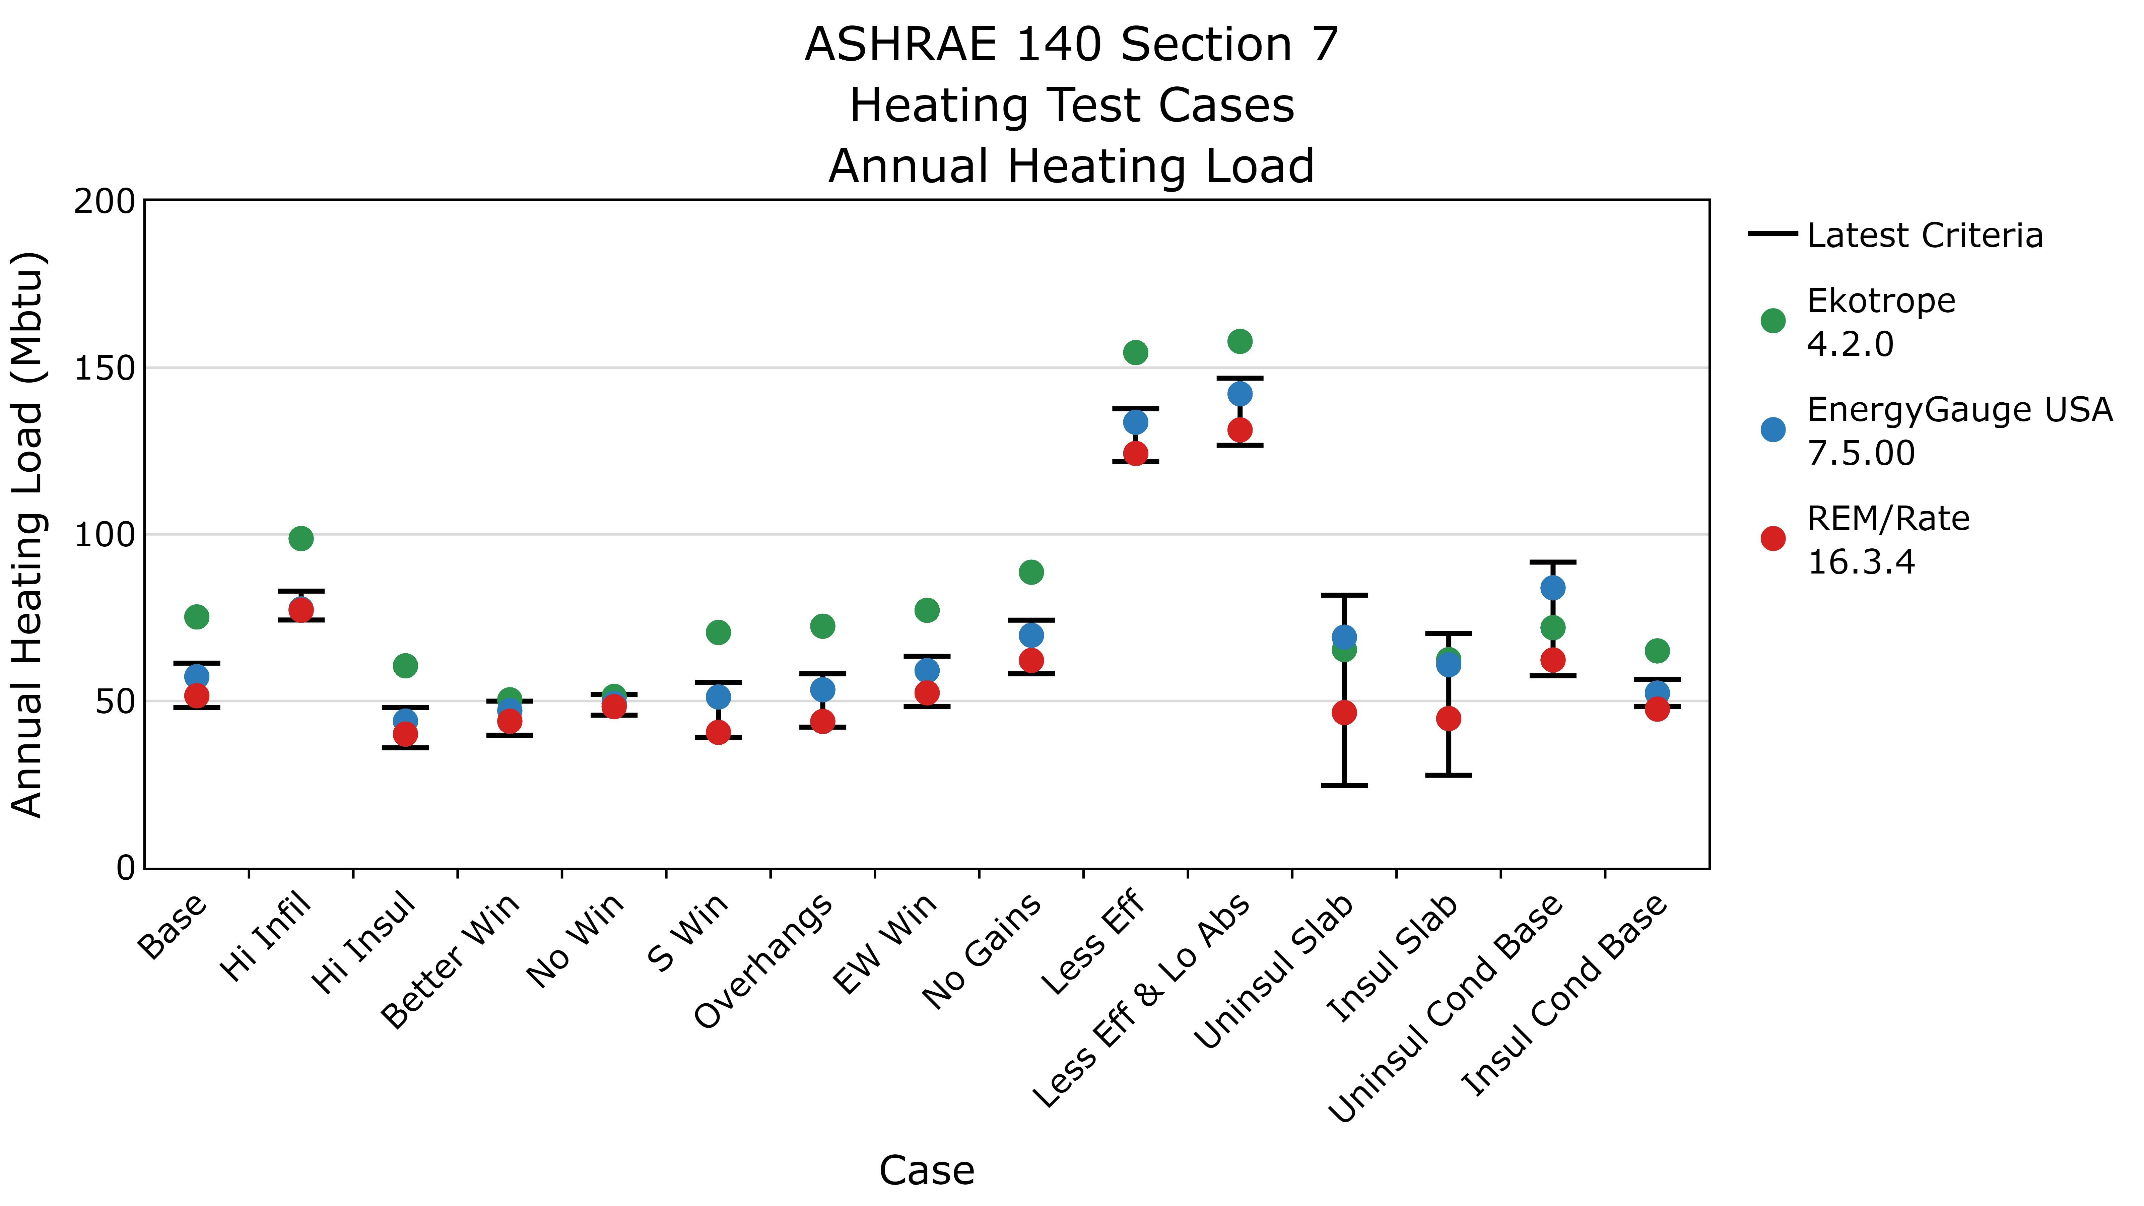
Notes:
So we used newer software to develop a new set of ranges
If I flip between these two, you can notice how many of the ranges are now much more narrow
and Ekotrope, which was comfortable within the old range just had the rug pulled out from under them
But Ekotrope knew this was coming and our committee established a timeline for them to get their software into compliance

Slide 13
Consistency Resolution Proposal
10/26/2023: Identify and outline software modifications required to meet new acceptance criteria
02/08/2024: Report assessment of impact on HERS Index
03/07/2024: SCC Review of impact and recommend compliance deadline to SDC 300
Notes:
To avoid having results change multiple times, the SCC recommended that the deadline should coincide with the compliance date for next MINHERS addendum

Slide 14
Notes:
That is addendum 76, with voluntary compliance date beginning January 1 (26 days ago).
Ekotrope’s version 5.0 has been accredited...

Slide 15
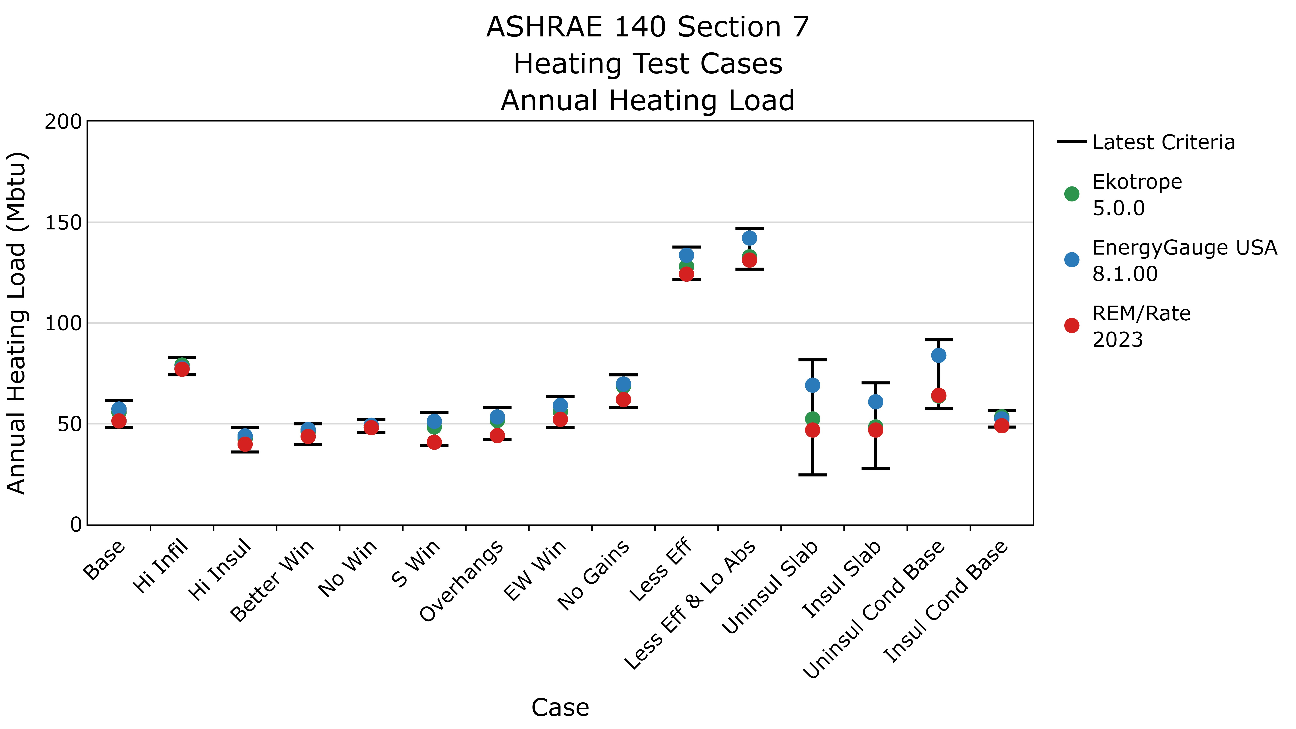
Notes:
Now their results fall well within the latest acceptance ranges
This is a big milestone for the SCC!

Slide 16
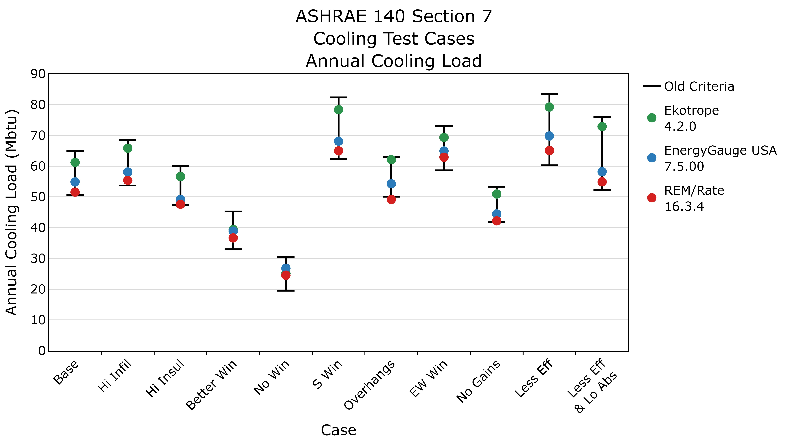
Notes:
For example, here we are showing the heating load test cases.
On the vertical axis we have the annual heating load, and
On the horizontal axis we have the variations among the test cases from a base case:
The black bars show the acceptance criteria range, and the colored dots show the test results from the latest version of each software tool.
Notice these are called the “Old criteria”. We call them “old” because they are based on results from reference software tools that are…well…

Slide 17
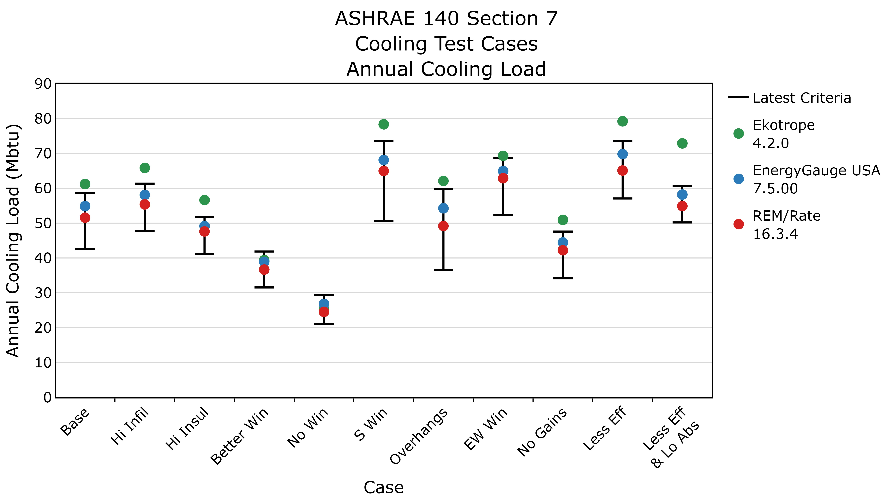
Notes:
For example, here we are showing the heating load test cases.
On the vertical axis we have the annual heating load, and
On the horizontal axis we have the variations among the test cases from a base case:
The black bars show the acceptance criteria range, and the colored dots show the test results from the latest version of each software tool.
Notice these are called the “Old criteria”. We call them “old” because they are based on results from reference software tools that are…well…

Slide 18
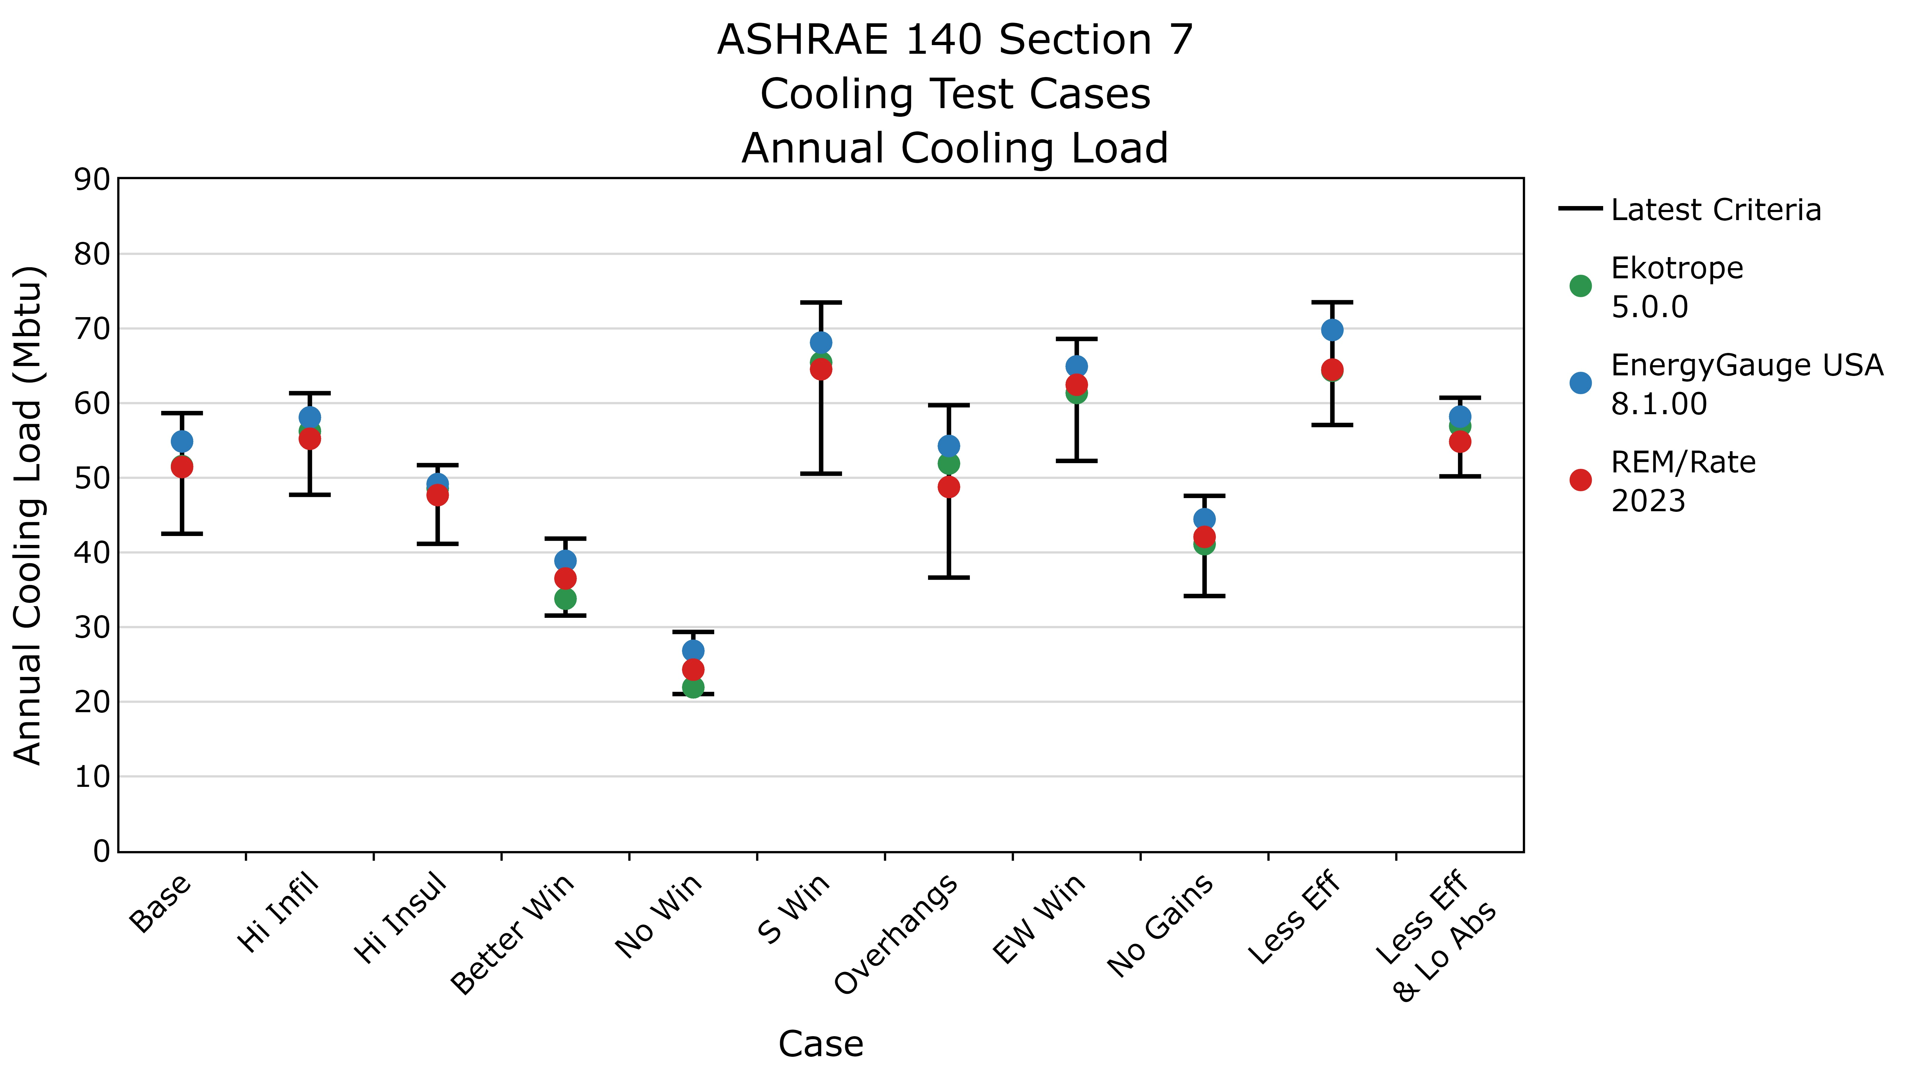
Notes:
For example, here we are showing the heating load test cases.
On the vertical axis we have the annual heating load, and
On the horizontal axis we have the variations among the test cases from a base case:
The black bars show the acceptance criteria range, and the colored dots show the test results from the latest version of each software tool.
Notice these are called the “Old criteria”. We call them “old” because they are based on results from reference software tools that are…well…

Slide 19
SCC Charter
Transition to hourly calculations
Revise accreditation testing criteria
Investigate consistency inquiries
Enhance software tests
Recommend standards updates
✅
✅
Notes:
and allows us to check off the second big item in the SCC’s charter
With the REM/Rate moving to an hourly engine, and Ekotrope enhancing their engine to align with state-of-the-art simulation tools, inconsistencies related to the fundamental calculations are much less prominent
While the work on consistency is not done—we will continue to perform the three tasks listed on the bottom
And we can shift our focus to other sources of inconsistency

Slide 20
Inconsistency Source: User Input
65
Modeler A
61
Software
Modeler B
Notes:
The largest source of inconsistency, by far, is user input error.
What can the software tools do to help with this?
Training
Establish consistent inputs, and help make it clear how they are used
Don’t rely on raters doing calculations
Smarter default inputs

Slide 21
Inconsistency Sources: Interpretation
Physics Engine
Rulesets
Developer
Software
Calculation Standard
Notes:
The next source of inconsistency is simply the interpretation of the calculation standard into the rulesets and physics engine within the software.
Identifying these types of inconsistencies is very valuable because it illuminates weaknesses in the standard rather than the software.
In fact, these are the most common sources of inconsistencies we have found through the SCC.
Each one requires us to evaluate the most appropriate interpretation of the standard and draft those changes for a future addendum.

Slide 22
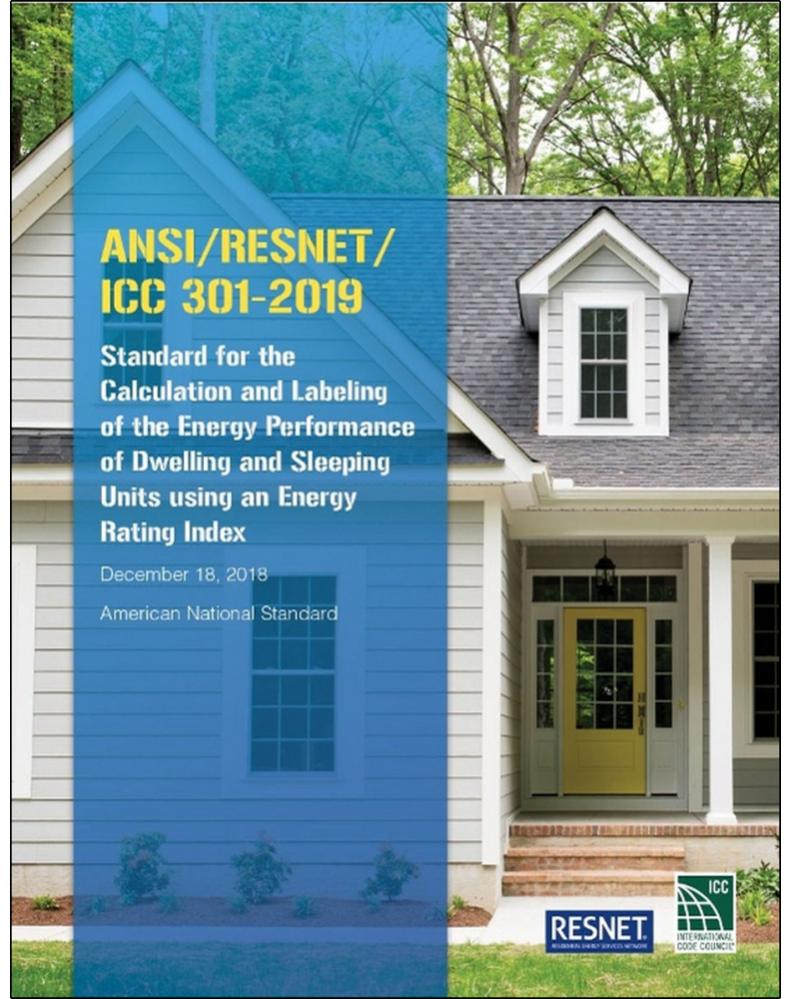
Inconsistency Sources: Updates
Notes:
The final remaining source of inconsistency is what I am starting to realize is the one that presents the most challenges and frustrations to the industry.
As we make amendments to improve our standards, those amendments can change the calculation of the HERS Index.
This isn’t an inconsistency among software, as much as it is an inconsistency over time.
While I think most people appreciate the value of improving our standards, they also want time to adapt to the resulting change.

Slide 23
SCC Charter
Transition to hourly calculations
Revise accreditation testing criteria
Investigate consistency inquiries
Enhance software tests
Recommend standards updates
✅
✅
Notes:
While consistency will always be a consideration in the work we do, our committee has taken on a much bigger role when it comes to modeling…
In fact, as it has evolved, there are some clear overlaps between the remaining SCC and the work done by SDC 300 Calculations Subcommittee
Both committees have many of the same members, and it is beginning to feel like we can be more effective

Slide 24
Proposed: Ratings Modeling Working Group
Investigate consistency inquiries
Enhance accreditation testing procedures
Enhance modeling standards
Respond to interpretation requests
Evaluate standards amendment impact on rating calculations
Notes:
That last one is relatively new, and it relates to inconsistencies from implementing updates to our standards.
RESNET recently adopted a new policy which requires RESNET Staff (in this case Nathan and me) to provide the standards management board with a ratings impact analysis for new MINHERS amendments before they can set compliance dates.

Slide 25
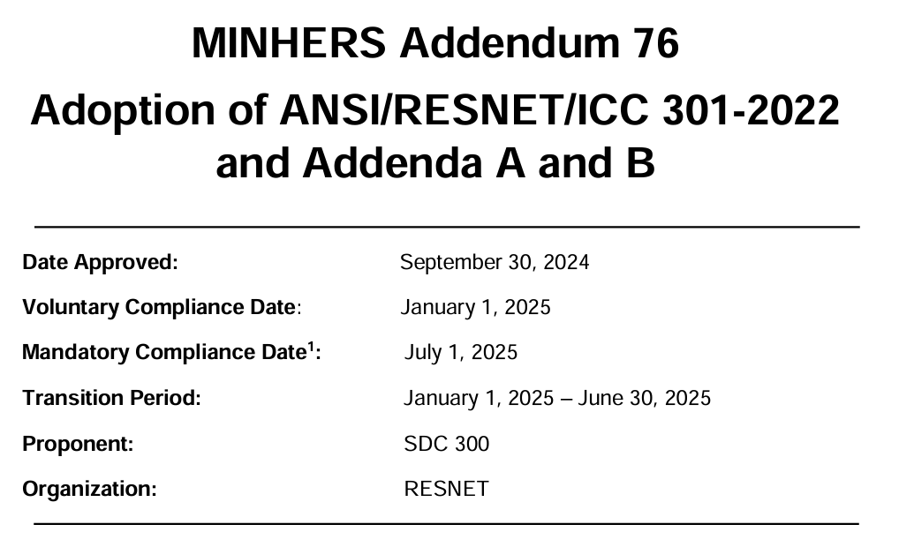
Notes:
MINHERS Addendum 76 was the first addendum that fell under this policy.
This update moved from 301-2019 with all of its addenda to 301-2022 with addenda A and B
We did not identify any of the changes in A and B that would impact ratings in a quantifiable way
However, two additional addenda (C and E) were also finalized
…and since both of these addenda were clarifications (and not changing the meaning of the standard)
…we encouraged software providers to also implement these addenda at the same time to avoid another change in ratings down the road
I’m going to quickly review the changes that were adopted, then Nathan will follow up to describe the analysis we performed

Slide 26
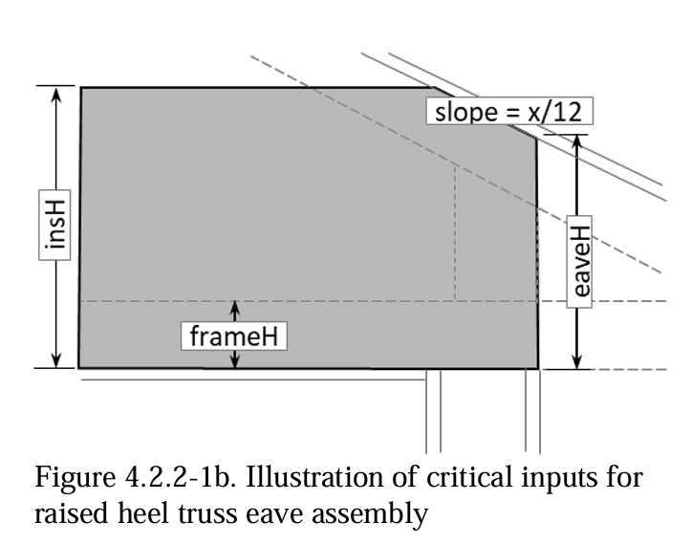
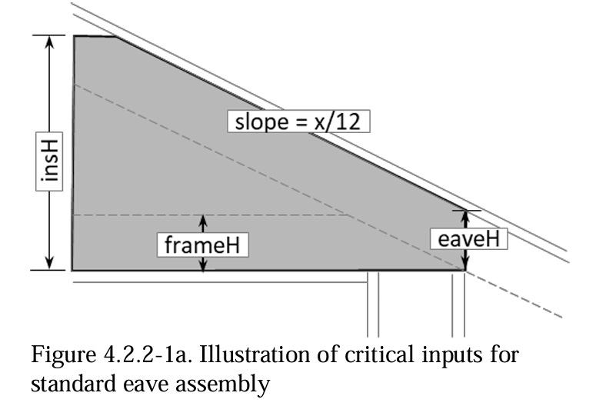
Standard 301-2022: Eave Insulation
Notes:
Modified to account for attic insulation getting compacted near eaves
Prior to this change, all ratings assumed attic insulation was uniform (as though there was always a raised-heel truss high enough)

Slide 27
Standard 301-2022: Framing Fractions
Structure | 301-2019 | 301-2022
Ceiling | 11% | 7%
Wall | 23% | 25%
Floor | 13% | 13%
Notes:
Default framing fractions also changed
For models using the defaults, ceiling decreased and wall increased.

Slide 28
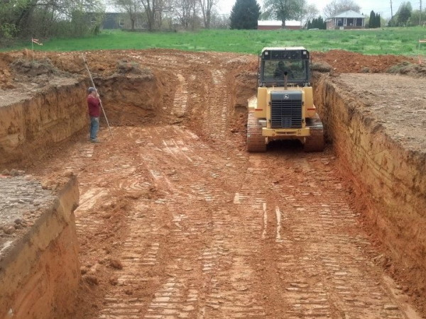
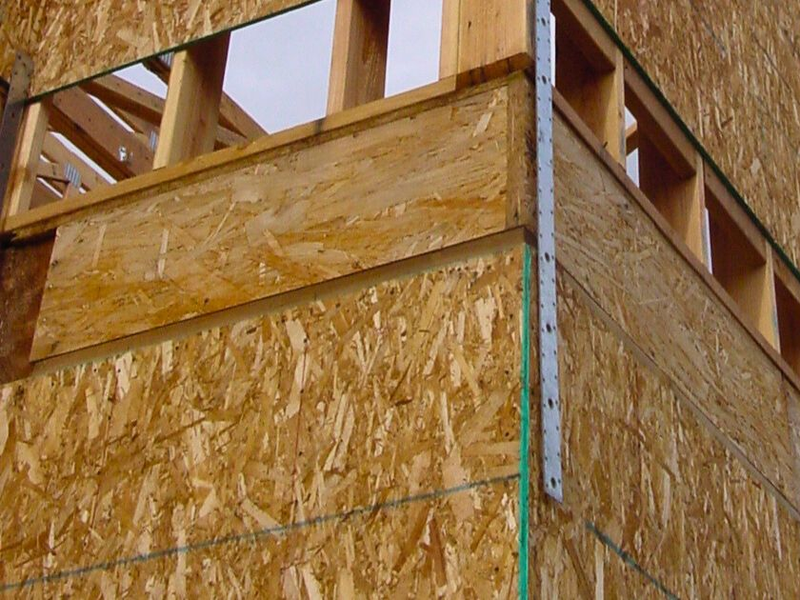
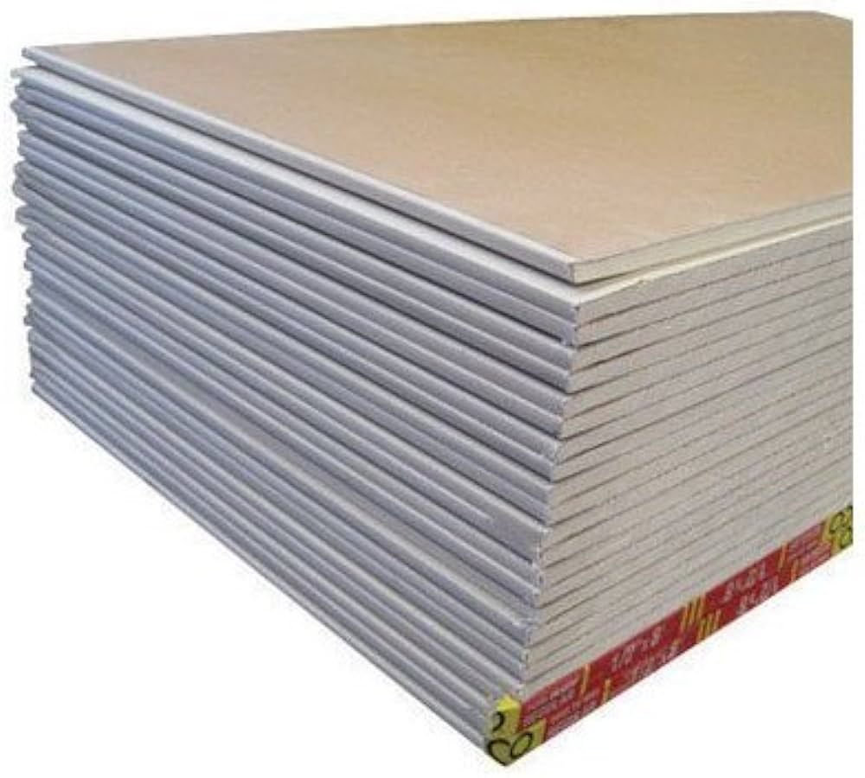
Addendum C: Material Properties
Notes:
We realized that there were several materials where software tools were using inconsistent material properties.
For each of these, we defined an assumed thermal conductivity

Slide 29
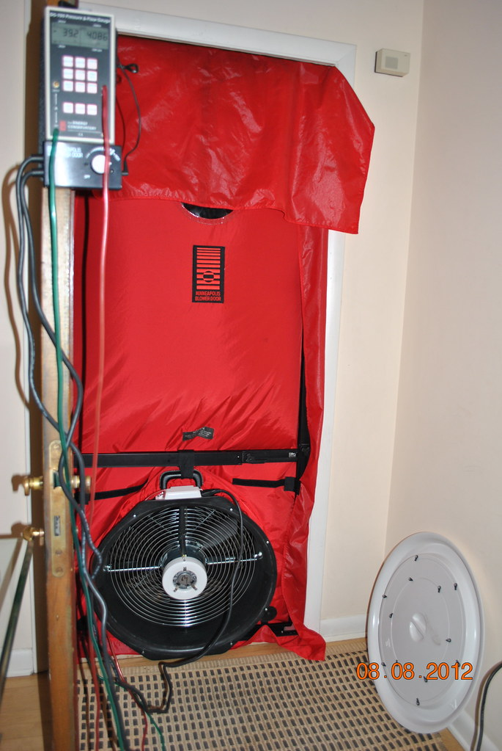
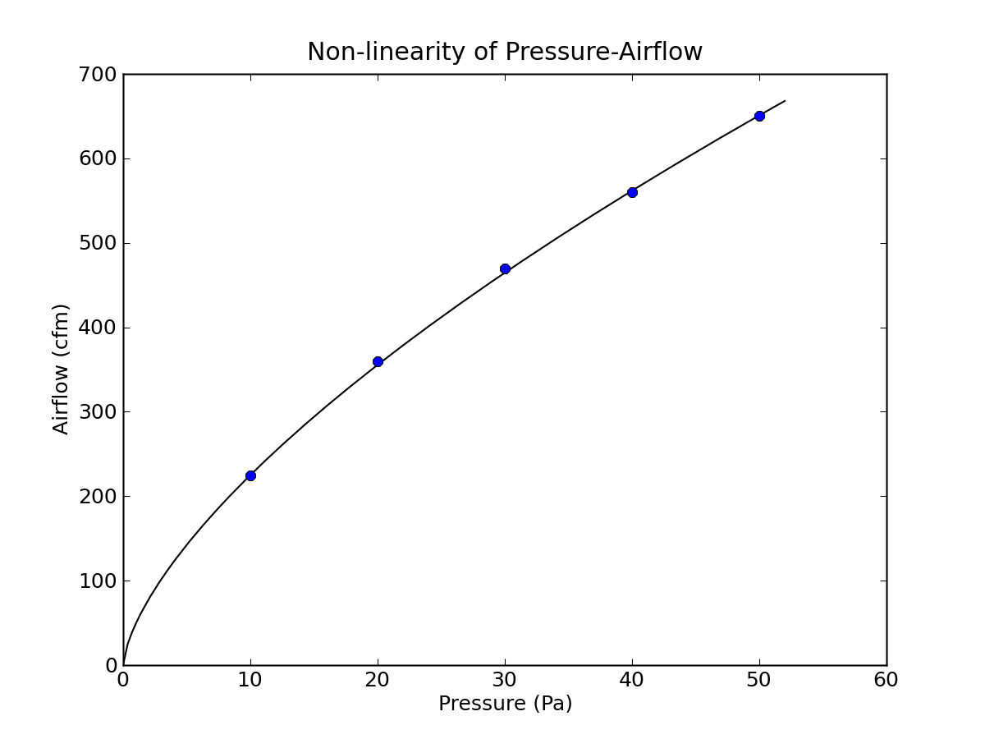
Addendum C: Infiltration Metrics
ELA
SLA
ach4
ach50
cfm50
cfm25
Notes:
We realized software tools were not using consistent approaches to converting between infiltration metrics

Slide 30
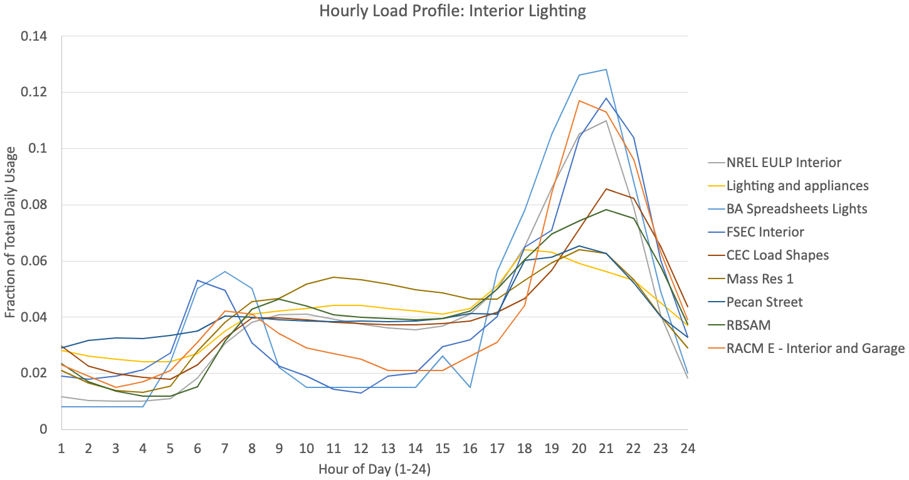
Addendum C: Hourly Schedules

Slide 31
Addendum C: Interior Shading

Slide 32
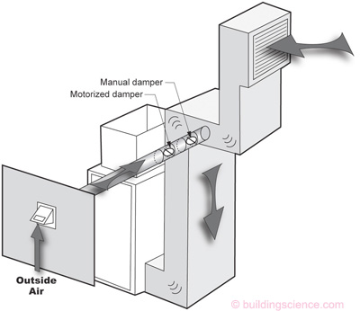
Addendum E: CFIS System
Home with CFIS in Minnesota (Climate Zone 6)
Compared REM/Rate and Ekotrope
No mechanical ventilation: 1 point difference
CFIS: 16 point difference
Notes:
Addendum E was actually driven by a RESNET member inquiry that was submitted through the online form
In this case, a user was noticing a huge difference between two software tools when adding a CFIS system
We ran the models in both software tools and confirmed the issue

Slide 33
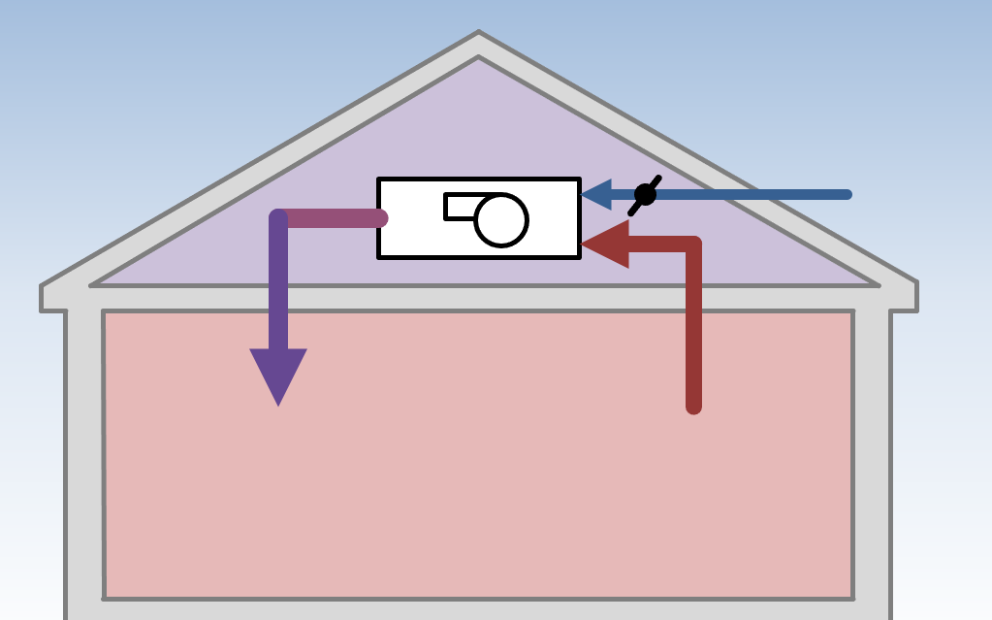
Addendum E: CFIS System
Ventilation Mode
Notes:
When a CFIS system runs in ventilation mode, it mixes outside air with air circulating through the home.
If the ducts are in an unconditioned space, then the ducts are acting like a giant heat exchanger for conditioned air and effectively increasing the load on the space beyond the load incurred from the outside air
Not all the software tools were capturing this effect, and now it is explicitly required in standard 301
In the process of this investigation, we discovered a lot of ambiguity in the definition of a CFIS system.
Addendum E makes several distinctions among CFIS systems, that previously were left to interpretation.
It’s possible that systems that previously were called CFIS systems no longer qualify, which could have a large impact on ratings.

Slide 34
MINHERS Addendum 76
Impact Analysis
Notes:
Let’s go ahead and get into our MINEHRS Addendum 76 Impact Analysis

Slide 35
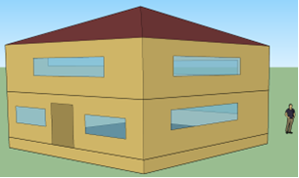
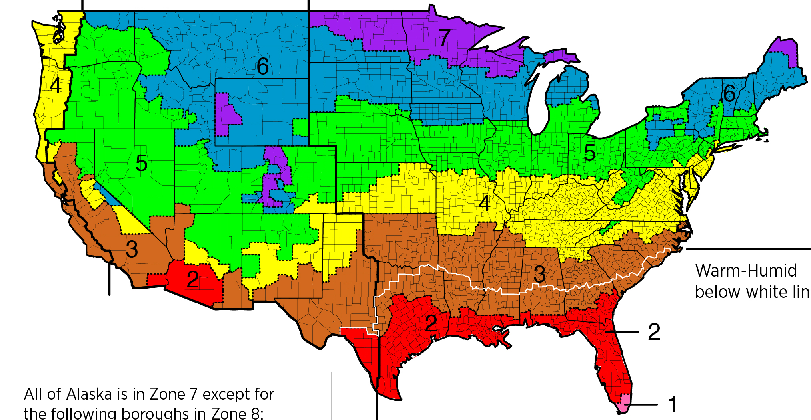
Multi-Climate Test Suite
Base
Mod
A
Mod
B
Mod
C
Notes:
For the impact analysis, we used our multi-climate test suite to analyze the impact of changes from MINHERS Addendum 76
This test suite is comprised of different combinations of homes configurations and climates
We have our baseline home, which is a standard two-story 2400 ft2 home
To get other home configurations, we make modifications to either the foundation, windows, HVAC equipment, duct location, etc.
Currently, we have 10 different cases, or home configurations
Climate Zones
Hot climates
Miami (1A)
Phoenix (2B)
Mild climate
San Francisco (3C)
Mixed climate
Baltimore (4A)
Cold climate
Duluth (7)
Run simulations on different combinations of home configurations and climates
For all of these tests, we can compare the HERS Index
Between different software tools
Between different versions of the same software tool
This helps us analyze changes in new software versions

Slide 36
Base Case
Generic single-family home with ‘simple’ systems
Natural gas furnace
Ducts in conditioned space
Balanced mechanical ventilation
Vented crawlspace
Notes:
Standard single-family home
Home has what we call simple systems
Simple system
Systems that are simple to model and should not be adding any inconsistency to our results.
This provides a good baseline to compare each software tool, and then compare between the Base Case and other home configurations.

Slide 37
List of Home Configurations
Base
Adiabatic Raised Floor
Conditioned Basement
Slab on Grade
CFIS
No Mechanical Ventilation
CFIS Ducts in Attic
No Mechanical Ventilation Ducts in Attic
Reference Windows
Notes:
Baseline home
Different floor types
Different mechanical ventilation (or no ventilation)
Reference windows
Removing the impact of windows

Slide 38
List of Multi-Climate Test Cases
Miami (1A) | Phoenix (2B) | San Francisco (3C) | Baltimore (4A) | Duluth (7)
Base Adiabatic Raised Floor Slab on Grade Reference Windows | Base Adiabatic Raised Floor Conditioned Basement Slab on Grade Reference Windows | Base Adiabatic Raised Floor Slab on Grade Reference Windows | Base Adiabatic Raised Floor Conditioned Basement Slab on Grade Reference Windows | Base Adiabatic Raised Floor Conditioned Basement CFIS CFIS Ducts in Attic No Mech. Vent. No Mech. Vent. Ducts in Attic Reference Windows
Notes:
Here is a list of home configurations tested in each climate
Currently there are 26 test cases
We do not want to run every combination of tests
Currently, it is a long manual process
We do not want to perform additional tests that will not result in any additional findings.
For example
We only run the CFIS case in Duluth
CFIS case will have the largest impact in Duluth
Duluth has the most extreme temperatures of the five climates
Bringing in outdoor air in Duluth’s extreme climate will have the largest impact on the load
If inconsistencies between the software tools can be fixed in Duluth, they should be fixed in other climates
We will see some CFIS Ducts in Attic results in other climates, but those results were generated to get a complete understanding of the impact of duct losses when running a CFIS system

Slide 39
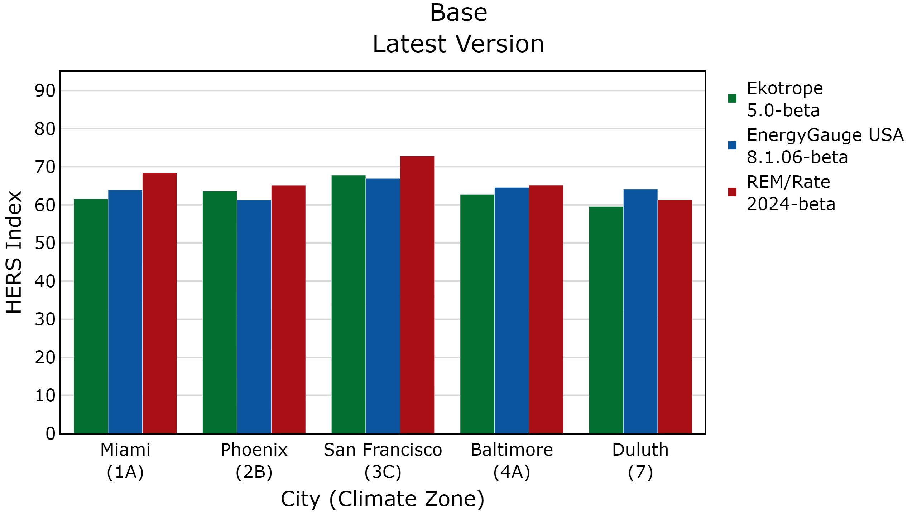
Notes:
Two main reasons for running these tests
Track consistency across software tools
Results of the base home for each software in different climates
X-axis is different climates
Y-axis is HERS Index
Introduce different colors
Snapshot in time
As the software consistency committee works on these issues…
The difference in scores becomes smaller
Some cases are more consistent
Some cases are less consistent
Now that we have the test infrastructure in place
1- Capability to even notice these issues
2- Address these issues
One thing you might notice are the difference in scores in San Francisco
You might think we need to focus on this case
SKIP
Difficult climate to obtain consistency
Heating and cooling loads are low relative to other climates.
The absolute difference in the loads might be small
But the percent difference might be quite large, and that shows up here in San Francisco.

Slide 40
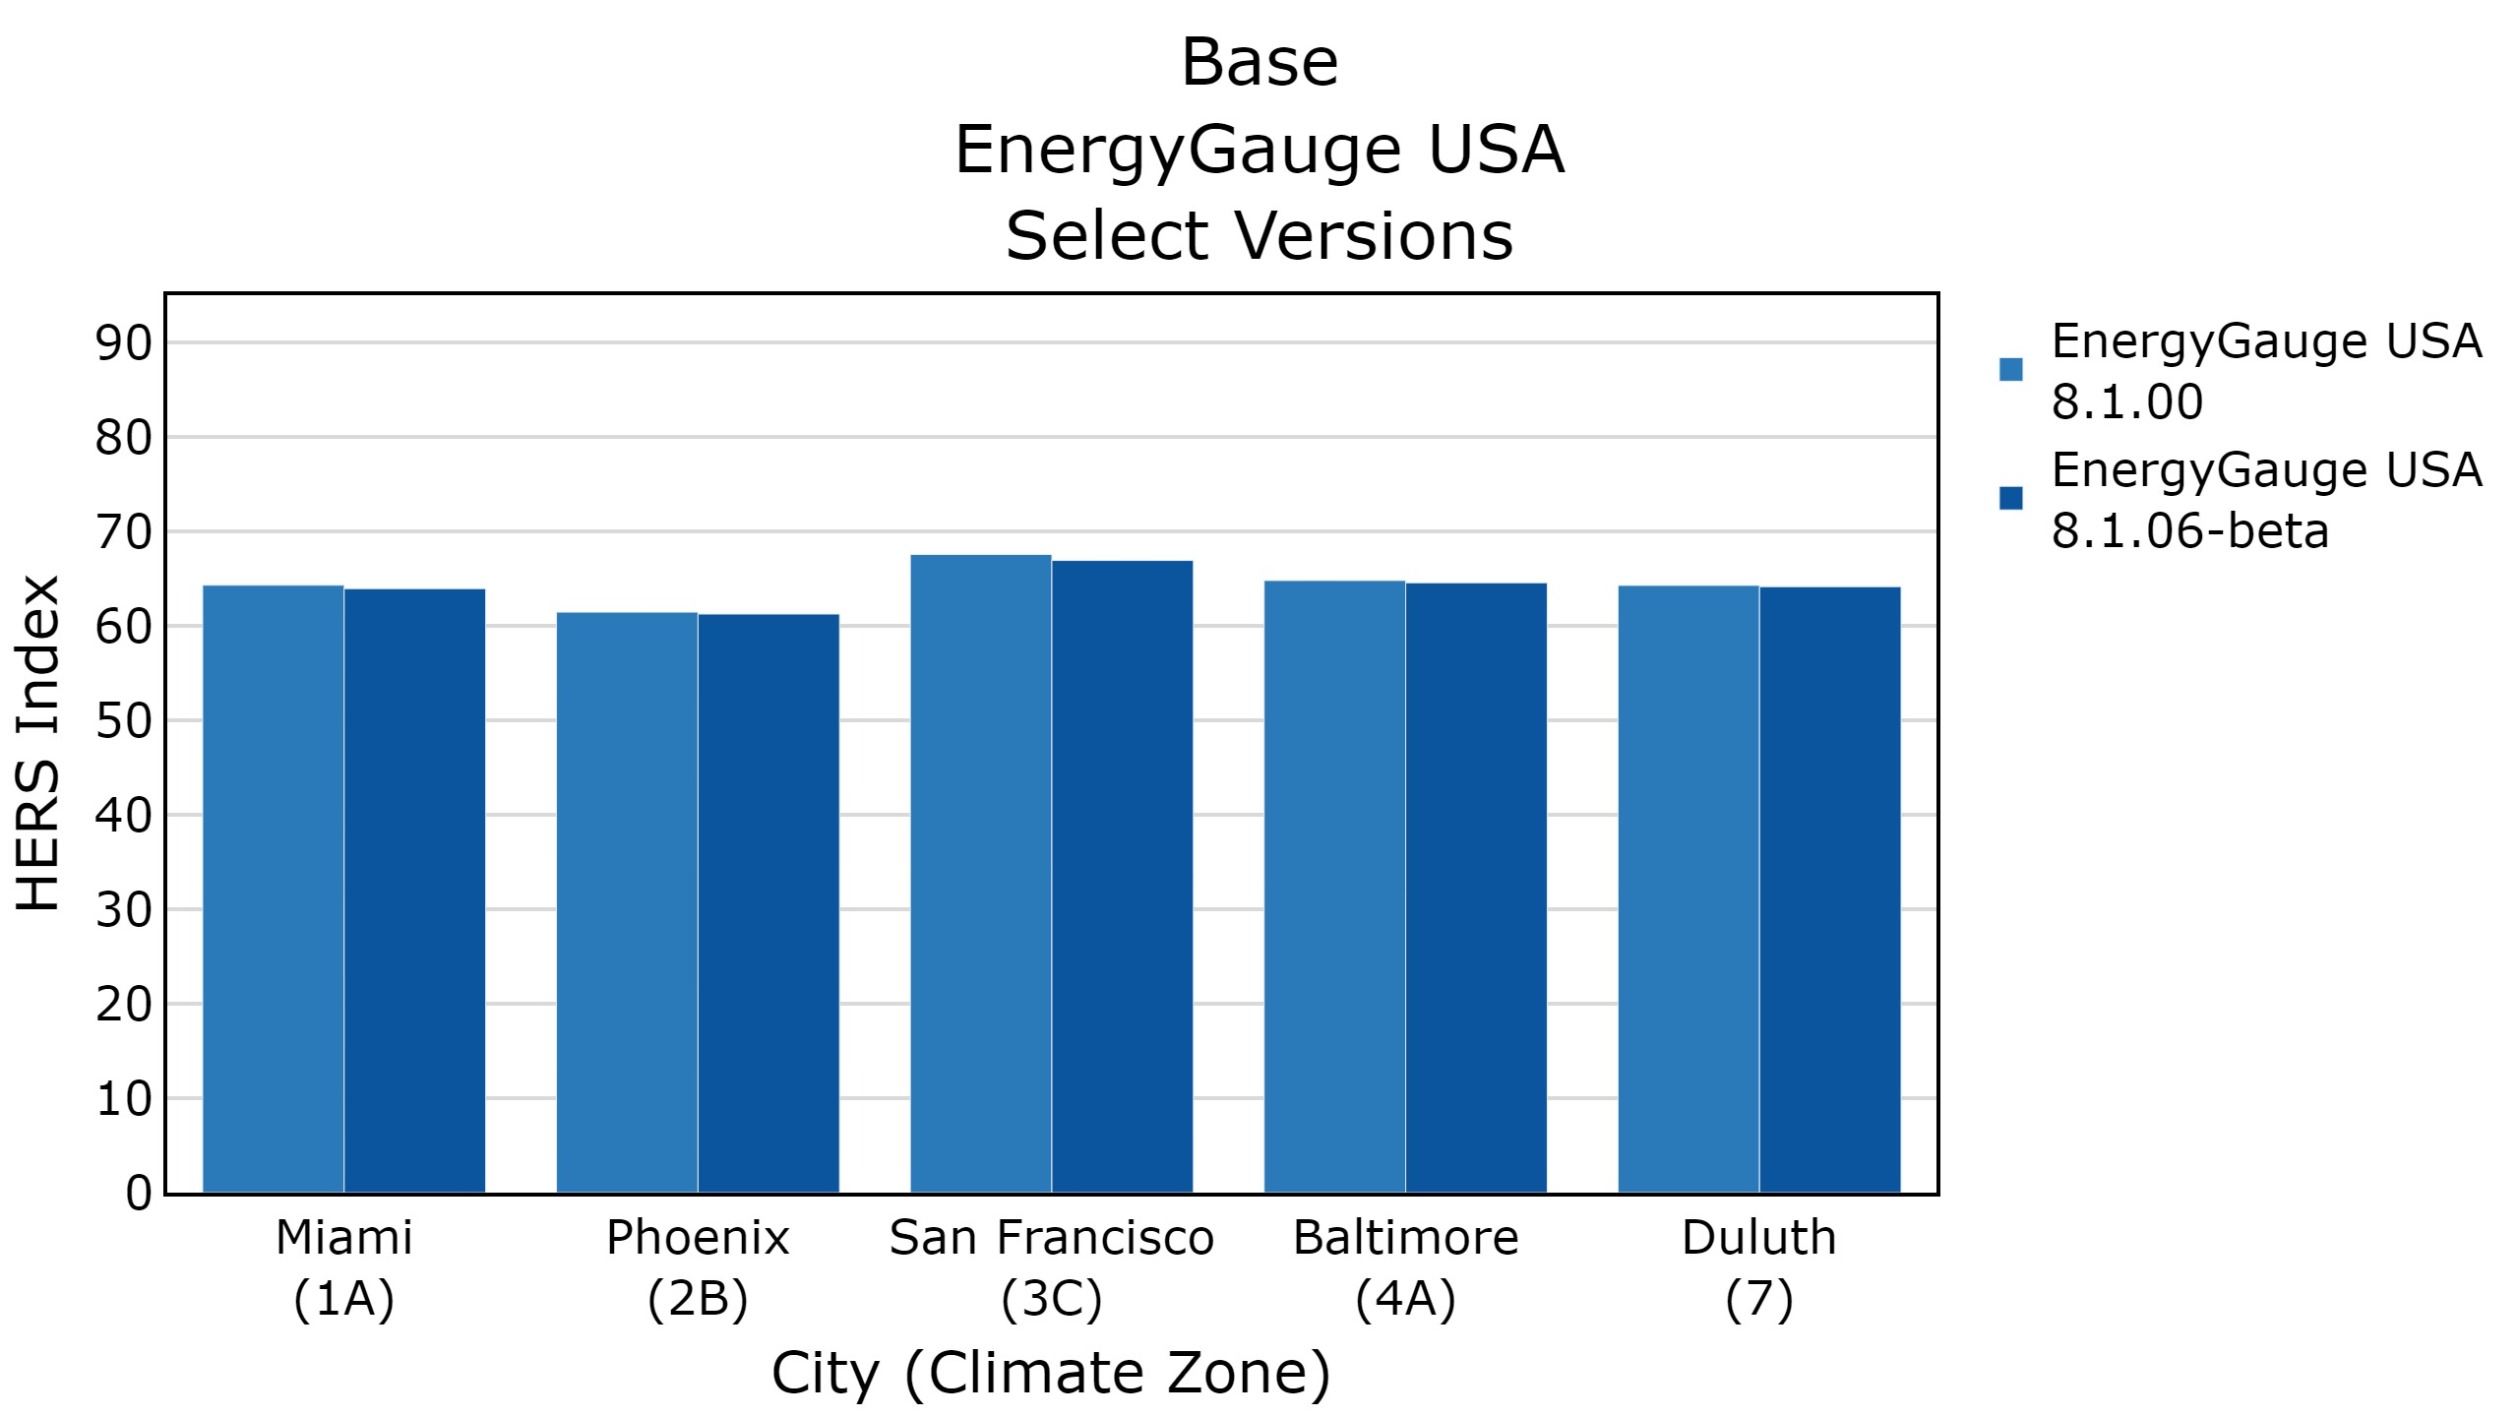
Notes:
For our impact analysis, we compared each software tools latest version to their beta version
Each software’s beta version adheres to Addendum 76
For example, these are the results for Base case for EnergyGauge
As you can see, the changes were minimal.

Slide 41
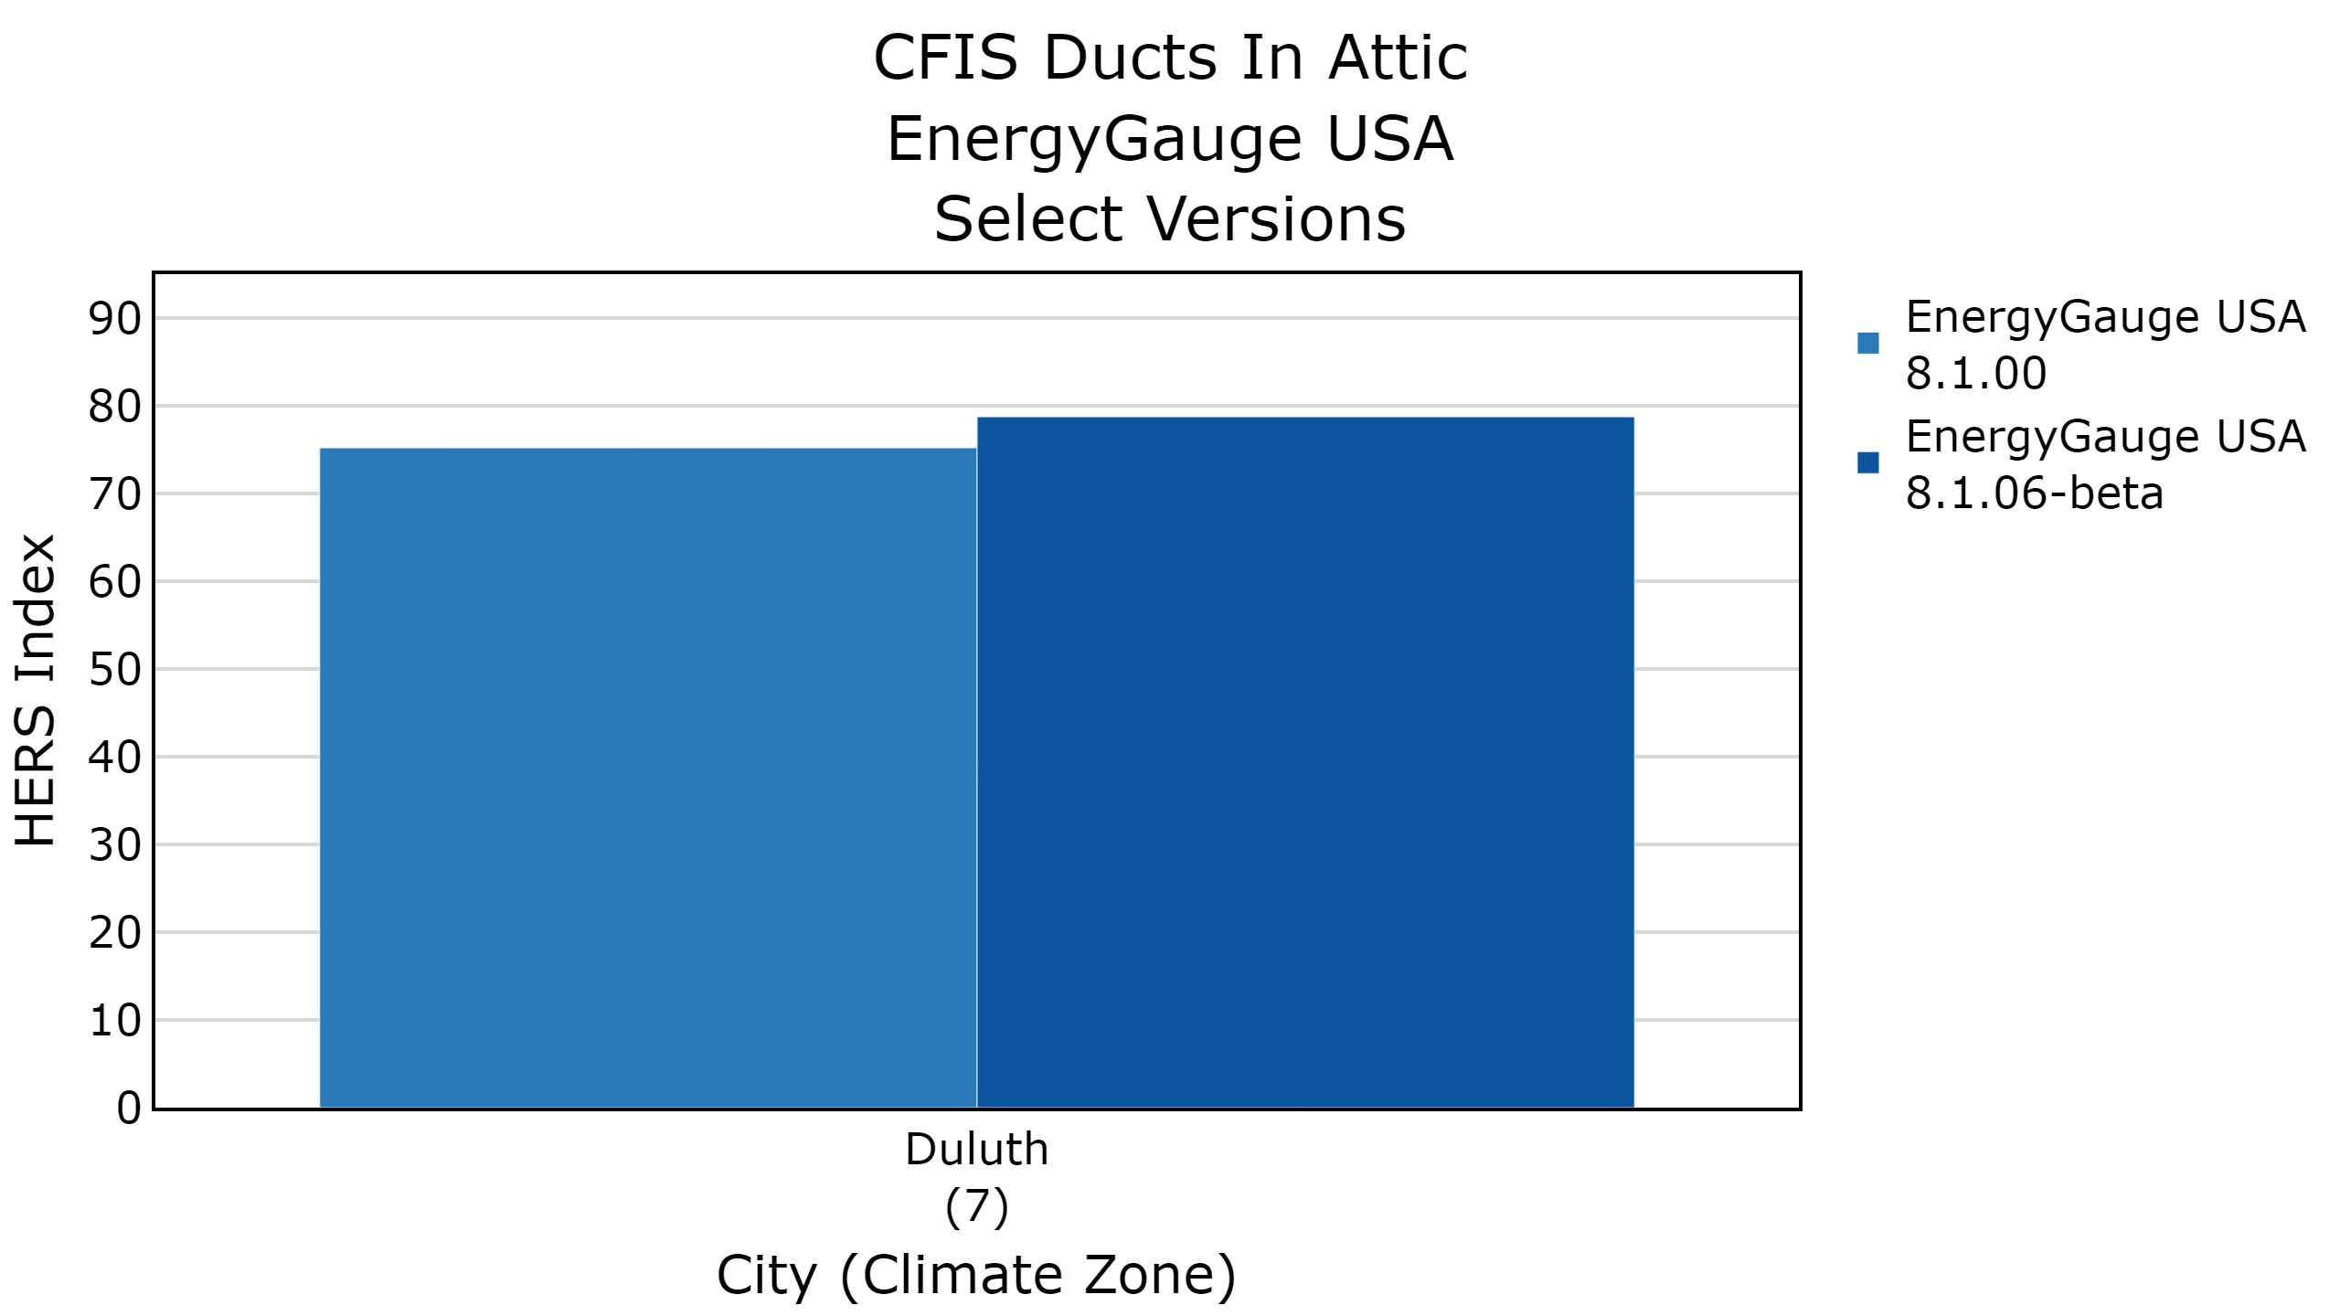
HERS Index Difference
Notes:
When looking at the Duluth CFIS Ducts in Attic case, you can see a significant difference in the HERS Index
Resulting in about a 3-and-a-half-point difference
For each case-city combination, we collected the difference in the HERS Index and plotted them on a histogram

Slide 42
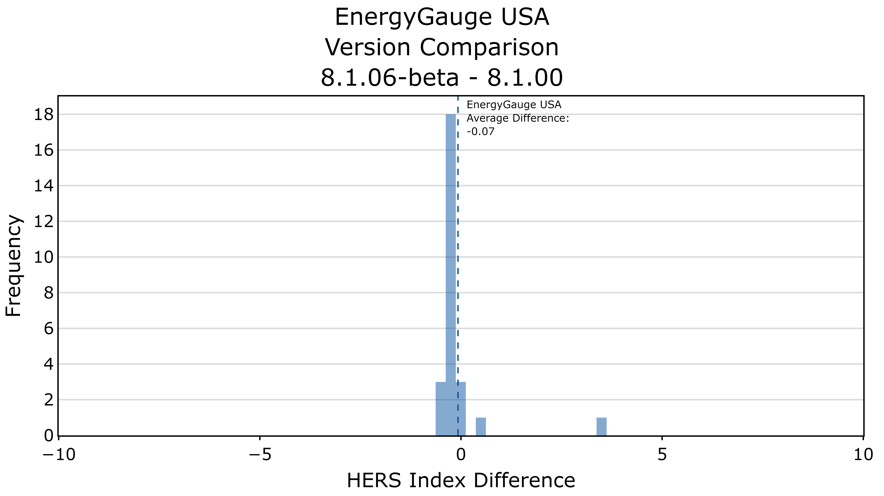
Duluth
CFIS Ducts In Attic
Notes:
…and we get this chart
This histogram shows us the impact of adopting MINHERS Addendum 76
For EnergyGauge, the overall impact was minimal, with an average reduction in the HERS Index of 0.07.
The exception was the Duluth CFIS Ducts in Attic Case, which you can see off to the far right (3.54).
Based on the changes made in Addendum 76, these were expected changes

Slide 43
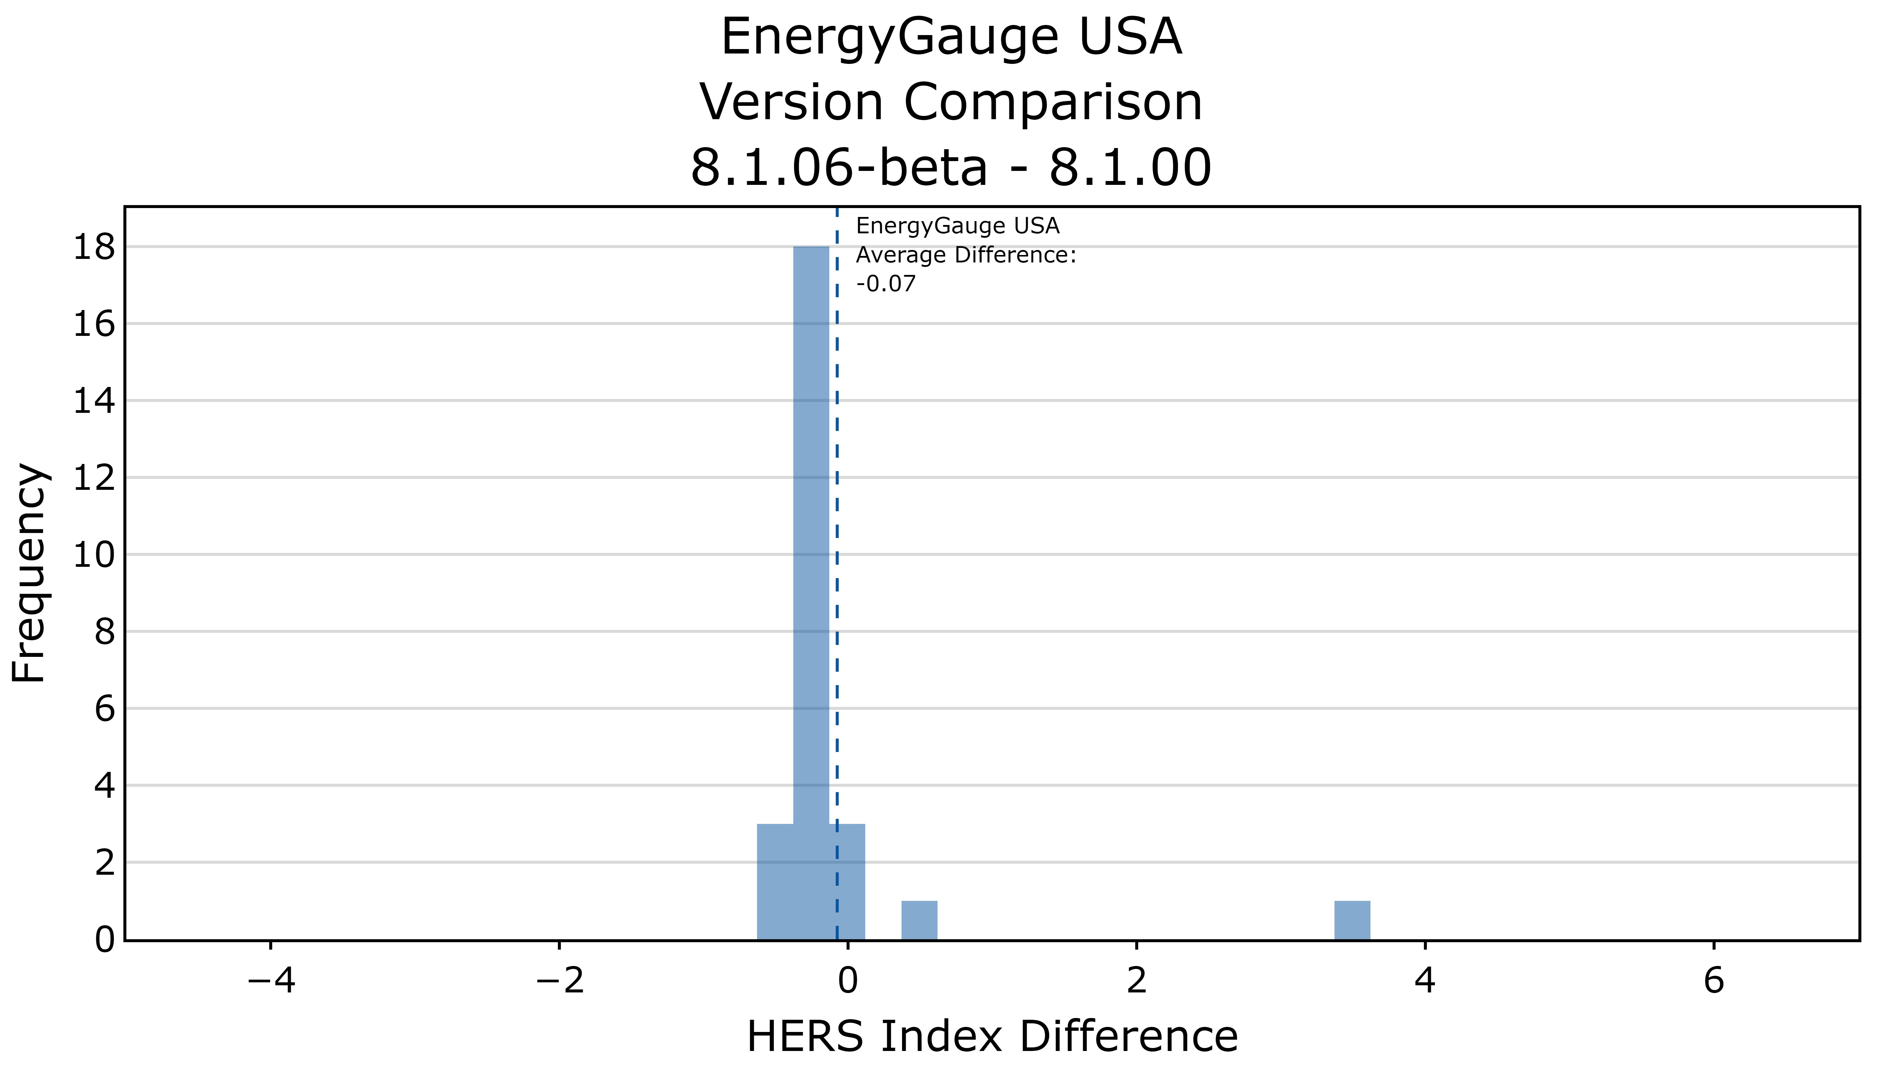
Duluth
CFIS Ducts In Attic
Notes:
Then we calculate the HERS Index for each case-city combination, and plot them on a histogram to get a sense of the overall impact of adopting MINHERS Addendum 76.
For EnergyGauge, the overall impact was minimal, with an average reduction in the HERS Index of 0.07.
The exception was the Duluth CFIS Ducts in Attic Case, which you can see off to the far right.

Slide 44
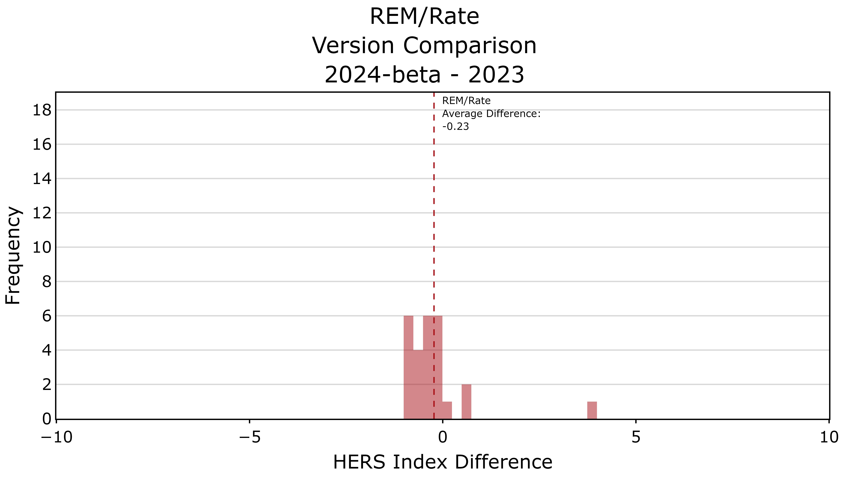
Duluth
CFIS Ducts In Attic
Notes:
A similar trend exists for REM/Rate, with an average reduction in the HERS Index of 0.23.
There was a similar increase in the Duluth CFIS Ducts in Attic Case for REM/Rate (3.81).

Slide 45
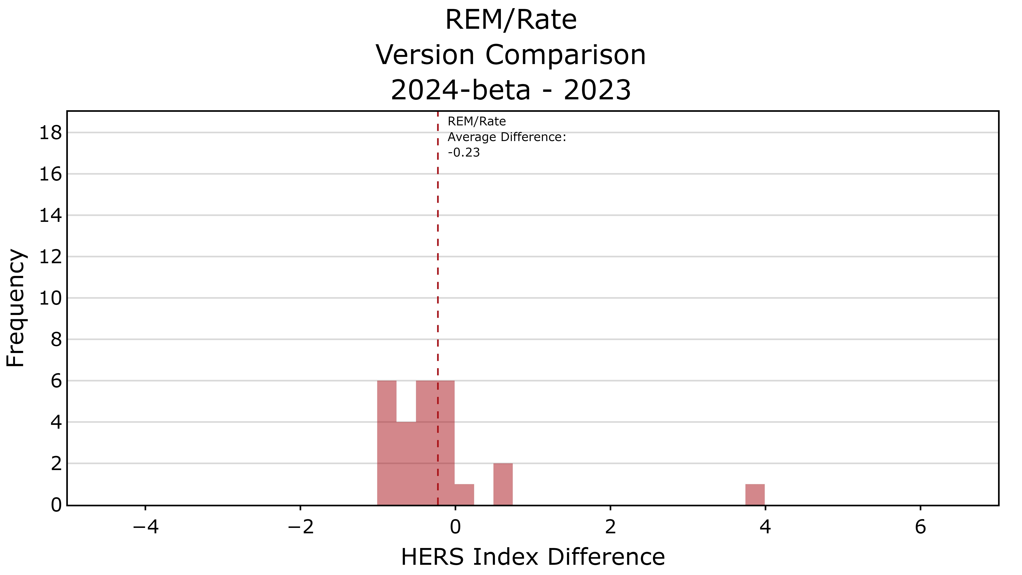
Duluth
CFIS Ducts In Attic

Slide 46
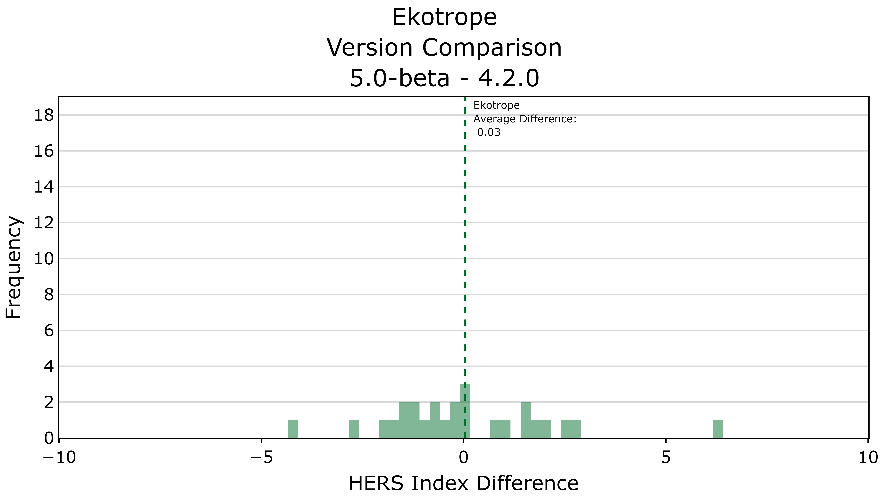
Changes due to
MINHERS Add. 76 Changes
Changes due to
Acceptance Criteria Compliance
Notes:
Comparing Ekotrope’s beta version against their latest version, we see a much wider spread in the HERS Index.
And there is a reason for this
All three software tools had changes due to adoption of MINHERS addendum 76
But Ekotrope also had changes due to adhering to the latest acceptance criteria

Slide 47
Notes:
As Neal showed you earlier, Ekotrope went from being outside the bounds

Slide 48
Notes:
….to inside

Slide 49
Changes due to
MINHERS Add. 76 Changes
Changes due to
Acceptance Criteria Compliance
Notes:
So the acceptance criteria is the primary reason we see this wide spread in the HERS Index difference when comparing their beta version to their latest version.
And we will see more as to why on the next slide

Slide 50
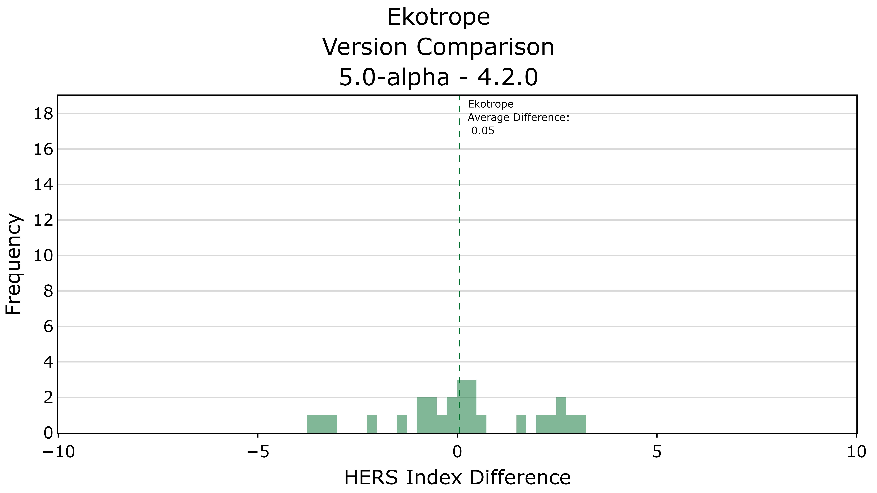
Changes due to
Acceptance Criteria Compliance
Notes:
5.0 alpha was a non-public version that Ekotrope created in early 2024 to adhere to the acceptance criteria.
As you can see here, the differences between 5.0-alpha and 4.2.0 create this large spread in HERS Index difference

Slide 51
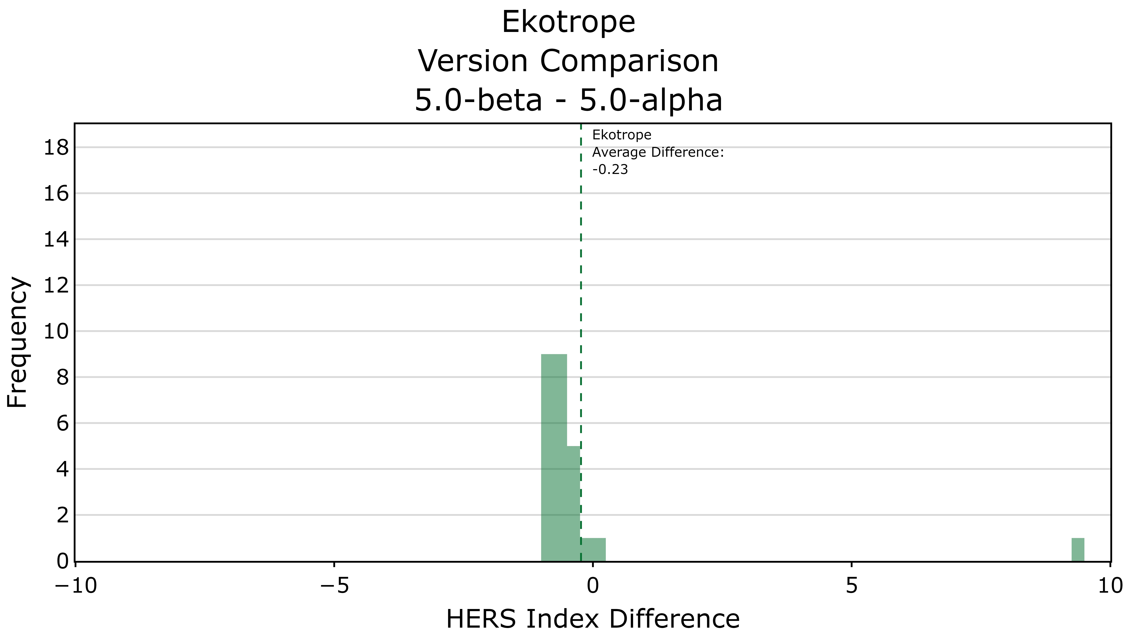
Changes due to
MINHERS Add. 76 Changes
Duluth
CFIS Ducts In Attic
Notes:
We can compare 5.0-beta and 5.0-alpha to isolate the impact of MINHERS Add. 76
As you can see, there is minimal spread, similar to the other two software tools
The case off to the far right is the Duluth CFIS Ducts in Attic case, with a difference of about 9 (9.26)

Slide 52
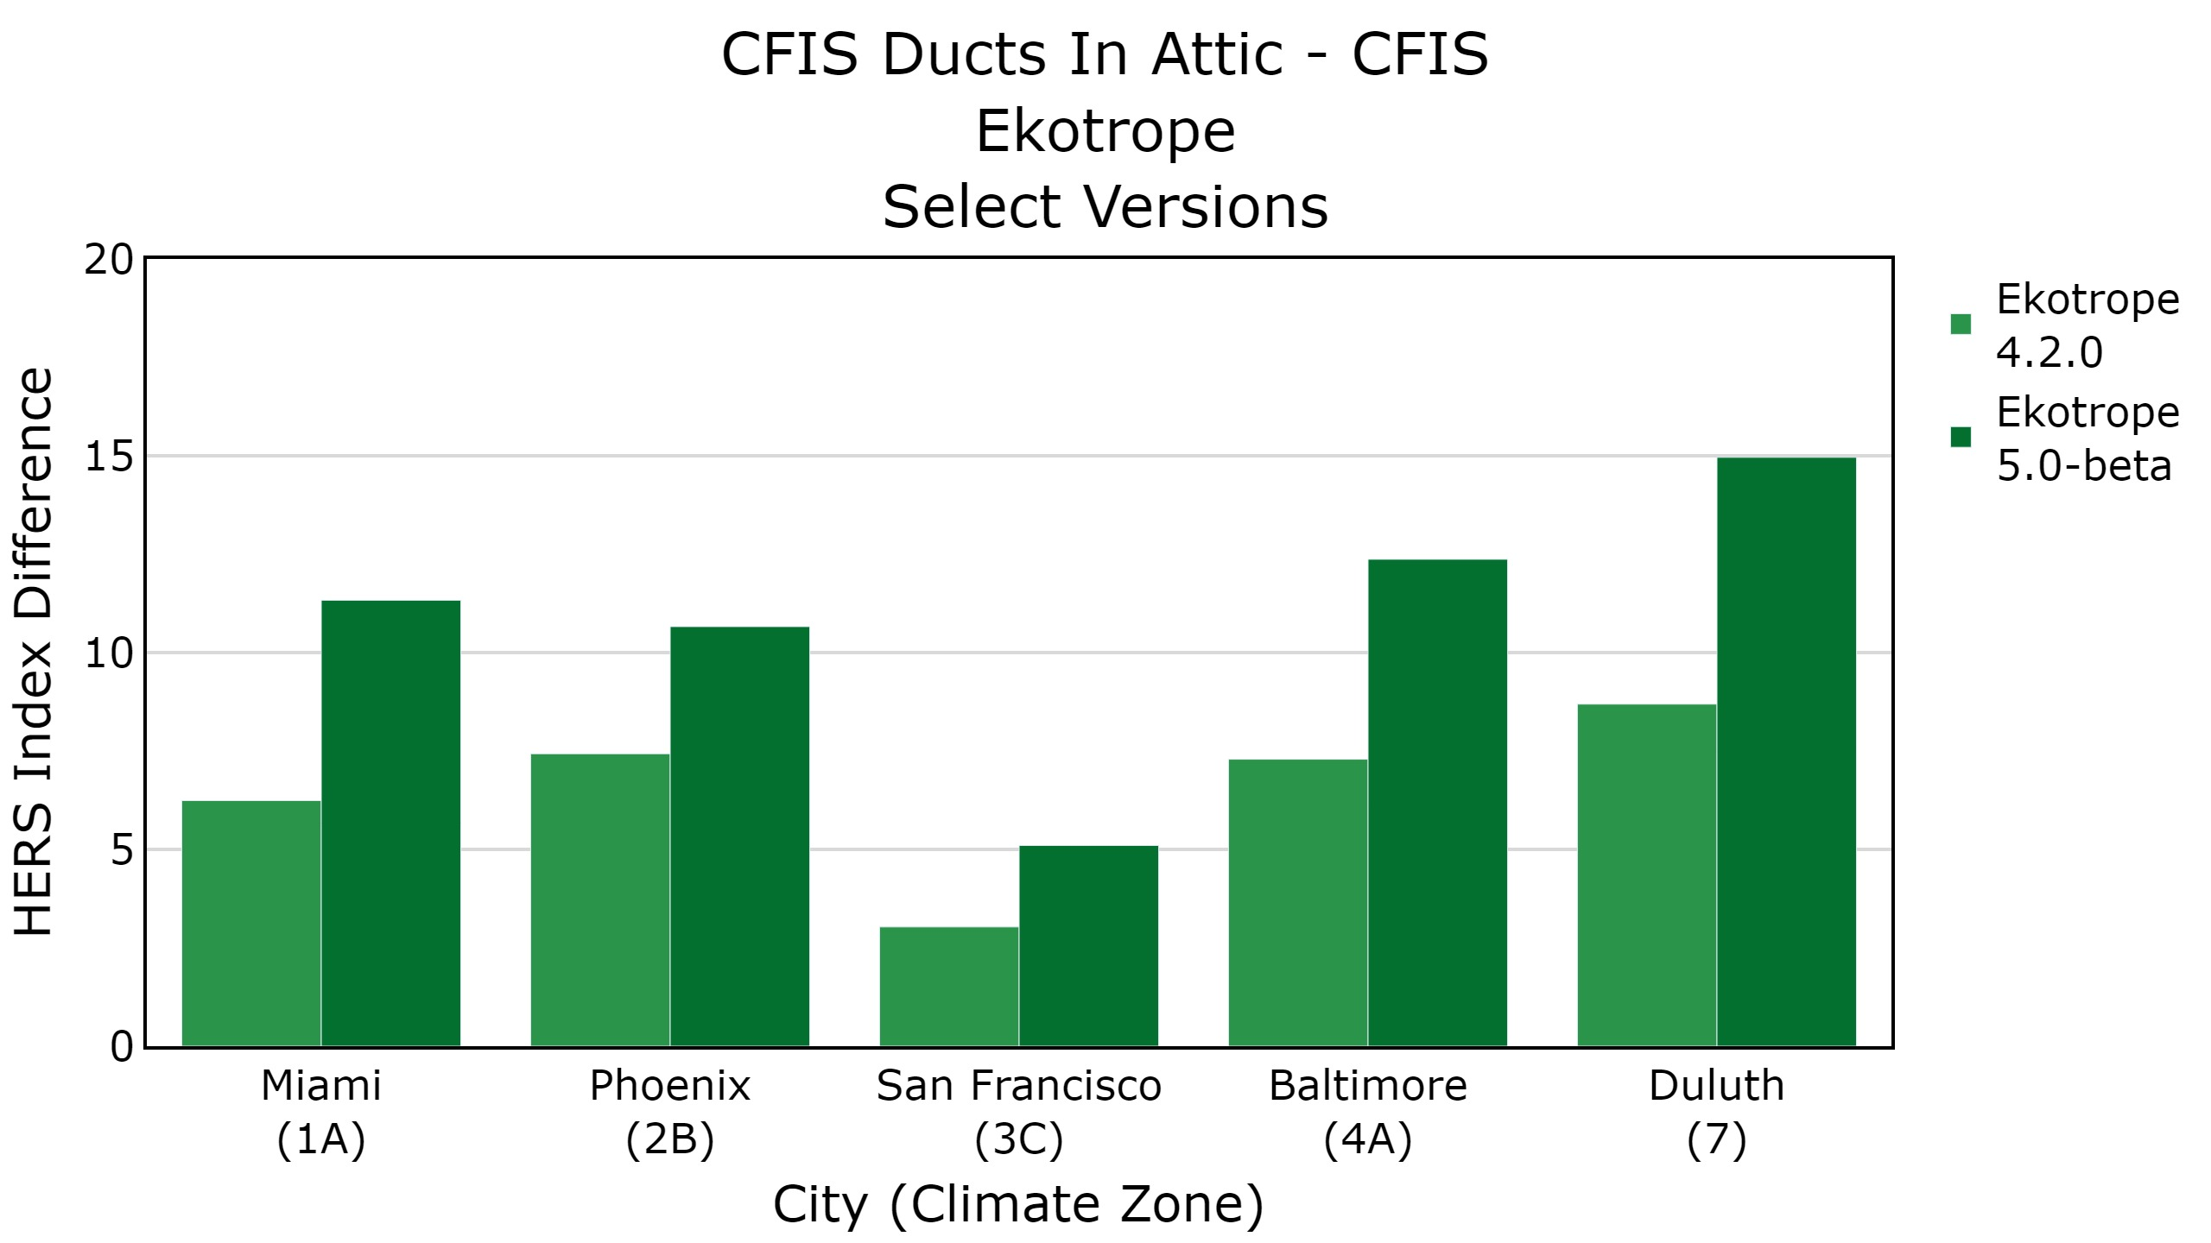
CFIS Ducts In Attic – CFIS Ducts In Conditioned Space
Ekotrope
Select Versions
Accounting for Duct Losses During Ventilation
Notes:
This chart compares the difference between a CFIS system with ducts in attic vs a CFIS system in conditioned space
… provides a good idea as to the impact of MINHERS addendum 76 on duct losses for a CFIS system
The difference between the beta version and v4.2.0 is primarily due to accounting for duct losses during ventilation mode

Slide 53
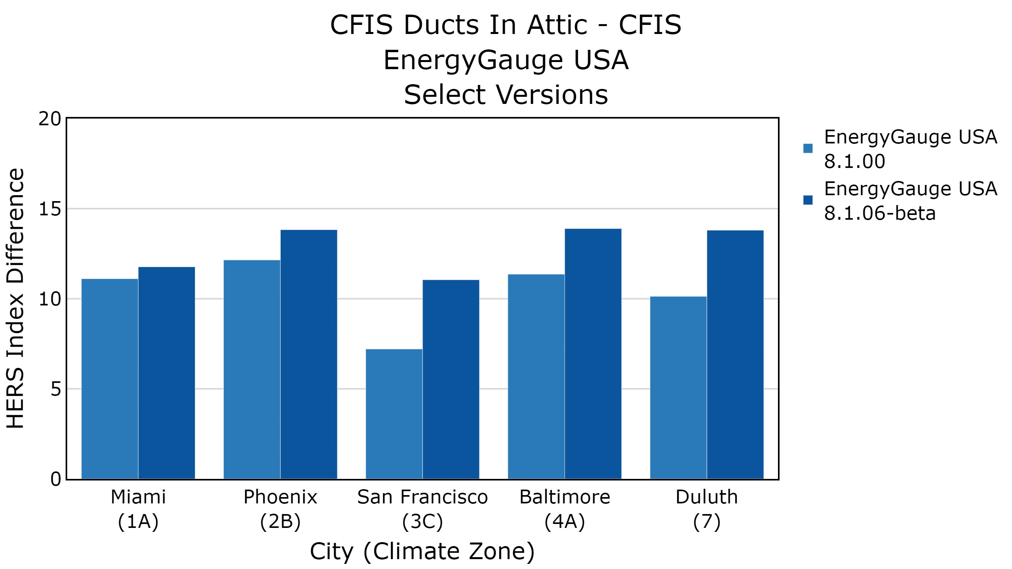
CFIS Ducts In Attic – CFIS Ducts In Conditioned Space
EnergyGauge USA
Select Versions
Notes:
EnergyGauge also showed similar results

Slide 54
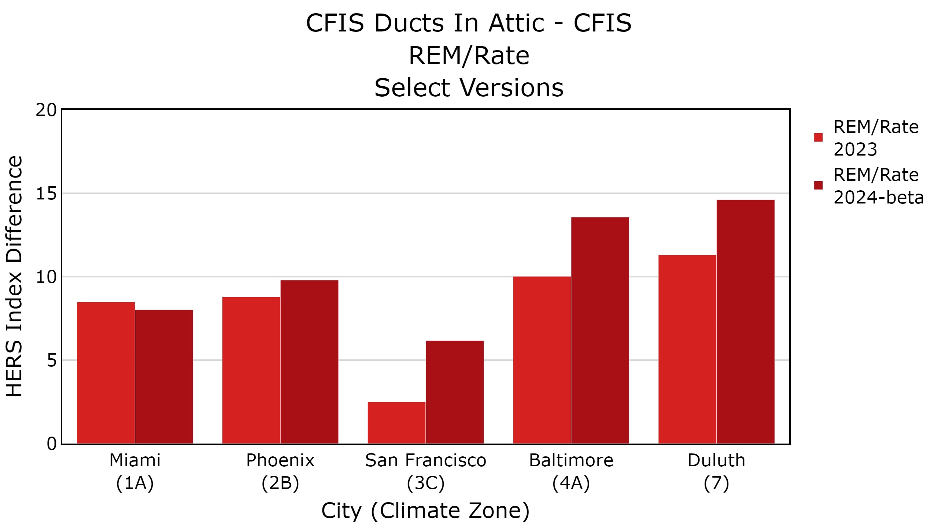
CFIS Ducts In Attic – CFIS Ducts In Conditioned Space
REM/Rate
Select Versions
Notes:
As well as REM/Rate

Slide 55
Standard- vs Raised-Heel Truss
Standard-Heel Truss
Raised-Heel Truss
Less Insulation
Along Attic Perimeter
More Insulation
Along Attic Perimeter
Notes:
Continuing our look into the impact analysis
Previously, there was no required input for eave height
The software tools were assuming uniform insulation across the attic
Which essentially assumed a raised heel truss
Now, this input is specified in MINHERS Addendum 76
Analyzed the impact of adding eave height as an input

Slide 56
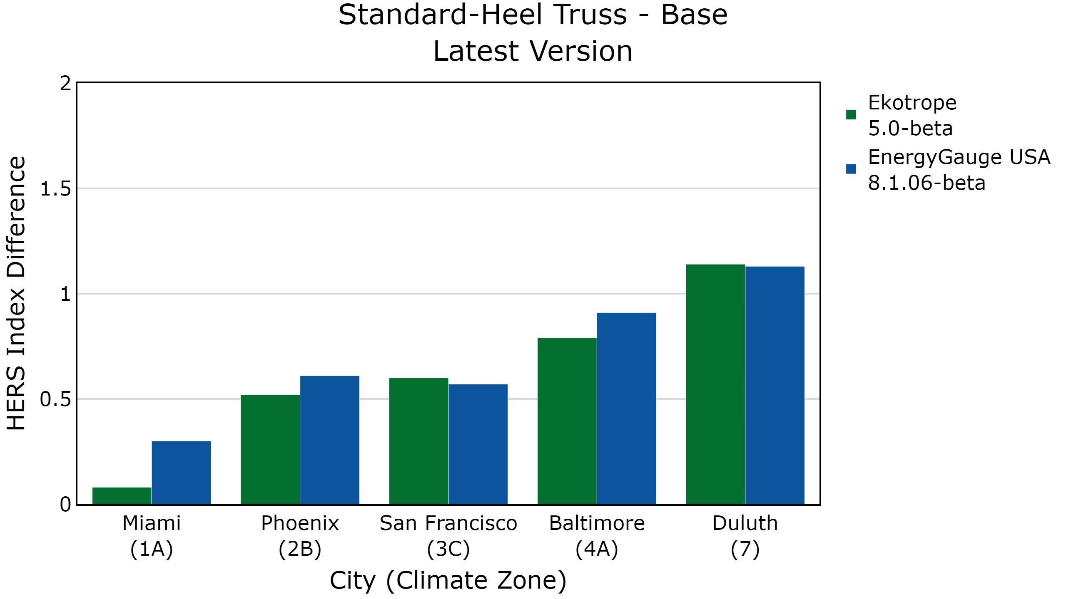
Standard-Heel Truss - Raised-Heel Truss
Beta Version
No results for
REM/Rate
Notes:
This chart shows the difference between a standard-heel truss and a raised-heel truss
Which also shows the impact of adding eave height as an input
This input may increase scores by a point, with a bigger impacting occurring in colder climates
A standard-heel truss has less insulation along the attic perimeter, so we should expect a higher HERS Index, which we can see here
REM/Rate had not implemented this input at the time of the analysis, so do not have results for their software

Slide 57
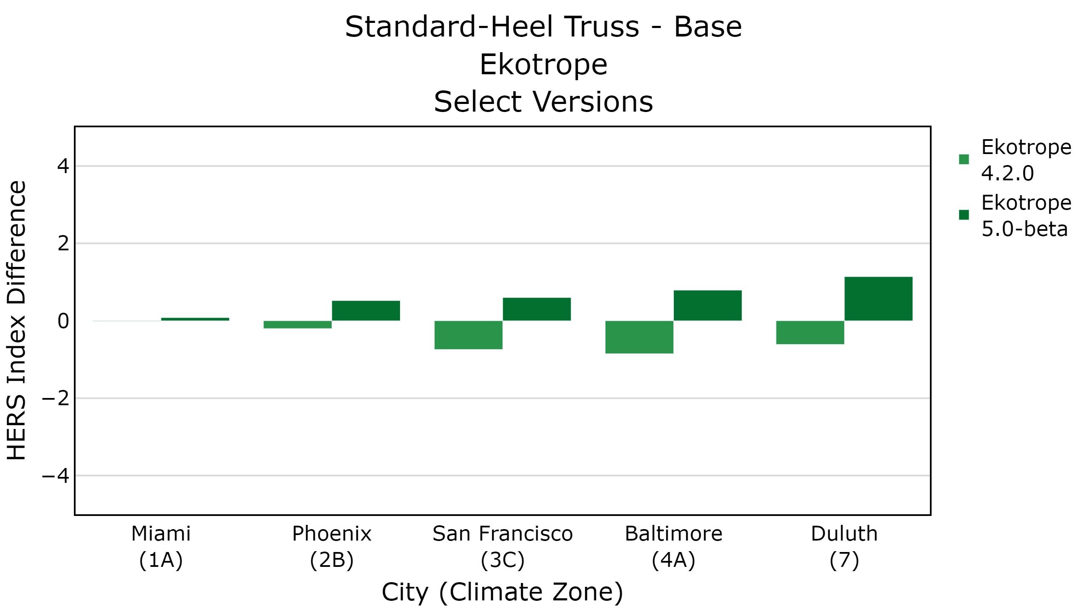

Slide 58
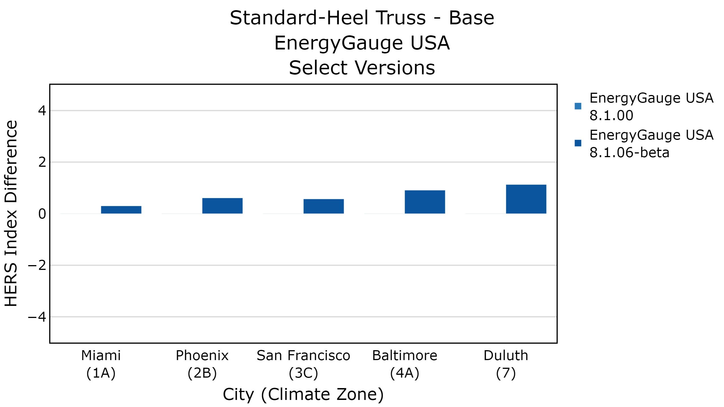
No results for
REM/Rate

Slide 59
Default Framing Fractions
Structure | 301-2019 | 301-2022
Ceiling | 11% | 7%
Wall | 23% | 25%
Floor | 13% | 13%
Changes in Default Framing Fractions resulted in negligible changes in the HERS Index
Notes:
Neal mentioned earlier that the framing fractions have changed between the two standards
We found that the default framing fractions had minimal impact on the HERS Index
The average difference was less than 0.1, so small it wasn’t even worth plotting

Slide 60
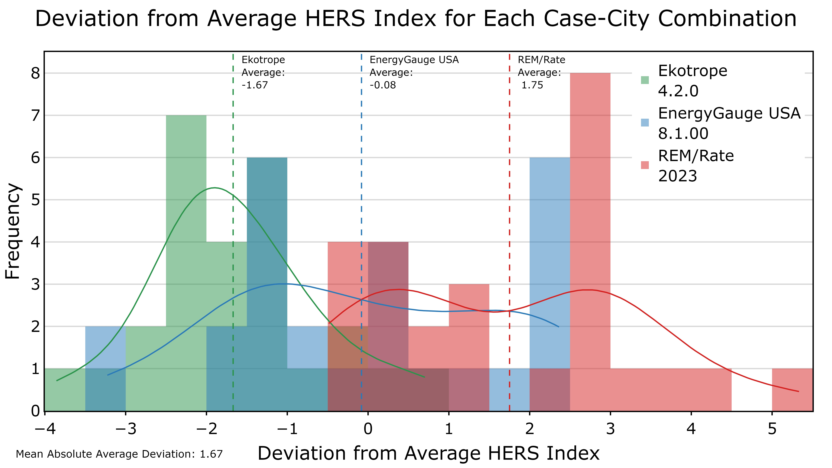
Duct Losses
Notes:
This histogram tracks the overall trend of the results from all test cases
Snapshot of consistency
Shows how different the results are between the software tools
Explain the extreme values
Ekotrope case that is 4 points lower than the average of the three software tools for a case
REM/Rate case that is 6 points higher than the average of the three software tools for a case
Mention the vertical lines are the average values for each software tool

Slide 61
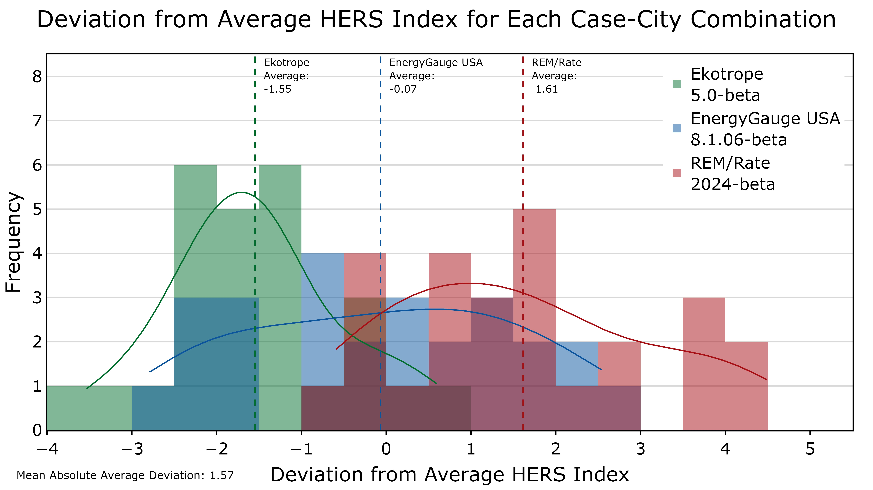
Duct Losses
Notes:
This histogram tracks the overall trend of the results from all test cases
Snapshot of consistency
Shows how different the results are between the software tools
Explain the extreme values
Ekotrope case that is 4 points lower than the average of the three software tools for a case
REM/Rate case that is 6 points higher than the average of the three software tools for a case
Mention the vertical lines are the average values for each software tool

Slide 62
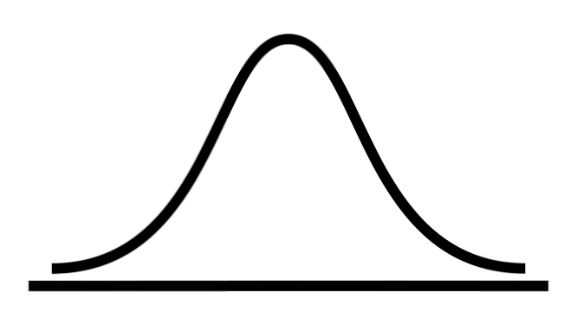
Notes:
This histogram tracks the overall trend of the results from all test cases
Snapshot of consistency
Shows how different the results are between the software tools
Explain the extreme values
Ekotrope case that is 4 points lower than the average of the three software tools for a case
REM/Rate case that is 6 points higher than the average of the three software tools for a case
Mention the vertical lines are the average values for each software tool

Slide 63
HERS Diagnostic
Output Schema
Notes:
The multi-climate test suite gives us a good comparison of the HERS Index for different cases and climates, but comparing the HERS Index only allows us to identify inconsistencies between software tools on the surface
HERS Diagnostic Output Schema, which we developed for RESNET, provides us a new way to dive underneath the surface of the HERS Index and evaluate the HERS Index calculation on an hourly basis

Slide 64
HERS Index
80
65
Software A
Software B
Notes:
Here we have two HERS Indices, one from software A, and one from software B
On the surface, you can’t tell which one is broken, at least one of them is broken, maybe both

Slide 65
HERS Index
80
65
Software A
Software B
Notes:
It’s like a doctor looking at two different arms, and trying to determine which one is broken
Just looking at these, you wouldn’t know which one is injured
Maybe the doctor can guess, but isn’t exactly sure
But a doctor has tools to identify the issue

Slide 66
HERS Diagnostic Output Schema
80
65
Software A
Software B
Notes:
The HERS Diagnostic Output Schema is like an x-ray, able to identify problems under the surface.

Slide 67
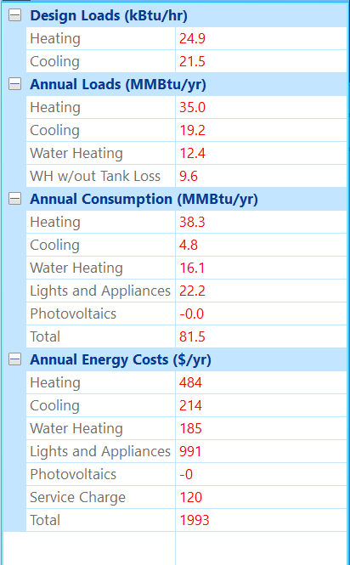
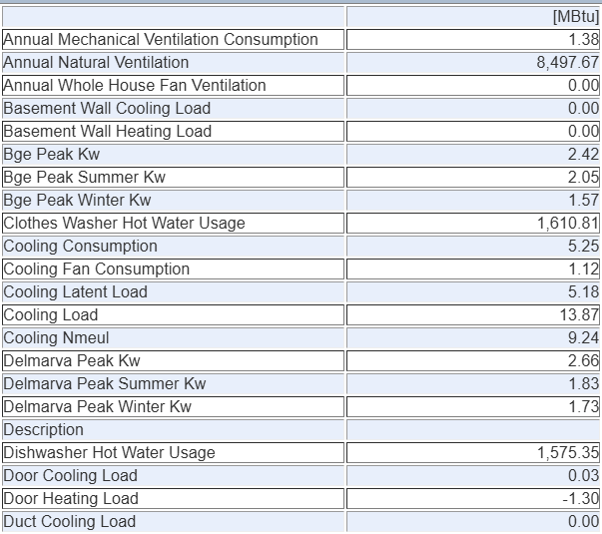
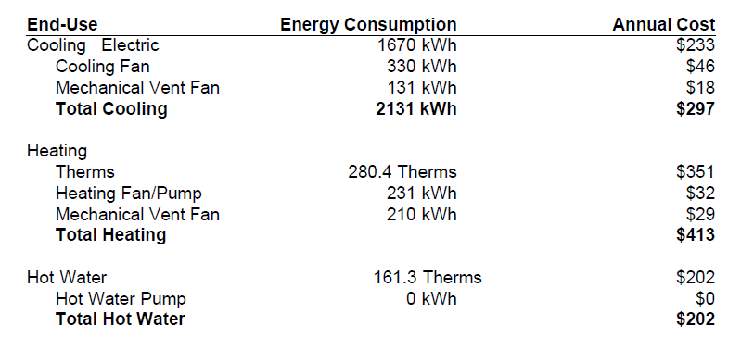
Current Software Tool Outputs
Notes:
Here are some examples of the outputs generated by the software tools that could be used to identify issues with the calculated HERS Index
The current software outputs are generally
only annual outputs
a lot of inconsistency between the outputs
Takes a lot of time to collect all of these outputs
The schema will fix all of these issues

Slide 68
Future Software Tool Outputs
Time | Rated Home Space Cooling Energy Use (kBtu) | Rated Home Space Heating Energy Use (kBtu) | … | Reference Home Lighting & Appliance Energy Use (kBtu) | Reference Home Ventilation Energy Use (kBtu)
Jan-01 00:00 | 0.00 | 0.71 | … | 1.70 | 0.00
Jan-01 01:00 | 0.00 | 0.76 | … | 1.55 | 0.00
… | … | … | … | … | …
Dec-31 22:00 | 0.00 | 1.06 | … | 3.40 | 0.00
Dec-31 23:00 | 0.00 | 1.12 | … | 2.20 | 0.00
Notes:
The outputs specified by the schema will be standardized.
Each software tool will output a file called a json file
It does not look like a table as you see here, but we can easily create a table like this from the output file
This schema allows us to use
Hourly outputs
It will be consistent

Slide 69
Reference Home:
Loads
Heat, Cool, HW
Energy
Heat, Cool, HW, LA, Vent, DH
Rated Home:
Energy
Heat, Cool, HW, LA, Vent, DH, OPP
67
Notes:
The HERS Index is calculated from several components
Reference Home and the Rated Home
Hourly energy consumption of the heating and cooling systems, ventilation, lighting, etc.
Reference home hourly loads, cooling, heating, hot water systems
Once we have all of this data from different software tools, we can compare, for example, the cooling system energy consumption of the rated home

Slide 70
HERS Diagnostic
Output Example

Slide 71
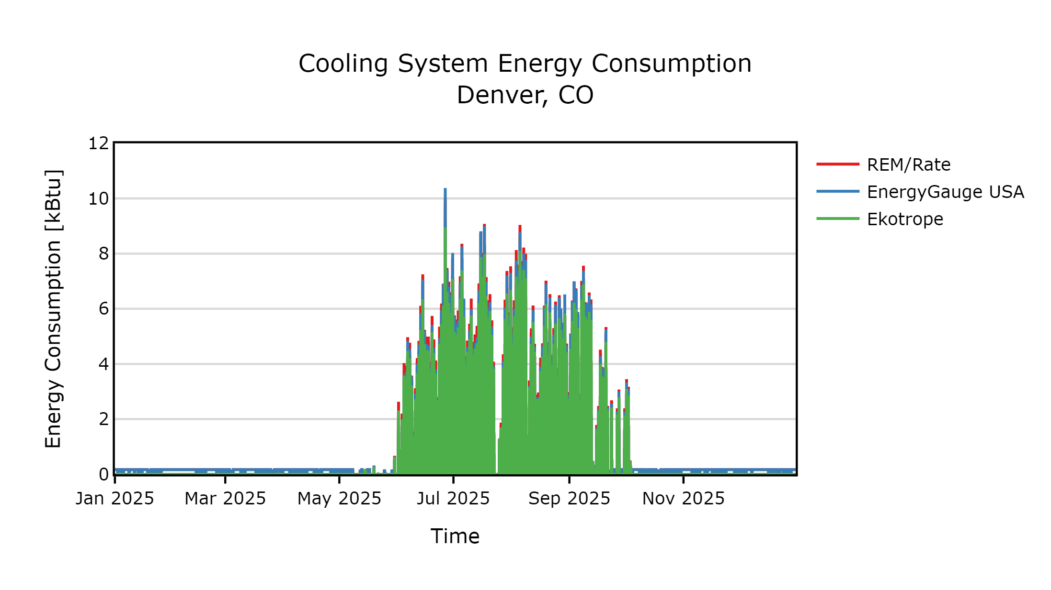

Slide 72
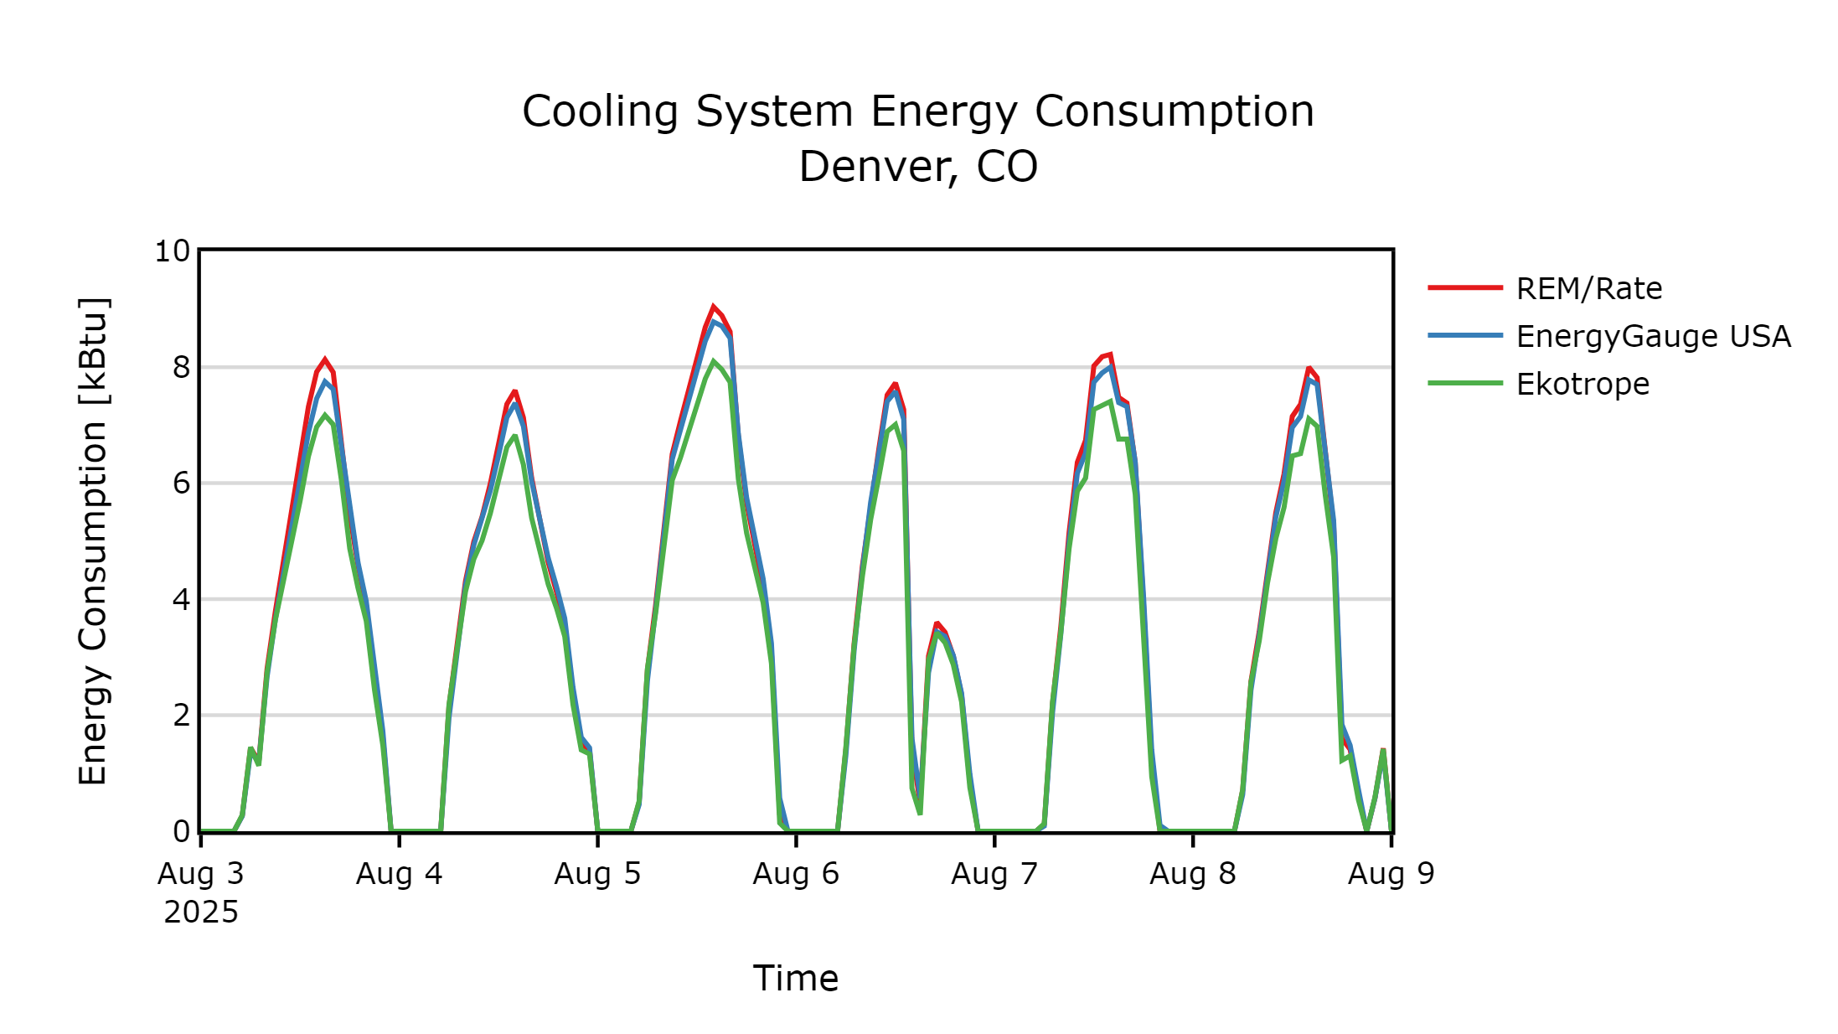

Slide 73
What’s Next?

Slide 74
Upcoming in Standard 301-2025
Duct Effective R-Values
Operable Window Area and Natural Ventilation
CMU R-Values
Heat Pump Air Conditioning COP
Notes:
TODO: update

Slide 75
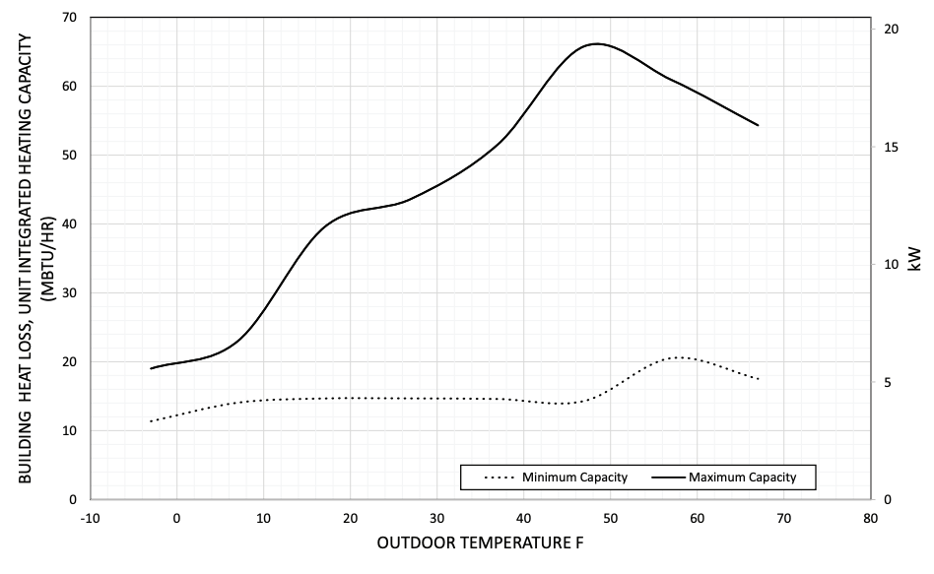
MINHERS 82: DX AC/HP Modeling
HSPF2
Notes:
The next change in the works is MINHERS addendum 82: Direct Expansion Air Conditioner and Heat Pump Modeling
In this plot, each of these points represents an hourly load in the building where we need to know what the heat pump’s capacity and efficiency are.
But the only information we can get about the equipment is the capacity at 47 and 17,
and the HSPF2 which is a weird weighted average efficiency
This addendum sets out to explain how modeling software can go from this sparse set of data to a complete map of performance at each of these points
This is the topic of a session I’m leading tomorrow, so I won’t go into more detail here.

Slide 76
Addenda in Progress: PV Systems
PV system rated features and modeling assumptions
Snow cover
Wiring losses
Dirt
Age degradation
Notes:
TODO: update

Slide 77
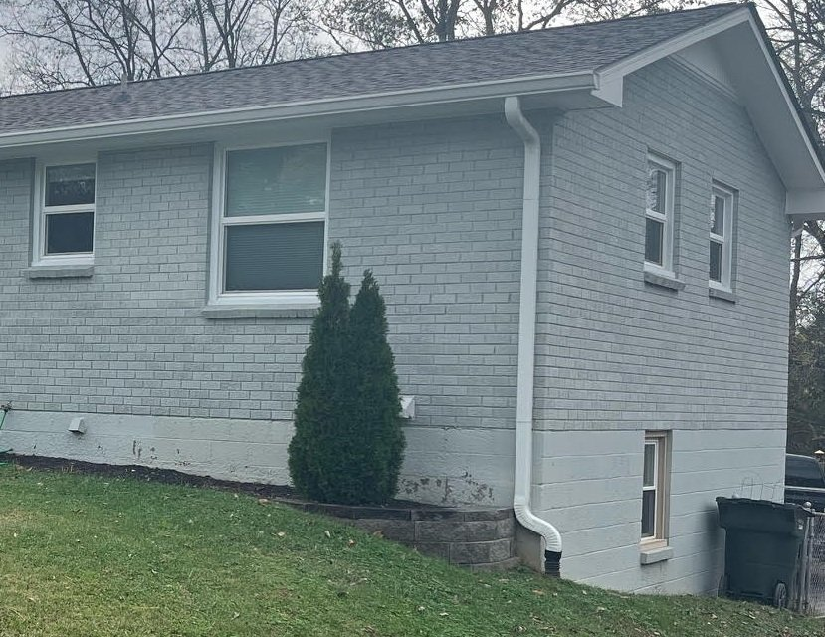
Addenda in Progress: Basement Walls
Notes:
One question we have been grappling with recently, is when is a basement wall not a basement wall anymore?
In the energy code, Basement walls have a much lower insulation requirement than above grade walls.
For a walkout basement, more and more of the wall is above grade, but it’s also part of the basement.
At what point does it transition from the definition of “basement wall” to ”above grade wall”?

Slide 78
Known Issues
Default design airflow for HVAC grading
Infiltration volume with open attic hatches or basement doors
Weather file mapping
Evaporative coolers
Combined space/water heating
PTHP/PTAC modeling

Slide 79
Publication 002 Working Draft
Multi-Climate Test Cases
Improved Distribution System Efficiency (DSE) tests
General Requirements
HERS Diagnostic Output Schema*
Batch Automation
Reference Home Inputs

Slide 80
Future Test Enhancements
Multiclimate cases
PV/Battery
Heat Pump
Physics tests
Distribution System Efficiency
HVAC

Slide 81
Questions?
Neal Kruis, PhD
neal.kruis@bigladdersoftware.com
Nathan Oliver
nathan.oliver@bigladdersoftware.com
81

Slide 82
“Someone with a watch knows what time it is”
“Someone with two watches is never sure.” -Segal’s Law

Slide 83
“Someone with three rating software tools is never sure what the HERS index is.”
-Kruis’s Law
63
67
64
Notes:
Since making this statement, I’ve discovered that people took this for face value: The only way for certainty is a single software tool.
Unfortunately, the irony of this seems to have been lost on some people who have quoted me to defend the opposite of the point I’m trying to make.

Slide 84
Segal's law
The mood of the saying is ironic. While at a surface level it appears to be advocating the simplicity and self-consistency obtained by relying on information from only a single source, the underlying message is to gently question and make fun of such apparent certainty – a man with one watch cannot really be sure he knows the right time, he merely has no way to identify error or uncertainty.
Nevertheless, the saying is also used in its purely surface sense, to caution against the potential pitfalls of having too much potentially conflicting information when making a decision.

Slide 85
“Someone with one watch cannot really know the right time, they merely have no way to identify error or uncertainty.”
–Corollary to Segal’s Law
Notes:
In other words: When you rely on information from a single source, you are accepting ignorance self-consistency.
It doesn’t matter if your watch is 10 minutes slow until you miss the last train home.
The corollary here is…

Slide 86
“Someone with one rating software tool cannot really know the right HERS Index, they merely have no way to identify error or uncertainty.”
-Corollary to Kruis’s Law
67
Notes:
Again: Self-consistency is NOT consistency. It is intentional ignorance.
It doesn’t matter if the software is developed by the latest smartest tech start up, the most experienced buildings science sages, or our nation’s top laboratories.
The problem is that they all make mistakes, and when your results don’t make sense you’re going to wish you had something to compare to.
It’s why patients seek a second option, and why we have three credit reporting bureaus.
Multiple sources of data provides accountability where a single source cannot

Slide 87
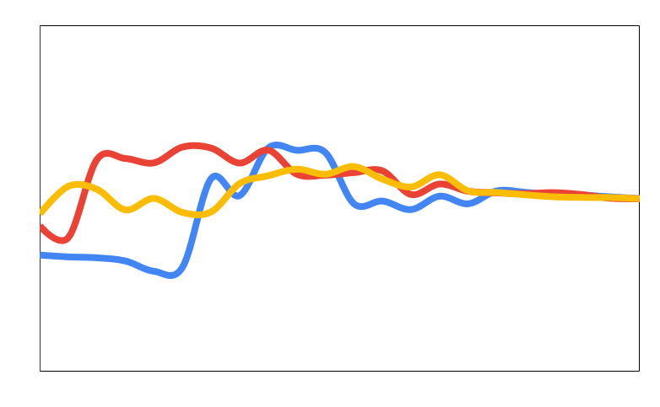
Software Consistency Over Time
Accountable Accuracy
HERS Index
Ignorant Self-Consistency
*Not real results. For Illustrative purposes only.
Time
Notes:
I’ve shared this illustration before too
I like it because it illustrates:
There will be some bumps along the way, but in the end we will be in a better place for it
If we only used one software, we would not arrive at the right HERS Index
Sometimes consistency changes impact some software more than others
But it’s purely hypothetical. If we are going to achieve accountable accuracy, we need to be better at measuring consistency. We’ll touch on that more in a bit.

