Slide 1



Iain Walker
LBNL
AVOIDING ELECTRIC PANEL AND SERVICE COSTS WHILE SAVING THE GRID

Slide 2

Avoiding Electric Panel and Service Costs while Saving the Grid
Iain Walker
LBNL, Scientist

Slide 3
Homes are adding electric loads
New construction & existing homes:
  “New”: Solar PV, Home charging of EVs, Batteries, backup power systems
  “Traditional”: Heat pumps for heating/cooling/hot water + other appliances: cooking, clothes drying
What are the issues?
New construction
Lots of expensive infrastructure – mostly transformers
Utility might reject your interconnection
Retrofit
Do we have enough amps?
Do we have enough breaker slots?
Do we need to add 240V circuits?
Utility might reject your interconnection

Slide 4
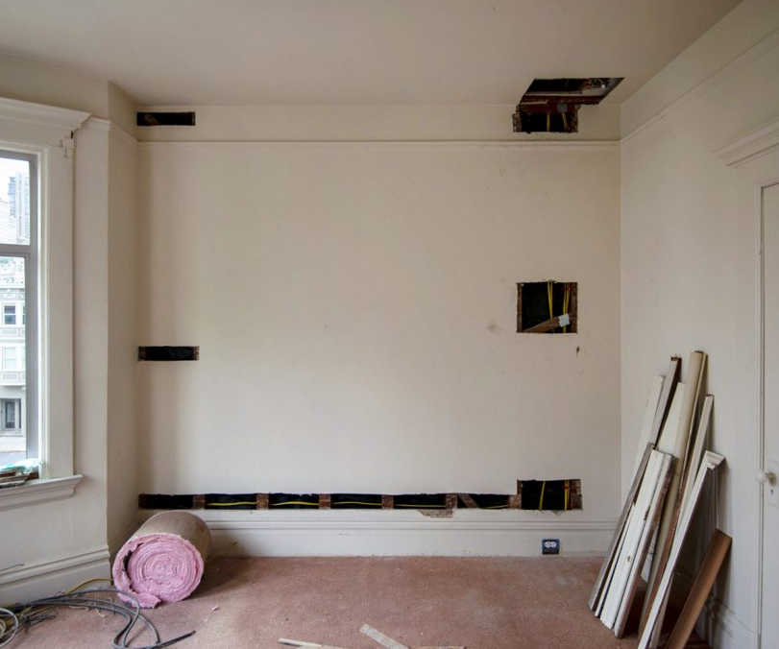
Issues in the home
What does it cost in retrofit?
  Circuits: $250-$750 each
  Panel replacement: $1,000-$5,000
  Service replacements: $1,000-$25,000 to homeowner + similar amount for utility
  Rewiring: Can trigger knob & tube replacement ~$10,000-20,000
Time delays
  3-6 months project delays
  >1-year lead time on transformers
What does it cost in new construction?
  Highly variable – depends on local grid and utility $1000s/home.
Image courtesy of All-electric California (Eric Morill)

Slide 5
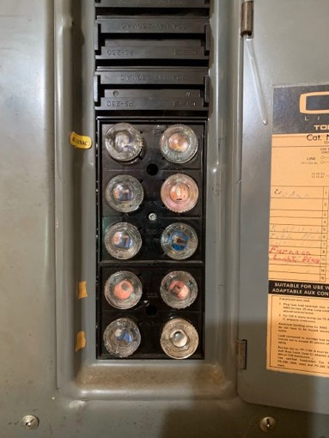
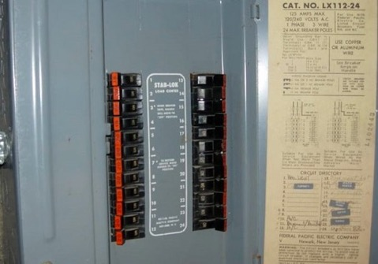
Sometimes an update is needed
Old, unsafe or damaged:
Panels
Breakers
Wiring
Junction boxes
Fuse Boxes

Slide 6
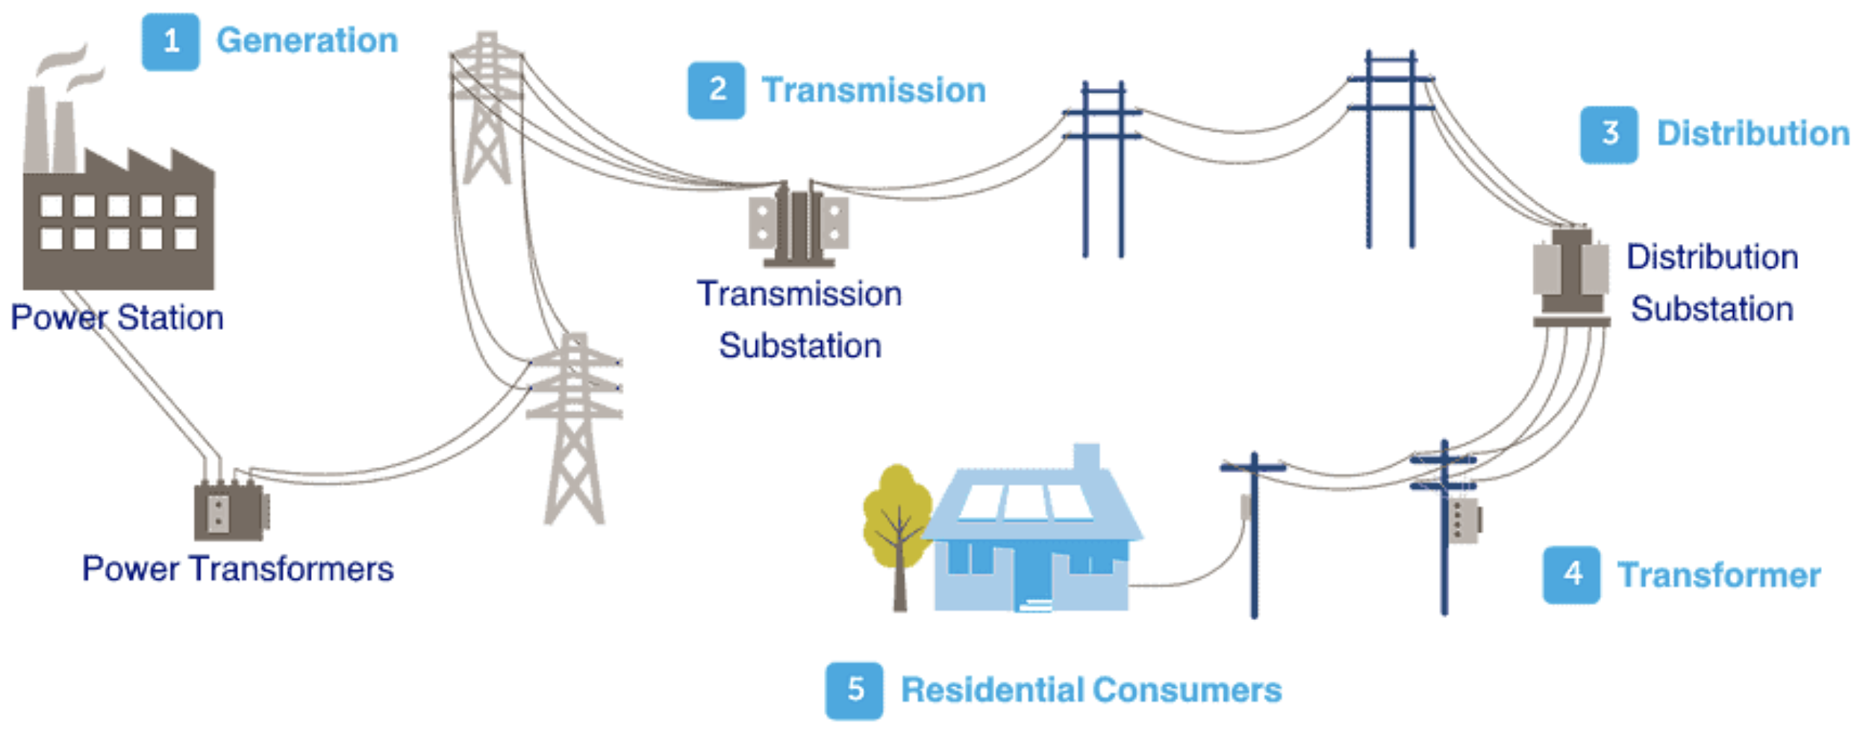
Issues for the grid
  Infrastructure driven by peak power, not energy
  High costs – passed on to ratepayers
  High peak power = more potential blackouts/restrictions – a problem for grid resilience

Slide 7
What can we do?
Energy Efficiency not enough!
We need to be Power Efficient in construction to:
Minimize customer side of the meter costs: wiring, replacement of electric infrastructure in existing homes
Minimize the power requirements on the grid: fewer transformers, less transmission infrastructure, less need for new power plants – all of which are paid for by ratepayers or builders/developers for new construction
  This also makes the grid more resilient: less peak power means fewer power disruptions due to grid limits

Slide 8
 | Power
Energy | High | Low
High | EV, Solar PV | HP/HPWH*
Low | Cooking, Dryer | Lights, plugs, etc.
* Depends on Auxiliary Resistance (“strip”) Heat
9

Slide 9
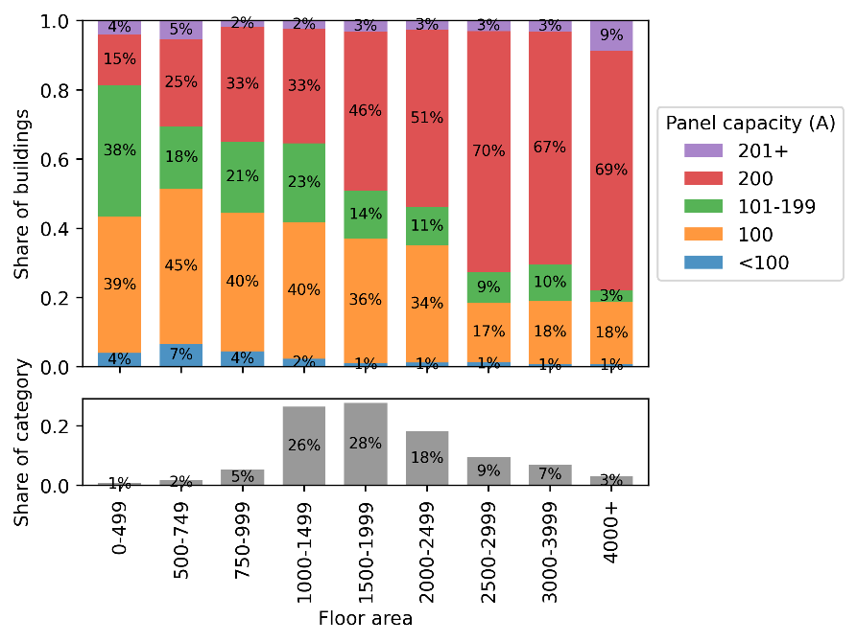
What’s Installed in Homes?
Panel capacity (AMPS) in 37,000 single-family homes (+ Modeling in >30,000 ResStock homes)
Does house size matter?
19

Slide 10
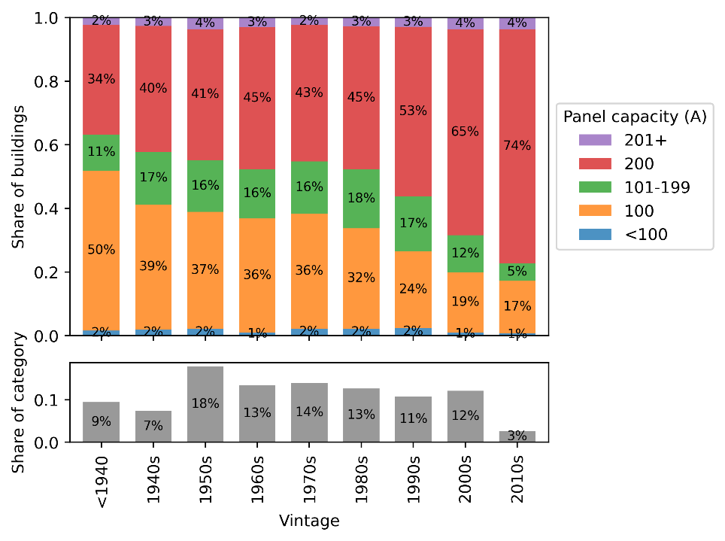
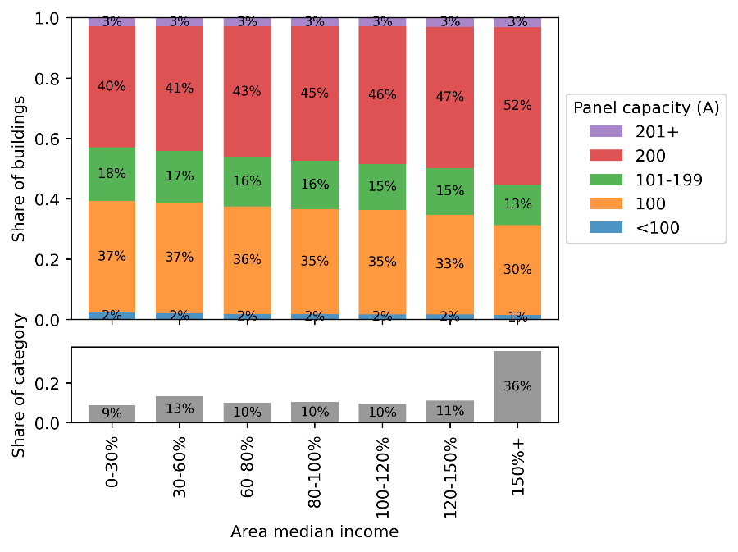
What’s Installed in Homes?
By Age
By Income
20

Slide 11
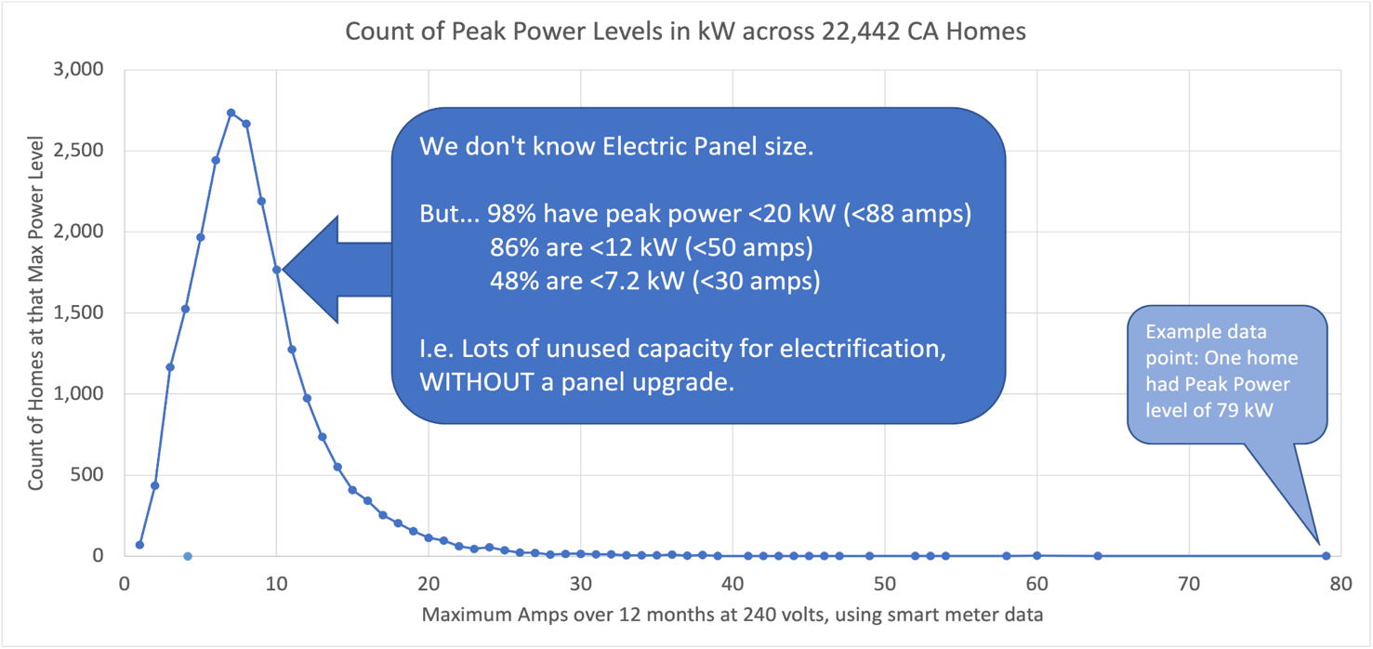
Can We Add new Loads?
An analysis from HEA of smart meter data across 22,000 homes in PG&E territory to identify peak power usage (the single greatest point use power draw from their electrical panel) over a year-long period.

Slide 12
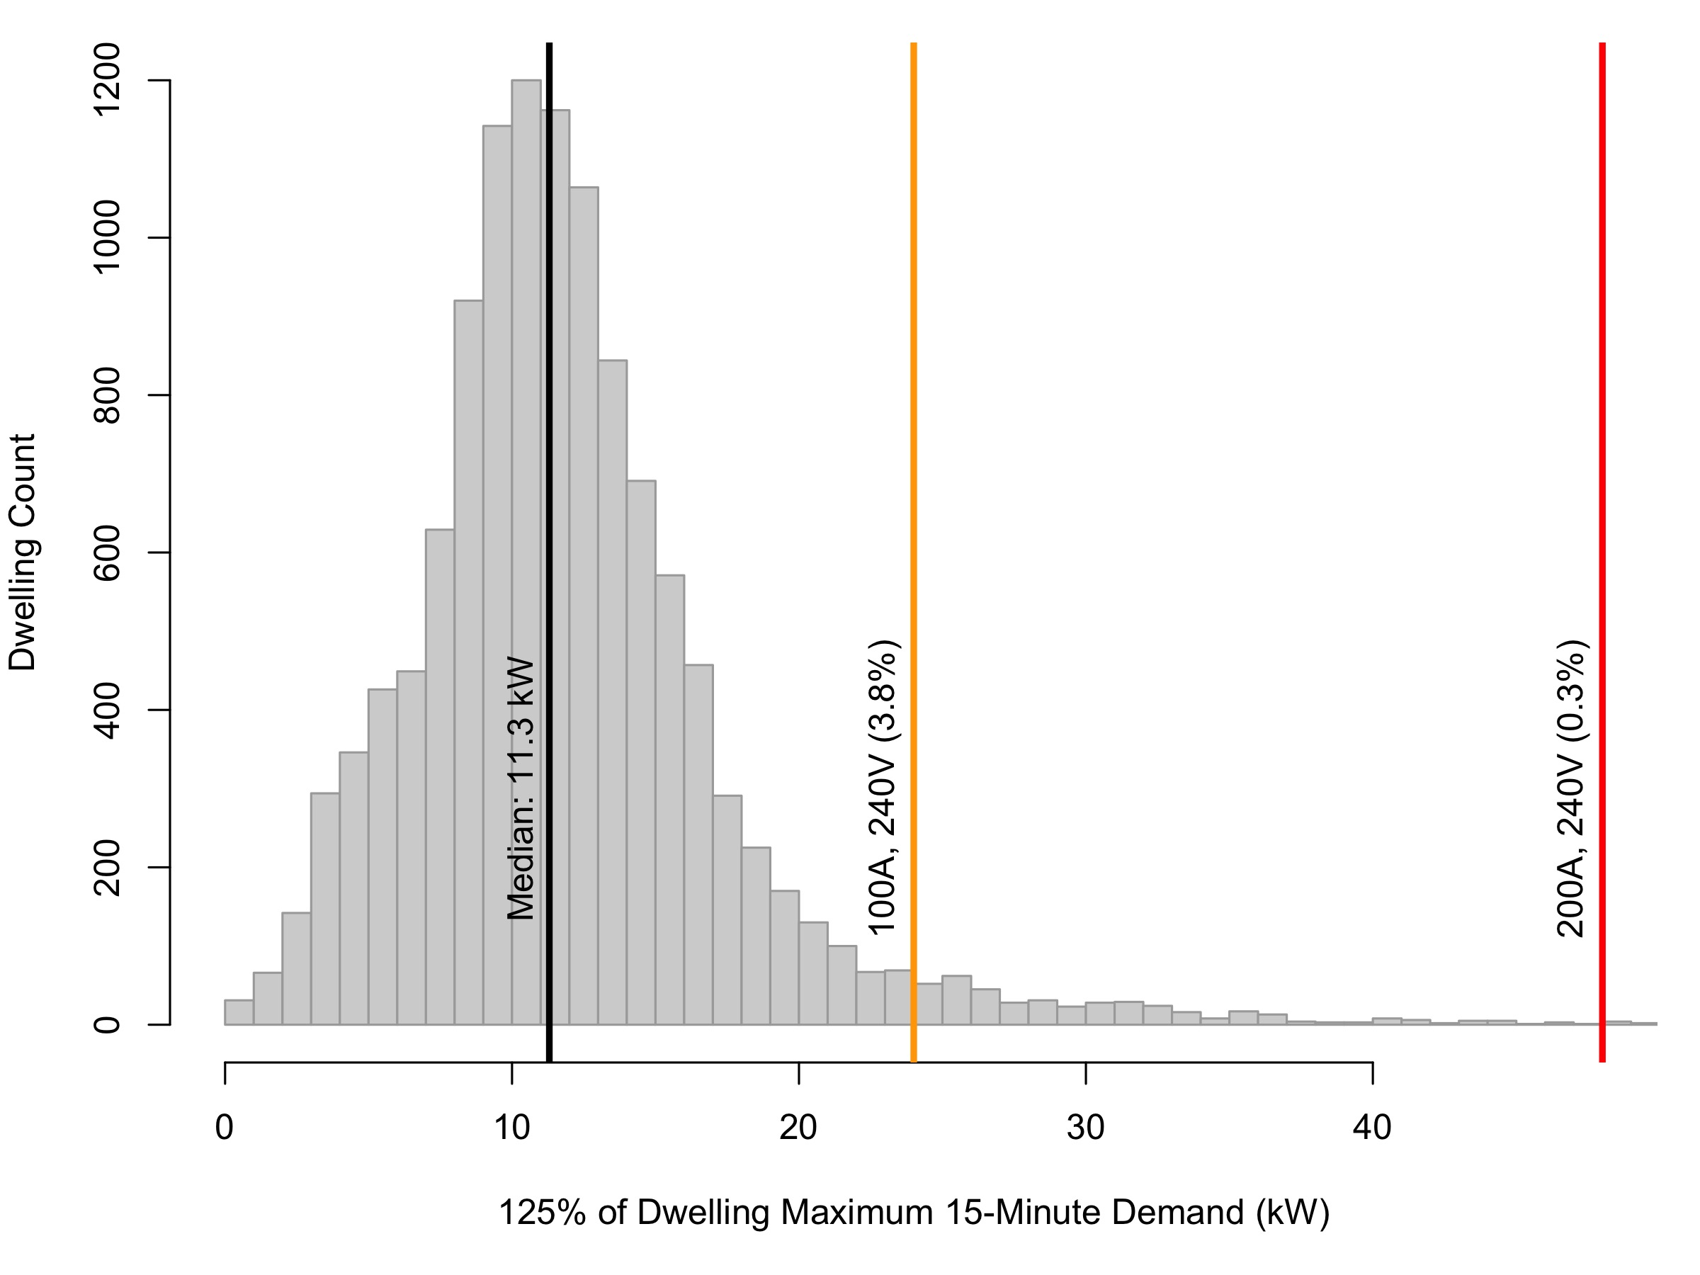
Can We Add new Loads?
The median home with a 100A panel uses <50% of its capacity
Vast majority never exceed 100A
Whole dwelling 15- and 60-minute demand data
11,750 existing US dwellings
2.7 years per dwelling
End-use sub-metering 15-minute data
957 existing US dwellings
9,490 branch circuits
3.5 years per dwelling
12.7 kW
36.7 kW

Slide 13
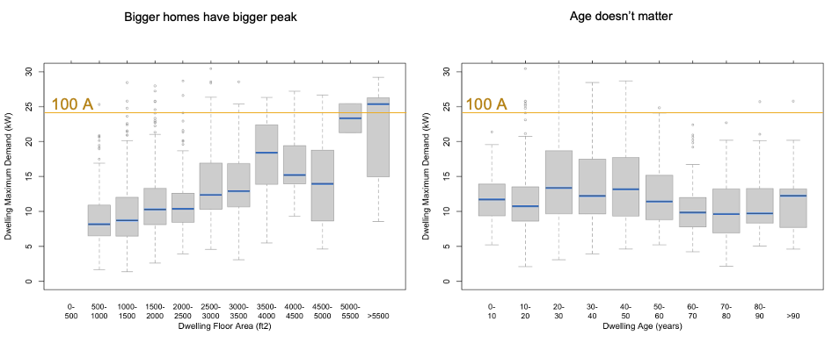
What homes are more likely to need a new panel/service?

Slide 14
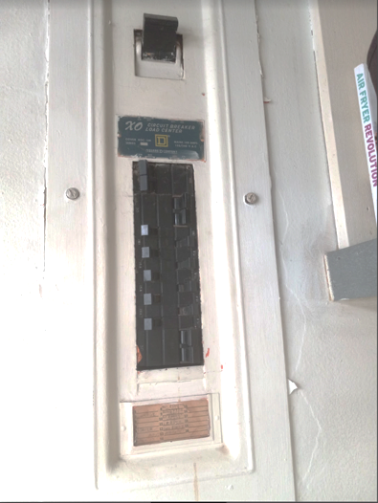
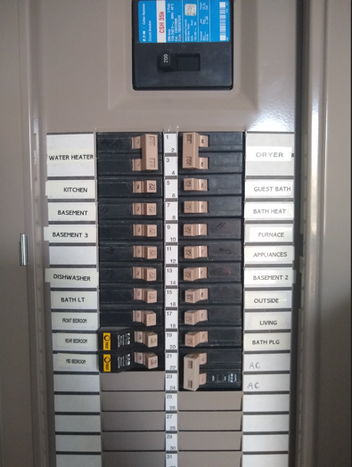
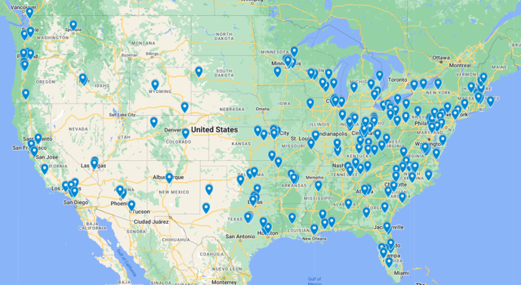
Beyond Amps – Space for breakers?
NO SPACE LOTS OF SPACE
BayRen Home Electrification Checklist (over 6,000 homes)
  100A: 31% have free space
  200A: 48% have free space
National Citizen Science approach – 300 homes
  100A: 75% have free space
  200A: 80% have free space

Slide 15
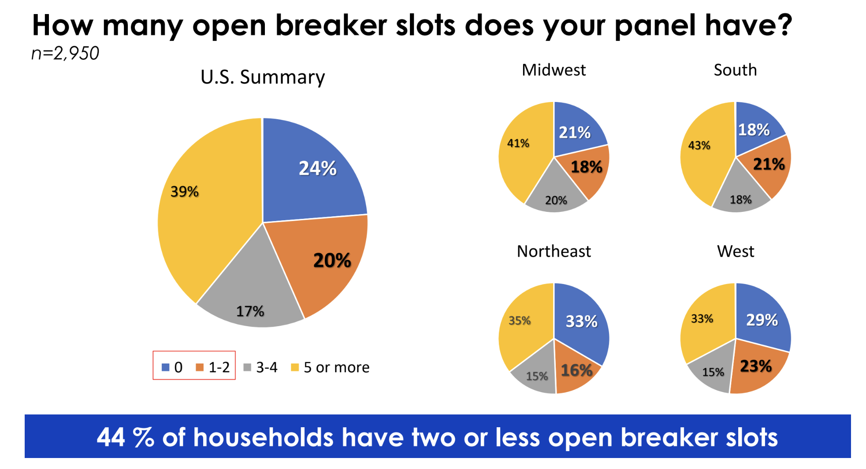
Beyond Amps – Space for breakers?
EPRI Study of Electrical Panels in 2,950 US Homes

Slide 16
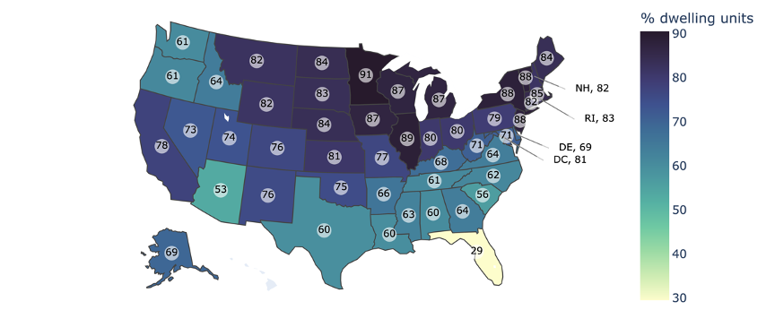
Prevalence of Electrification Constraints –
Physical Space or Electrical Capacity
Business-as-usual electrification, L2 EV charging, 2023 NEC 220.83
Preliminary - do not cite

Slide 17
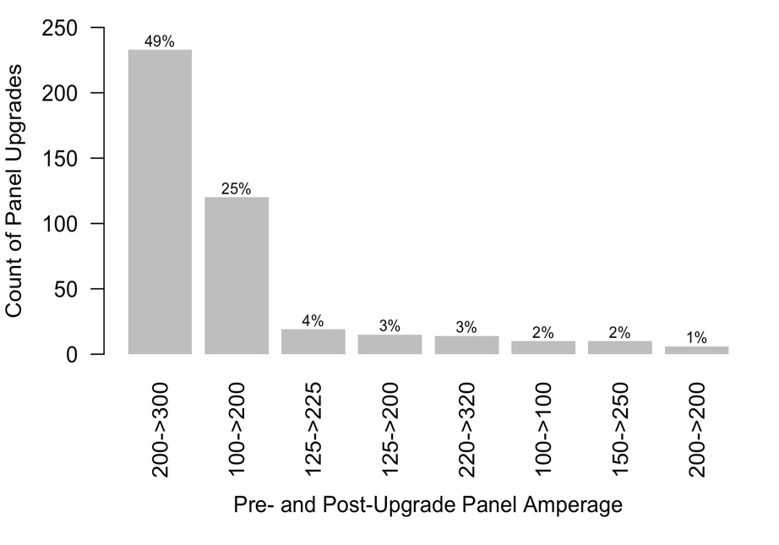
Is HVAC a driver of panel changes?
TECH Clean California
6% of 21,146 heat pump projects replaced panels
Vermont HP program
10,000 heat pumps – on average added only ~200 W (Nameplate was 3600 W)
Cadmus ccASHP study
  8% service panel replacement
  10% subpanel installs
  1% utility transformer replacement
Most panel changes were from 200A to 300A - for other reasons?
More replacements with heat pump water heaters, in part due to incentive structure

Slide 18

What is driving panel replacement and service changes?
Reports from utilities: Current main drivers are adding Solar PV and EV Charging
Simplified approaches by electricians
  Not using existing paths in the National Electric Code, e.g., using metered data
  Profitable upsell
  Habit/comfort/risk aversion
NEC unclear about options/exemptions
NEC may not be using reasonable peak power and load diversity assumptions
Local code authorities unprepared
  Some will not allow circuit sharing or smart panel controls
27

Slide 19
What drives capacity?
NEC 220.87 – Metered Data (very rarely used)
Existing loads based on metering data (15 minute*)
Total load = (Metered Load) x 1.25 + New Load
NEC 220.83 – Sum Connected Loads
Existing loads = sum of connected loads with different treatment when adding HVAC
No New HVAC: 100% of first 8,000 watts + 40% of remaining loads (including heating and cooling)
New HVAC: 100% of first 8,000 watts + 40% of remaining loads + max(heating, cooling)
* Not the 60 minute data you get from your utility smart meter ☹

Slide 20
What drives capacity?
New homes:
Don’t have “metered” option
Typically 200A for single family.. .but … heading towards 400A to accommodate solar PV, EV charging, batteries, etc.
Local code authorities unprepared
  Some will not allow circuit sharing or smart panel controls – even though they are covered by the NEC

Slide 21
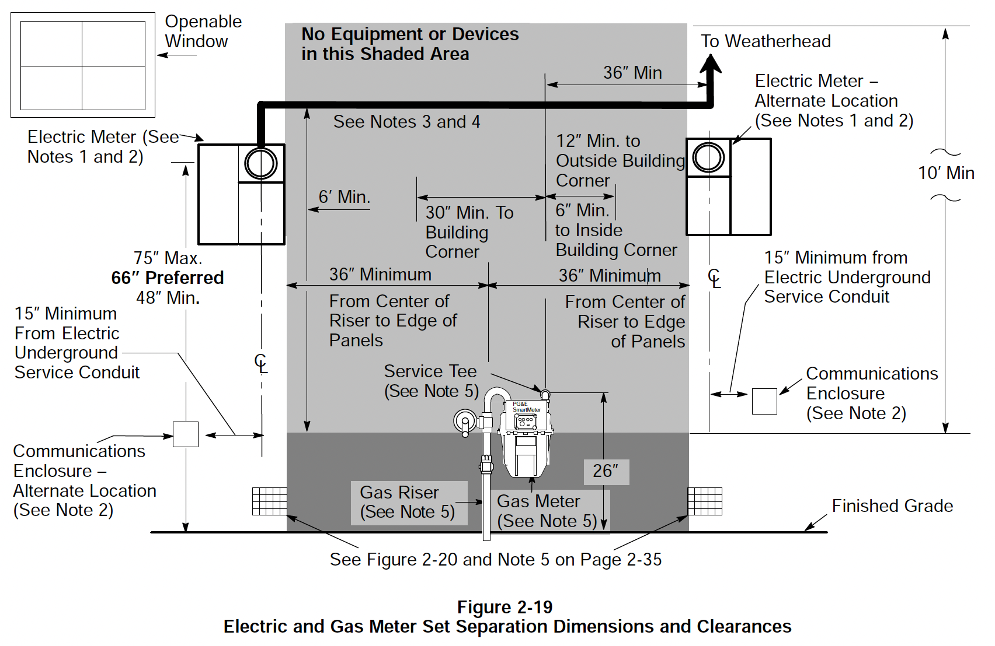
Other Regulation Challenges
Utility service “PG&E Green book” – leads to expensive work – moving panels, rewiring, new service drop, potential service denial
52

Slide 22

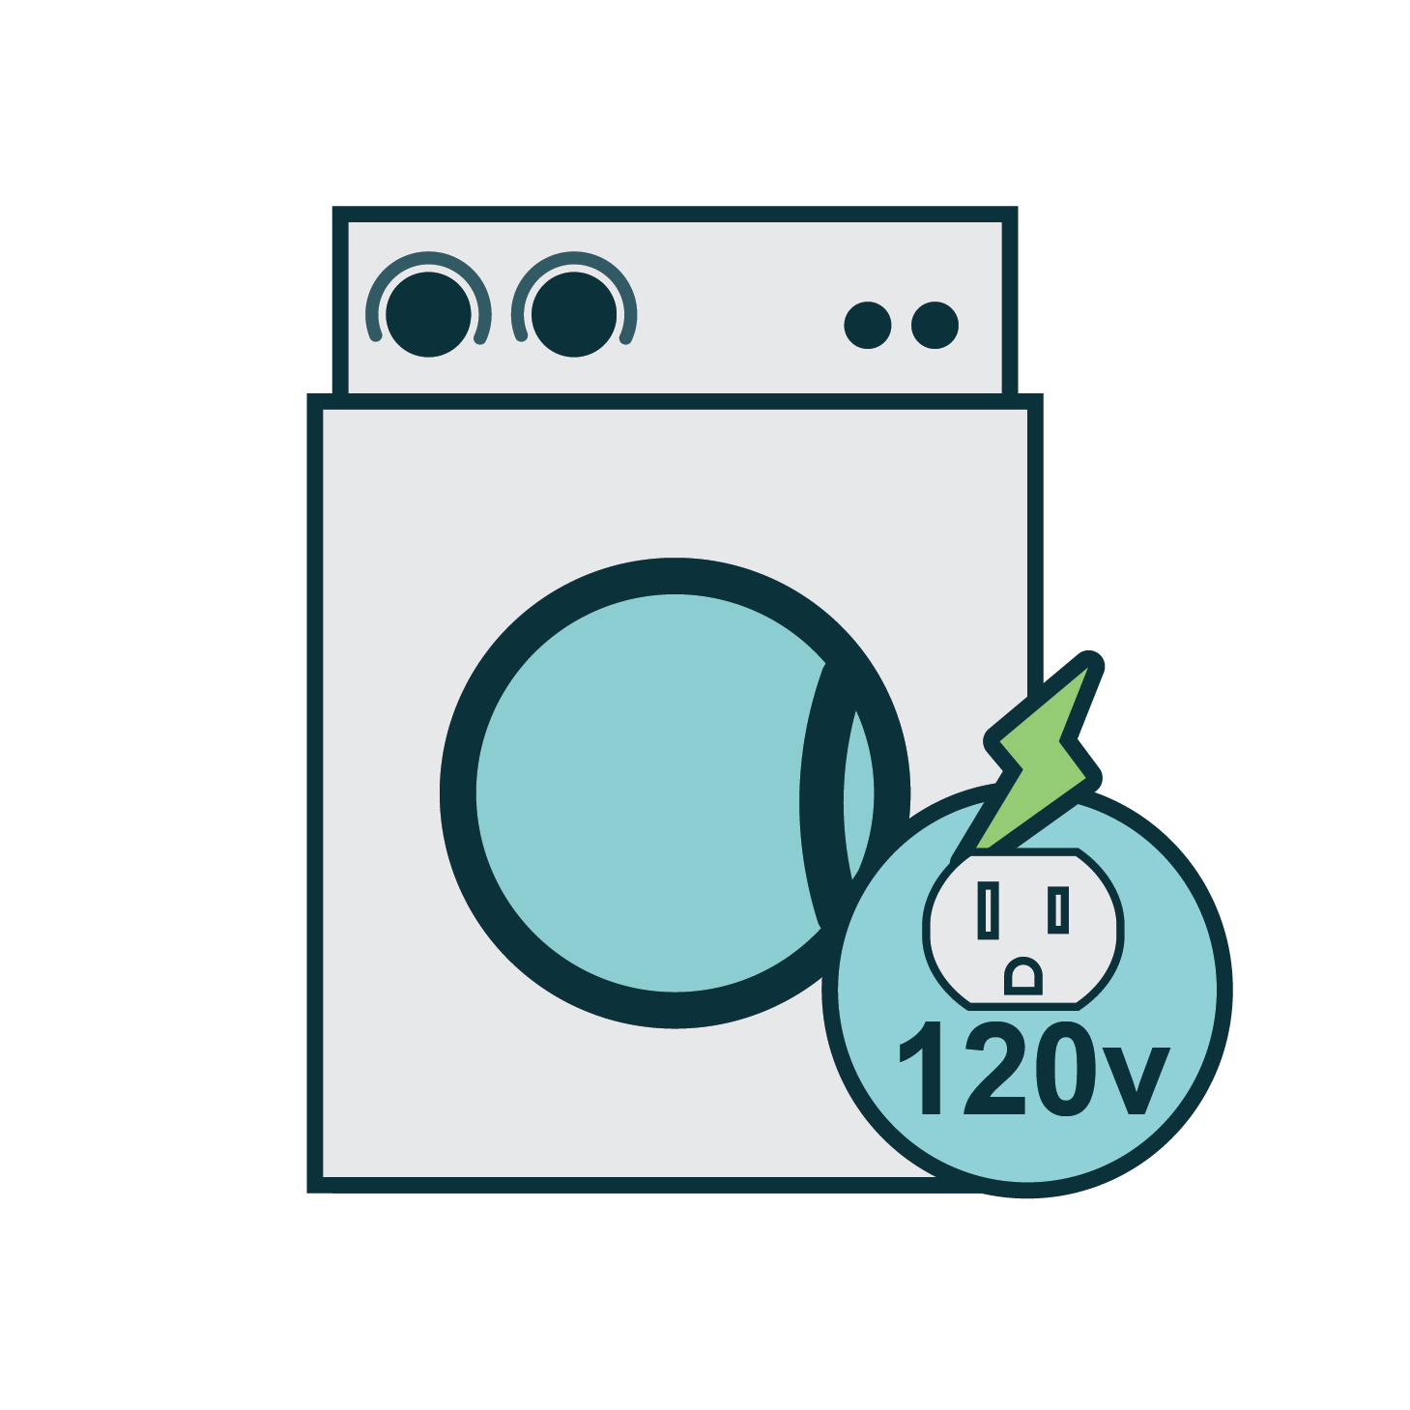



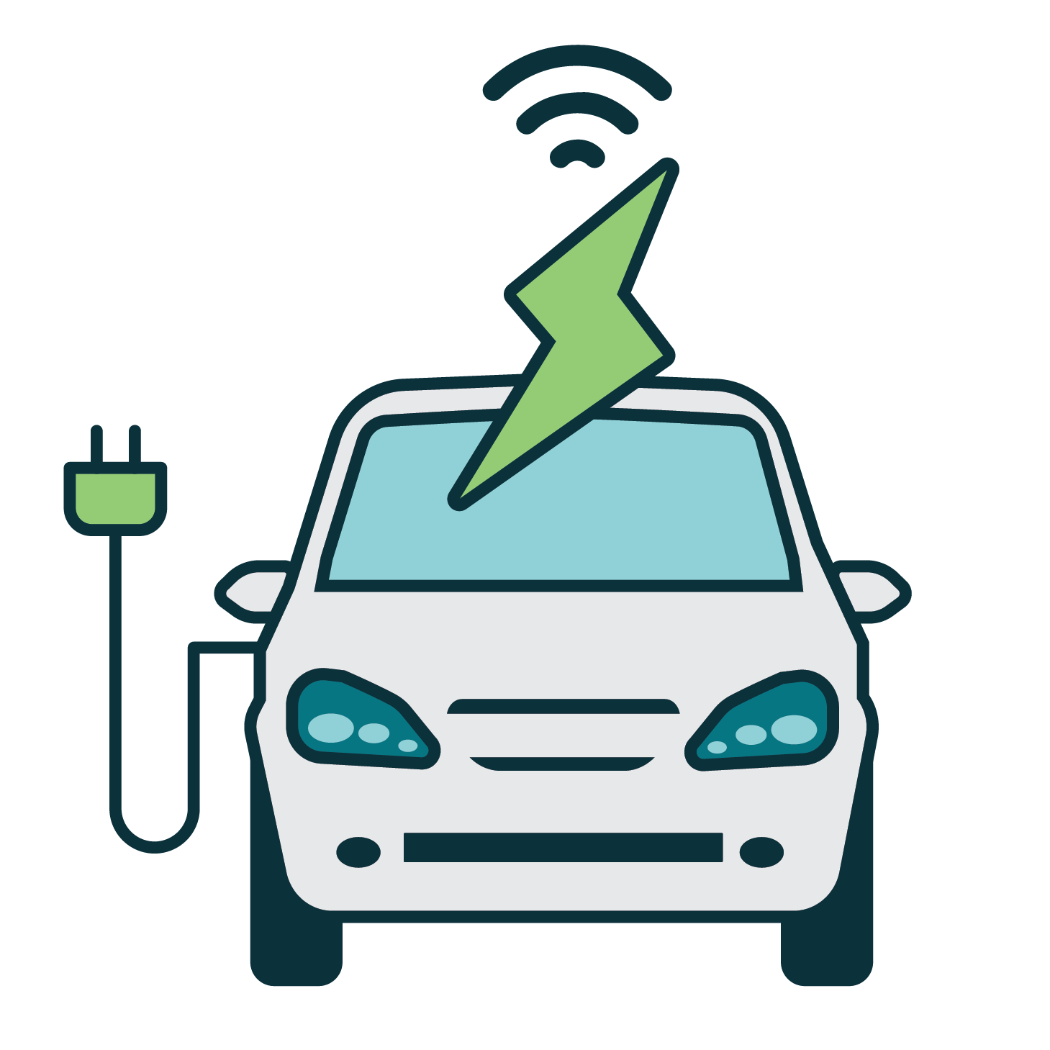
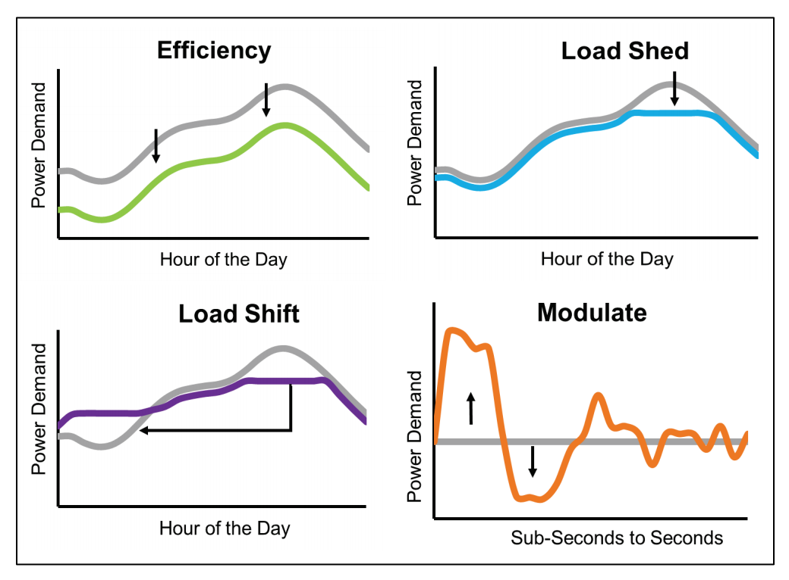
How Do We Address This?
Advances in Technology
Code Innovations

Slide 23
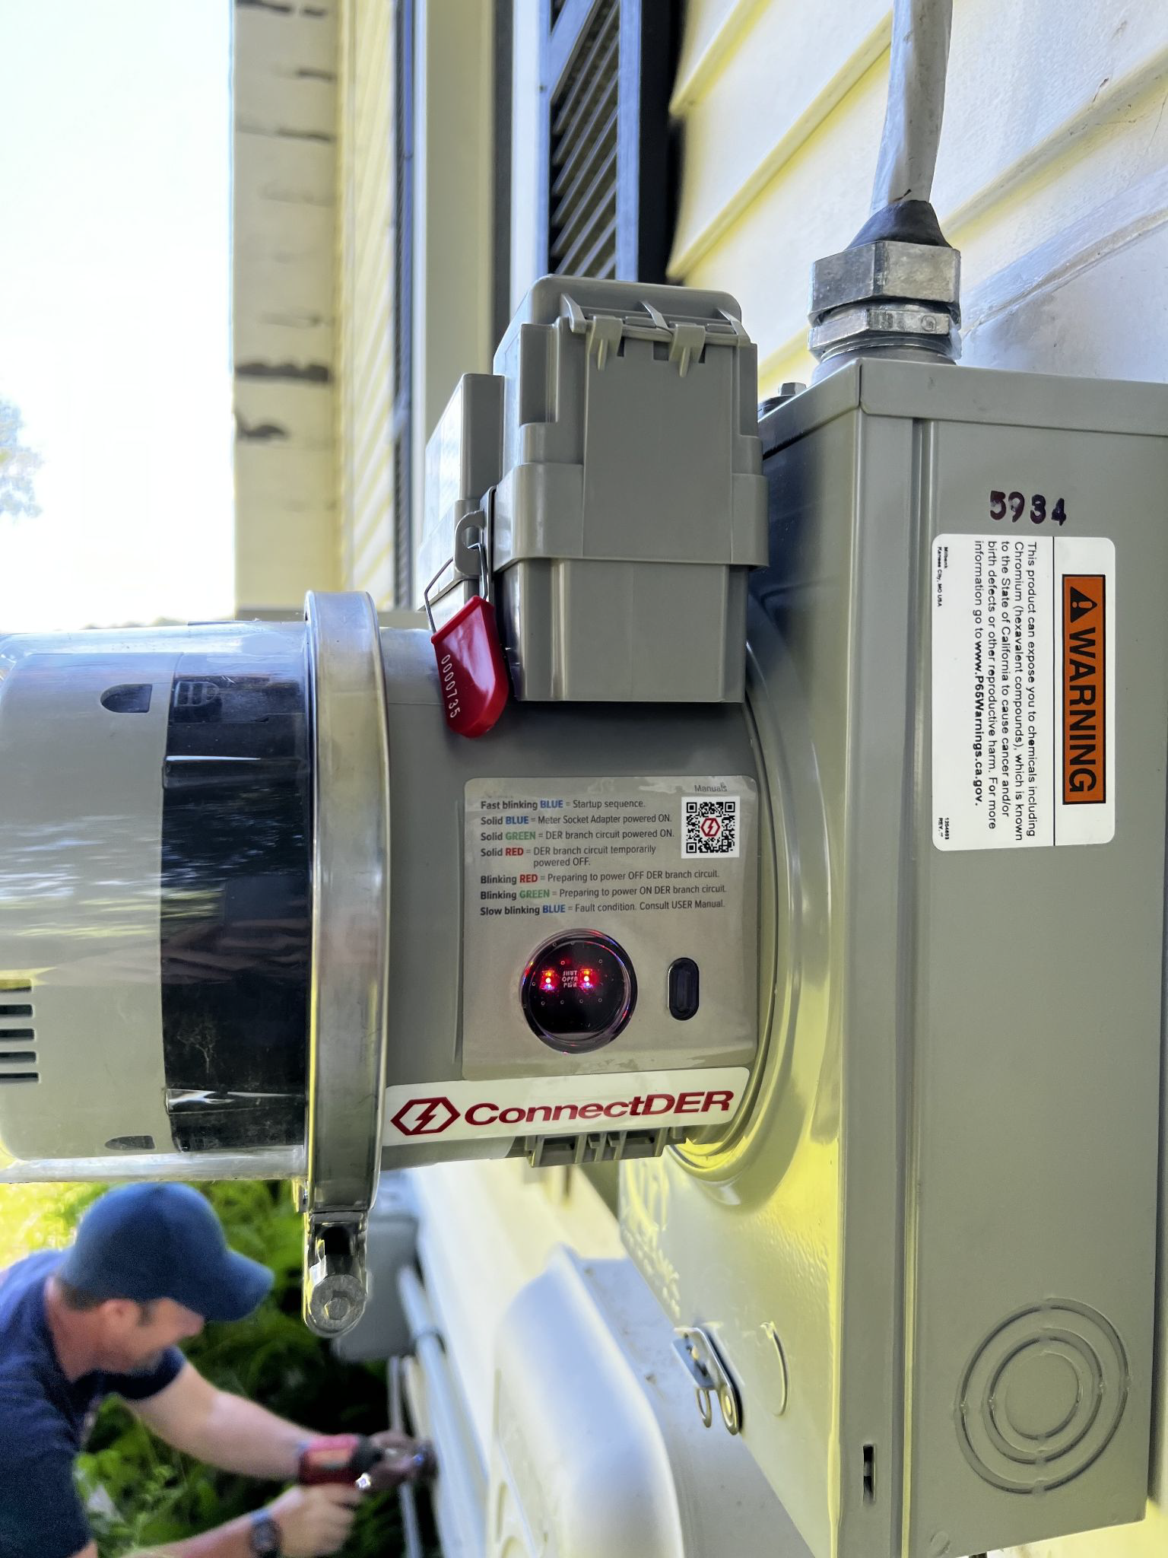
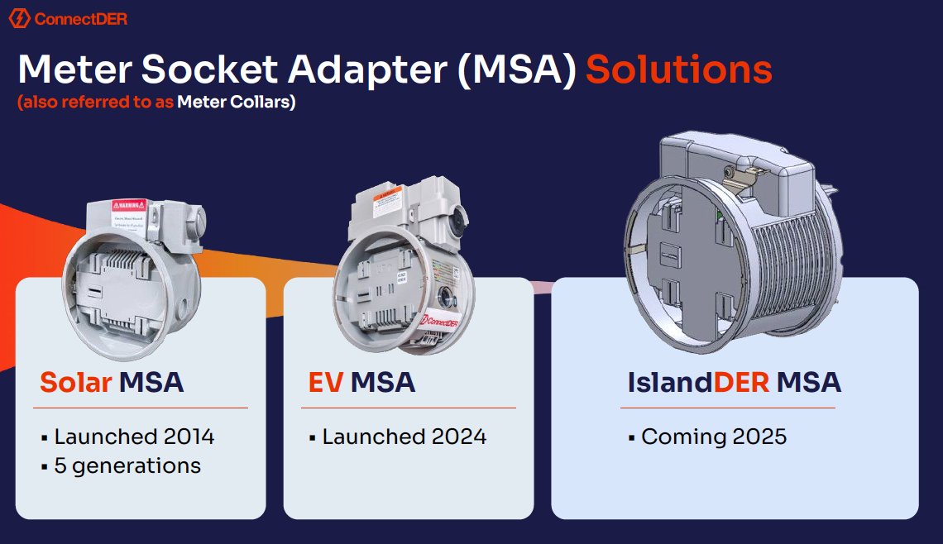
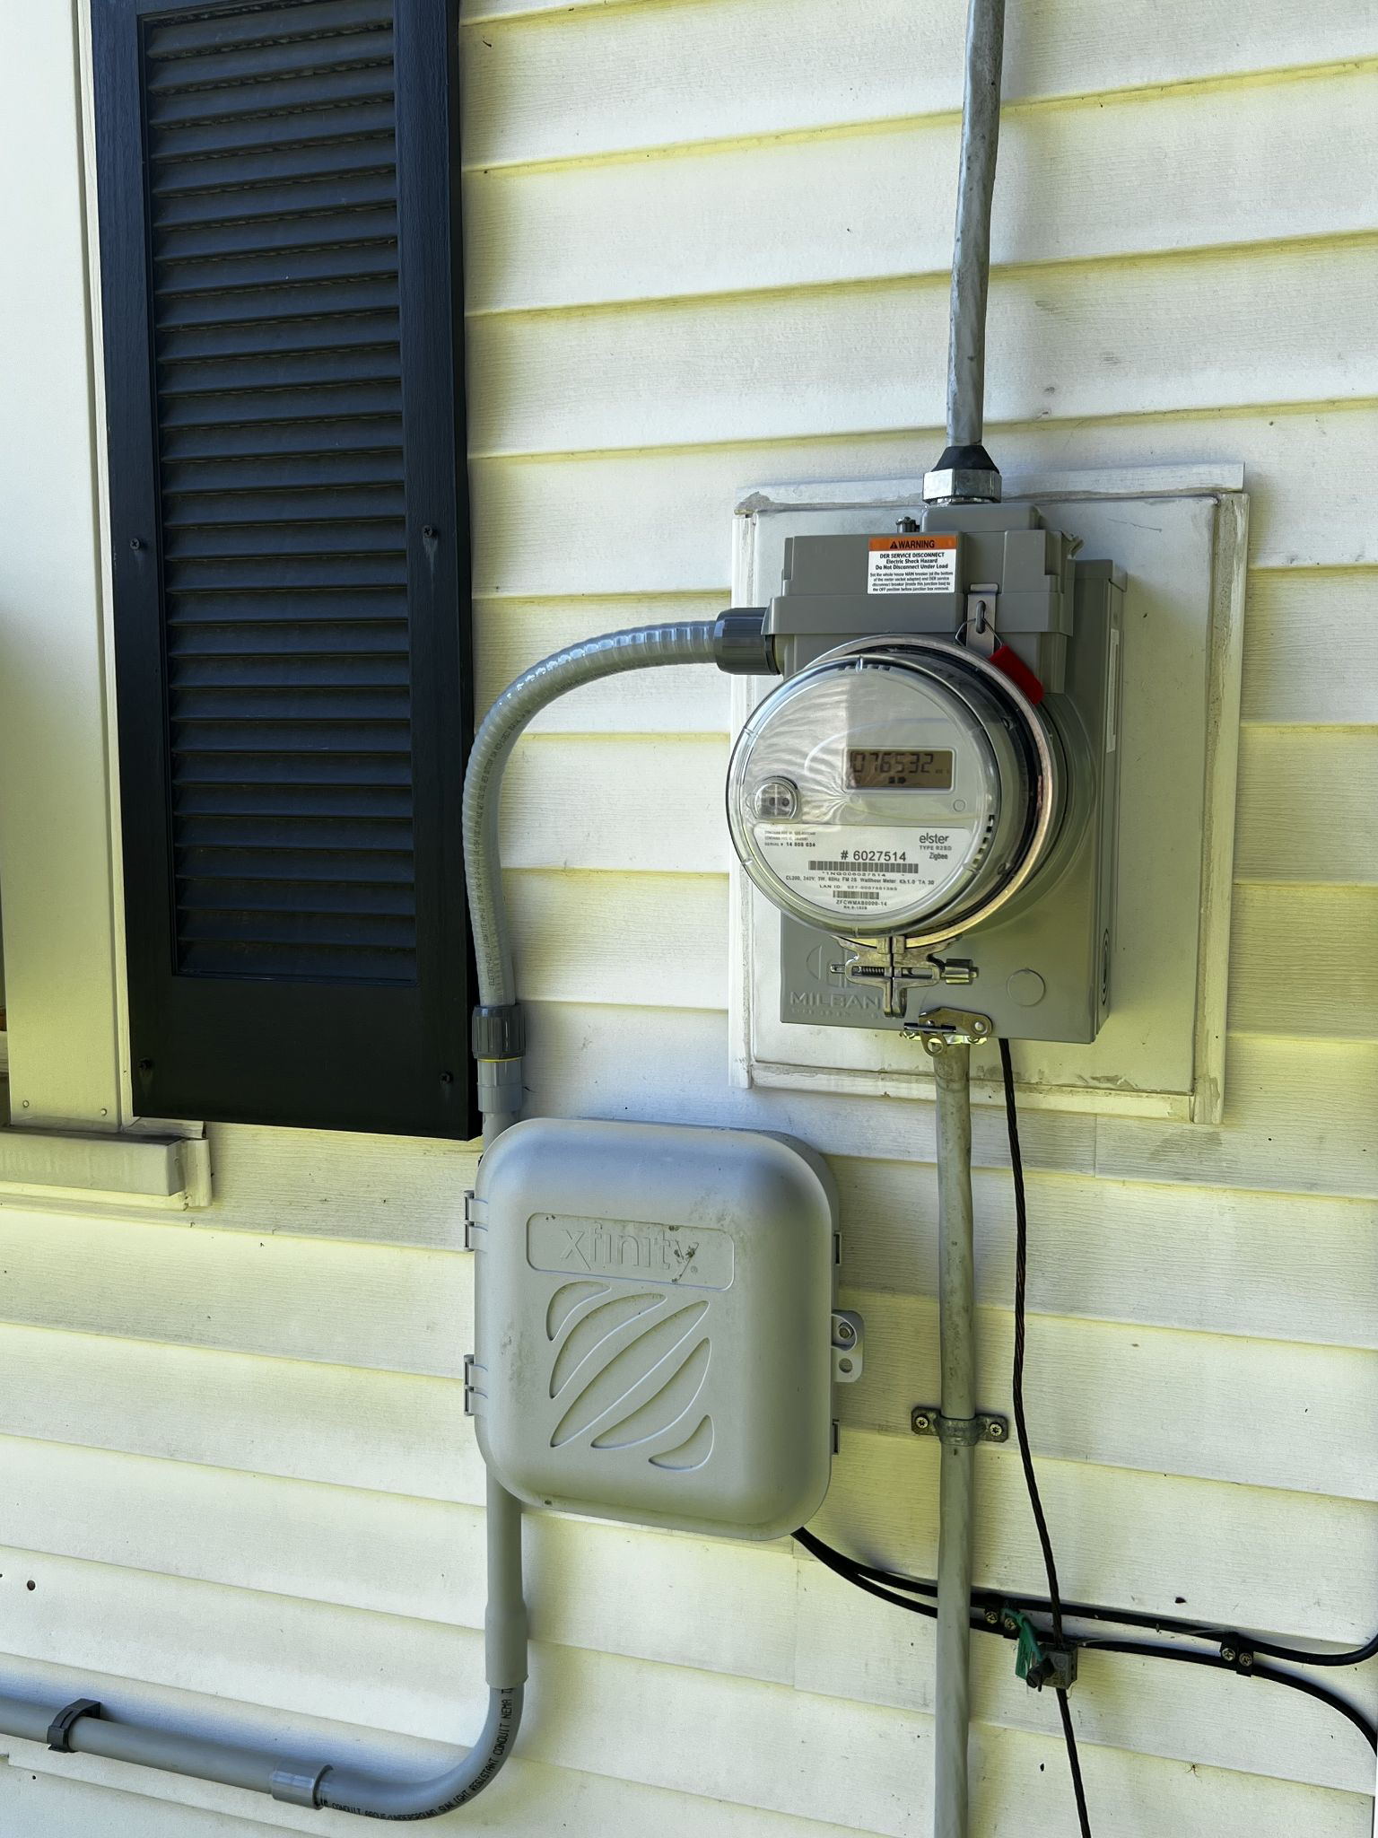
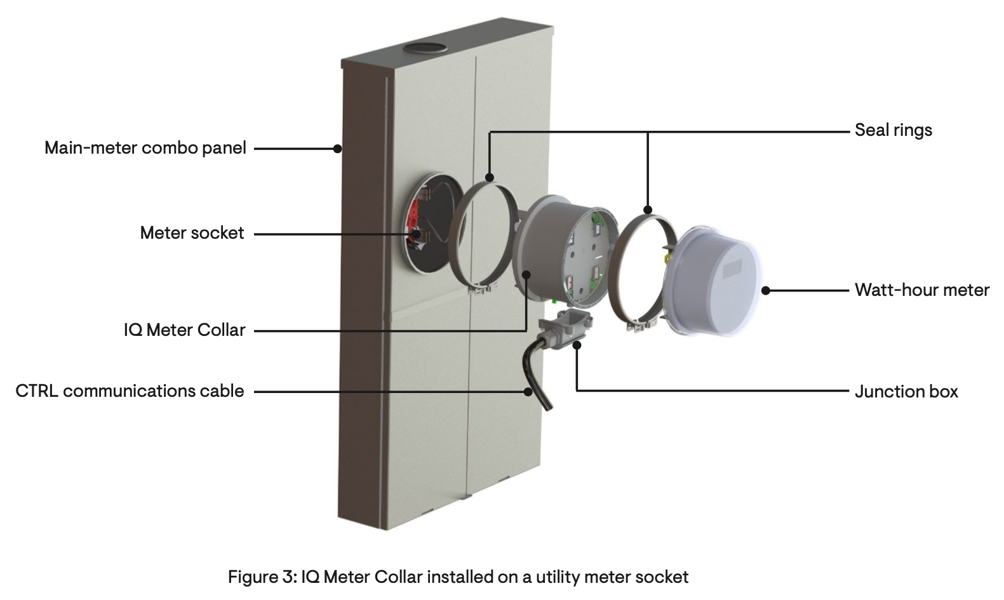
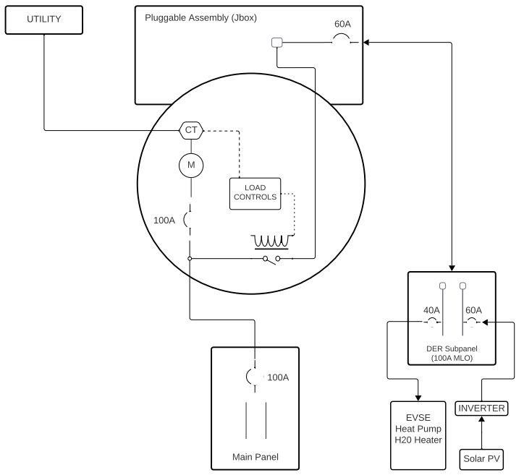
Advances in Technology – Meter Socket Adapter
Interconnection outside of the panel/busbar
Address space constraints and sizing limitations imposed by solar 120% rule
Islanding capability coming soon – disconnect from utility allows house to remain powered
Images credit: Connect DER and Enphase

Slide 24



Advances in Technology – “Balcony” Solar
Backfeed solar power into household wiring instead of into panel
Power limited for safety (<800W) – no utility isolation
Currently not allowed in the US, but ~500k in Germany
Relatively low cost: ~$500
Can have integrated battery
Portable – ideal for renters
Non-”balcony” applications

Slide 25


Advances in Technology – Battery-Integrated Appliances
Re-use existing range/cooktop 120V receptacle for cooker interconnection
Saves space and reduces electrical load
Electric cooking is largest nameplate load in most homes (~12kW)
Reduce to ~1.5 kW at 120V using battery to serve short-term loads
Impulse cooktop 3 kWh battery
Copper range 5 kWh battery
Future integrations likely include water heating, HVAC and others

Slide 26
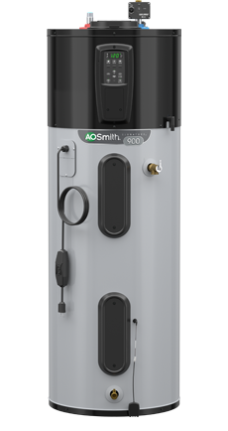

Advances in Technology – 120V Appliances
120v HPWH
Can plug into regular 120V outlet
Typical operation only 400W
Strip heat <<< 240V water heaters
120V Plug in heat pump

Slide 27
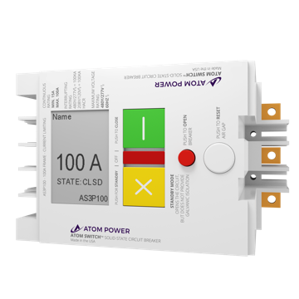


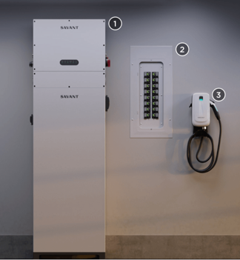
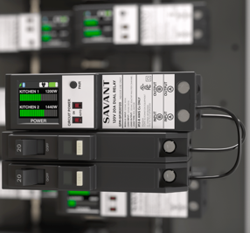
Advances in Technology – Controls
Whole house power limits – great for avoiding new utility service drop or as a “service’ to limit peak load on the grid
Smart Breakers
Smart Panels

Slide 28
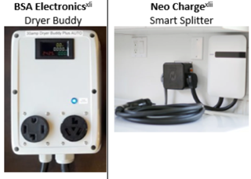
Advances in Technology – Circuit Sharing and Pausing

Slide 29
Circuit Sharing
Inconvenience?
15 minute data from 1300 homes from NEEA study
If high power devices share a circuit how often would one have to be switched off?
40 minutes/week
34

Slide 30
Code Innovations

Slide 31

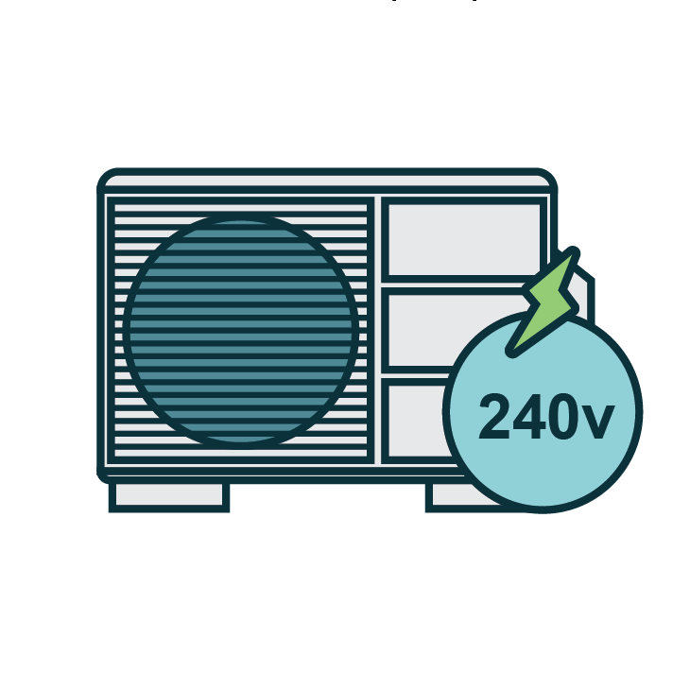
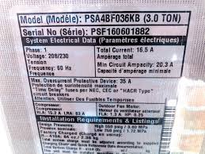
Current Treatment of HVAC Heat Pumps in the NEC
%
Existing Load
12 kVA
(50A, 240V)
New Heat Pump Load
5.5 kVA
(23A, 240V)
NEC Demand Factor
100%
New Load
17.5 kVA
(73A, 240V)

Slide 32
Current Treatment of HVAC Heat Pumps in the NEC
Is this value appropriate?
Do HVAC heat pumps behave this way in reality?
Is this conservative approach necessary for safety?
Is there an alternative that reduces unnecessary panel replacements while being safe?
%
NEC Demand Factor
100%

Slide 33
Data Sources
NEEA End-Use Load Research (EULR)
  Detailed sub-metering data
  No actual retrofits
  181 highly-electrified dwellings in Pacific Northwest (OR, WA, ID, MT)
Pecan Street Dataport
  Detailed sub-metering data
  No actual retrofits
  776 conventional dwellings across US (mostly TX, smaller numbers in CA, NY, CO)
VEIC ccASHP
  Smart meter 15-minute interval data
  Actual cold climate heat pump upgrades
  9,093 Vermont dwellings (includes some multi-family)
  Dwelling maximum demand values derived from smart meter data before and after incentivized installation of cold climate heat pumps

Slide 34

Calculating HVAC Heat Pump Demand Factor

Slide 35
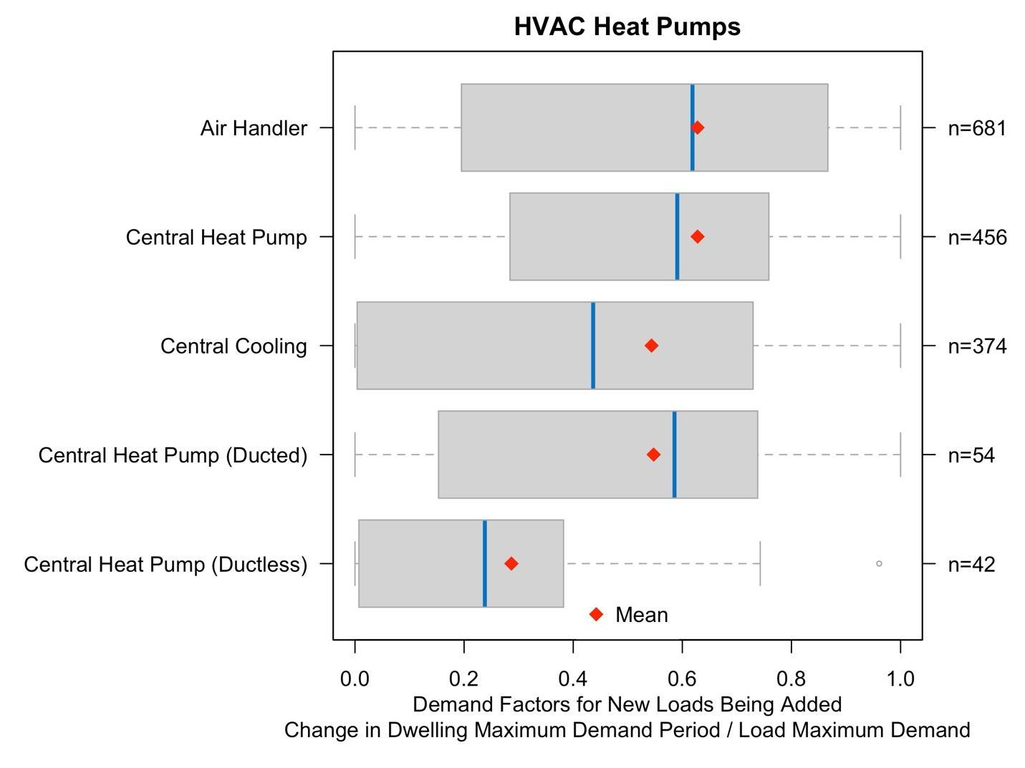
End-Use Sub-Metered Homes
HVAC heat pump demand factors are widely varying (40-60%)
Ductless heat pumps show lower demand factors (25%)
Proposed value of 50% for all new loads, based on this and other end-uses
Load Names | Number of Systems | Load Maximum Demand (kW) | Change in Whole Dwelling Maximum Demand When New Load is Added (kW) | Demand Factor for New Load Being Added
Air Handler | 681 | 0.70 | 0.46 | 62%
Central Heat Pump | 456 | 2.99 | 1.52 | 59%
Central Cooling | 374 | 2.80 | 1.13 | 44%
Central Heat Pump (Ducted) | 54 | 2.88 | 1.50 | 59%
Central Heat Pump (Ductless) | 42 | 1.85 | 0.40 | 24%

Slide 36
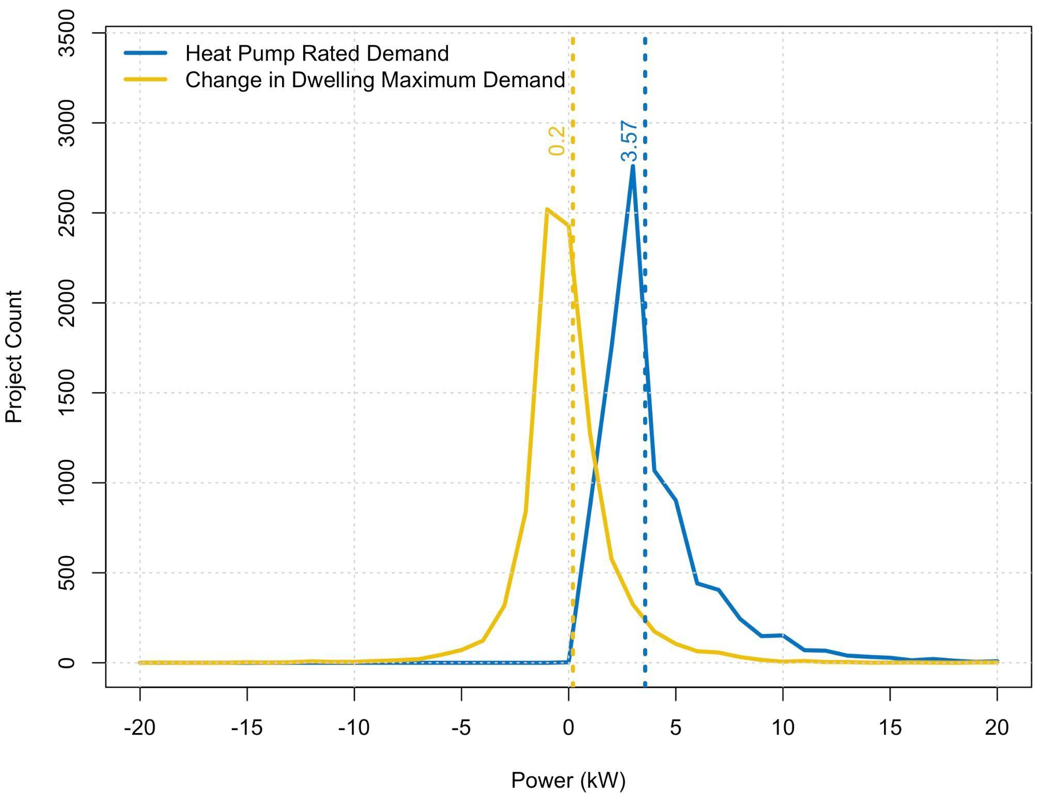
VEIC ccASHP Heat Pump Rated Demand vs. Change in Dwelling Demand
Change in dwelling maximum demand (0.2 kW) is MUCH less than the HVAC heat pump name-plate rating (3.6 kW)
  ~5% demand factor
Roughly half of homes reduce demand after installing HVAC heat pump
Small minority of homes increase demand by more than the HVAC heat pump rating
Why?
  Adding/removal of equipment we do not track (e.g., AC)
  Year-on-year variability in max demand
  Do other end-uses drive peak (electric clothes dryers, electric cooking, resistance heaters, etc.)?

Slide 37
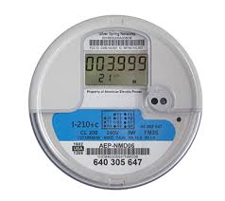
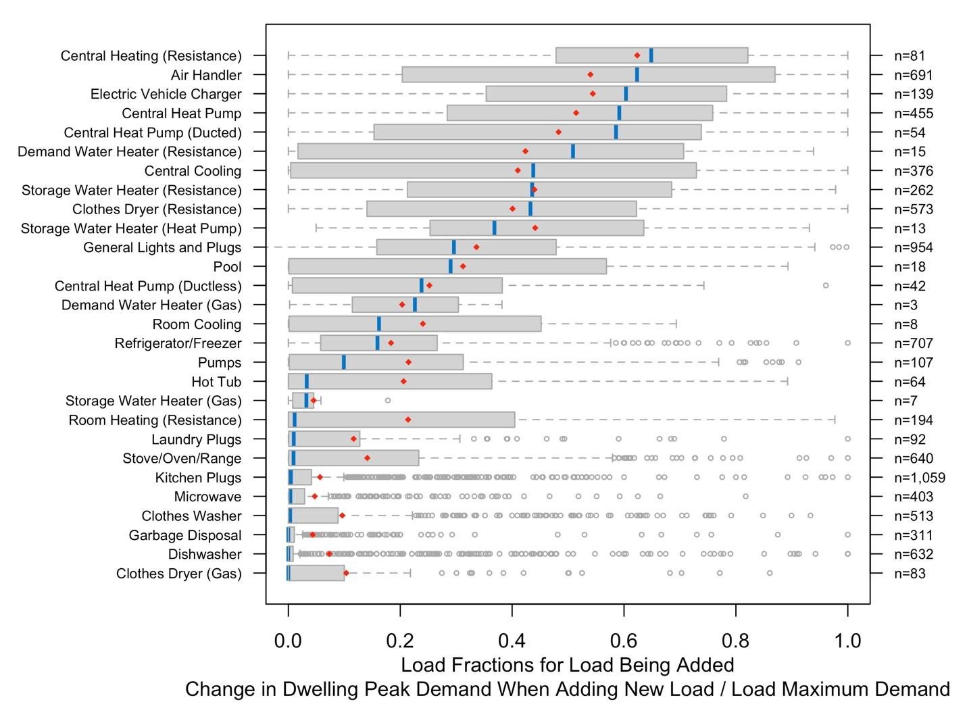
Code Innovations –
Determining Existing Loads (NEC 120.87)
When using metered demand to determine existing loads, new ability to:
                Deduct loads removed from dwelling
                Treat loads added or removed using values and use different demand factors

Slide 38
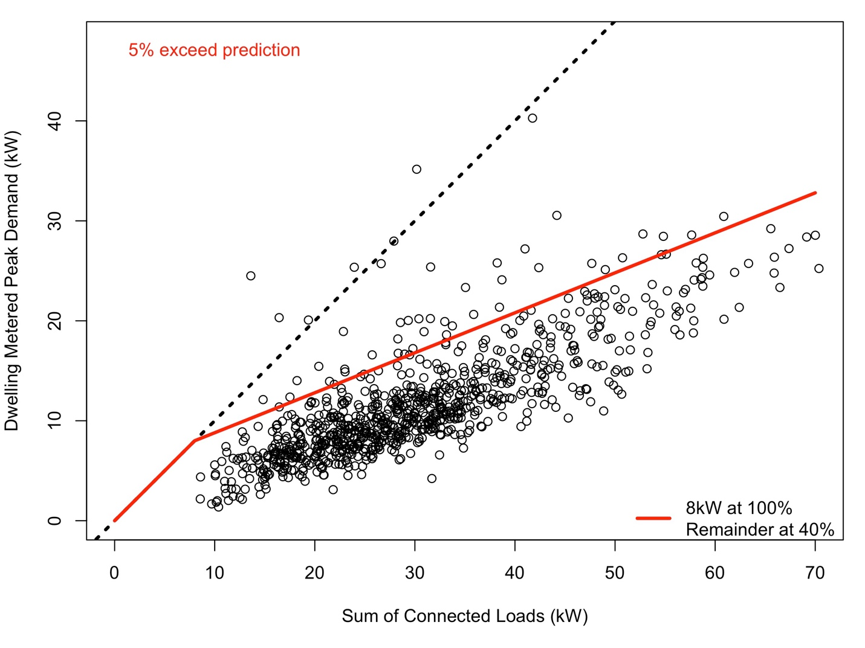
Code Innovations –
Existing Dwelling Unit (NEC 120.83)
When using inventory of appliance/equipment nameplates:
Simplified language – easier for contractors and AHJs
New HVAC heat pumps at 50% (was 100%) of nameplate rating
EV charging and resistance heating at 80% of nameplate
Lighting and receptacle loads reduced from 3 to 2 watts per ft²
Eliminate double-counting of loads

Slide 39
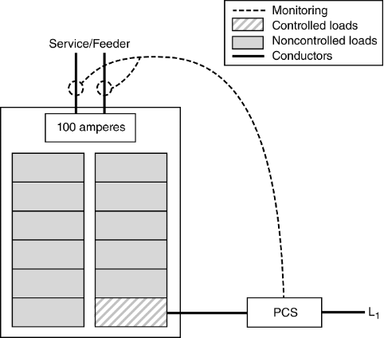
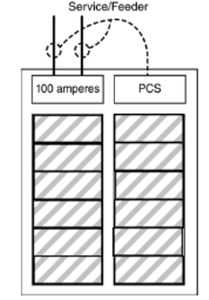

Code Innovations –
Using Load Controls
  Power Control Systems (NEC 120.7):
  Move load control provisions to Part I of Section 120, clarifying they apply to ALL load calculations
  Energy Management Systems (EMS, UL 916) replaced by Power Control Systems (PCS, UL 3141) for controls used in load calculations
  Appropriate treatment of PCS load controllers that address common use cases in dwellings
  New Appendix D Calculation examples using PCS
  Noncoincident Loads (120.6):
  Explicit allowance for noncoincident loads provided by listed equipment

Slide 40
Prevalence of Electrification Constraints –
Physical Space or Electrical Capacity
Business-as-usual electrification, L2 EV charging, 2023 NEC 220.83
Preliminary - do not cite

Slide 41
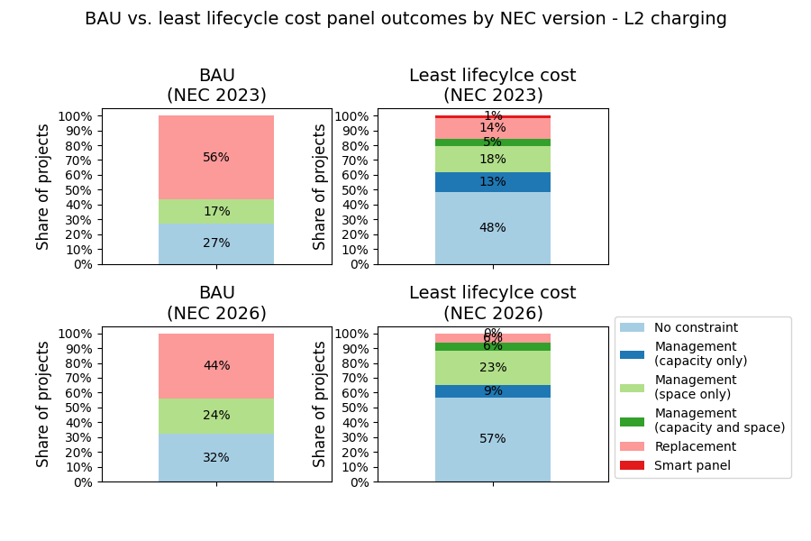
NEC revisions significantly reduce panel replacements
Technology Solutions
Least-cost technology solutions combined with 2026 NEC revisions lead to 9x reduction in required panel replacements in US single-family homes
With business-as-usual electrification:
56% (2023 NEC)
44% (2026 NEC)
With least-cost technical solutions:
15% (2023 NEC)
6% (2026 NEC)
NEC Version
Preliminary - do not cite

Slide 42
Summary of Topics for Raters/ RESNET
We need to adopt new technologies and NEC approaches to reduce costs and help the grid be affordable and resilient
Improvements in 2026 NEC can significantly reduce need for new panels and/or high power utility service
Need to think about POWER and energy impacts of: batteries, thermal storage, smart panels/controls, EV charging, balcony solar
High POWER end uses are driving this problem not high ENERGY uses
How are new technologies going to be treated in energy codes/ratings?
Could RESNET Consider a power efficiency rating?
42

Slide 43


MS 90-3074
1 Cyclotron Road
Berkeley, CA 947020
510 486 4692
iswalker@lbl.gov

Slide 44

THANK YOU

