Slide 1



Best Practices for a New HERS® Rater: Things You Wish Someone Had Told You

Slide 2
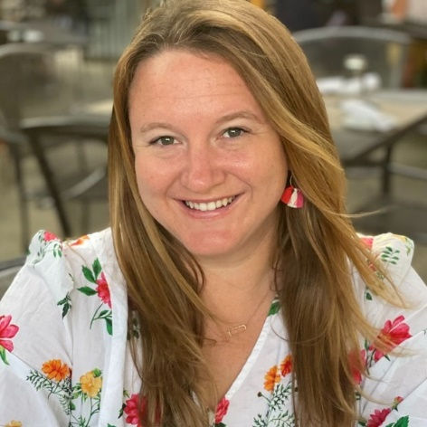
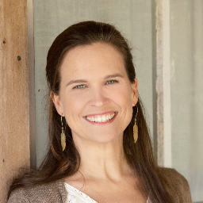
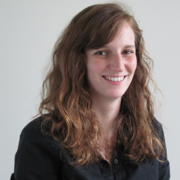

Today’s Panel
Julie Christesen
ES Green & Co., LLC,
Tallahassee, Florida
esgreenfl@outlook.com
Anna Keene Miller
Keen Living
Fairhope, Alabama
anna@keenliving.pro
Amelia Godfrey
Southface
Atlanta, Georgia
agodfrey@southface.org
Andre Eble
Green Coast Enterprises LLC
New Orleans, Louisiana
andre@greencoastenterprises.com

Slide 3

What is your background?
How did you get started in the HERS industry?
How did you find your job(s)?

Slide 4

What is your specialty?
Single-family
Multi-family
Disaster relief
Advocacy

Slide 5

Equipment
What will you need and how to acquire it?
Blower door/duct blaster
HVAC grading
Manometers for pressure differentials
Balometers
Descriptions

Slide 6

What advice would you give a new rater candidate on shopping for a Provider?
Advantages or disadvantages to being employed directly by the Provider?
Is the fee structure similar? Are there additional costs?
Does the provider work with the software you prefer?
Any benefits to consider (also a Training Provider or locally based)?
resnet.us/providers/accredited-providers/accredited-rating-providers/

Slide 7

Working in this field can be lonely.
How do you connect with your fellow rating professionals?
resnet.us/raters/emerging-leadership-council-elc/

Slide 8


What other certifications do you have?
How have you expanded your services?
resnet.us/about/resnet-professionals-career-path/

Slide 9
Where do you go to keep up with new changes?
How do you stay up to date on training?
resnet.us/providers/accredited-providers/accredited-rater-training-providers/
resnet.us/about/standards/

Slide 10

THANK YOU

