Slide 1
“If you don’t like the road your walking, start paving another one.”
Dolly Parton

Slide 2
HERS Rater Advocacy Group
Creating A HERS Rater Advocacy Group will help to meet RESNET’S Goal of 1 Million HERS Ratings per year by 2028
Speakers: Ryan Meres - RESNET Program Director
Paulette McGhie - RESNET Programs Manager
Michael Matthews – RESNET Programs Engagement Specialist
Phil Crone – VP of Leading Builders of America
Notes:
Welcome & thank you for participating in our HERS Rater Advocacy Group Session, we will be working together to drive the RESNET Goals of achieving 1 Million HERS Ratings per year by the year 2028

Slide 3
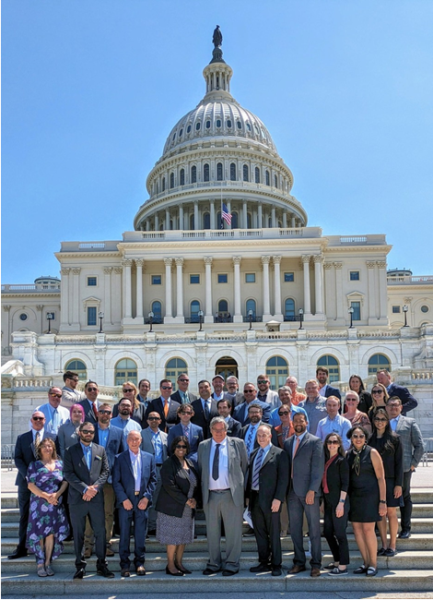
Together we are a powerful voice for the HERS Industry.
Notes:
When we all work together we become a very powerful voice for the HERS Industry, providing support for advancing energy codes, 45 L Federal Tax Credits, working together to support a WaterSense Tax Credit. We have a lot of opportunities out there, to take advantage of, that will grow our businesses & the HERS Industry!

Slide 4
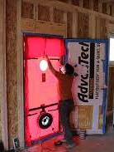
What is Advocacy?
Advocacy is the activity carried out by an individual or groups with the aim to influence and change the decisions made by political, economic, and social institutions

Slide 5
What is a HERS Advocacy?
The RESNET HERS Advocacy Group seeks to ensure;
Our voice is heard on issues that are important to HERS Industry
Protect and promote HERS Industry in all States
Supporting HERS Rating views to be genuinely considered when decisions are being made
Supporting 45L Federal Tax Credits & and creating a WaterSense Federal Tax Credit
5
Notes:
Supporting initiatives like the 45L TAX credit for new homes, creating support for a WaterSense Federal Tax Credit in Congress, working with stakeholders to create campaigns that support energy efficiency and water conservation. All drive the need for more HERS Raters & Ratings.

Slide 6
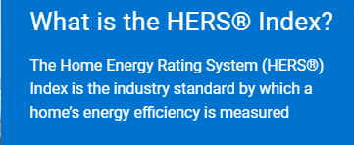
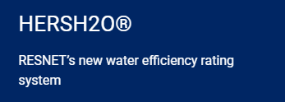
Key components of a successful HERS Rater Advocacy Campaign includes the following:
Understand the issues and getting all the facts:
About Adopting HERS Index Pathway as Code Compliance Method
About Adopting HERS Index as a Stretch Code Option
Adopting amended ERI with QA & Registry requirements
About RESNET HERS Registry Benefits to States, Cities & Counties
About Adopting HERS H20 & WaterSense in drought affected States
About how to Support 45L Tax Credit for WaterSense ($2000)
About the benefits of the HERS Carbon Index
Notes:
To be successful, you must know the issues and have all the facts: We will have available to you template presentations on all aspects advocating for HERS Industry:

Slide 7
Find out for whom you are advocating and for what you are advocating:
Increasing the need for more HERS Rating Companies & Providers
Promoting & Supporting HERS Workforce Development
Growing the ICC IECC/HERS Code Compliance Specialist Designation
Identify the decision maker(s) and find out what their motives are:
State Energy Development Offices
State Divisions of Water Resources
Water Districts
ICC Code Chapters
Utilities
Building Official Associations
HBA’s
Leading Builders of America
Notes:
Networking is one of the best avenues to use.

Slide 8
RESNET Goals for Energy Code Adoption
Meet states/jurisdictions where they are and help them establish a path for improving energy efficiency
An energy code that sets forward looking, performance-based efficiency target scores
Set expectations for builders and give them plenty of time to prepare
Third-party energy code compliance verification, backed by quality assurance oversight
Reduce the burden of energy code compliance verification on code officials
Consistent compliance documentation
Give them access to data for ease of verification

Slide 9
HERS Advocacy Supporting HERS Industry
Bar Chart
Join the HBA’s in your State:
We need HERS Raters to participate in the IECC Code Adoption Process in every State!
Join the Education Committees, Government Affairs Committees and Code Adoption committees.
Offer CEU Credits thru HBA’s to Educate Builders on using;
Benefits of HERS Index Pathway
HERS H20 & WaterSense Programs
Energy Star & Net Zero Ready Homes
45 L Federal Tax Credits for Home Builders
Utility Incentives
Complete the ICC IECC/HERS Compliance Specialist Designation
Promote HERS Index as Code Compliance Pathway or amend the ERI to be incorporated in the HERS Registry with QA requirements
Provide HERS Workforce Development Opportunities

Slide 10
10

Slide 11
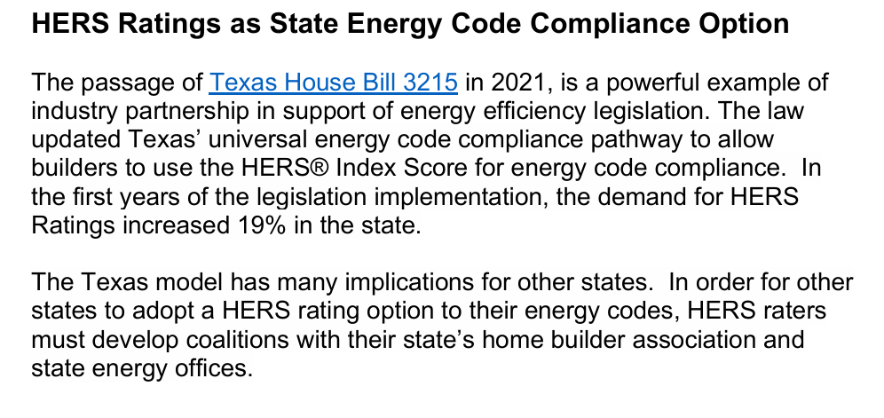
11
Notes:
To tell us more about the Texas House Bill 3215, l would like to introduce Phil Crone, Leading Builders of America.

Slide 12
PRESENTING
The Successful adoption of HERS Index in Texas.
Phil Crone
Leading Builders of America
Creating A HERS Rater Advocacy Task Force

Slide 13
Effective HERS Advocacy
Build the coalition
State/local home builders associations
Raters
Municipal building officials
Product agnostic advocates
Focus on the policy merits – avoid rabbit holes
Performance centric
Predictable and impactful transition
Availability of verification professionals
Connection to other incentive programs

Slide 14
Paths to Energy Code Compliance (Texas – Pre HB 3215)
IECC Mandatory Requirements
Prescriptive Path
Performance Path
ENERGY STAR Certification
Energy Rating Index Path (w TX amended Scores)
2015/2018/2021 IECC Compliance
2015/2018/2021 IECC Compliance Equivalent

Slide 15
Paths to Energy Code Compliance (Texas)
IECC Mandatory Requirements
Prescriptive Path
Performance Path
ENERGY STAR Certification
Energy Rating Index Path (w TX amended Scores)
HERS+2018 IECC (HB 3215)
2015/2018/2021 IECC Compliance
2015/2018/2021 IECC Compliance Equivalent
2018/2021 IECC Compliance Equivalent

Slide 16
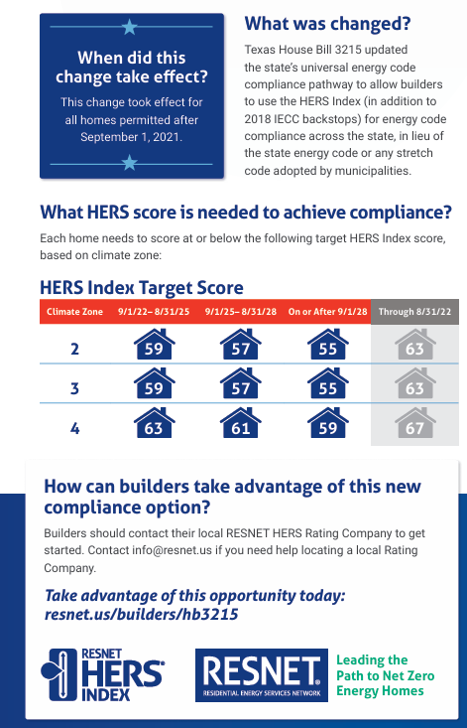
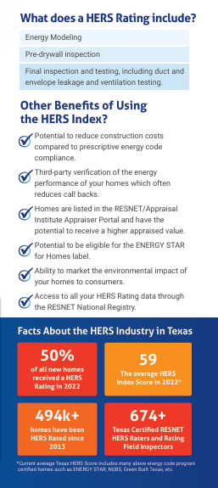
16

Slide 17
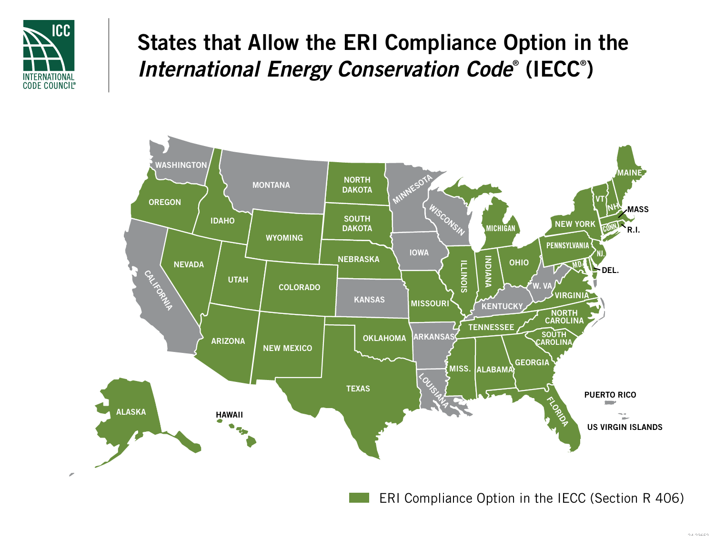
States Using ERI / HERS Index
What is happening in other States?

Slide 18
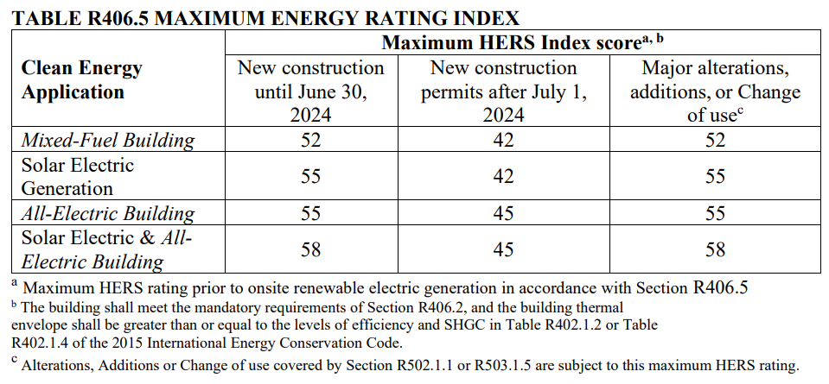
Massachusetts Stretch Code Using HERS Index
98% of new homes in MA received a HERS Rating in 2023
HERS target scores based on fuel types
New construction and substantial renovations

Slide 19
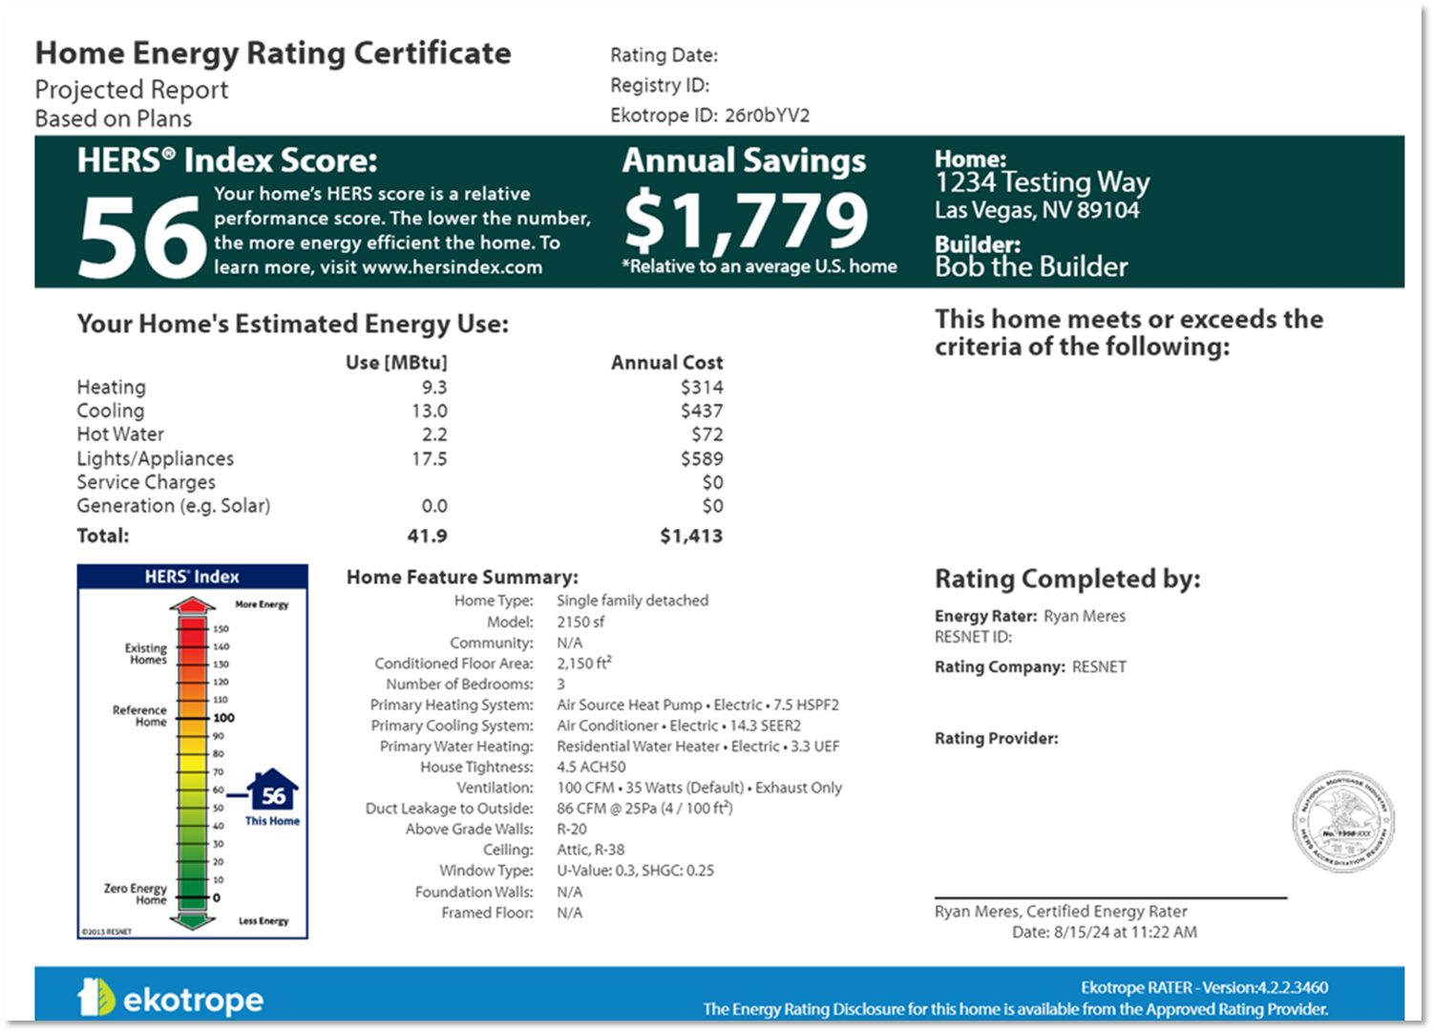
Southern Nevada Amended ERI Proposal
Highlights
Amendment to the 2024 IECC, section R406
References current version of ANSI/RESNET/ICC 301
2024 IECC envelope backstop
Quality Assurance oversight required
Submit to RESNET Registry
HERS Target scores based on prescriptive path
Climate Zone 3 = HERS 56
Climate Zone 5 = HERS 58
Target scores are reduced by 4 points every 3 years through 2033
Working with SNHBA, SNBO & HERS Rating Industry

Slide 20
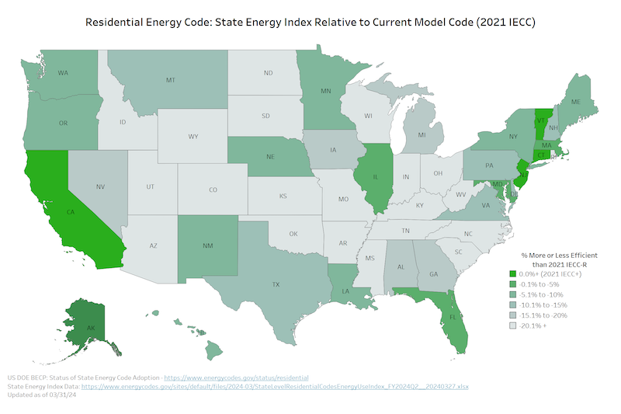
20

Slide 21
An effective advocacy plan of action at the State Level should include:
Strength in Numbers. We have over 2,000+ raters that should come together and form a group or coalition to approach legislators State Energy Offices and Home builder associations in a common cause.
Individual outreach and one-off contacts typically does not carry the same weight of influence.
Additionally, policy makers don’t want to pick sides and will embrace solutions that have already
been discussed amongst a broad coalition of stakeholders.
21

Slide 22
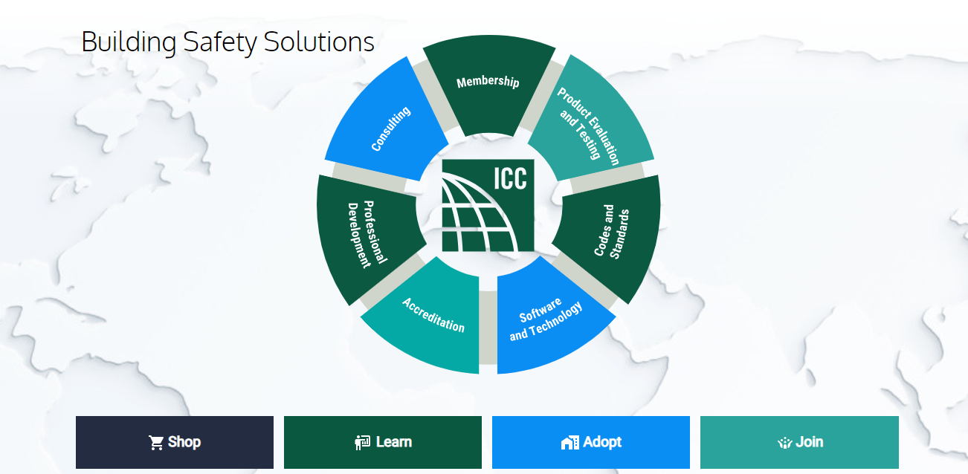
Find other organizations with which to partner. Reach out to state home builders associations, state Energy offices, code official chapters, and well-respected environmental groups. These groups may not share universal agreement on all issues. But you can find areas of common benefit (economic development, job creation, energy efficiency, decarbonization etc.
22

Slide 23
Examples of Successful Coalitions:
1. Nevada Energy Star Partners
(HERS Raters, Builders, Utilities, Review Journal & Energy Star) To increase use of Energy Star New Homes Program in Las Vegas.
2. Utah Building Energy Efficiency Strategies UBEES (Utah DFCM, Utah SED, Governors Office & Utah Clean Energy) To improve energy efficiency of buildings (2009 – 2015).
Once you have formed your coalition, give it
some formality and presence, for example:
a. Assign a group Name (HERS Raters of
State)
b. Choose a spokesperson
c. Create letterhead
d. Set up PO Box and email account for
correspondence
23

Slide 24
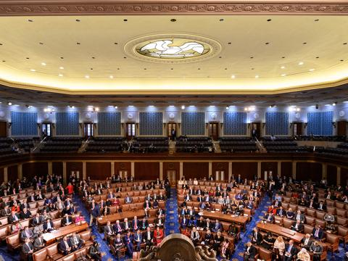
Identify the state legislators representing your
Community or District for outreach. Organizations often want to start at the top of the food chain, but the legislative leadership of your state are going to want to know if your local member of the legislature is onboard.
Learn which members serve on the
Committees of jurisdiction that would codify relevant Legislation. Persistence is the key.
24

Slide 25
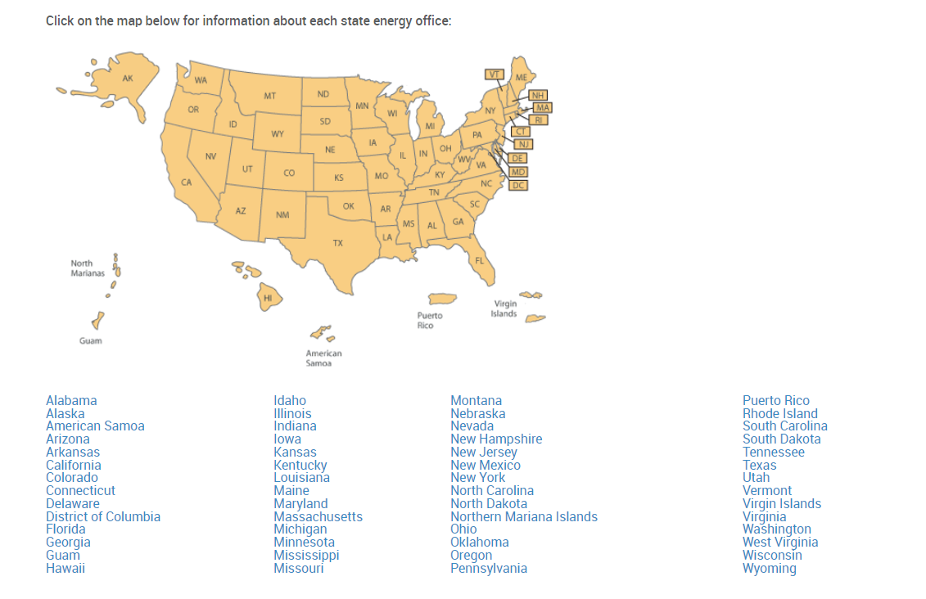
Contact your State Energy Office and explain what took place in Texas and how it benefits builders. How it would help Implement the code.
The state energy offices are posted at
https://www.naseo.org/members-states
25

Slide 26
Contact your state or local Home Builders Association.
Explain what took place in Texas, how it benefited builders
in meeting code in the state. Most builders belong to a builder's association. You can ask a builder to introduce you to the HBA.
Join the HBA in your State & Community
26

Slide 27
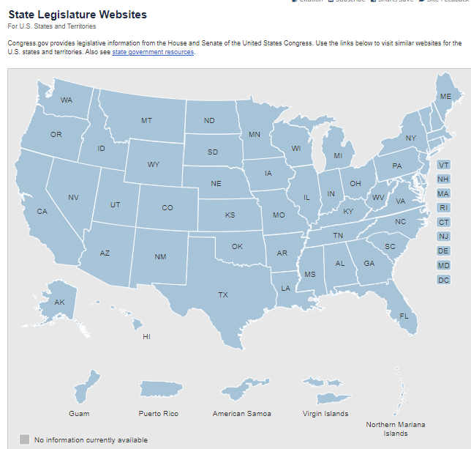
Take an inventory of your political contacts within your coalition. You may not have a direct relationship with a State elected official – but you may know local Elected officials (school board, city council, county Superintendent, etc.), that could help you with introductions.
All you have to do is ASK!
27

Slide 28
After Joining the HBA in your area, sign up for the following committees:
Energy Code Committees
a. Sign up for the IECC Code Review Committee
b. Introduce Amendments supporting ERI using HERS Index requirements
2. Education Committees
Offer CEU credits for Builders for upcoming Energy Codes, HERS Index, HERS H20 & WaterSense, Energy Star & Net Zero Ready Homes etc..
3. Governor Affairs Committees
Be the expert in the room on Energy Efficiency, Energy Codes, above code programs & providing Education!
28

Slide 29
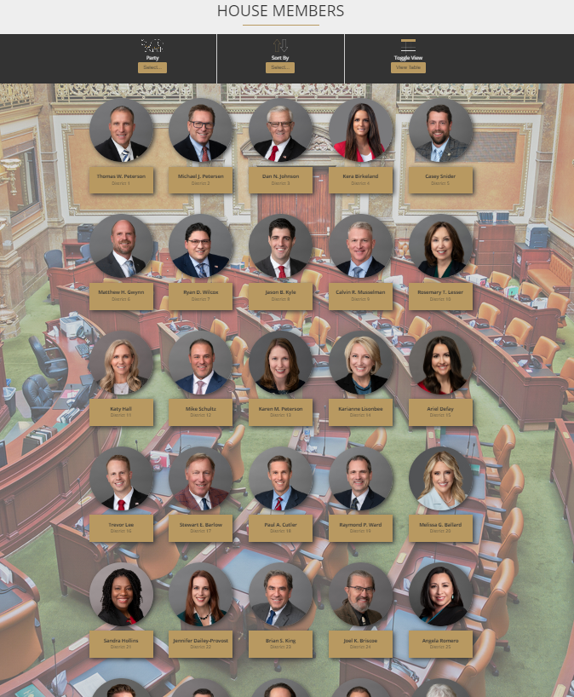
Once you’ve been connected to a State Legislator, send correspondence on your organization's letterhead or email account, requesting a meeting with Legislator staff.
Work with your coalition leadership to develop a White Paper that can outline your goals. Send your while paper with meeting request, so your future audience has some context.
https://house.utleg.gov/house-members/
https://le.utah.gov/
29

Slide 30
Don’t be hesitant to sit down with staff. The elected officials are often overscheduled. Staff will need to be convinced that your organization has merit and will be the ones to endorse your request.
30
Notes:
Met with Harry Reid & John Ensign in Las Vegas & Washington DC. Also met with Orrin Hatch in Washington DC to discuss Federal Tax Credits for new home builders.

Slide 31
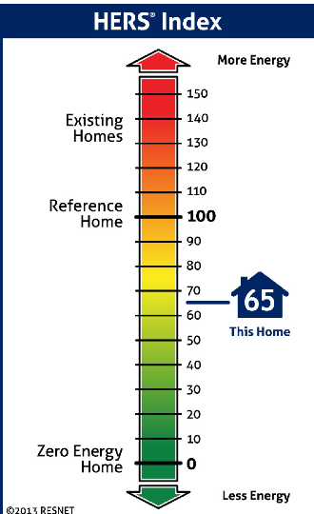
The meeting should outline for the staff who HERS Raters are, what HERS Raters do, and how that work creates energy efficient, sustainable and affordable housing
RESNET will support your meetings with Powerpoint presentations, flyers and compliance data for your State & local Jurisdictions
31
Notes:
In Utah during the 2009 IECC Code review and adoption process, legislators were not aware of RESNET or HERS Raters that were already available to provide Blower Door & Duct Leakage Testing. They were going to reject adopting the 2009 IECC . I asked Steve Baden to come and address the Utah Legislators about the HERS Industry already in place in Utah. Several Energy Star Builders also helped to support the adoption of 2009 IECC. Steves presentation changed the outcome, So we were able to successfully adopt the 2009 IECC.

Slide 32
Once you have established a relationship, ask the Legislative aide for assistance in scheduling meetings with the State Energy Office (SEO).
Your goal is to ensure that the SEO staff recognizes HERS methods in Code development and implementation of retrofit programs.
32

Slide 33
Once you establish a relationship with stakeholders you can participate in opportunities for
Code improvement and retrofit. Don’t be left out of the conversation…..
33

Slide 34
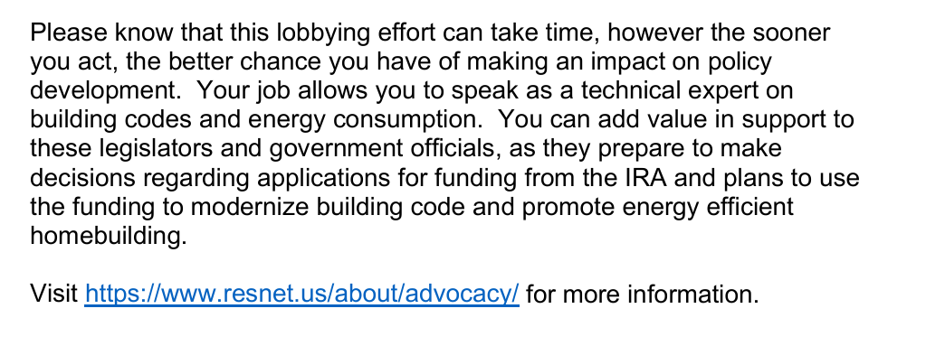
To join please drop your Business
Card in the basket.
34

Slide 35
Goals for HERS Rater’s
Bullet Highlights
Help to Grow the RESNET Network
“Be a Voice for the HERS Industry”

Slide 36
Overview of Advocacy Activities Include:
Bullet Highlights
Participate in Code Adoption Committees in your State
Participate in the Education Committees providing CEU’s for Energy Codes, HERS Index, HERS H20, & WaterSense, Energy Star, Net Zero Ready Homes, Utility Incentives & 45 L Opportunities
Outreach to State SEP Offices providing Energy Code Education that supports HERS Industry Programs
Participate in Stretch Code Advocacy in your State (Green Programs or Carbon Index)
Participate in adopting the HERS Index as Code Compliance Option
Create Workforce Development Opportunities
Creating an Outreach, Education & Advocacy HERS Group in your State
Become an active member of the HERS RESNET Advocacy Group (Strength in numbers)
* Resnet to hold Bi-Monthly meetings to hear about your State Activities & accomplishments

Slide 37
Growing HERS H20 & WaterSense Programs
#RESNET2023
HERS_{H2O} Ratings
National Launch in 2021
400+ Certified Raters
27 Accredited Providers
5,989 Ratings in 2024
Meet with Water Districts & States to implement HERS H20 & WaterSense Programs.
47%
2
1903
6
2169
1858
51
2024 HERS_{H2O} Ratings
37

Slide 38
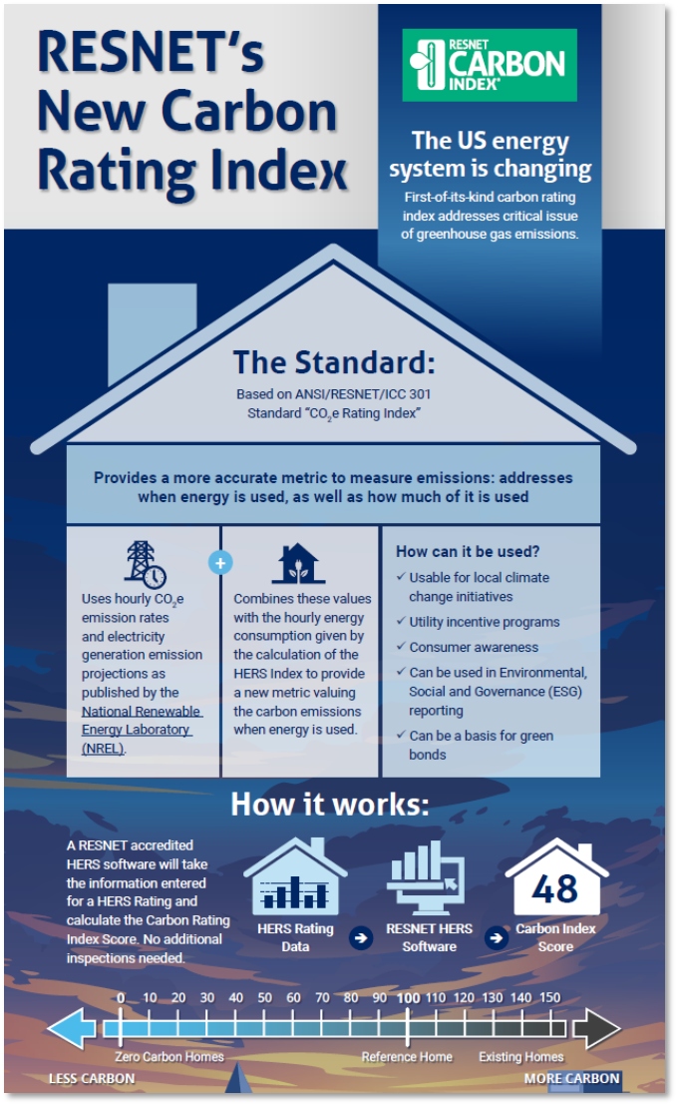
Promote Carbon Index
#RESNET2023
Standard
Scope
Amendment to Standard 301
Replaces previous emissions calculations
Same as Std. 301
47%
Providers
Raters/RFIs
Nothing additional required
Nothing additional required
Calculations done in software
Software
Inspections
Included in all RESNET accredited software
Must be included on Rating Certificate
No additional inspections or testing required
38

Slide 39
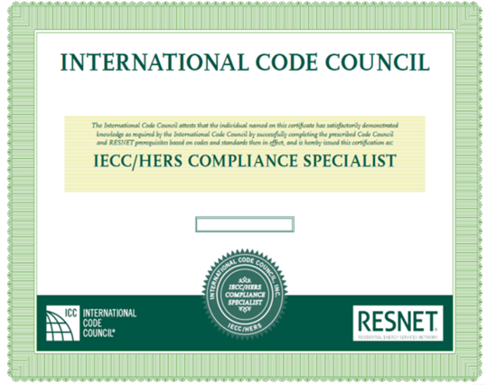
#RESNET2022
Become a IECC/HERS Compliance Specialist Designation – January 2026
Be a certified RESNET HERS Rater or Rating Field Inspector
Pass the Residential Energy Inspector/Plans Examiner Test (online through ICC)
Apply to ICC to receive the designation
Get listed on the ICC Website:
https://www.iccsafe.org/search-for-certified-professionals/
Notes:
The first step for a HERS Rater or RFI to participate is to obtain the ICC IECC/HERS Compliance Specialist Designation.
You do have to be actively certified as a Rater or RFI
Then, you need to pass the Residential Energy Inspector/Plans Examiner Test (which is now available to be taken online)
Finally, you will fill out an application on the ICC website to obtain the designation. And you will be listed on the ICC’s “search for certified professionals” webpage.
Many States are facing a Building Inspector shortage, due to retirement, the designation will be beneficial to expanding your role in Energy Inspections
There is a RESNET session on the IECC/HERS Compliance Specialist with Chris McTaggart

Slide 40
What’s Next?
Bullet Highlights
Resnet 2025
Embodied Carbon
New calculation standard being developed.
Expanding HERS_{H2O}
Update to Standard 850 to incorporate multifamily
Energy Codes
Expanding the role of the IECC/HERS Compliance Specialist.
Uniform compliance documentation
Indoor AirPlus
Awaiting HCO opportunity

Slide 41
41

Slide 42
Once you establish a relationship with stakeholders you can participate in opportunities for
Code improvement and retrofit. Don’t be left out of the conversation…
…lead the conversation!
42

Slide 43
Strength in Numbers
Sign up even if you don’t know your availability
43

Slide 44
A HERS Rater Advocacy Group is the logical first step:
Sign up
a. Give us your business card to sign up - Don’t wait
b. Complete the emailed survey - Check your Inbox next week
2. Meet monthly (to start in February)
Share your knowledge - What are the roadblocks, needs to advance, and efforts that are in action?
Learn from each other - What worked and what didn’t work in other regions. How can we avoid repeating ineffective action, because time is money.
3. Go forth and inform to lead change
a. Be the expert in the room on HERS Index, ERI, and the benefits of using the registry
b. Educate those who are reluctant or don’t understand the value you bring
44

Slide 45
RESNET
Ryan Meres - Program Director
Paulette McGhie – Program Manager
Michael Matthews – Programs Engagement Specialist
THANK YOU!
Ryan 760-681-2391
Paulette 760-214-6637
Michael 760-390-4400
ryan@resnet.us
paulette@resnet.us
michael@resnet.us

