Slide 1
Making Sense of Heat Pump Performance for Home Energy Ratings
MINHERS PDS-01 Addendum 82, DX AC/HP Modeling
Neal Kruis, PhD Big Ladder Software, Vice President
RESNET, Energy Modeling Director

Slide 2
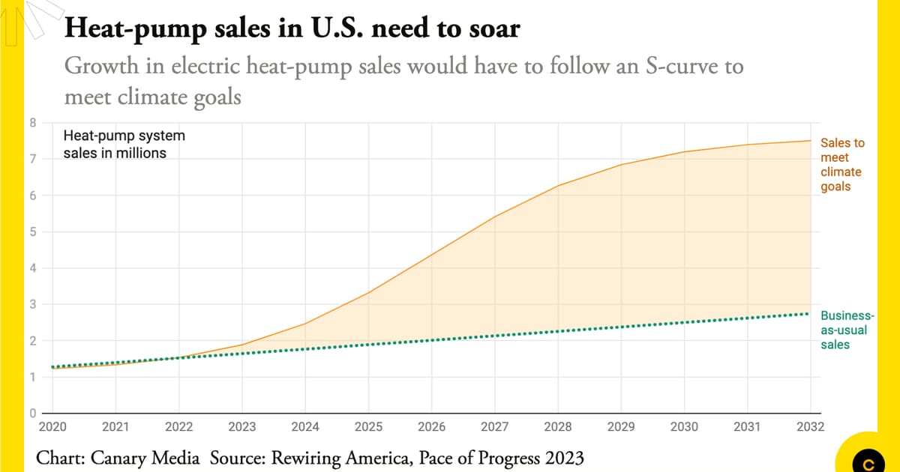
Notes:
We know heat pumps are getting a lot of attention and are seen as a key technology to solve the global climate and energy crisis
We are going to continue to see big pushes for heat pump deployment
Heat pumps are also a sophisticated technology that is still maturing, and we still have a lot to learn about how they work
For these reasons, RESNET Standards have been relatively quiet about how to model heat pumps

Slide 3
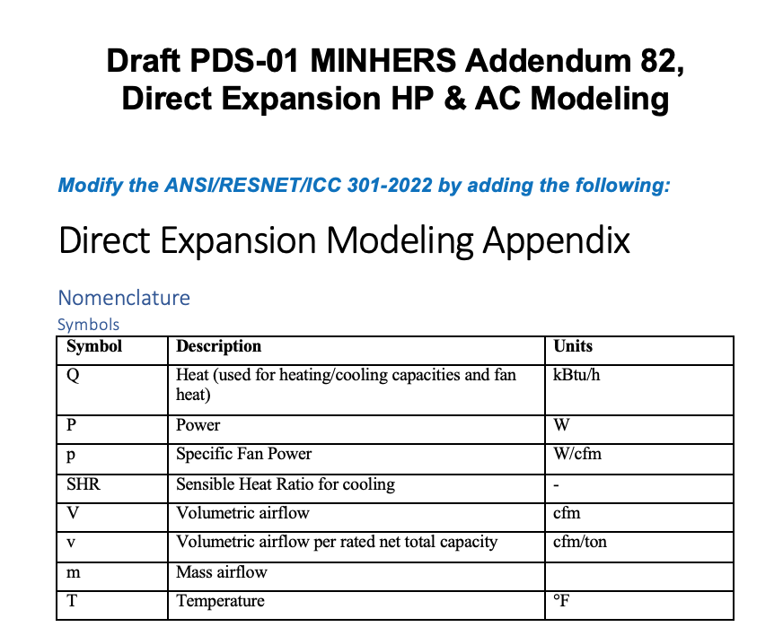
Notes:
Today I'm going to be talking about MINHERS Addendum 82, which aims to standardize the best modeling assumptions for heat pumps and air conditioners
MINHERS Addendum 82 wrapped up its first public review exactly one week ago
Our hope with this first draft was to get input from the manufacturers on how we are planning to represent their equipment in ratings
Unfortunately, we received no public comments
Which means the first draft was either
Perfect
it went way over everyone’s heads
It didn’t get in front of the right people
They didn’t have
There are already some areas that we’ve already decided need to be clarified so we will put out a seond

Slide 4
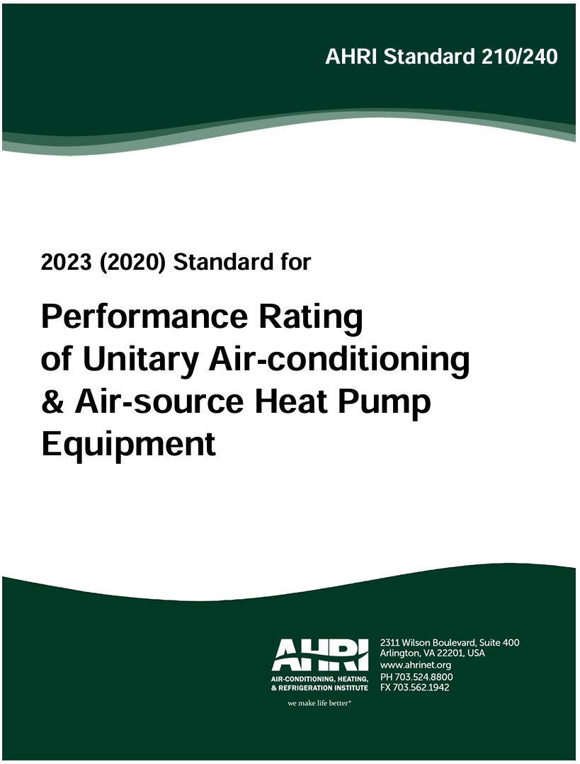
Excluded Systems
Multi-splits
Window AC
Portable AC
PTAC/PTHP
Ground Source HP
Notes:
I want to start by setting the stage.
The scope of this addendum covers anything that is covered by AHRI 210/240:
Any air conditioner or heat pump rated with a SEER2 and HSPF2
Anything else is not covered in this addendum, though we hope to cover more technologies in future addenda

Slide 5
RESNET® Standard 301
Notes:
Let’s start by going over how these systems are currently covered by RESNET Standard 301

Slide 6
Standard 301-2022
Notes:
Data collected by the raters includes the capacity and efficiency

Slide 7
Standard 301-2025 (Preliminary Draft 01)

Slide 8
Standard 301-2025 (Preliminary Draft 01)

Slide 9
Standard 301-2025 (Preliminary Draft 01)

Slide 10
Net vs. Gross Performance
Gross
Q_{net,clg} = Q_{gross,clg} - Q_{fan,clg}
P_{net,clg} = P_{gross,clg} + P_{fan,clg}
Q_{net,htg} = Q_{gross,htg} + Q_{fan,htg}
P_{net,htg} = P_{gross,htg} + P_{fan,htg}
Net
Notes:
All the data we get from manufacturers is net performance, meaning that it includes the impact of the fan.
However, in energy modeling, we need to be able to model the fan separately.
The fan adds power and adds heat to the air stream.

Slide 11
Standard 301-2025 (Preliminary Draft 01)

Slide 12
Standard 301-2025 (Preliminary Draft 01)
Notes:
It doesnt say exactly how to do this, so it is left to the interpretation of the software developer

Slide 13
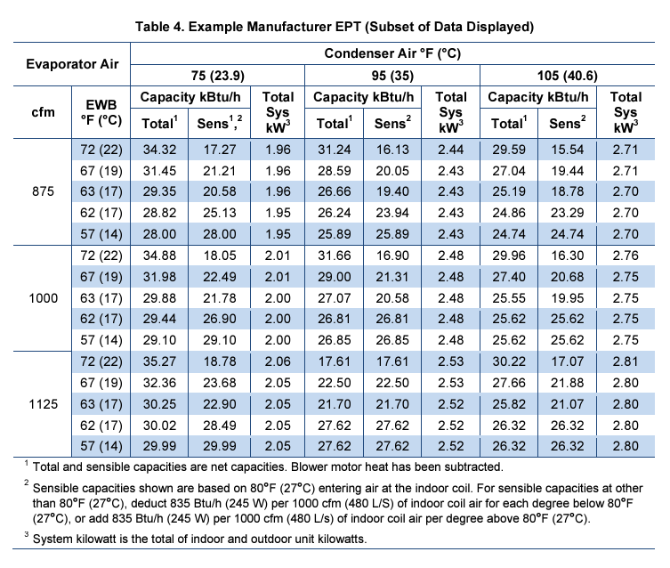
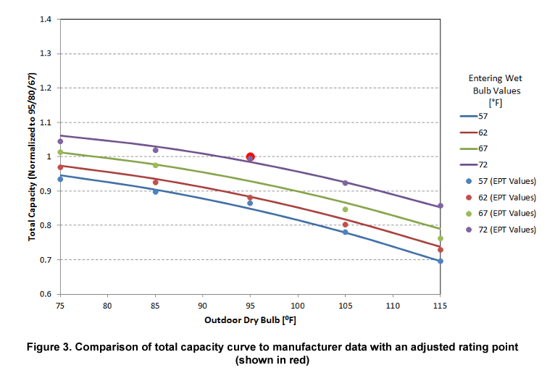
Notes:
Many people reference the “Cutler curves”.
Normalized capacity and efficiency as a function of outdoor temperature, indoor temperature and flow rate.
This still plays a role in Addendum 82

Slide 14
Standard 301-2025 (Preliminary Draft 01)
Notes:
On a whole, this paragraph says a lot about what to do, but not much about how to do it.
As a result, there is a wide range of interpretation and any consistency across software tools is either informal or coincidental.

Slide 15
RESNET Heat Pump Modeling Working Group
Notes:
To resolve this, I established a working group to develop standard language to codify best modeling practices
This a working group of my Software Consistency Committee aiming to standardize an accurate and consistent approach to modeling these new technologies

Slide 16
Software Providers:
Collaboration Organizations:
Manufacturers:
National Labs:

Slide 17
Ratings, Codes, and Incentives:
Notes:
Perhaps most importantly, this working group convenes representations from organizations who are all trying to answer the same question: how do we model VCHPs for our programs?

Slide 18
MINHERS Addendum 82
Notes:
The result is MINHERS Addendum 82, which is currently out for public review.
My hope is to get feedback, especially from manufacturers since this addendum basically explains the assumptions we need to make in order to represent the full performance of their equipment given the sparse amount of data available.
The software providers are also reviewing and providing comments back through the software consistency committee.
There have already been some suggested changes relative to what is currently out for public review. Where that’s the case, I’ll point it out.

Slide 19
Minimum Rated Features
AHRI Certificate/Directory:
Cooling:
Capacity @ 95F
SEER2
*EER2
Heating:
Capacity @ 47F
*Capacity @ 17F
HSPF2
Notes:
While there is other information about performance available, this data is available for all relevant products and independently certified.
Notice this adds two new features to collect, that were not previously required.

Slide 20
Minimum Rated Features
Product Literature:
Number of Speeds/Stages
Fan Motor Type
Type of Supplemental Heating
Minimum Compressor Operating Temperature
Notes:
Number of speeds/stages: AHRI categorizes equipment as either:
single stage
Two stage
Variable speed
But it doesn’t record the type on the certificate or the directory!
Fan motor type is either BPM or PSC
Supplemental heating: Electric, Gas, None
Minimum Temp: 0 for single/two stage, -20 for variable speed. 25F for dual fuel heat pumps.
If you’re a rater, that covers the changes to your work related to this addendum. Once you’ve collected this information and inputted into the software, the software should take care of the rest.
The rest of this webinar, I’ll go over the calculations the software needs to make to provide the best estimate of equipment performance in the HERS rating.
I’ll also go into a bit more of the rationale behind some of the calculations since it isn’t explained as thoroughly in the normative standard.

Slide 21
Terminology
Metrics
Q = Capacity
P = Power
EIR = Energy Input Ratio (= P/Q)
COP = Coefficient of Performance (= Q/P)
Notes:
It’s sometimes hard for me to keep everything straight, so I’m going to try to set up some terminology before we dive in.
The two primary performance metrics we will talk about are capacity and power.
Sometimes, we rely on other metrics like EIR and COP to help derive the power under certain conditions.

Slide 22
Terminology
Compressor Speeds:
min = Minimum capacity compressor speed
full = Full load capacity compressor speed
max = Maximum capacity compressor speed
Single Stage Systems: Full
Two Stage Systems: Min, Full
Variable Speed Systems: Min, Full, Max
Notes:
Note:

Slide 23
Terminology
Normalizations
Ratio: performance relative to maximum compressor speed (at a fixed temperature)
Maintenance: performance relative to a less extreme outdoor temperature (at a fixed speed)
Notes:
Just like Energy Input Ratio is a normalized power metric, there are other metrics that are useful when comparing two capacities or two powers.

Slide 24
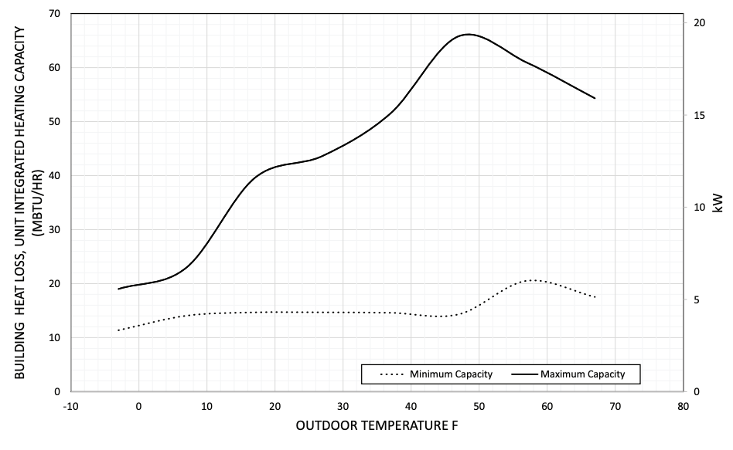
47F Capacity Ratio @ Min
= 14 / 65 = 22%
47F Capacity @ Max = 65 kBtu/h
47F Capacity @ Min = 14 kBtu/h
47
Notes:
To illustrate these concepts, here is example heating capacity data for a variable speed system found in manufacturer’s product literature.
It illustrates how minimum and maximum capacities change across a range of outdoor temperatures.
If we wanted to know the 47 degree capacity ratio at min speed…
Because this ratio is normalized, If we felt it was representative of most units, we could then use it to fill assumptions about minimum capacity at 47 for other units too.

Slide 25
Max Capacity Maintenance @ 17F
= 39 / 65 = 60%
Max Capacity @ 47F = 65 kBtu/h
Max Capacity @ 17F = 39 kBtu/h
17
47
Notes:
Similarly for maintenance. If we want to know the maximum capacity maintenance at 17F…
Again, characterizing normalized values like this can help us expand the data to temperatures beyond those reported in AHRI data

Slide 26
HSPF2
Notes:
Now, our goal is to develop a map of performance for any operating condition that is also consistent with the AHRI certified data.
Each of these dots represents the load at one hour of the year for a home.
In order to predict the heating energy use for this heat pump, we need to know both power and capacity at each of these points.
The challenge is: the only information we have is:
The full load capacity at two temperatures, and
The HSPF2, which is a weighted average of efficiencies at different temperatures and loads
With so little to work with here and historically little guidance, it shouldn’t be surprising that there could be a wide range of interpretation in how to model heat pumps and air conditioners.
To resolve this, Addendum 82 aims to flesh out a much more comprehensive performance map based on the best available data sources.
This means establishing performance at more temperatures, including the extremes. We also include 5F because it is commonly reported.
…we also establish points at minimum capacity
…and maximum capacity
This finishes the full map of performance!
These points are critical because anytime the load is below the minimum capacity, the unit cycles with degradation.
Compressor modulating
Supplemental heating
I’m going to illustrate how the addendum goes about this starting with the case of single speed system.

Slide 27
Single Stage Systems
Capacity
Power
-20
0
5
17
47
60
82
95
125
9 Temperatures x 2 Metrics x 1 Speed = 18 Values
Notes:
This is the performance map we will fill out…

Slide 28
Single Stage Systems
 | Outdoor Temperature [°F]
 | Heating |  |  |  |  | Cooling
Metric | 0 | 5 | 17 | 47 | 60 | 60 | 82 | 95 | 125
Capacity
Power
9 Temperatures x 2 Metrics x 1 Speed = 18 Values
Notes:
This is the performance map we will fill out…

Slide 29
Single Stage Systems
 | Outdoor Temperature [°F]
 | Heating |  |  |  |  | Cooling
Metric | 0 | 5 | 17 | 47 | 60 | 60 | 82 | 95 | 125
Capacity |  |  | ✅ | ✅ |  |  |  | ✅
Power |  |  |  |  |  |  |  | ✅
P95 = Q95 / (EER2/3.412)
4 of 18 Values
Notes:
We start by filling in the information we already know

Slide 30
Single Stage Systems
 | Outdoor Temperature [°F]
 | Heating |  |  |  |  | Cooling
Metric | 0 | 5 | 17 | 47 | 60 | 60 | 82 | 95 | 125
Capacity | ⬅️ | ⬅️ | ✅ | ✅ | ➡️ |  |  | ✅
Power |  |  |  |  |  |  |  | ✅
7 of 18 Values
Notes:
We need at least two points to make a straight line
We extrapolate heating capacity in both directions
For both cooling capacity and power, we need at least one more point to make a straight line.

Slide 31
Notes:
Remember the “Cutler Curves” I described earlier? These give us capacity and EIR maintenance values.

Slide 32
Single Stage Systems
 | Outdoor Temperature [°F]
 | Heating |  |  |  |  | Cooling
Metric | 0 | 5 | 17 | 47 | 60 | 60 | 82 | 95 | 125
Capacity | ⬅️ | ⬅️ | ✅ | ✅ | ➡️ |  |  | ✅
Power |  |  |  |  |  |  |  | ✅
7 of 18 Values
Notes:
We can use the capacity maintenance at 82 degrees assumed in the curves to calculate the capacity at 82 degrees based on the capacity at 95 degrees

Slide 33
Single Stage Systems
 | Outdoor Temperature [°F]
 | Heating |  |  |  |  | Cooling
Metric | 0 | 5 | 17 | 47 | 60 | 60 | 82 | 95 | 125
Capacity | ⬅️ | ⬅️ | ✅ | ✅ | ➡️ |  | ☑️ | ✅
Power |  |  |  |  |  |  |  | ✅
8 of 18 Values
Notes:
We can then extrapolate cooling capacity to cover the full range

Slide 34
Single Stage Systems
 | Outdoor Temperature [°F]
 | Heating |  |  |  |  | Cooling
Metric | 0 | 5 | 17 | 47 | 60 | 60 | 82 | 95 | 125
Capacity | ⬅️ | ⬅️ | ✅ | ✅ | ➡️ | ⬅️ | ☑️ | ✅ | ➡️
Power |  |  |  |  |  |  |  | ✅
10 of 18 Values
Notes:
The next step is cooling power at 82
Fortunately, we can use the SEER2 value to help fill this in

Slide 35
Notes:
The AHRI standard has separate sets of equations to calculate SEER2 and HSPF2 for each staging type of equipment

Slide 36
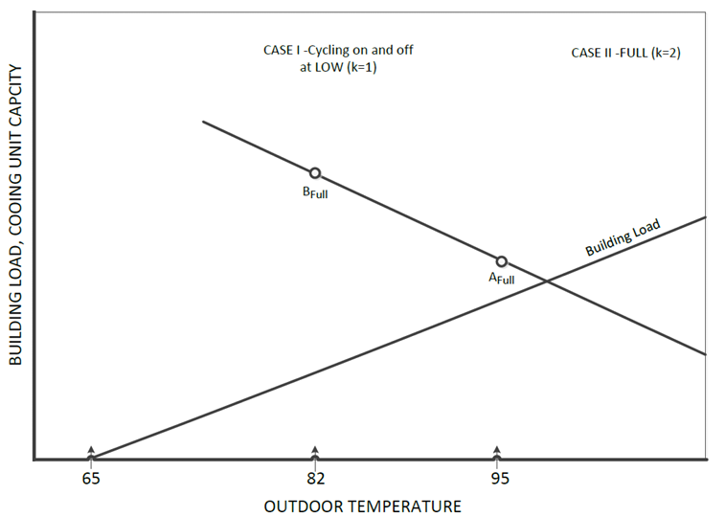
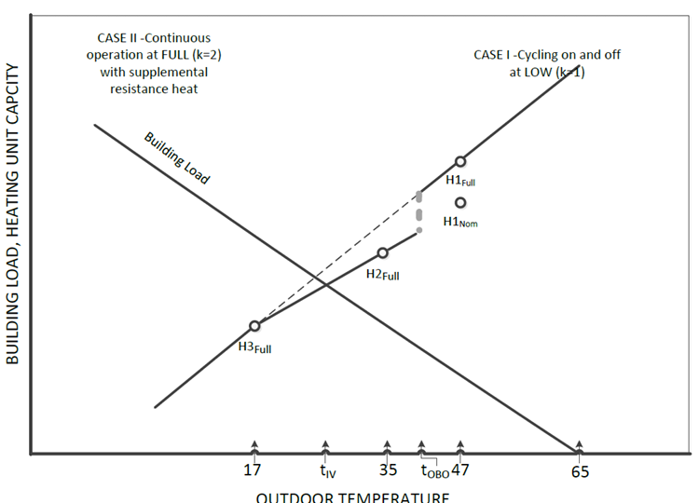
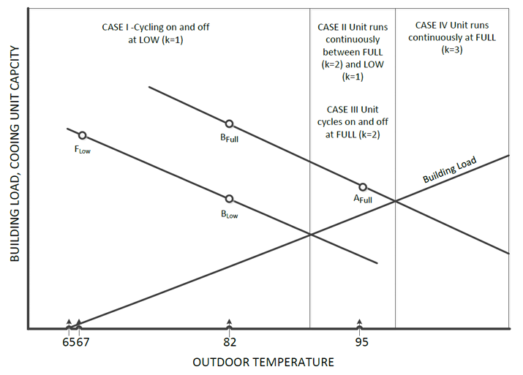
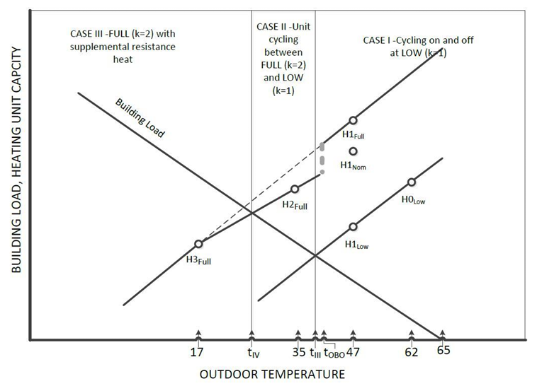
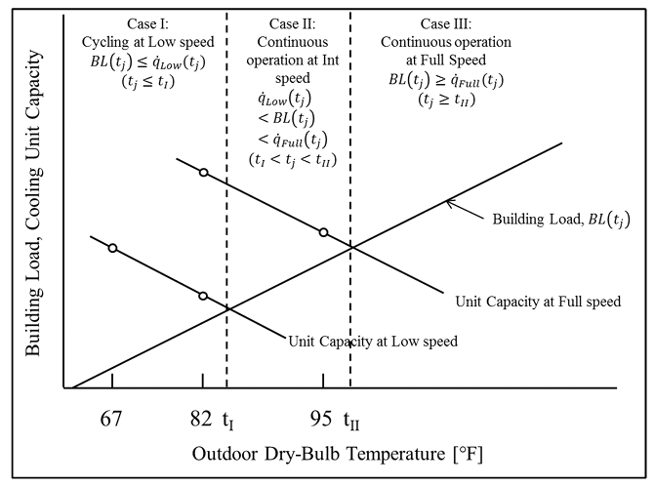
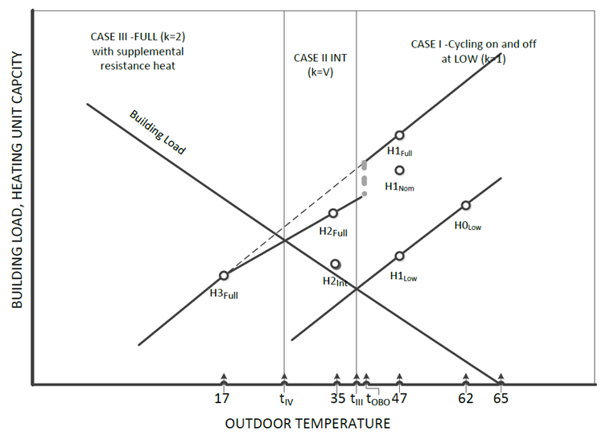
Notes:
The AHRI standard has separate sets of equations to calculate SEER2 and HSPF2 for each staging type of equipment

Slide 37
Single Stage Systems
SEER2 = COP82 ∙ (1 – 0.5∙C_{D}) ∙ 3.412
COP82 = SEER2 / ((1 – 0.5∙C_{D}) ∙ 3.412)
Assume C_{D} = 0.08
COP82 = SEER2 / 3.276
Notes:
The AHRI standard has separate sets of equations to calculate SEER2 and HSPF2 for single stage, two stage, and variable speed systems.
Of these six calculations, SEER2 is by far the easiest.
With an assumption for the cycling degradation coefficient, we can calculate the COP at 82 directly from the SEER2 value.

Slide 38
Single Stage Systems
 | Outdoor Temperature [°F]
 | Heating |  |  |  |  | Cooling
Metric | 0 | 5 | 17 | 47 | 60 | 60 | 82 | 95 | 125
Capacity | ⬅️ | ⬅️ | ✅ | ✅ | ➡️ | ⬅️ | ☑️ | ✅ | ➡️
Power |  |  |  |  |  |  |  | ✅
10 of 18 Values
Notes:
With the COP and capacity at 82…

Slide 39
Single Stage Systems
 | Outdoor Temperature [°F]
 | Heating |  |  |  |  | Cooling
Metric | 0 | 5 | 17 | 47 | 60 | 60 | 82 | 95 | 125
Capacity | ⬅️ | ⬅️ | ✅ | ✅ | ➡️ | ⬅️ | ☑️ | ✅ | ➡️
Power |  |  |  |  |  |  | ☑️ | ✅
P82 = Q82 / (SEER2/3.276)
11 of 18 Values
Notes:
… we can calculate the power at 82

Slide 40
Single Stage Systems
 | Outdoor Temperature [°F]
 | Heating |  |  |  |  | Cooling
Metric | 0 | 5 | 17 | 47 | 60 | 60 | 82 | 95 | 125
Capacity | ⬅️ | ⬅️ | ✅ | ✅ | ➡️ | ⬅️ | ☑️ | ✅ | ➡️
Power |  |  |  |  |  | ⬅️ | ☑️ | ✅ | ➡️
13 of 18 Values
Notes:
We’re now left with just heating power
For all the other cases so far, we’ve had at least one anchor point to start from.
What can we do?
Cutler curves will tell us the EIR maintenance so we can calculate the power at 17 if we know the power at 47
So then the question is: what to use for power at 47?
The last bit of information we have is the HSPF2, which we can also calculate if we have a full performance map
Now this calculation is a lot more involved than the SEER2 calculation I just showed, so….

Slide 41
Single Stage Systems
 | Outdoor Temperature [°F]
 | Heating |  |  |  |  | Cooling
Metric | 0 | 5 | 17 | 47 | 60 | 60 | 82 | 95 | 125
Capacity | ⬅️ | ⬅️ | ✅ | ✅ | ➡️ | ⬅️ | ☑️ | ✅ | ➡️
Power |  |  |  | 1️⃣ |  | ⬅️ | ☑️ | ✅ | ➡️
13 of 18 Values
Notes:
We resort to using good old fashioned iterative solving!
We guess a value for the COP at 47 to get the power at 47

Slide 42
Single Stage Systems
 | Outdoor Temperature [°F]
 | Heating |  |  |  |  | Cooling
Metric | 0 | 5 | 17 | 47 | 60 | 60 | 82 | 95 | 125
Capacity | ⬅️ | ⬅️ | ✅ | ✅ | ➡️ | ⬅️ | ☑️ | ✅ | ➡️
Power |  |  | ☑️ | 1️⃣ |  | ⬅️ | ☑️ | ✅ | ➡️
13 of 18 Values
Notes:
We use the EIR maintenance from the cutler curves to get the power at 17

Slide 43
Single Stage Systems
 | Outdoor Temperature [°F]
 | Heating |  |  |  |  | Cooling
Metric | 0 | 5 | 17 | 47 | 60 | 60 | 82 | 95 | 125
Capacity | ⬅️ | ⬅️ | ✅ | ✅ | ➡️ | ⬅️ | ☑️ | ✅ | ➡️
Power | ⬅️ | ⬅️ | ☑️ | 1️⃣ | ➡️ | ⬅️ | ☑️ | ✅ | ➡️
X
HSPF2_{simulated} = HSPF2?
13 of 18 Values
Notes:
We extrapolate to the full range of temperatures
And we calculate the resulting HSPF2 for this performance map
And we check if it matches the HSPF2 from the rating
If it doesn’t…

Slide 44
Single Stage Systems
 | Outdoor Temperature [°F]
 | Heating |  |  |  |  | Cooling
Metric | 0 | 5 | 17 | 47 | 60 | 60 | 82 | 95 | 125
Capacity | ⬅️ | ⬅️ | ✅ | ✅ | ➡️ | ⬅️ | ☑️ | ✅ | ➡️
Power |  |  |  | 2️⃣ |  | ⬅️ | ☑️ | ✅ | ➡️
13 of 18 Values
Notes:
…we try a new (more informed) guess, and repeat the process

Slide 45
Single Stage Systems
 | Outdoor Temperature [°F]
 | Heating |  |  |  |  | Cooling
Metric | 0 | 5 | 17 | 47 | 60 | 60 | 82 | 95 | 125
Capacity | ⬅️ | ⬅️ | ✅ | ✅ | ➡️ | ⬅️ | ☑️ | ✅ | ➡️
Power | ⬅️ | ⬅️ | ☑️ | 2️⃣ | ➡️ | ⬅️ | ☑️ | ✅ | ➡️
HSPF2_{simulated} = HSPF2?
13 of 18 Values
Notes:
Good old fashioned iterative solving!

Slide 46
Single Stage Systems
 | Outdoor Temperature [°F]
 | Heating |  |  |  |  | Cooling
Metric | 0 | 5 | 17 | 47 | 60 | 60 | 82 | 95 | 125
Capacity | ⬅️ | ⬅️ | ✅ | ✅ | ➡️ | ⬅️ | ☑️ | ✅ | ➡️
Power | ⬅️ | ⬅️ | ☑️ | ☑️ | ➡️ | ⬅️ | ☑️ | ✅ | ➡️
HSPF2_{simulated} = HSPF2!
18 of 18 Values
Notes:
When the HSPF2 eventually matches, we claim victory and move on!
Programming the whole AHRI calculation procedure is a lot, and it can take up precious computer time to go through the iterative process
So we pre-calculated COP47 for a range of HSPF2 values and a range of capacity maintenance values

Slide 47
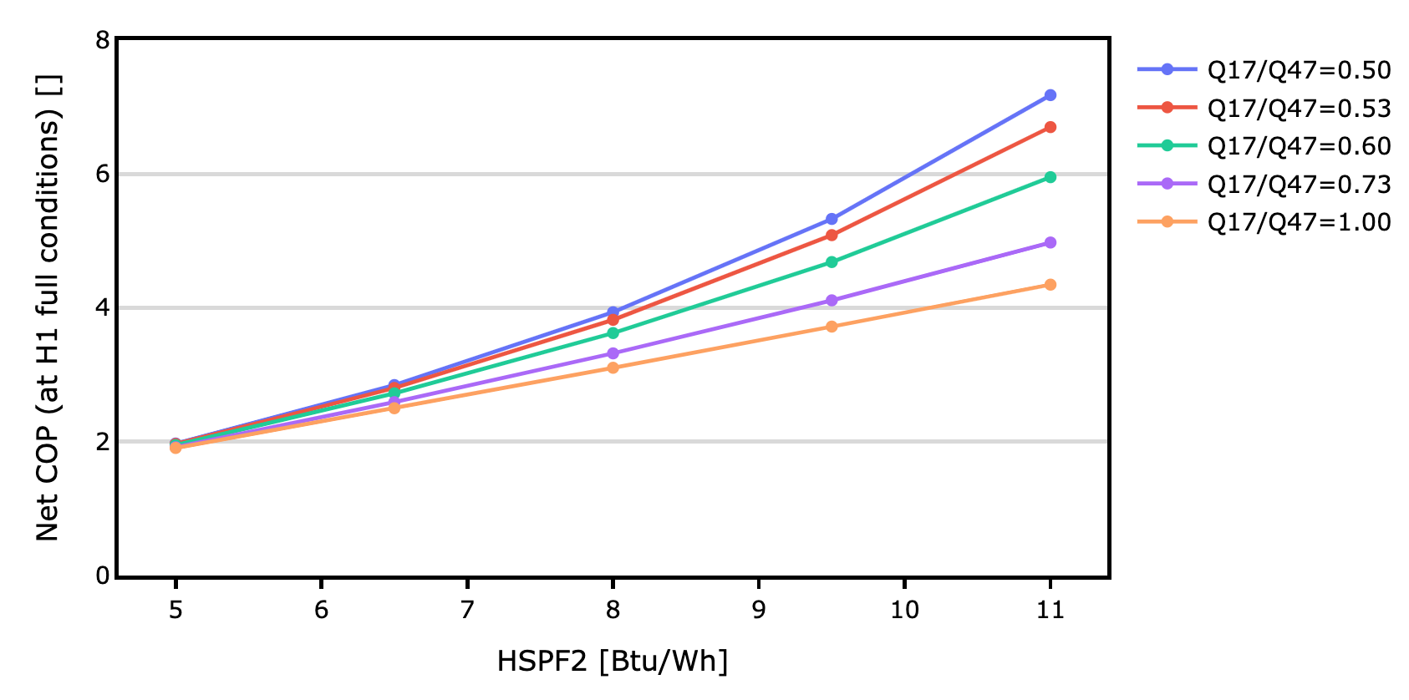
Single Stage Systems
Notes:
These values appear in a table, so developers can just look them up instead of doing the iterations themselves
Remember, the rater has already collected and input HSPF2, Q17 and Q47, so the software has everything it needs to look up the COP when interpolating the values in the table

Slide 48
Two-Stage Systems
 |  | Outdoor Temperature [°F]
 |  | Heating |  |  |  |  | Cooling
Metric | Speed | 0 | 5 | 17 | 47 | 60 | 60 | 82 | 95 | 125
Capacity | Full
 | Min
Power | Full
 | Min
9 Temperatures x 2 Metrics x 2 Speeds = 36 Values
Notes:
For two-stage systems, the process is similar, but we now have 36 performance values to determine

Slide 49
Two-Stage Systems
 |  | Outdoor Temperature [°F]
 |  | Heating |  |  |  |  | Cooling
Metric | Speed | 0 | 5 | 17 | 47 | 60 | 60 | 82 | 95 | 125
Capacity | Full |  |  | ✅ | ✅ |  |  |  | ✅
 | Min
Power | Full |  |  |  |  |  |  |  | ✅
 | Min
4 of 36 Values
Notes:
We start with the same data from AHRI

Slide 50
Two-Stage Systems
 |  | Outdoor Temperature [°F]
 |  | Heating |  |  |  |  | Cooling
Metric | Speed | 0 | 5 | 17 | 47 | 60 | 60 | 82 | 95 | 125
Capacity | Full | ⬅️ | ⬅️ | ✅ | ✅ | ➡️ | ⬅️ | ☑️ | ✅ | ➡️
 | Min | ⬅️ | ⬅️ | ☑️ | ☑️ | ➡️ | ⬅️ | ☑️ | ☑️ | ➡️
Power | Full |  |  |  |  |  | ⬅️ | ☑️ | ✅ | ➡️
 | Min
22 of 36 Values
Notes:
We use the Cutler correlations for both maintenance and and ratios to establish two points where we can and perform the extrapolations
And we’re left with a situation again where we need to find power values that result in the correct SEER2 and HSPF2.
Unfortunately, the SEER2 calculation for two-stage systems is a lot more like the HSFP2 calculation for single stage systems than it is like the SEER2 calculation for single stage systems.

Slide 51
Two-Stage Systems
 |  | Outdoor Temperature [°F]
 |  | Heating |  |  |  |  | Cooling
Metric | Speed | 0 | 5 | 17 | 47 | 60 | 60 | 82 | 95 | 125
Capacity | Full | ⬅️ | ⬅️ | ✅ | ✅ | ➡️ | ⬅️ | ☑️ | ✅ | ➡️
 | Min | ⬅️ | ⬅️ | ☑️ | ☑️ | ➡️ | ⬅️ | ☑️ | ☑️ | ➡️
Power | Full |  |  |  |  |  | ⬅️ | ☑️ | ✅ | ➡️
 | Min |  |  |  |  |  |  | 🔃
SEER2_{simulated} = SEER2?
22 of 36 Values
Notes:
But we can still use the same iterative process.
And this time we are calculating the COP at 82 degrees and minimum compressor speed that gives us the correct SEER2 value

Slide 52
Two-Stage Systems
 |  | Outdoor Temperature [°F]
 |  | Heating |  |  |  |  | Cooling
Metric | Speed | 0 | 5 | 17 | 47 | 60 | 60 | 82 | 95 | 125
Capacity | Full | ⬅️ | ⬅️ | ✅ | ✅ | ➡️ | ⬅️ | ☑️ | ✅ | ➡️
 | Min | ⬅️ | ⬅️ | ☑️ | ☑️ | ➡️ | ⬅️ | ☑️ | ☑️ | ➡️
Power | Full |  |  |  |  |  | ⬅️ | ☑️ | ✅ | ➡️
 | Min |  |  |  |  |  | ⬅️ | ☑️ | ☑️ | ➡️
SEER2_{simulated} = SEER2!
26 of 36 Values
Notes:
Once we do that, we can use EIR maintenance at 95 from the Cutler curves and extrapolate for the rest of the cooling power values

Slide 53
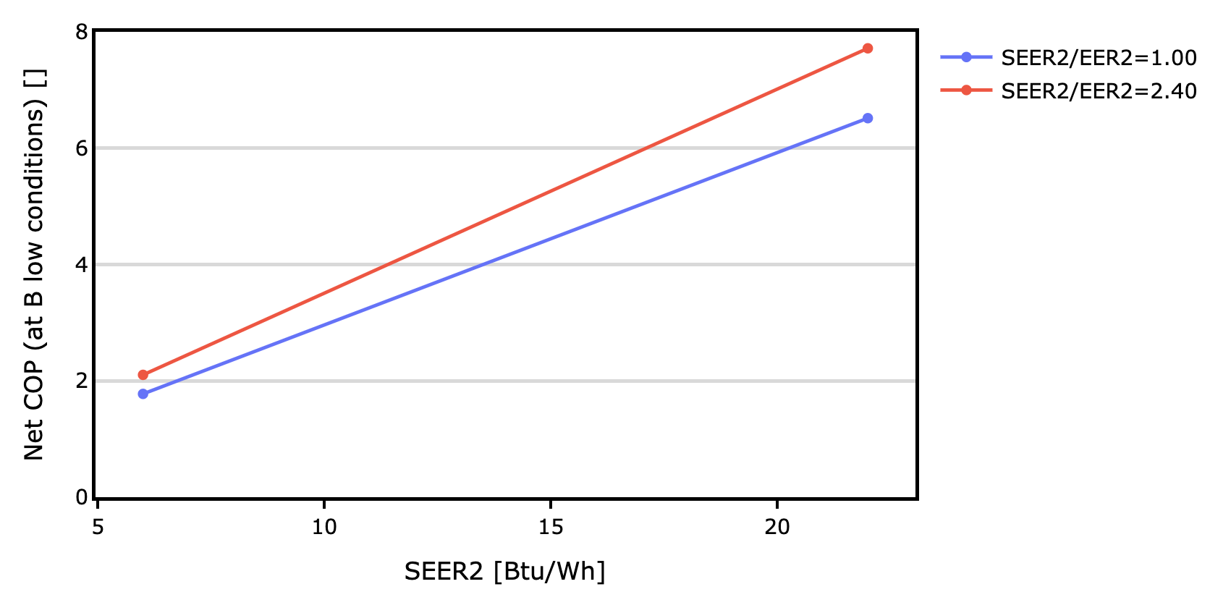
Two-Stage Systems
Notes:
Even though the calculation of SEER2 is more complicated for two stage systems, the relationship is remarkably linear, so we only need four data points to cover the expected range of inputs.
In this case, we are also comparing against the ratio of SEER2 and EER2

Slide 54
Two-Stage Systems
 |  | Outdoor Temperature [°F]
 |  | Heating |  |  |  |  | Cooling
Metric | Speed | 0 | 5 | 17 | 47 | 60 | 60 | 82 | 95 | 125
Capacity | Full | ⬅️ | ⬅️ | ✅ | ✅ | ➡️ | ⬅️ | ☑️ | ✅ | ➡️
 | Min | ⬅️ | ⬅️ | ☑️ | ☑️ | ➡️ | ⬅️ | ☑️ | ☑️ | ➡️
Power | Full |  |  |  | 🔃 |  | ⬅️ | ☑️ | ✅ | ➡️
 | Min |  |  |  |  |  | ⬅️ | ☑️ | ☑️ | ➡️
HSPF2_{simulated} = HSPF2?
26 of 36 Values
Notes:
We use the same iterative approach again for HSPF2

Slide 55
Two-Stage Systems
 |  | Outdoor Temperature [°F]
 |  | Heating |  |  |  |  | Cooling
Metric | Speed | 0 | 5 | 17 | 47 | 60 | 60 | 82 | 95 | 125
Capacity | Full | ⬅️ | ⬅️ | ✅ | ✅ | ➡️ | ⬅️ | ☑️ | ✅ | ➡️
 | Min | ⬅️ | ⬅️ | ☑️ | ☑️ | ➡️ | ⬅️ | ☑️ | ☑️ | ➡️
Power | Full | ⬅️ | ⬅️ | ☑️ | ☑️ | ➡️ | ⬅️ | ☑️ | ✅ | ➡️
 | Min | ⬅️ | ⬅️ | ☑️ | ☑️ | ➡️ | ⬅️ | ☑️ | ☑️ | ➡️
HSPF2_{simulated} = HSPF2!
36 of 36 Values
Notes:
and flesh out the rest of the heating power values using Cutler correlations and extrapolation

Slide 56
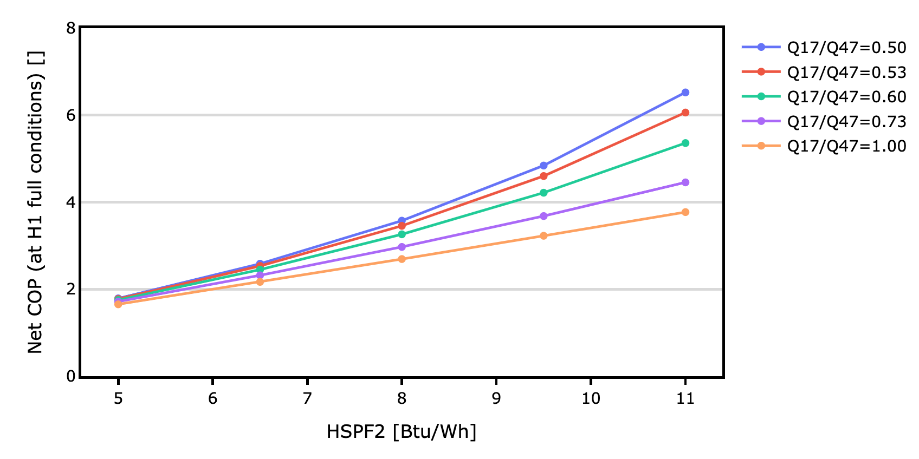
Two-Stage Systems
Notes:
…and arrive at a similar table of values for software lookup

Slide 57
Variable Speed Systems
 |  | Outdoor Temperature [°F]
 |  | Heating |  |  |  |  | Cooling
Metric | Speed | -20 | 5 | 17 | 47 | 60 | 60 | 82 | 95 | 125
Capacity | Max
 | Full
 | Min
Power | Max
 | Full
 | Min
9 Temperatures x 2 Metrics x 3 Speeds = 54 Values
Notes:
This brings us to variable speed systems, where we now have at least 3 speeds and 54 values to fill

Slide 58
Variable Speed Systems
 |  | Outdoor Temperature [°F]
 |  | Heating |  |  |  |  | Cooling
Metric | Speed | -20 | 5 | 17 | 47 | 60 | 60 | 82 | 95 | 125
Capacity | Max
 | Full |  |  | ✅ | ✅ |  |  |  | ✅
 | Min
Power | Max
 | Full |  |  |  |  |  |  |  | ✅
 | Min
4 of 54 Values
Notes:
We can add the same AHRI points we already know
But this time, we can’t rely on the Cutler curves to determine the maintenance and ratio values
Cutler’s work was done in the early 2010s before variable speed systems really hit the market

Slide 59
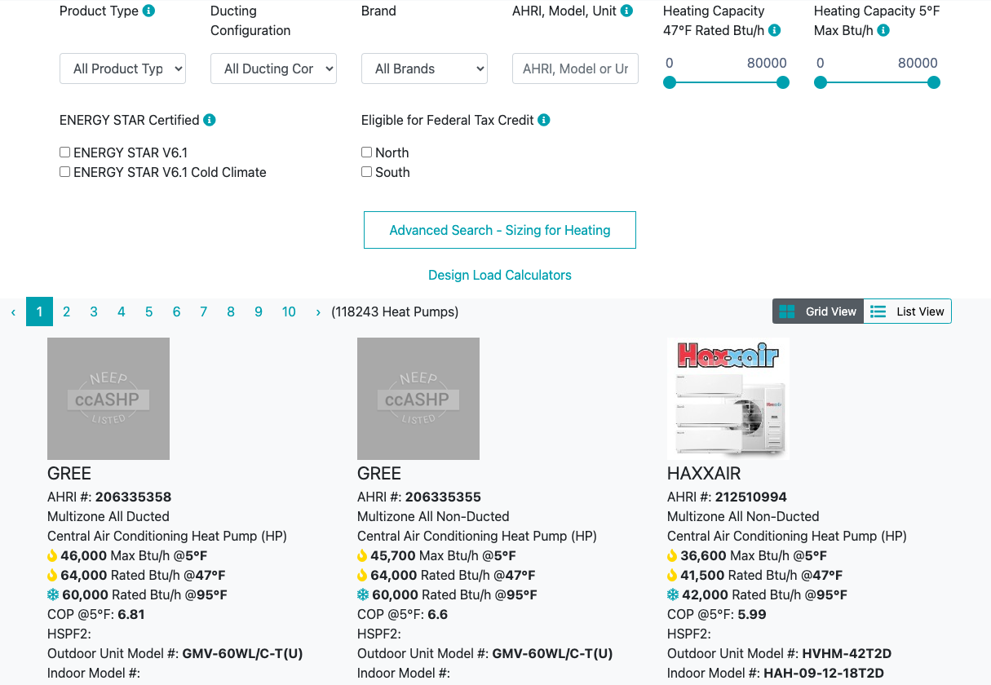
(144921 Heat Pumps)
Notes:
Fortunately, Northeast Energy Efficiency Partnerships (NEEP) has assembled a database of heat pump units that includes performance beyond AHRI ratings
There are now almost 150,000 products in this list that meet their cold climate requirements:
Variable capacity
COP > 1.75 at 5F

Slide 60
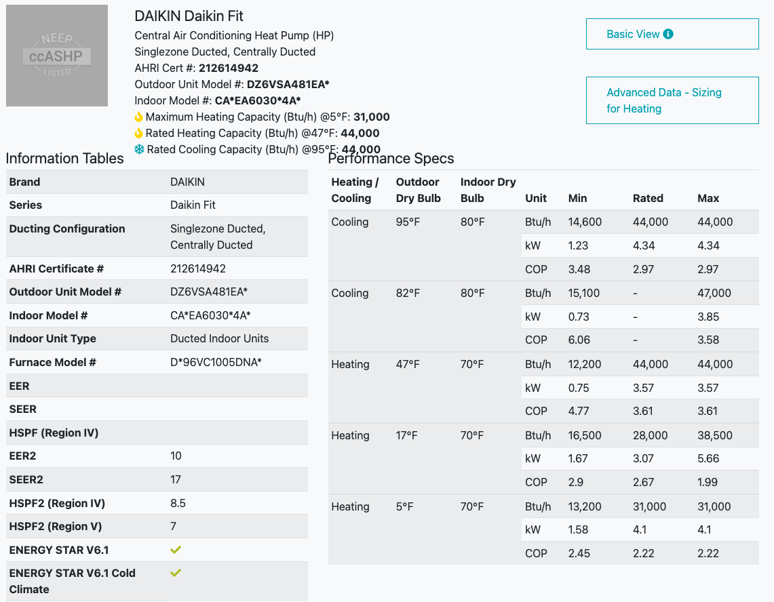
AHRI Rating Data
NEEP Data
Notes:
The NEEP contains the AHRI rating data (highlighted in red), but also includes capacity and efficiency at more speeds and temperatures.
The nice thing is they have data at 5 degrees, and some units have data at lower temperatures, called “Lowest Catalogued Temperature”.

Slide 61
AHRI Rating Data
NEEP Data
Notes:
This gives a much more complete picture of performance
And with product-specific data, the hope was that energy modelers could use this data directly and capture the more subtle technological distinctions among heat pump products

Slide 62
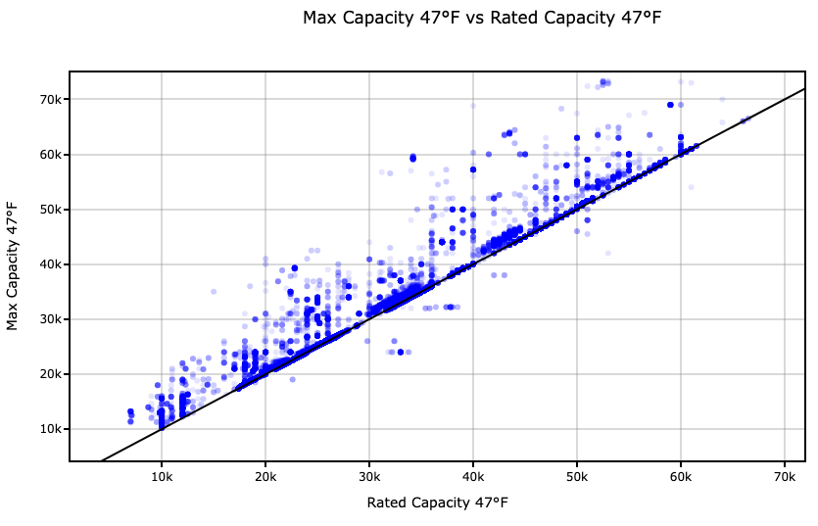
???
Notes:
…but on closer inspection, some of the data is obviously problematic
Like having minimum capacities higher than maximum capacities.
Or COPs greater than Carnot efficiency
We’ve worked with NEEP to build in much more comprehensive quality control checks
But that will take some time to implement and get corrected data
In the meantime, we decided we couldn’t rely on individual NEEP records
But there was still good and useful data we could use to inform a better modeling approach

Slide 63
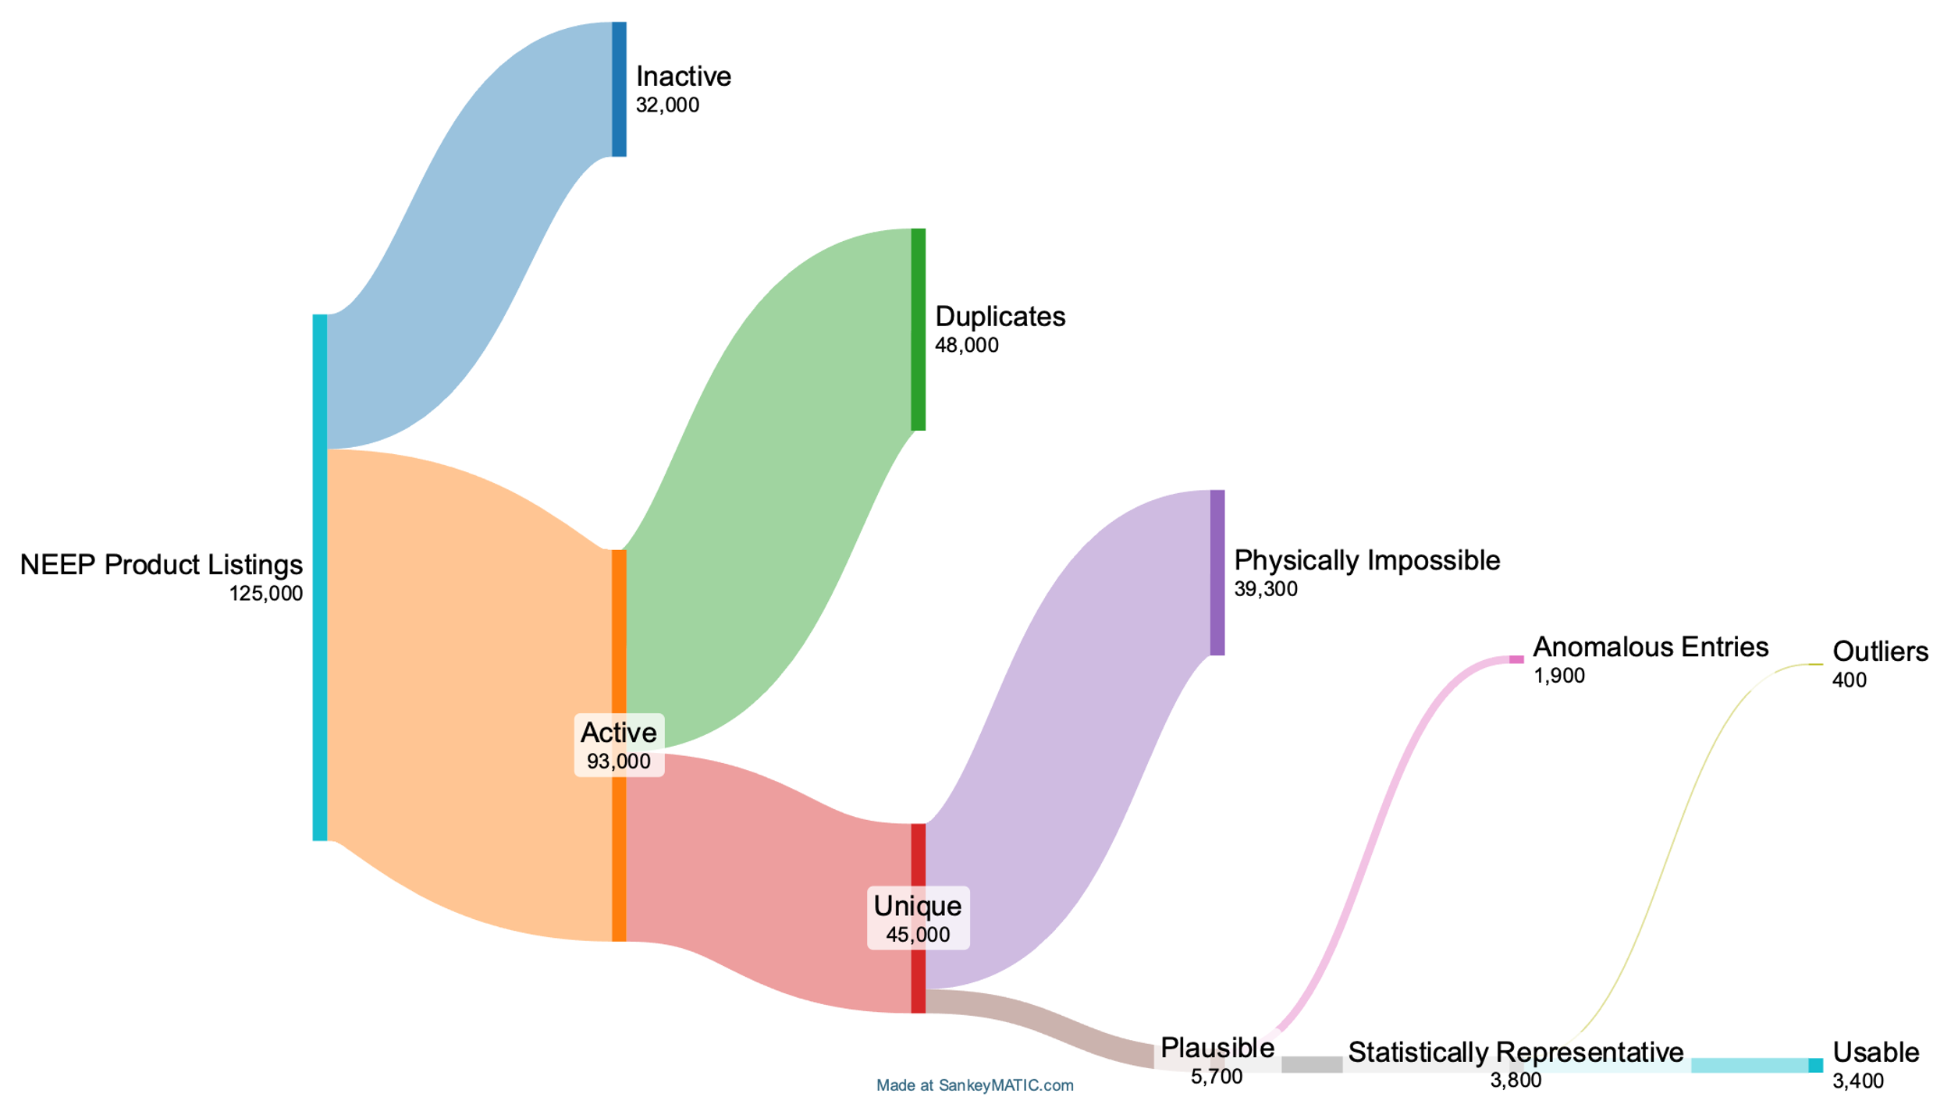
Notes:
At the time we started with 125,000 units
We filtered out:
Inactive units
Duplicates (same product under a different brand)
Physically impossible (COP greater than Carnot)
A few other filters
Arrived at 3,400 usable units (which is still a respectable sample size)

Slide 64
AHRI Rating Data
NEEP Data
Notes:
So how can we use the remaining data to flesh out the performance data?

Slide 65
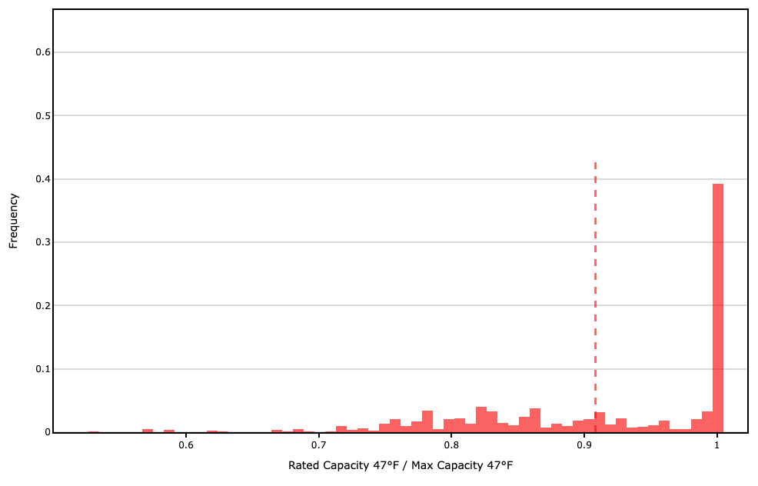

Slide 66
AHRI Rating Data
NEEP Data
Notes:
So how can we use the remaining data to flesh out the performance data?

Slide 67
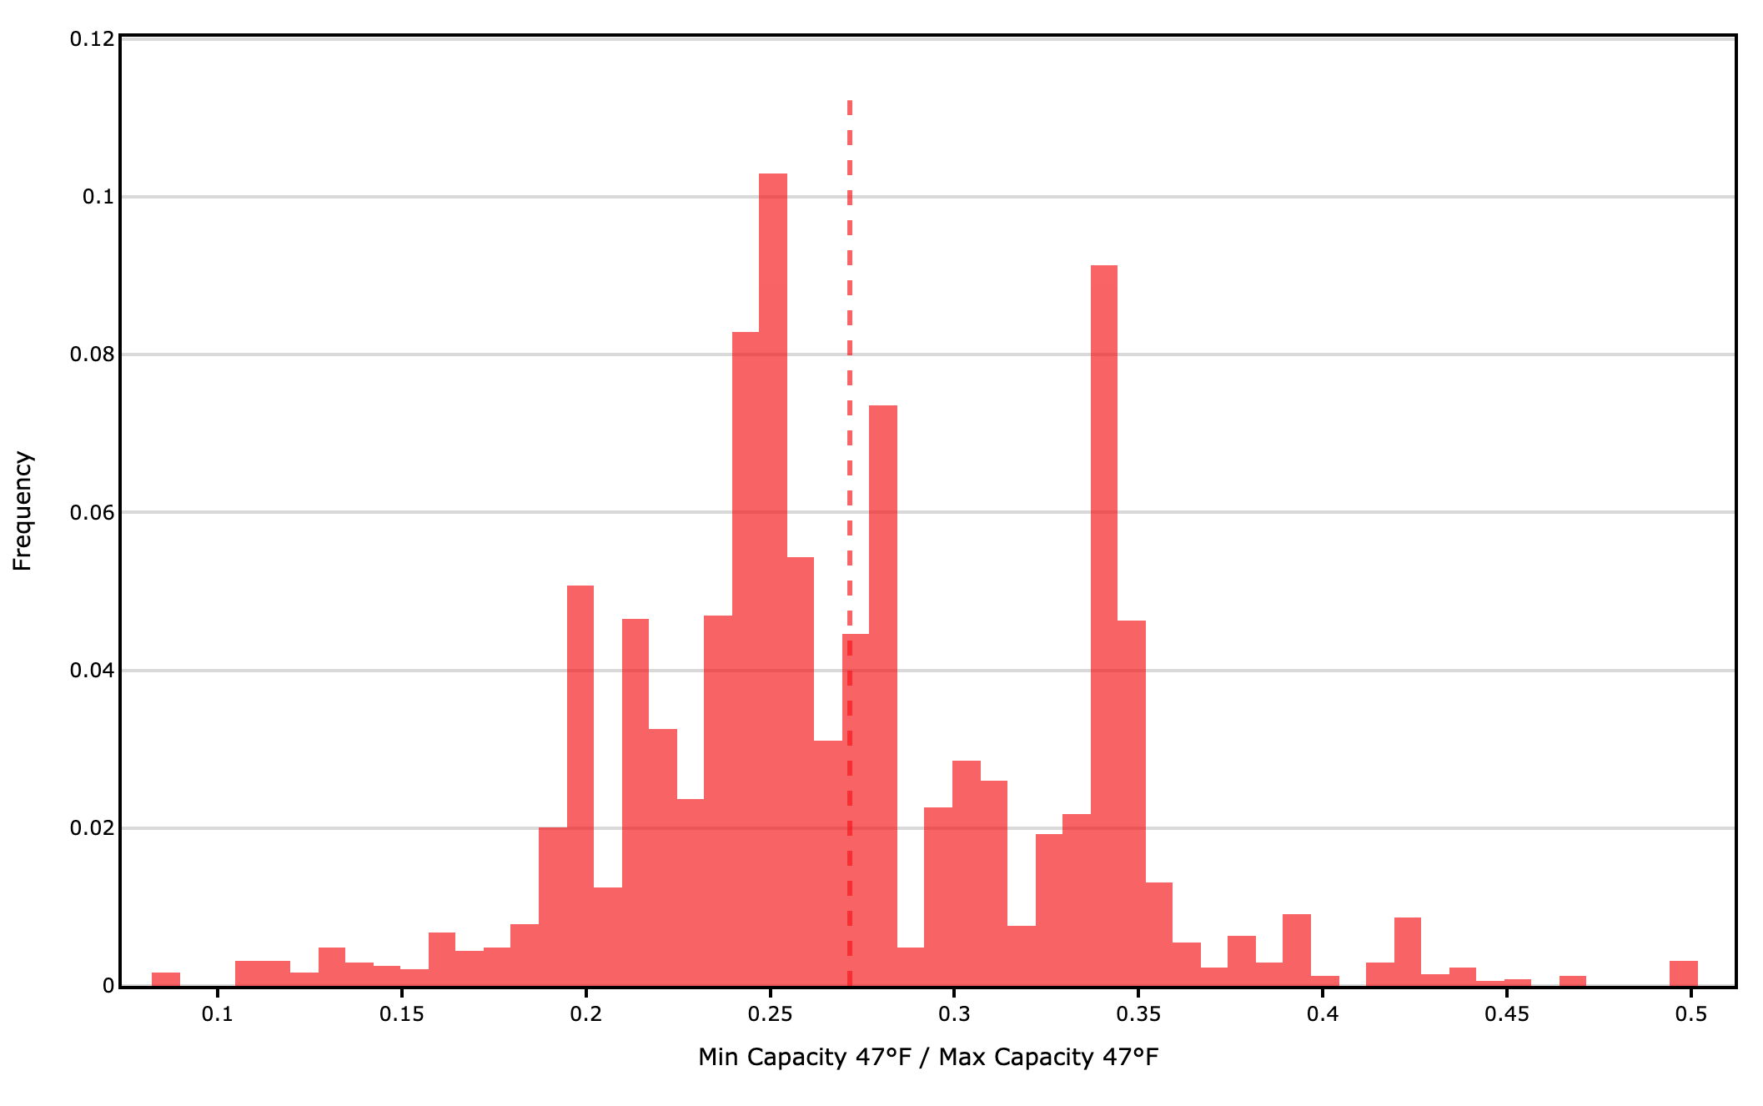

Slide 68
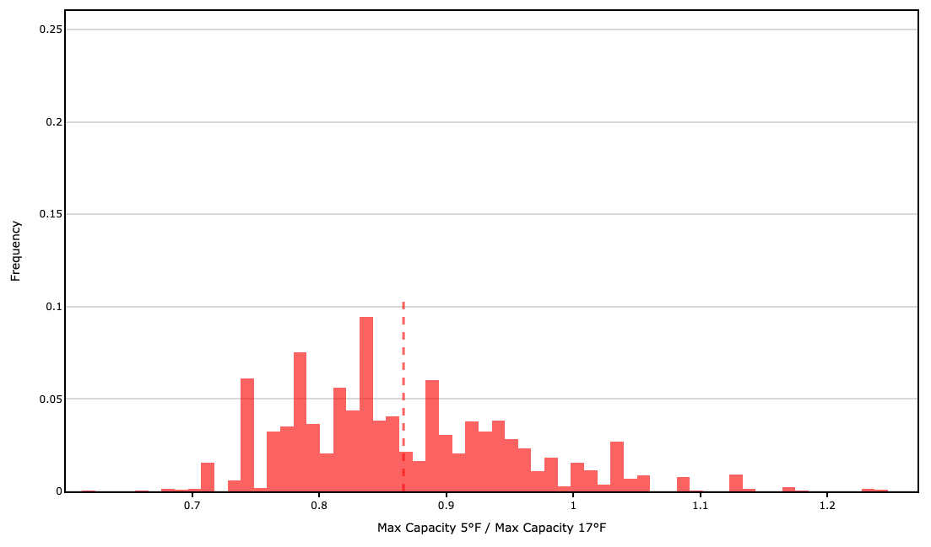

Slide 69
AHRI Rating Data
+NEEP data
Notes:
So how can we use the remaining data to flesh out the performance data?
We use the same approach to establish ratios for the remaining points, and interpolate between these to get the performance during a simulation.
The last little bit of magic is defining the COPs at each of these points so that if you were to simulate the AHRI rating tests, you’d arrive at the a HSPF2 that matches the certified rating.

Slide 70
Variable Speed Systems
 |  | Outdoor Temperature [°F]
 |  | Heating |  |  |  |  | Cooling
Metric | Speed | -20 | 5 | 17 | 47 | 60 | 60 | 82 | 95 | 125
Capacity | Max | ☑️ | ☑️ | ☑️ | ☑️ | ➡️ | ⬅️ | ☑️ | ☑️ | ➡️
 | Full | ☑️ | ☑️ | ✅ | ✅ | ➡️ | ⬅️ | ☑️ | ✅ | ➡️
 | Min | ☑️ | ☑️ | ☑️ | ☑️ | ➡️ | ⬅️ | ☑️ | ☑️ | ➡️
Power | Max |  |  |  |  |  | ⬅️ | ☑️ | ☑️ | ➡️
 | Full |  |  |  |  |  | ⬅️ | ☑️ | ✅ | ➡️
 | Min
35 of 54 Values
Notes:
We can use these normalized maintenance and ratio values to flesh out a lot of the performance values.
Note that we actually have data at temperatures below 17F for heating and we don’t need to extrapolate
We’re left with the same problem we faced for single and two stage equipment of selecting power values that are consistent with the SEER2 and HSPF2 of the equipment.
And the approach remains the same…

Slide 71
Variable Speed Systems
 |  | Outdoor Temperature [°F]
 |  | Heating |  |  |  |  | Cooling
Metric | Speed | -20 | 5 | 17 | 47 | 60 | 60 | 82 | 95 | 125
Capacity | Max | ☑️ | ☑️ | ☑️ | ☑️ | ➡️ | ⬅️ | ☑️ | ☑️ | ➡️
 | Full | ☑️ | ☑️ | ✅ | ✅ | ➡️ | ⬅️ | ☑️ | ✅ | ➡️
 | Min | ☑️ | ☑️ | ☑️ | ☑️ | ➡️ | ⬅️ | ☑️ | ☑️ | ➡️
Power | Max |  |  |  |  |  | ⬅️ | ☑️ | ☑️ | ➡️
 | Full |  |  |  | 🔃 |  | ⬅️ | ☑️ | ✅ | ➡️
 | Min |  |  |  |  |  |  | 🔃
HSPF2_{simulated} = HSPF2?
SEER2_{simulated} = SEER2?
35 of 54 Values
Notes:
Iteratively solve for the values of COP 82 min and COP 47 full that give us matching SEER2 and HSPF2 values respectively.

Slide 72
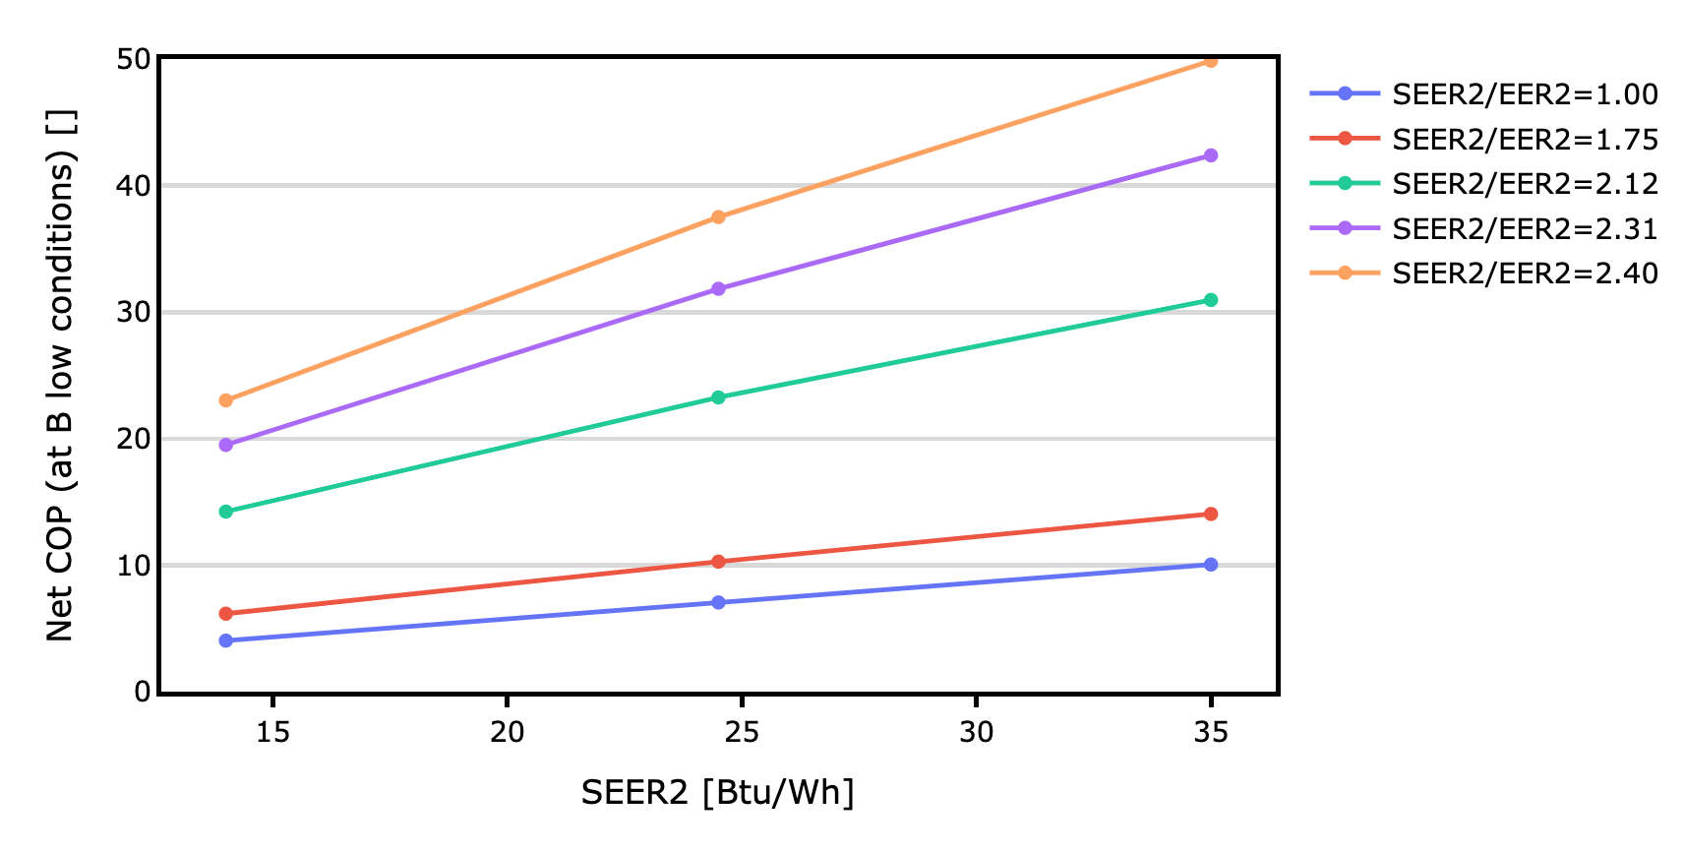
Variable Speed Systems
Notes:
We get a similar interpolation table for SEER2,

Slide 73
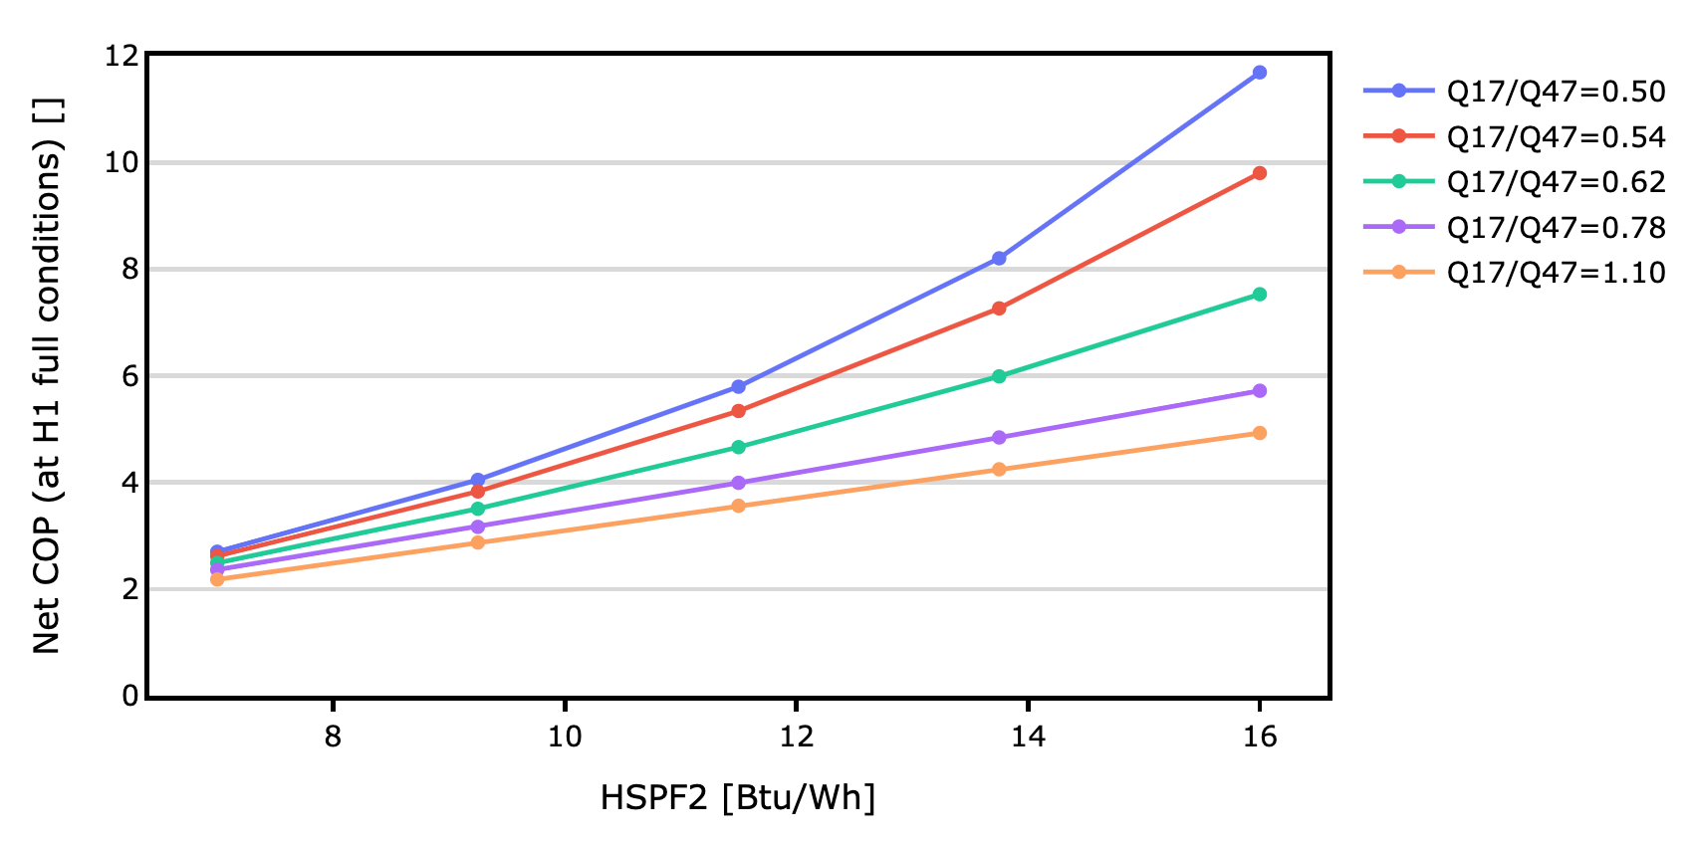
Variable Speed Systems
Notes:
…and for HSPF2

Slide 74
Variable Speed Systems
 |  | Outdoor Temperature [°F]
 |  | Heating |  |  |  |  | Cooling
Metric | Speed | -20 | 5 | 17 | 47 | 60 | 60 | 82 | 95 | 125
Capacity | Max | ☑️ | ☑️ | ☑️ | ☑️ | ➡️ | ⬅️ | ☑️ | ☑️ | ➡️
 | Full | ☑️ | ☑️ | ✅ | ✅ | ➡️ | ⬅️ | ☑️ | ✅ | ➡️
 | Min | ☑️ | ☑️ | ☑️ | ☑️ | ➡️ | ⬅️ | ☑️ | ☑️ | ➡️
Power | Max | ☑️ | ☑️ | ☑️ | ☑️ | ➡️ | ⬅️ | ☑️ | ☑️ | ➡️
 | Full | ☑️ | ☑️ | ☑️ | ☑️ | ➡️ | ⬅️ | ☑️ | ✅ | ➡️
 | Min | ☑️ | ☑️ | ☑️ | ☑️ | ➡️ | ⬅️ | ☑️ | ☑️ | ➡️
54 of 54 Values
Notes:
…and we can flesh out the rest of the performance map!
That sums up the bulk of the work that went into this addendum, but there are a few loose ends I’d like to cover if we have time

Slide 75
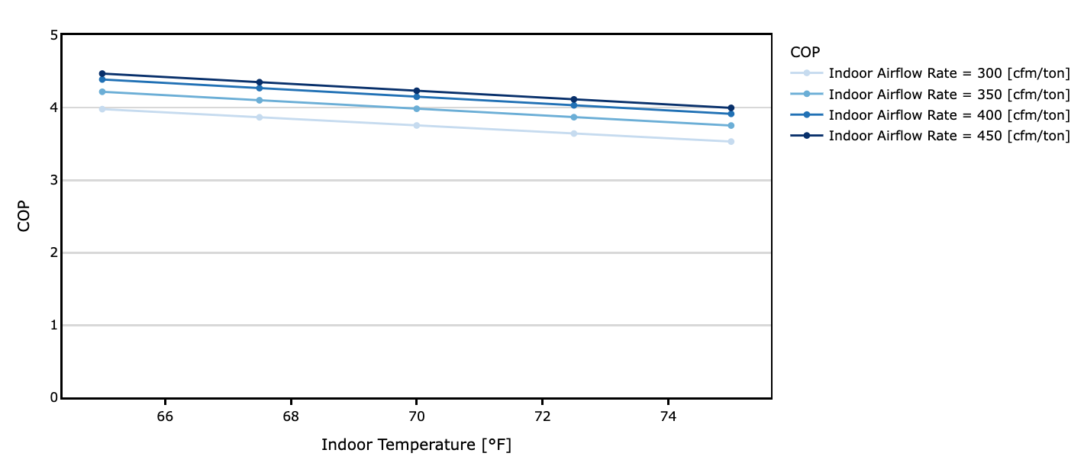
Variability with indoor conditions
Data Source: Cutler et al.
Notes:
Performance isn’t only dependent on compressor speed and outdoor temperature.
It also depends on the indoor conditions, like indoor drybulb temperature and the flow rate across the coil
This is variation is also not something that is readily available
So we rely on the relationships established by the cutler curves

Slide 76
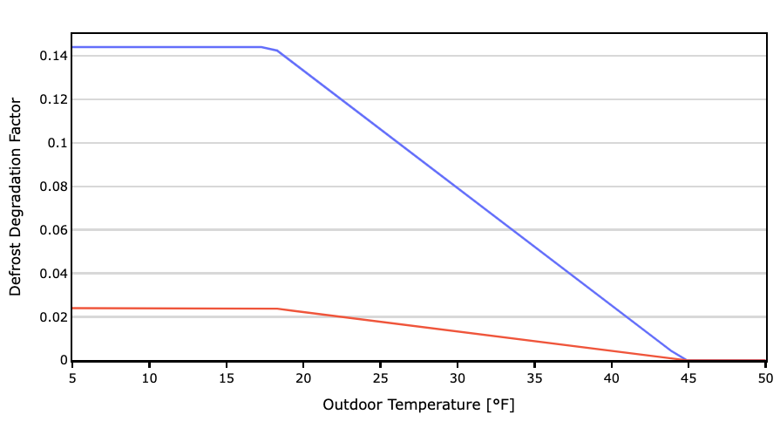
Defrost
Max Defrost Temperature
Supplemental heat is active and indoor fan is running
Pan heater: 150W when below 32F
Data Source: Central Valley Research Homes
Notes:
Next is defrost
Also very little data is available from the manufacturers about how heat pumps work in defrost operation.
There’s also a wide range of strategies that can be used to defrost the outdoor coil, but it’s not documented in a way that can be readily determined by a rater.
So we apply the same assumptions to all heat pumps at every speed of operation: Timed reverse cycle defrost
We apply a degradation factor to both heating capacity and heating power depending on the outdoor temperature
At temperatures below 40F, the degradation factor slowly increases to a maximum degradation at around 18F.
The capacity can be degraded by up to ~14%, which reflects the fact that you are actually cooling the indoor air in the home during defrost, and this air must by re-heated with supplemental heat
The power is actually lower by about 2%, which reflects the fact that the compressor actually has to shut off before it can switch into defrost mode.
We also assume a pan heater is operating to prevent the melt off from re-freezing below the unit.

Slide 77
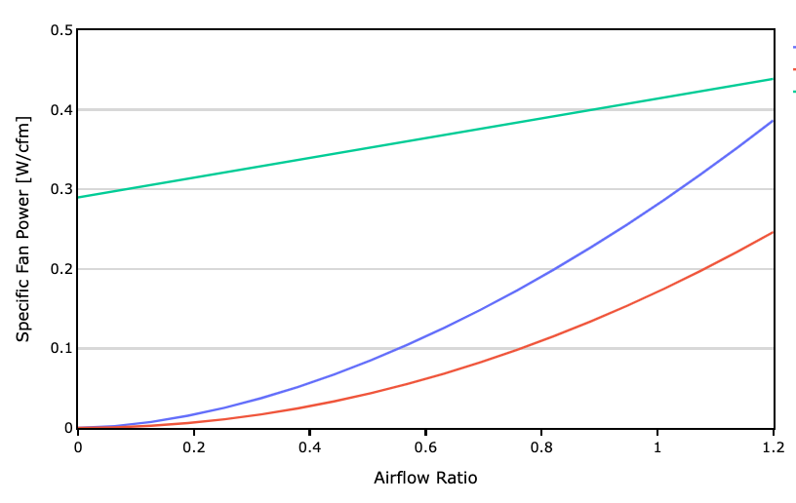
Indoor Fan Power
(0.414 W/cfm)∙(0.3∙x+0.7)
Full Speed Cooling
Min Speed Cooling
(0.281 W/cfm)∙x^{1.75}
(0.171 W/cfm)∙x²
Notes:
The next complication is indoor fan power.
As I mentioned, the manufacturers provide net capacity and net power, which lumps the indoor fan in with the coil.
In order to get to the gross performance, we need to make assumptions about the fan performance used in the AHRI rating process so we know how much heat and power to remove.
For AHRI ratings, the airflow ratio is the airflow relative to the air flow for full speed cooling operation.
We assume that the fan operates at a different flow rate for each compressor speed for both heating and cooling.
Each flow rate is proportional to the capacity of the system at that speed.
So if the cooling capacity ratio at minimum speed is 30%, you can use these relationships to determine what the fan power is when operating at minimum cooling speed.
The W/cfm values shown here are the assumed rated specific fan power at full speed cooling operation.
If airflow and fan power are measured as part of the HVAC grading process, we use similar curves to estimate the fan power at other speeds and modes of operation.

Slide 78
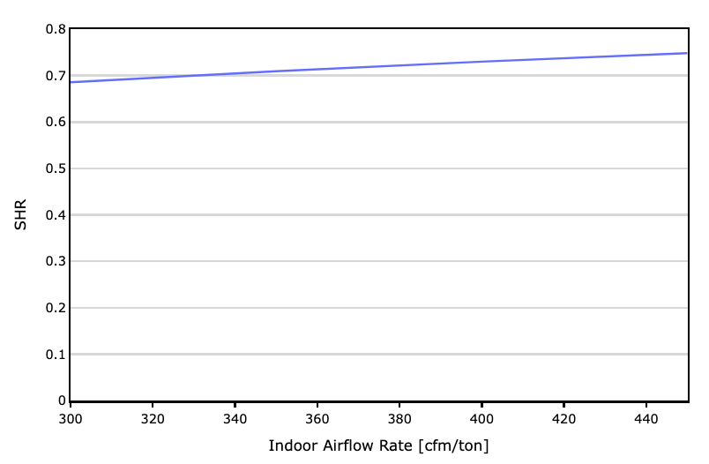
Sensible Cooling
Apparatus Dew Point Methodology
Data Source: Proctor Engineering
Notes:
I’m not going to spend a lot of time explaining how the sensible cooling capacity is calculated, outside of mentioning that:
We use a correlation developed by proctor engineering that estimates the rated sensible heat ratio depending on the rated cfm/ton
And we use what’s called the “Apparatus Dew Point Methodology” to calculate the sensible heat ratio at off-rated conditions.

Slide 79
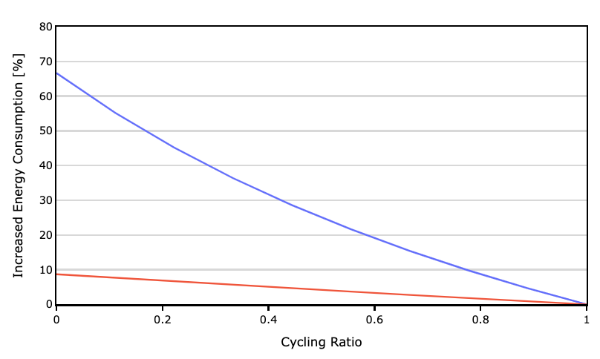
Operating Performance
C_{D} = 0.4
C_{D} = 0.08
Notes:
Single and two stage based on CEC database. My understanding is reducing cycling losses was favored path to improved seasonal efficiency.
Variable speed based on field studies and testing done at Purdue. Variable speed systems don’t need as good of cycling management because the spend much less time cycling.

Slide 80
Crankcase Power
10 W per ton of rated full load net cooling capacity when the system is not on and the temperature is below 50°F.

Slide 81
MINHERS Addendum 82 Public Review
Comment period: Nov 22, 2024 – Jan 21, 2025
2nd Draft out for public review soon!
Notes:
So that sums up my overview of the addendum.
A lot of work went in to piecing this all together, and I'd like to thank
all the members of the working group
and Nathan Oliver from Big Ladder who did most of the statistical analysis of the NEEP database
As I said the addendum is out for public review right now (and for the next 11 days). Please take a chance to review and provide any comments back through the web form.
Thank you!

Slide 82
Big Ladder Software
Address
Number
Email
1617 Wazee St
Unit 200
Denver, CO 80202
720.583.5587
neal.kruis@bigladdersoftware.com

