Slide 1
Next Gen:
Shaping the Future Building Performance Professionals
Emma Bennett, CAE
RESNET | NONPROFIT RESOURCES

Slide 2
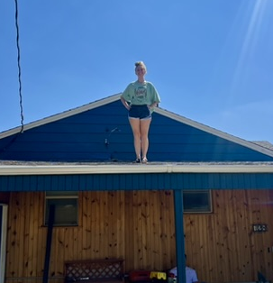
About Me…
Work things…
CEO of Nonprofit Resources
Event Manager for RESNET
Executive Director for WBFI
Volunteer things…
VP of SD-STRA
Next Gen Rep for AMCI
Jr. High Volleyball Coach

Slide 3
Nonprofit Resources
Nonprofit Resources is a woman-owned & family-operated Association Management Company (AMC) serving national & international nonprofit organizations with full & fractional services.
CLIENTS WE SERVE/SERVED IN THE INDUSTRY:

Slide 4
What We Will Cover
GENERATIONAL OVERVIEW
NEXT GEN DEVELOPMENT
Understand the current demographics of the workforce and generational characteristics.
Find pathways, resources, and strategies to find career development within the industry.
INDUSTRY STATS
OPEN DISCUSSION
Overview of statistics within the building performance industry.
Roundtable conversation and Q&A
INCLUSIVE WORKPLACES
Discover the opportunities and challenges that come with creating age-diverse & inclusive workplaces.

Slide 5
Check Your Bias!
Notes:
Important to know we all have biases, myself included. It’s what makes us human based on societal norms, expectations and personal experience.
When it comes to discussion of age diversity, and we’ll touch a bit on gender diversity, it’s important that we stick with facts.
For example – I am going to be sharing SOME generalized info based on research and data, but we don’t want to talk disparagingly on one demographic.
One of my favorite quotes when there’s facts we’ll use facts, but if we’re going to use opinions we’ll use mine ☺

Slide 6
Creating Age-Diverse Workplaces
Opportunities
Broader Range of Skills and Experiences
Enhanced Creativity and Innovation
Inter-Generational Mentorship and Learning
Better Representation of Customer Demographics
Challenges
Communication and Cultural Difference
Overcoming Stereotypes and Ageism
Balancing Varied Work Expectations
Adapting to Different Technological Proficiencies
Notes:
https://www.corporatewellnessmagazine.com/article/age-diversity-in-the-workplace-benefits-and-challenges
Opportunities:
.Older employees contribute with deep industry knowledge and tried-and-tested methods, while younger employees offer up-to-date educational knowledge and familiarity with the latest technologies and social trends
Diverse age groups bring different ways of thinking and problem-solving. This diversity leads to more innovative and creative solutions as teams can draw upon a wide array of viewpoints and experiences
Inter-Generational Mentorship and Learning: An age-diverse workplace fosters an environment where mentorship and learning occur across generational lines.
A workforce that reflects the age diversity of the customer base is more equipped to understand and meet the needs of a broader audience. This alignment can significantly enhance customer service and outreach

Slide 7
Legal Requirements
“Reverse” age discrimination
Connecticut
District of Columbia
Florida
Hawaii
Illinois
Iowa
Maine
Maryland
Michigan
Minnesota
Montana
New Hampshire
New Jersey
New York
Oregon
Vermont
IMPORTANT!
Age Discrimination in Employment Act (ADEA) primarily protects individuals who are 40 years of age or older from age discrimination.
However, there are some state and local laws that offer protections against age discrimination for younger workers as well…
Notes:
https://www.youthrights.org/age-discrimination-under-40/

Slide 8
Business Sense/Cents
Creating Inclusive Culture…
Employees in inclusive workplaces are 3.5 times more likely to be engaged.
Organizations with diverse management teams have a 45% higher likelihood of capturing new markets.
Organizations with a high level of age diversity are 19% more likely to have above-average financial performance.
Companies with inclusive cultures experience a 22% lower turnover rate.
Notes:
https://www.youthrights.org/age-discrimination-under-40/

Slide 9
Generational Timeline
1946-1964
1965- 1980
1981-1996
1997-2012
Baby Boomer (AGE: 61-79)
Generation X (AGE: 44-60)
Millennials (AGE: 28 – 44)
Generation Z (AGE: 13-27)
Key Traits: Goal-oriented, self-assured, and resourceful
Values: Strong work ethic, loyalty, and a focus on relationships
Work Preferences: Prefer structured environments, value job security, and are often motivated by position and prestige
Key Traits: Independent, resourceful, and adaptable
Values: Work-life balance, self-reliance, and skepticism towards authority
Work Preferences: Favor flexible work arrangements, value efficiency, and are comfortable with technology
Key Traits: Tech-savvy, collaborative, and purpose-driven
Values: Personal growth, social responsibility, and work-life integration
Work Preferences: Prefer teamwork, seek meaningful work, and value feedback and mentorship
Key Traits: Digital natives, pragmatic, and socially conscious
Values: Diversity, mental health/wellness, and flexibility
Work Preferences: Favor gig work and freelance opportunities, prioritize work-life balance, and value purpose-driven roles.

Slide 11
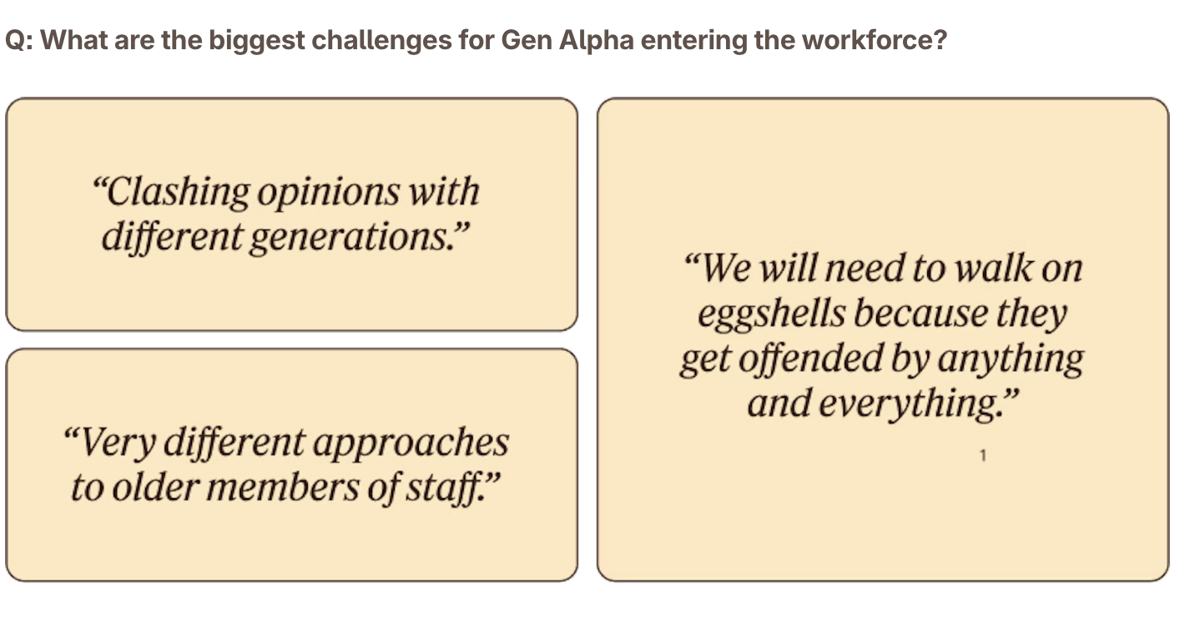
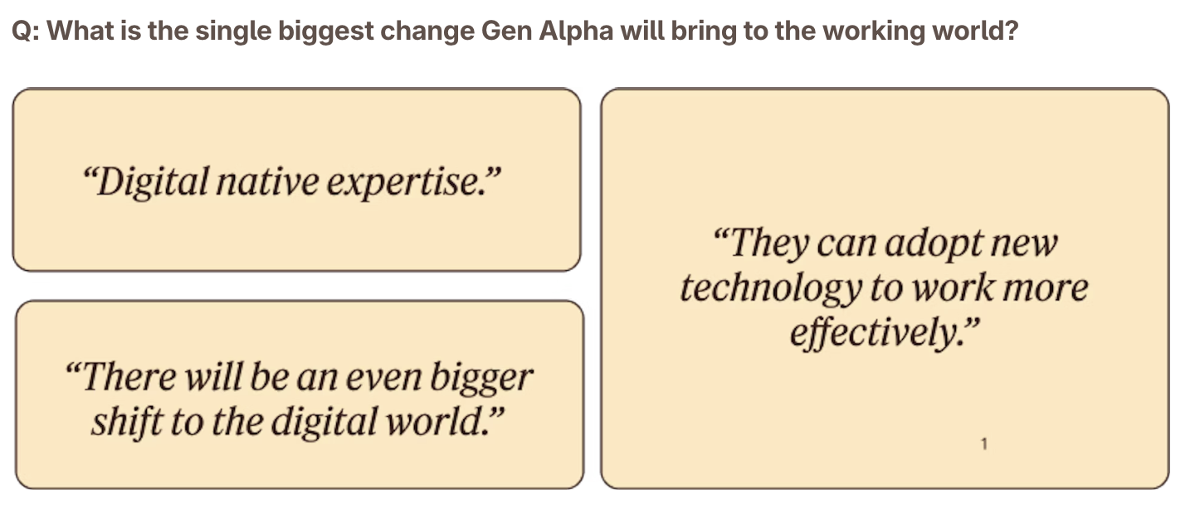
Gen Alpha
2013-
2025
981-1996
1997-2012
Gen Alpha (AGE: 0-12)
???
Notes:
https://unmind.com/blog/generation-alpha-and-the-next-wave-of-change-for-work

Slide 12
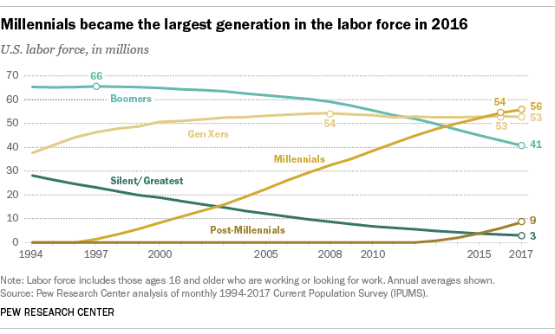
The Millennial Era
981-1996
1997-2012
Notes:
https://www.pewresearch.org/short-reads/2020/04/28/millennials-overtake-baby-boomers-as-americas-largest-generation/#:~:text=Generation%20X,-For%20a%20few&text=When%20Gen%20%20Xers%20were%20born,Xers%20and%2062.9%20million%20Boomers

Slide 13
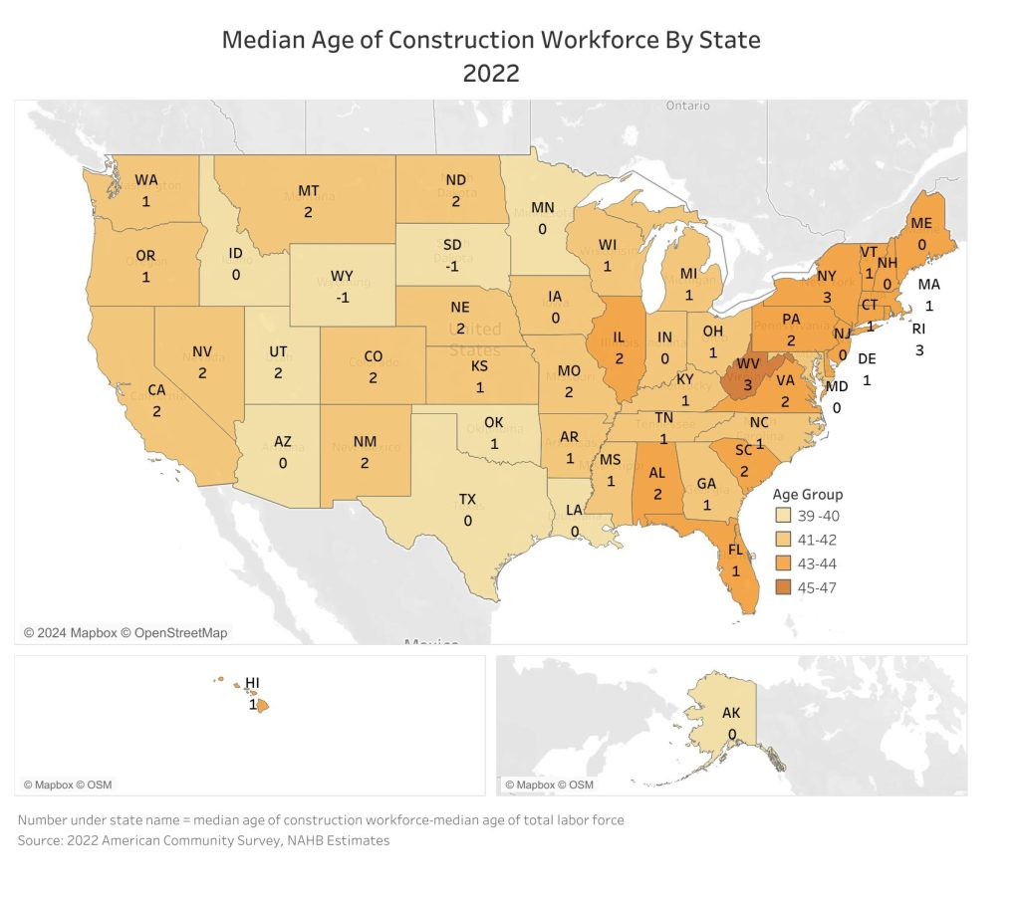
Industry Stats
The median age of construction workers is 42, one year older than a typical worker in the national labor force, according to NAHB analysis of the most recent 2022 American Community Survey (ACS) data.
However, more younger people are joining the construction industry.
Notes:
https://lbmjournal.com/more-gen-zers-entering-the-construction-industry/
Note on east coast higher age demographics compared to the west and Midwest

Slide 14
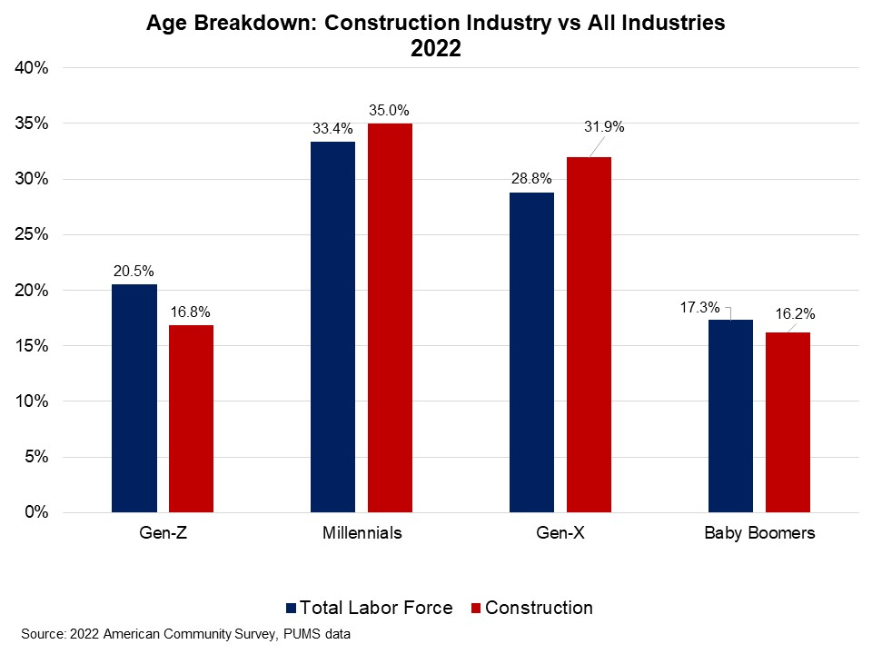
Industry Stats
Notes:
https://lbmjournal.com/more-gen-zers-entering-the-construction-industry/

Slide 15
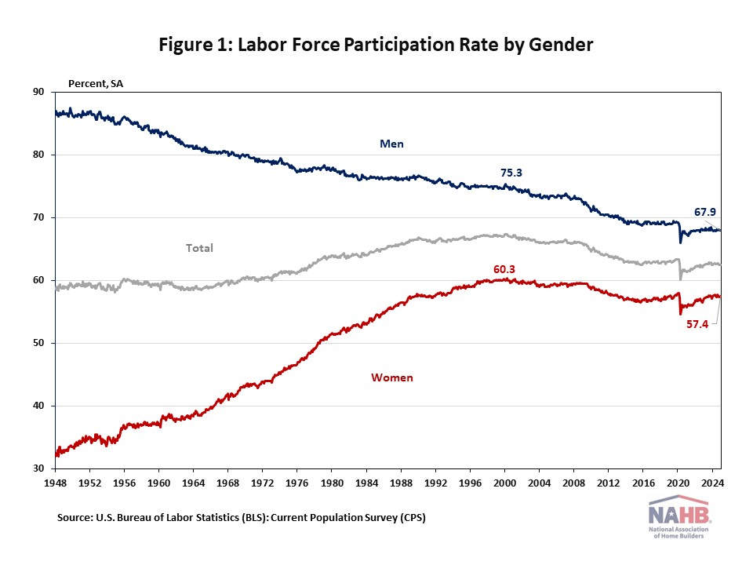
Gender demographics
Women currently make up roughly half of the U.S. labor force, representing about 47% of the labor force market. By industry, women accounted for more than half of all workers within several sectors in 2023, such as education and health services (74.4%), other services (53.3%), financial activities (51.1%), and leisure and hospitality (50.8%).
Comparably, women were substantially underrepresented (relative to their share of total employment) in manufacturing (29.5%), agriculture (29.3%), transportation and utilities (24.3%), mining (15.3%), and construction (10.8%).
Men tend to have a higher labor force participation rate than women historically, even though this gap has narrowed from 54.7 percentage points in January 1948 to a difference of 10.5 percentage points in December 2024.

Slide 17
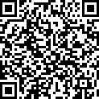
Building Performance
Next Generation of Workforce Development Survey
By leaving your name and email at the end of the survey, you will enter a drawing for one of two $25 virtual gift cards!

Slide 18
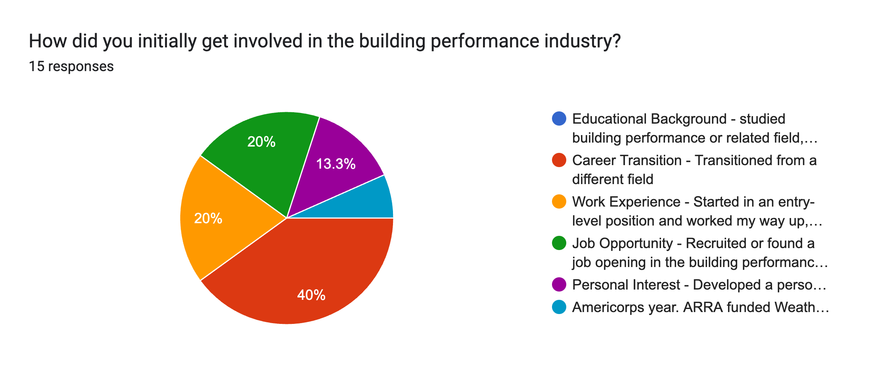

Slide 19
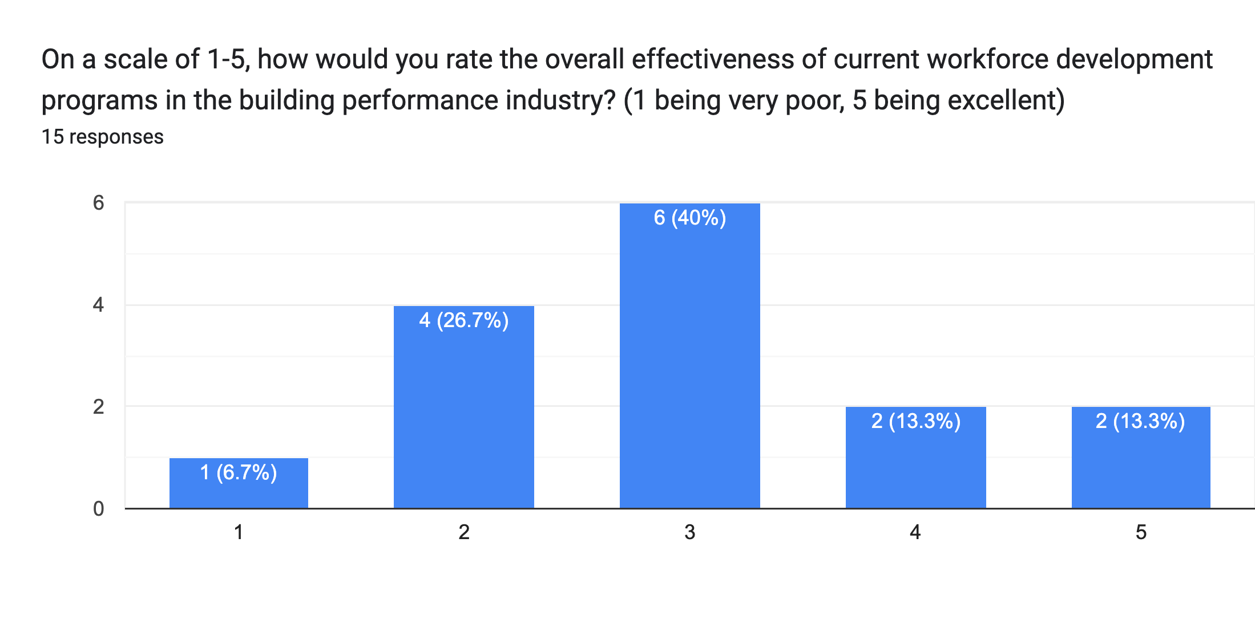

Slide 20
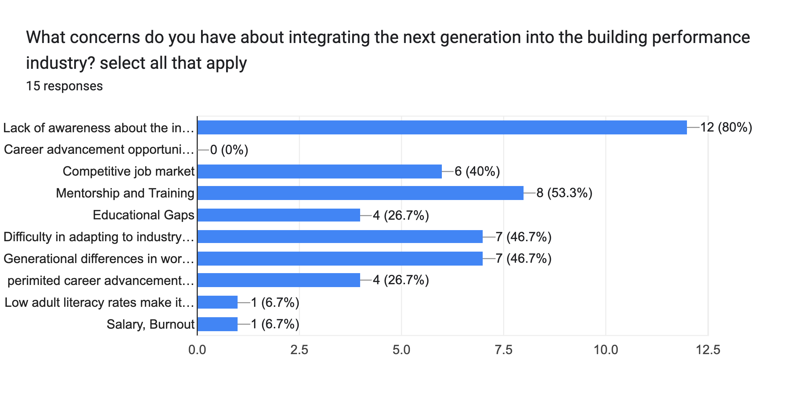

Slide 21
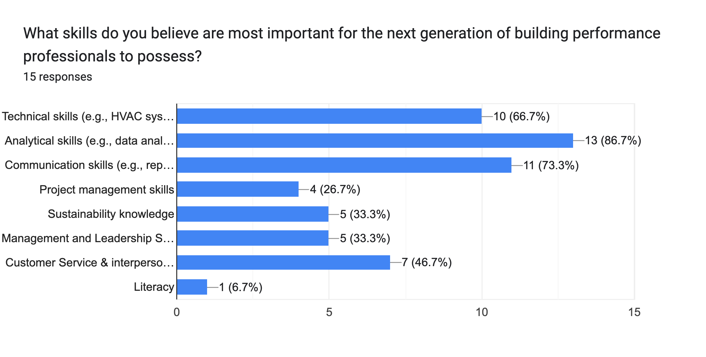

Slide 22
Recruit & Retain

Slide 23
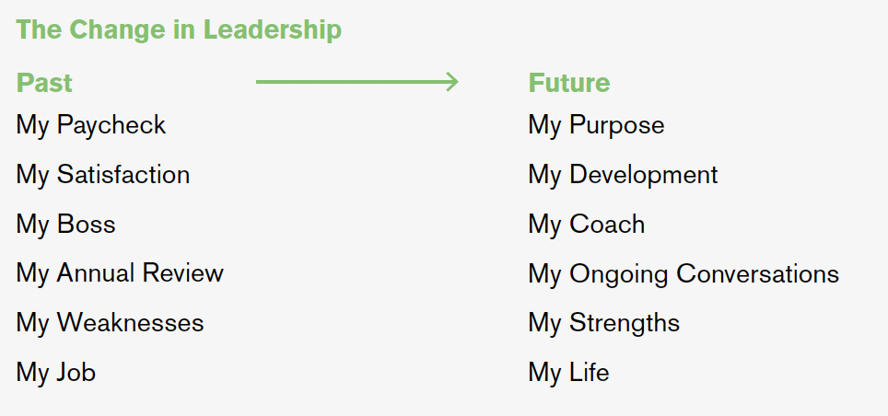
How Millennials Want to Work and Live
981-1996
1997-2012
Notes:
Gallup report on millennials

Slide 25
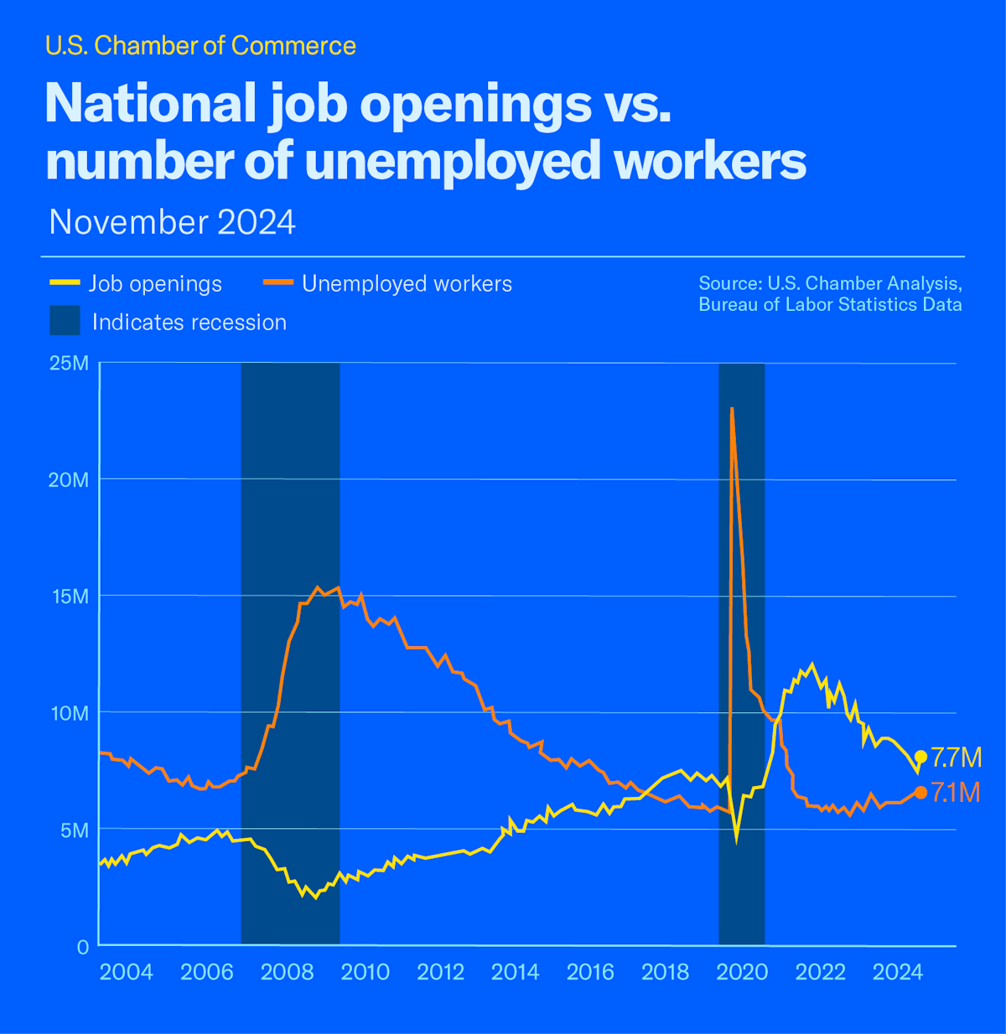

Slide 28
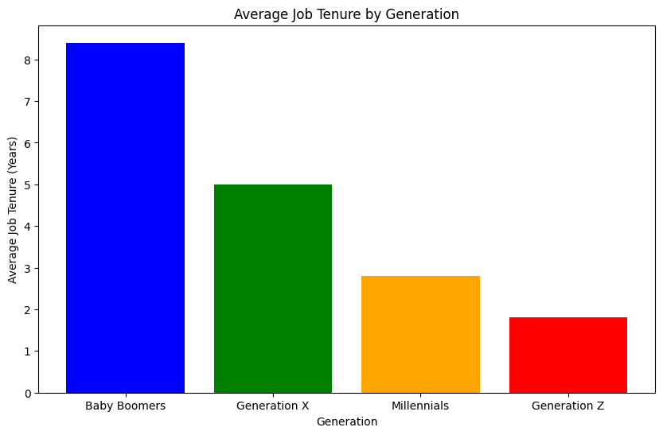
981-1996
1997-2012
Notes:
Job Tenure and Frequency of Job Changes by Generation
Generation X (Born 1965-1980):
Average Job Tenure: Gen Xers typically stay in a job for about 5 years
Job Changes: This generation is known for their independence and adaptability, often changing jobs to seek better opportunities and work-life balance
Baby Boomers (Born 1946-1964):
Average Job Tenure: Baby Boomers have the longest job tenure, averaging around 8.4 years
Job Changes: They tend to stay with employers longer, valuing job security and loyalty
Millennials (Born 1981-1996):
Average Job Tenure: Millennials tend to stay in a job for an average of 2.8 years1
Job Changes: On average, Millennials are expected to change jobs about 4 times by the age of 32
This generation values job satisfaction, work-life balance, and opportunities for growth, which often leads them to seek new opportunities more frequently1
Generation Z (Born 1997-2012):
Average Job Tenure: Gen Z workers are projected to stay in a job for an average of 1.8 years
Job Changes: This generation is expected to change jobs frequently, with many planning to switch jobs within two years of entering the labor market
. They prioritize job satisfaction, flexibility, and opportunities for growth

Slide 29
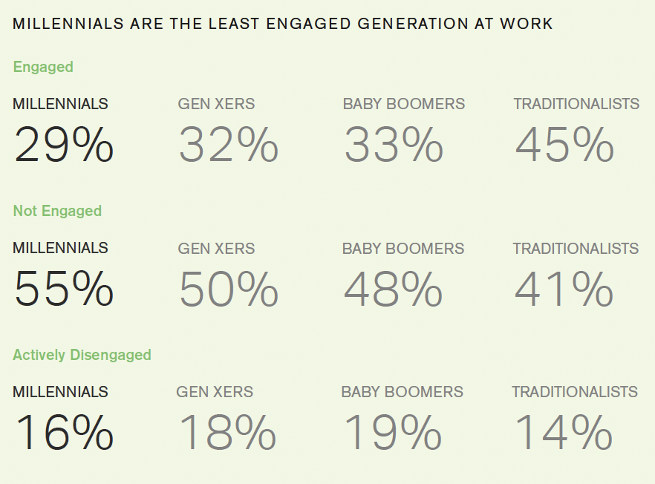
The Millennial Era
981-1996
1997-2012
Gallup estimates that millennial turnover due to
lack of engagement costs the U.S. economy
$30.5 BILLION ANNUALLY.
Notes:
https://www.pewresearch.org/short-reads/2020/04/28/millennials-overtake-baby-boomers-as-americas-largest-generation/#:~:text=Generation%20X,-For%20a%20few&text=When%20Gen%20%20Xers%20were%20born,Xers%20and%2062.9%20million%20Boomers

Slide 30
Creation of “Sticky” Jobs
Strong Company Culture
2 cultures for each company: the one you try to create and the one that truly exists
Emphasis on values
Technological Integration
Utilizing AI for the mundane parts of the job
Allow staff to test/recommend tools
Clear Communication and Transparency
Emphasis on the “WHY,” not just the “HOW”
Flexible Work Arrangements
Remote/hybrid flexibility
Weekly hour flexibility
Competitive Compensation and Benefits
Employee Satisfaction Surveys
Tuition reimbursement
Opportunities for Growth and Development
hint hint… conferences!
Purpose-Driven Work
Explain more beyond the bottom line
981-1996
1997-2012

Slide 31
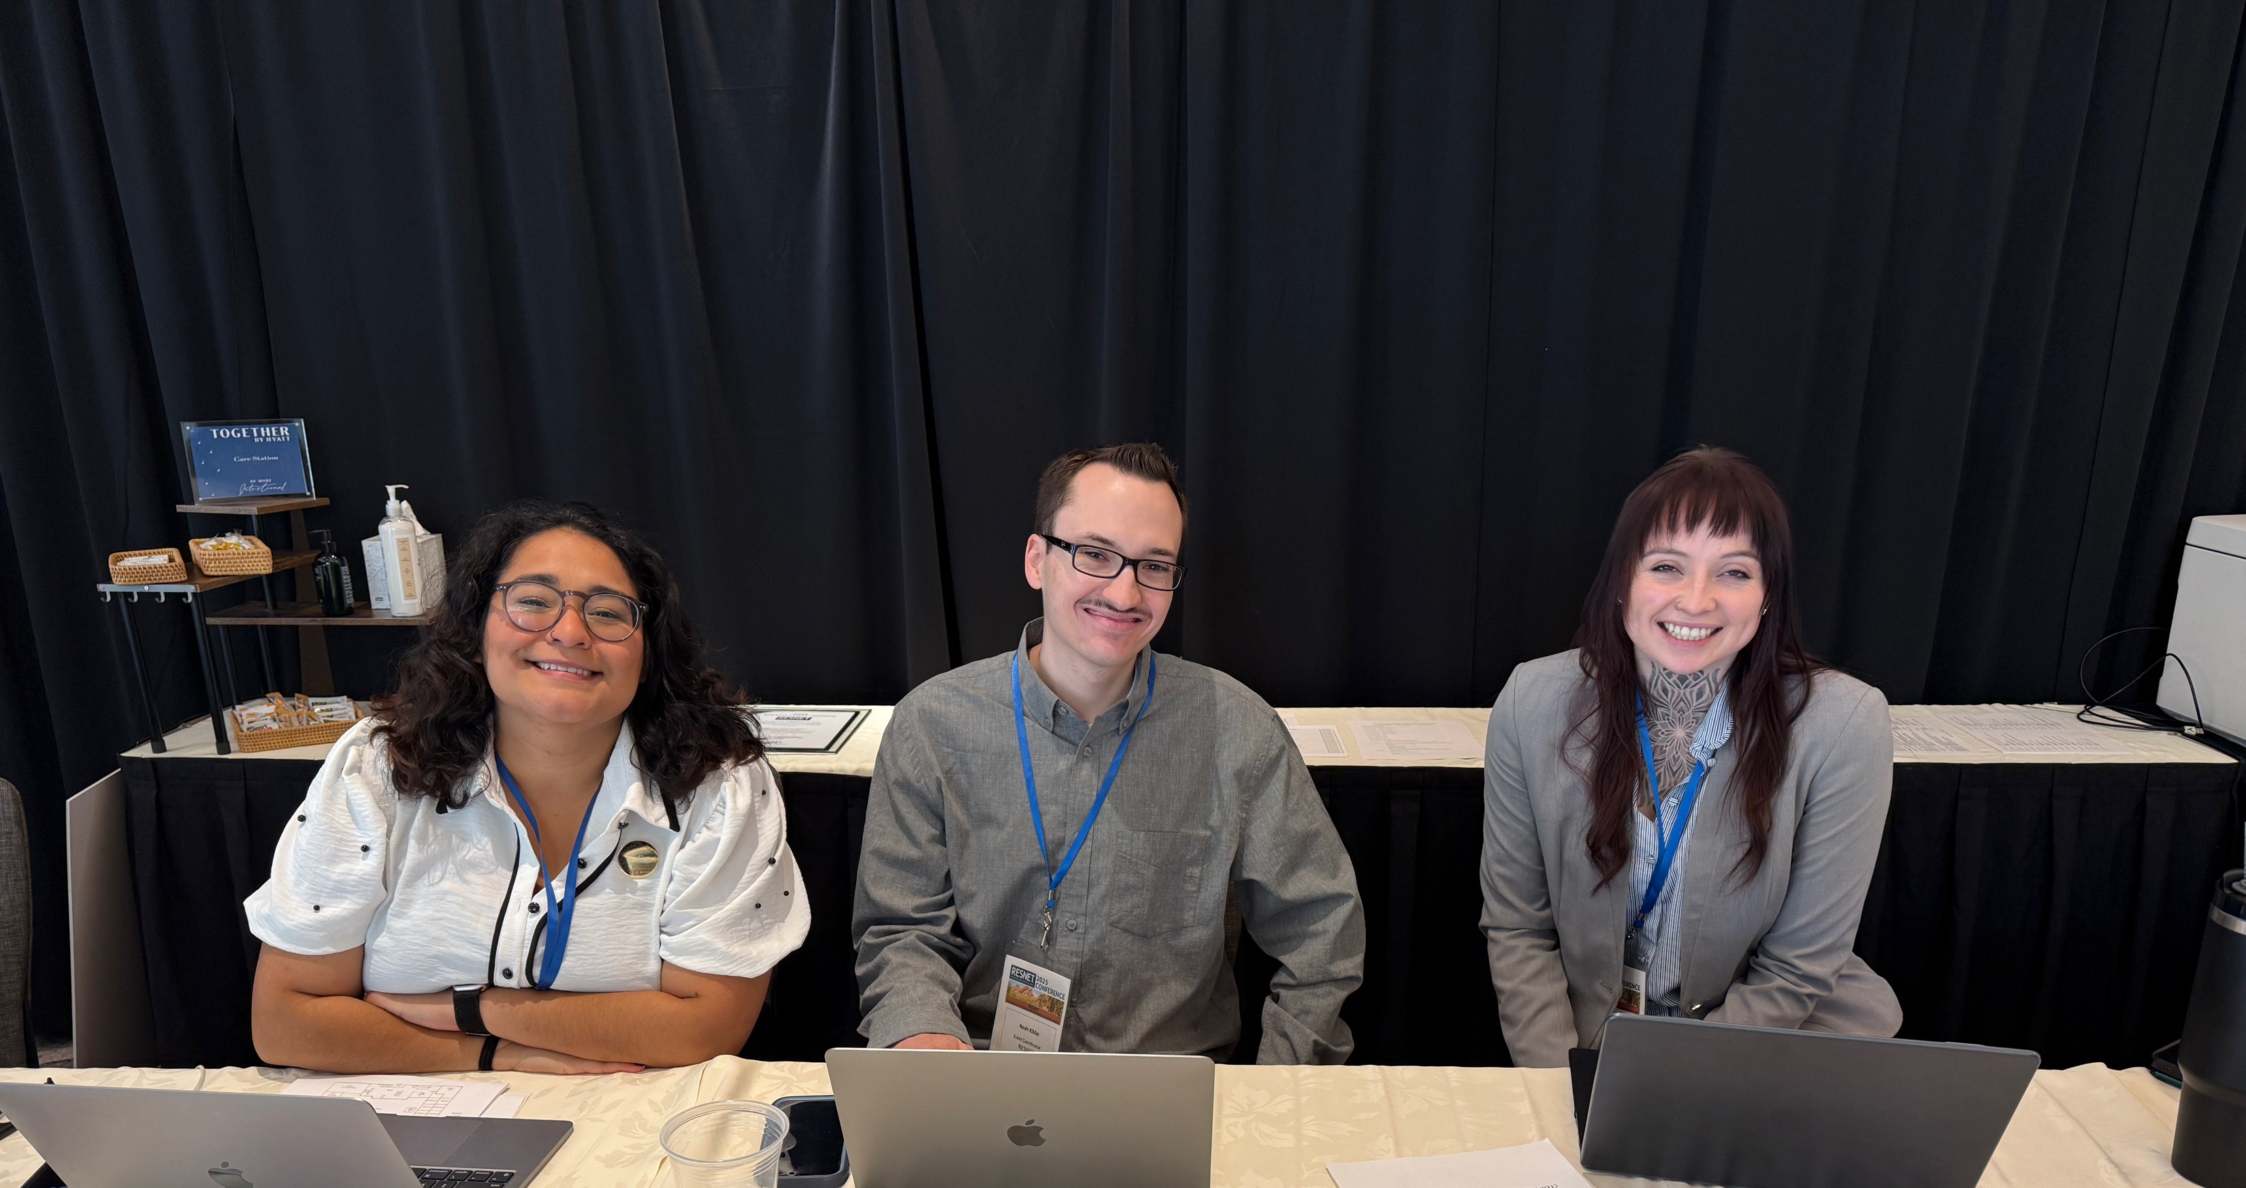
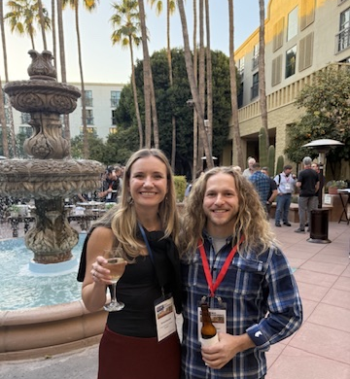
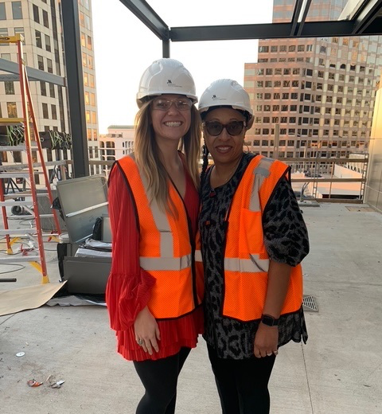
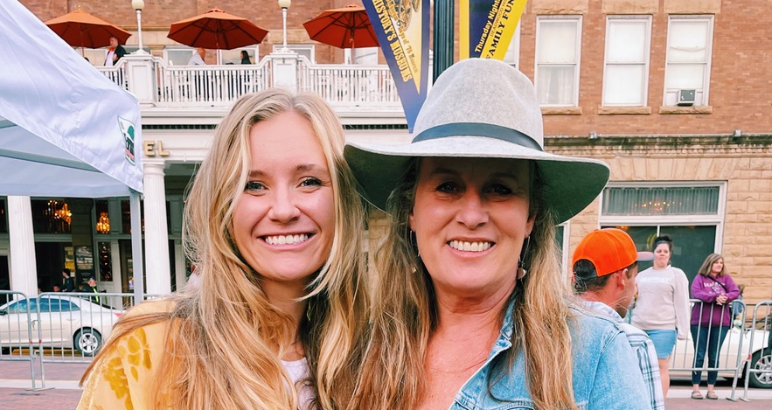
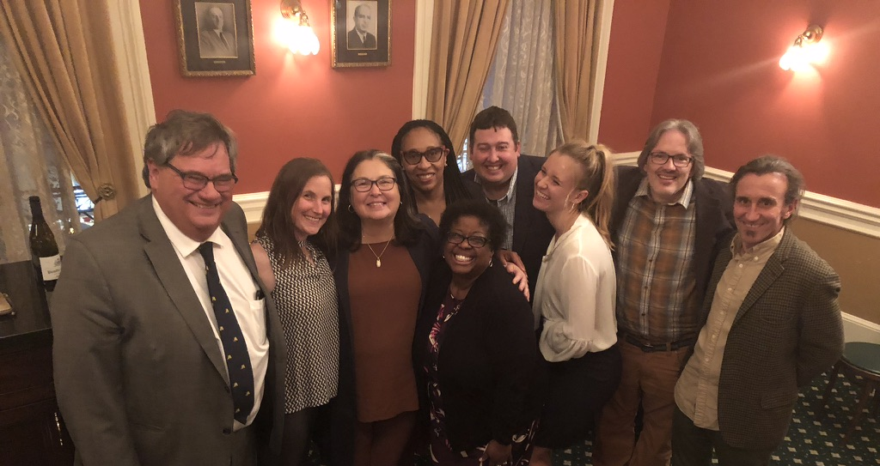
Mentorship & Reverse Mentorship

Slide 32
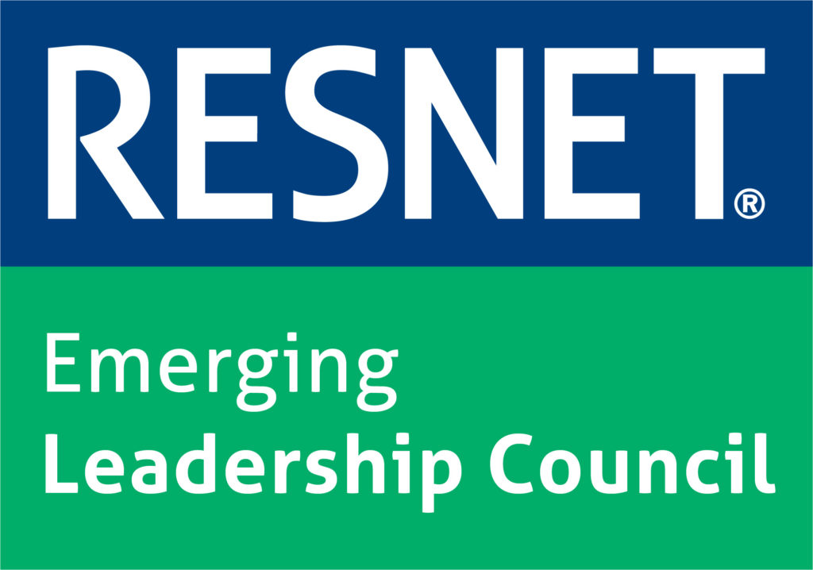
For Next Gen at RESNET…
Education and Certification Programs
Mentorship and Networking
Hands-On Experience
Continuous Learning and Development
Embracing Technology and Innovation
Promoting a Culture of Sustainability

Slide 33
emma@resnet.us
emma@nonprofitresources.us
Q&A

Slide 34
Building Performance
Next Generation of Workforce Development Survey
By leaving your name and email at the end of the survey, you will enter a drawing for one of two $25 virtual gift cards!

Slide 35
References
Eye on Housing. (2025, January). Demographic Analysis of Labor Force Participation Rate. Retrieved from https://eyeonhousing.org/2025/01/demographic-analysis-of-labor-force-participation-rate/
Unmind. (n.d.). Generation Alpha and the Next Wave of Change for Work. Retrieved from https://unmind.com/blog/generation-alpha-and-the-next-wave-of-change-for-work
Purdue Global. (n.d.). Generational Workforce Differences Infographic. Retrieved from https://www.purdueglobal.edu/education-partnerships/generational-workforce-differences-infographic/
Pew Research Center. (2020, April 28). Millennials Overtake Baby Boomers as America’s Largest Generation. Retrieved from https://www.pewresearch.org/short-reads/2020/04/28/millennials-overtake-baby-boomers-as-americas-largest-generation/#:~:text=Generation%20X,-For%20a%20few&text=When%20Gen%20%20Xers%20were%20born,Xers%20and%2062.9%20million%20Boomers
LBM Journal. (n.d.). More Gen Zers Entering the Construction Industry. Retrieved from https://lbmjournal.com/more-gen-zers-entering-the-construction-industry/
Youth Rights. (n.d.). Age Discrimination Under 40. Retrieved from https://www.youthrights.org/age-discrimination-under-40/
Corporate Wellness Magazine. (n.d.). Age Diversity in the Workplace: Benefits and Challenges. Retrieved from https://www.corporatewellnessmagazine.com/article/age-diversity-in-the-workplace-benefits-and-challenges
Building Performance Association. (n.d.). Mentorship Matters. Retrieved from https://building-performance.org/bpa-journal/mentorship-matters/
Harvard Business Review. (2019, December). Real Mentorship Starts with Company Culture, Not Formal Programs. Retrieved from https://hbr.org/2019/12/real-mentorship-starts-with-company-culture-not-formal-programs

