Slide 1
RESNET-Pearl Existing Homes Electrification Offering to Rental Portfolio Owners
Robin LeBaron
January 28, 2024

Slide 2
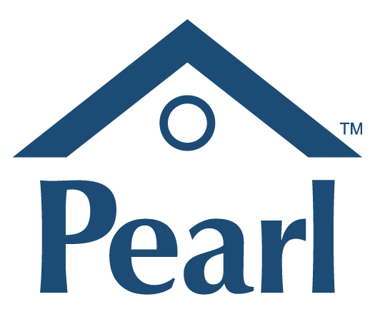

Slide 4
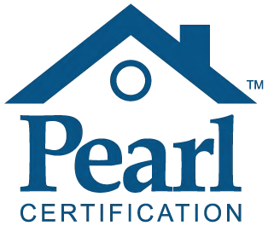
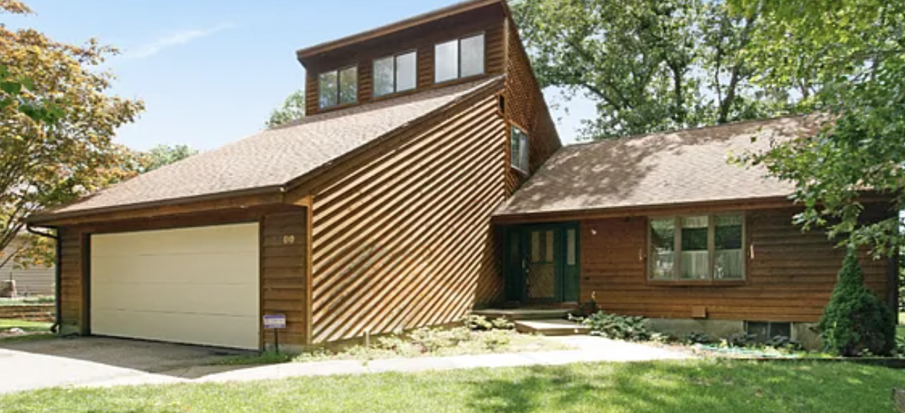
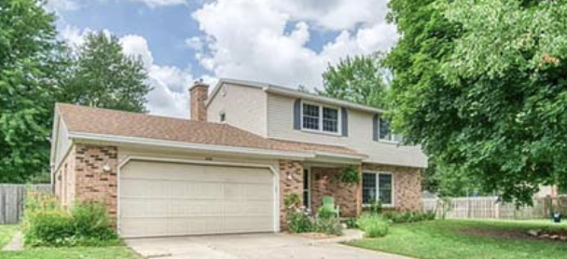
The Problem
Both in Rockford, MI
0.6 miles apart
4 bedrooms / 3 bathrooms
Built in 1988
0.38 acres
2,216 sq. ft.
4 bedrooms / 3 bathrooms
Built in 1966
0.39 acres
2,466 sq. ft.
Which one is high-performing?

Slide 5
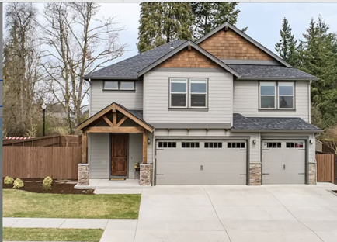
The Problem (different angle)
Built in 2015
HERS 48
NGBS Gold
Sold in 2019
“Heat pump, ENERGY STAR qualified equipment”
lost in translation

Slide 6
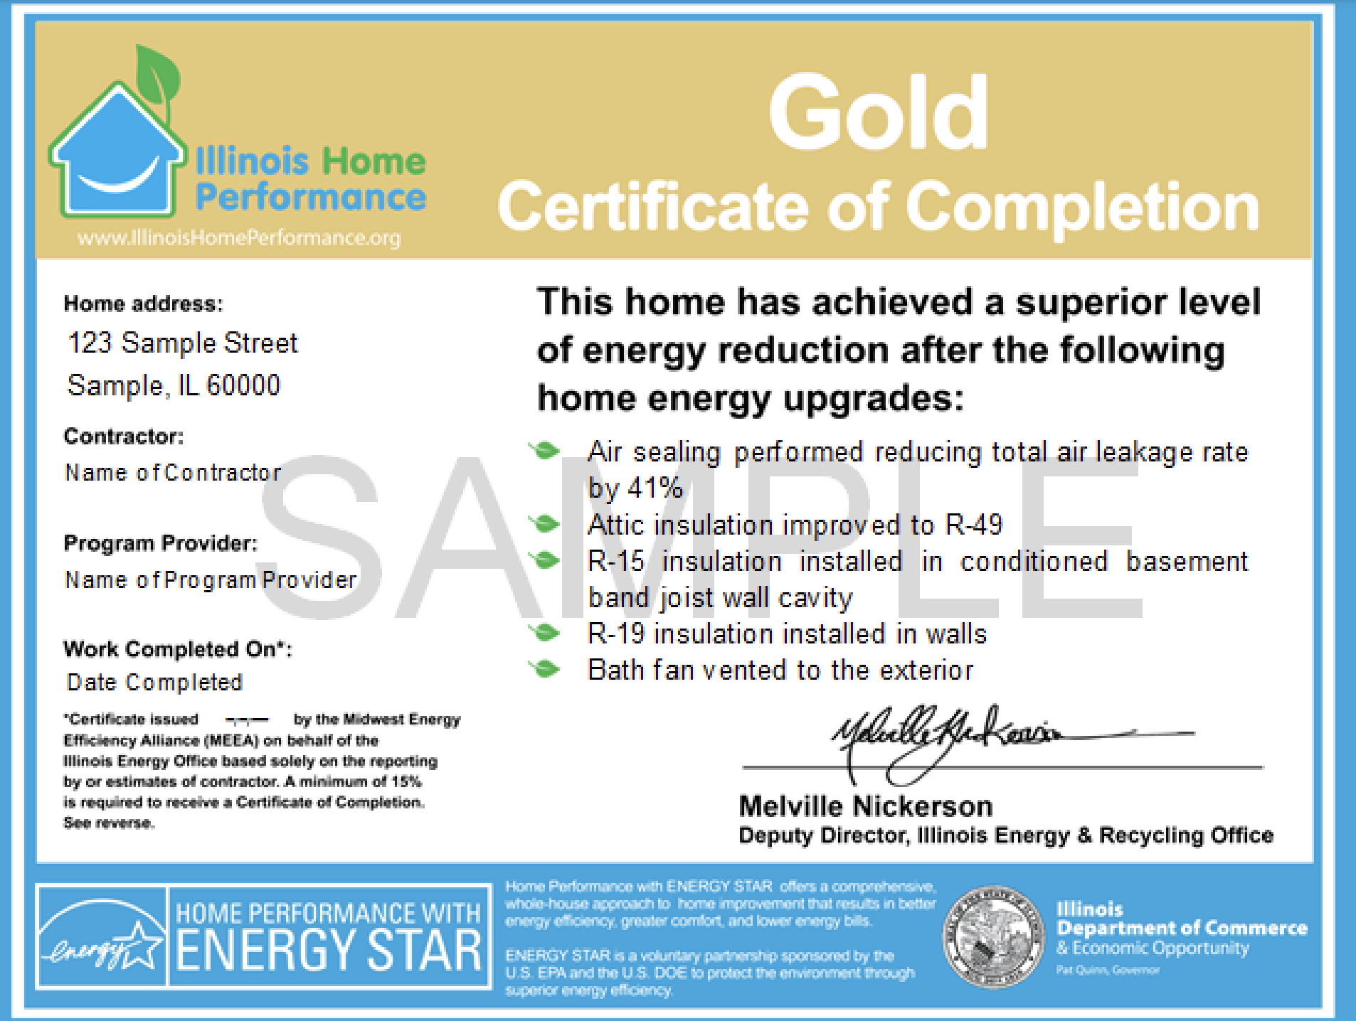
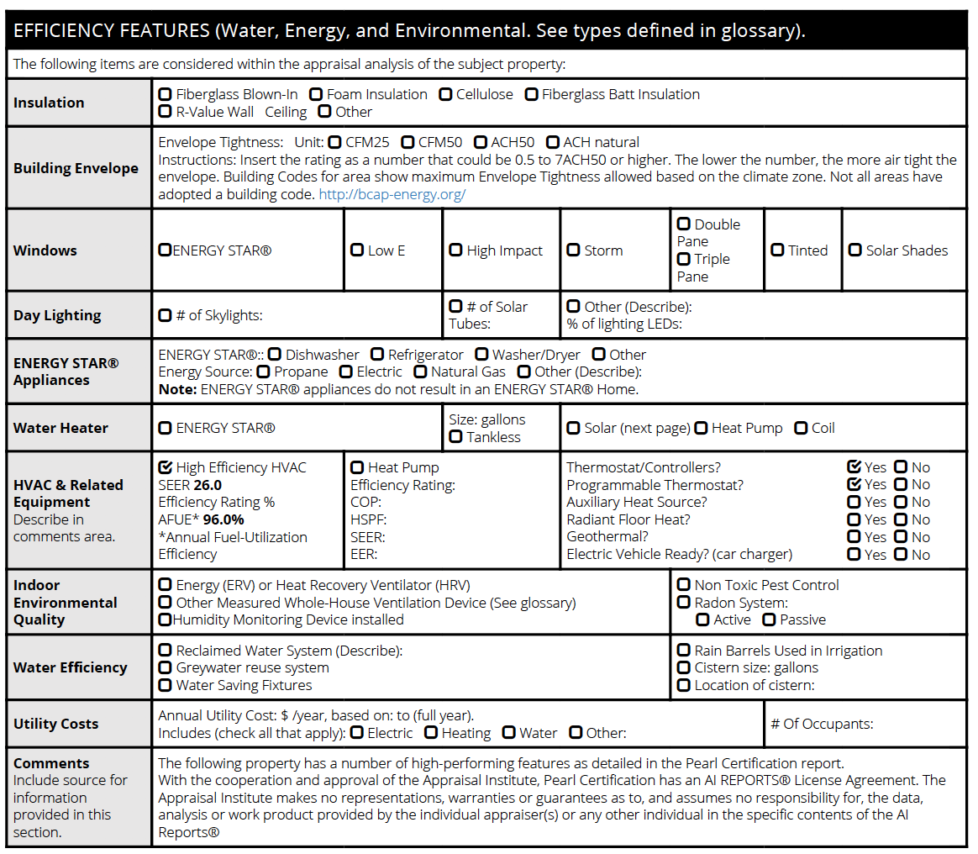
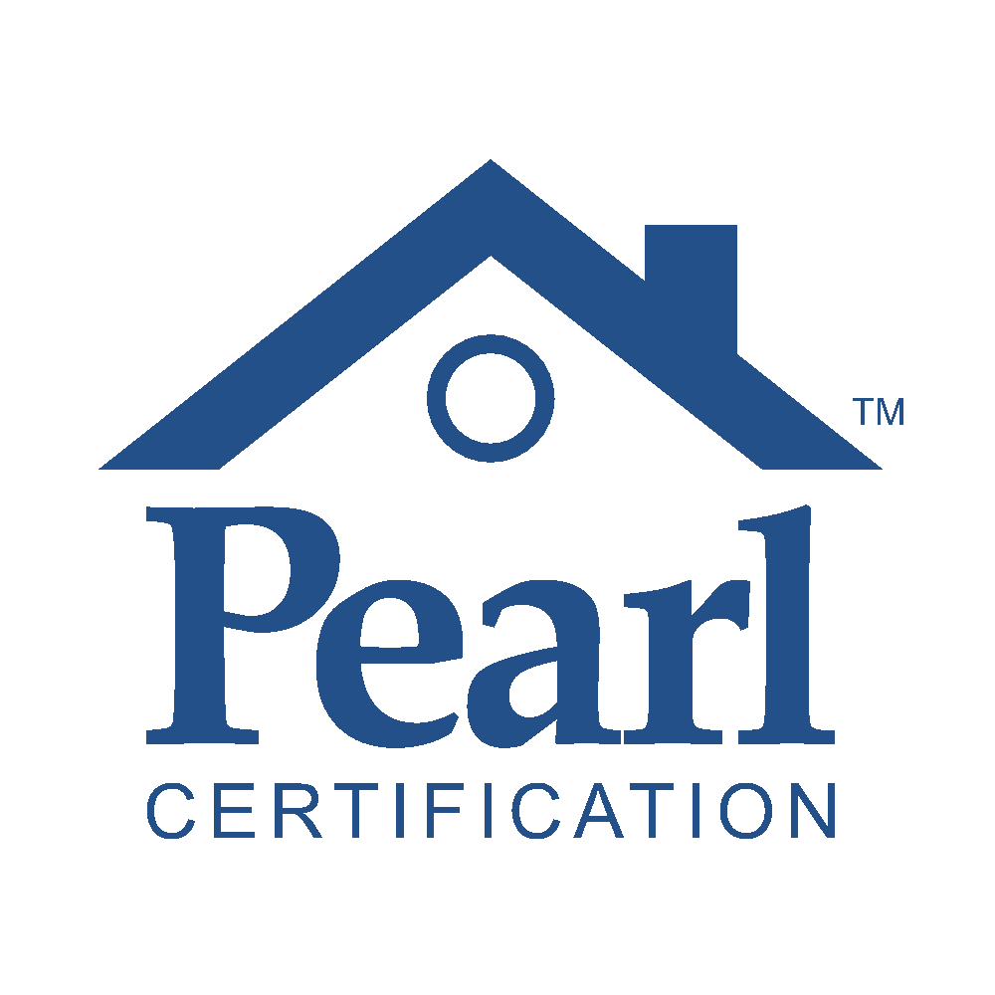
What energy efficiency has traditionally offered

Slide 7
Why should you buy a deck?
Entertaining
Increased home value
Barbecue
Space for kids to play
Space to grow plants
Storage space underneath
Enjoy the outdoors

Slide 8
What homeowners care about
Features
Finished basement
Patio / deck
Open floor plan
Attic Insulation
Stainless steel appliances
Air sealing
Heat pump
Benefits
Finished basement
Heat pump
Attic Insulation
Patio / deck
Air sealing
Open floor plan
Stainless steel appliances

Slide 9
What Realtors think homeowners care about
Features
Open floor plan
Finished basement
Patio / deck
Stainless steel appliances
Attic Insulation
Air sealing
Heat pump
Benefits
Open floor plan
Finished basement
Patio / deck
Stainless steel appliances
Attic Insulation
Air sealing
Heat pump

Slide 10
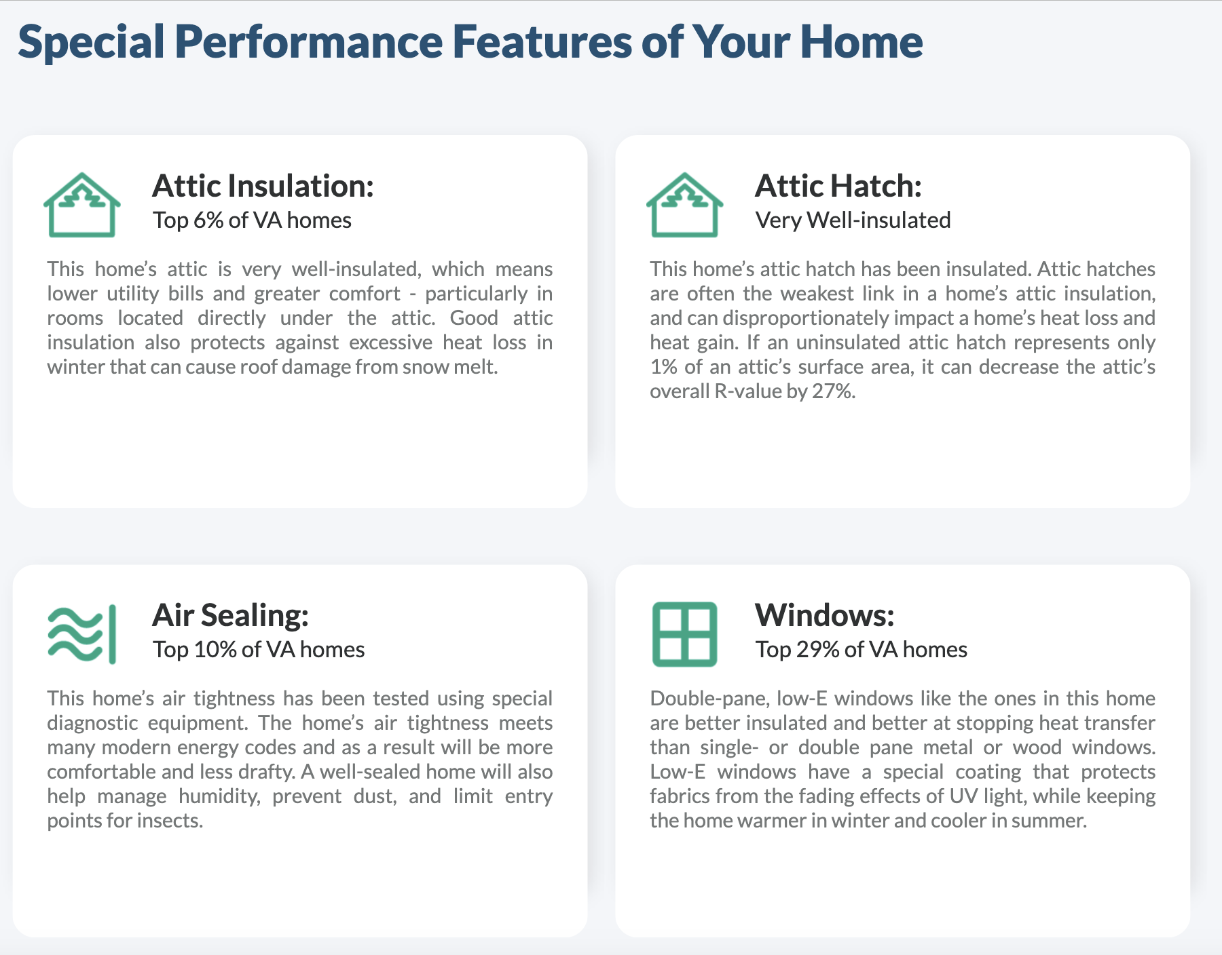
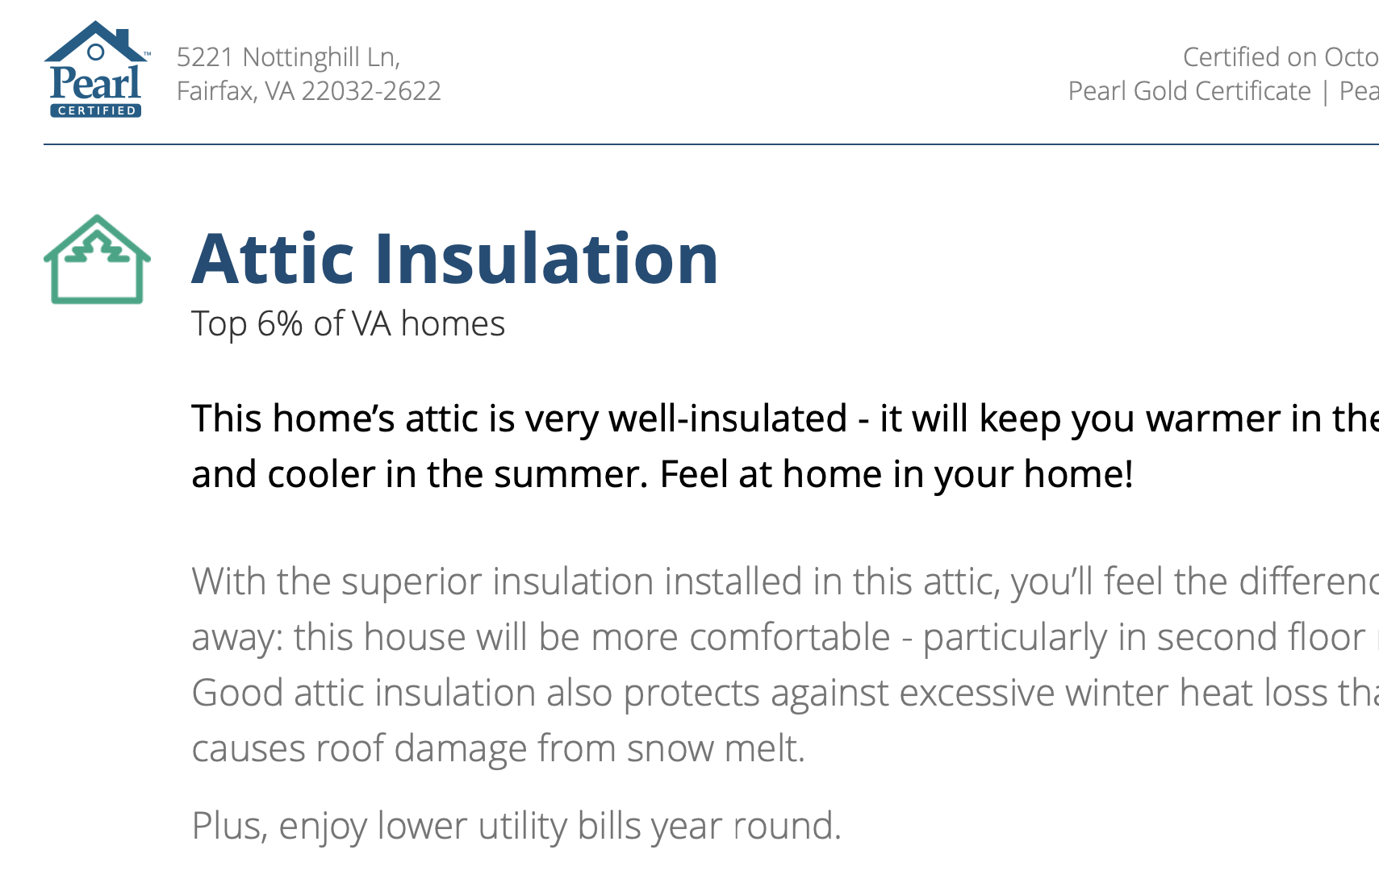
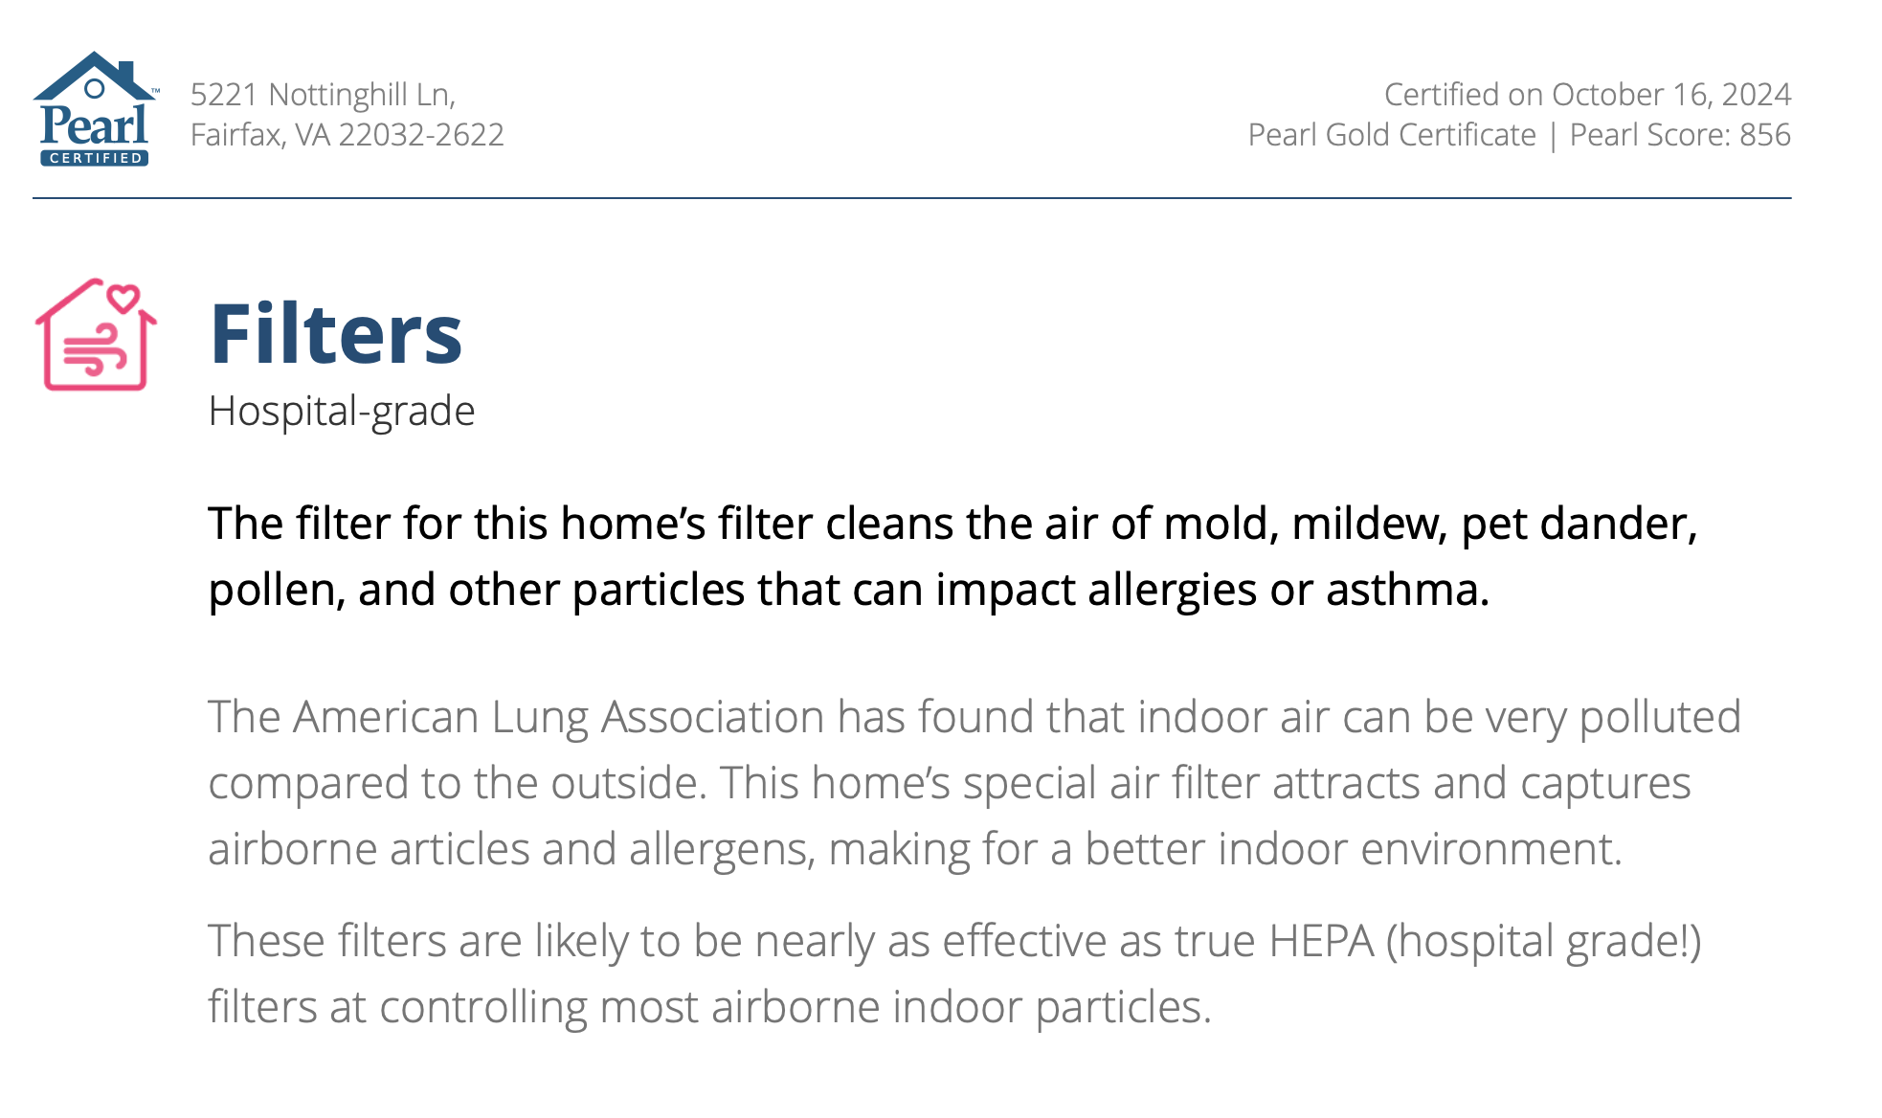
What the market needs
Energy data
Features and benefits
Marketing materials

Slide 11
Making Value Visible
96 AFUE gas furnace
R-49 attic insulation
4.8 ACH50
Ductwork within conditioned space
Double-pane low-e windows
Pearl Gold
Has Heating (Unspecified Type)

Slide 12
Making Value Visible
$270,000
$298,000
Marketed as Pearl Gold
Pearl Certification included in MLS listing
Home tour placards
Home tour flyer
Social media posts

Slide 13
From “ecobrokers” to NAR “Strategic Opportunity”
Dozens of “green” agents vs 700 MLS’s

Slide 14
Current RESNET-Pearl Collaboration
Notes:
· Slide 3 – Pearl was founded…
o Pearl was founded to transform the market for high-performing homes
o We are a 3rd party certification services provider that certifies new and existing single family and multifamily homes
o Our co-founders and many of our staff lived through the ARRA days and saw that once the money dried up, so too did homeowner and contractor interest in energy efficiency
§ Pearl is unique in that we are able to tie the efficiency features of a home directly to home value in the form of equity

Slide 15
Current RESNET-Pearl Collaboration
HERS Index Score & Pearl Report:
HERS Index Score appears on Pearl’s Home Performance Dashboard
RESNET/Pearl auto-populate MLS’s and real estate apps:
Makes the RESNET Rating and Pearl Certification Transparent in Housing Market

Slide 16
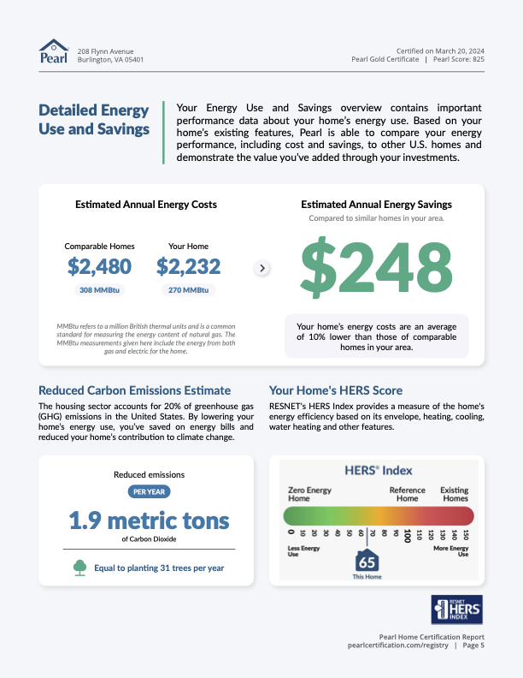
The Pearl Report
CONFIDENTIAL ©2021
Notes:
Co-branded certification reports highlight high efficiency features in the home, explain those features in terms of benefits, and also provide an engagement guide for homeowners, contractors, real estate agents and appraisers
Certifications come from several streams: contractors, builders, agents, manufacturers but mainly contractors today
80% of our certifications come from data integrations
Also have the ability to certify solar installations

Slide 17
Current RESNET-Pearl Collaboration
HERS Index Score & Pearl Report:
HERS Index Score appears on Pearl’s Home Performance Dashboard
RESNET/Pearl auto-populate MLS’s and real estate apps:
Makes the RESNET Rating and Pearl Certification visible at time of sale

Slide 18
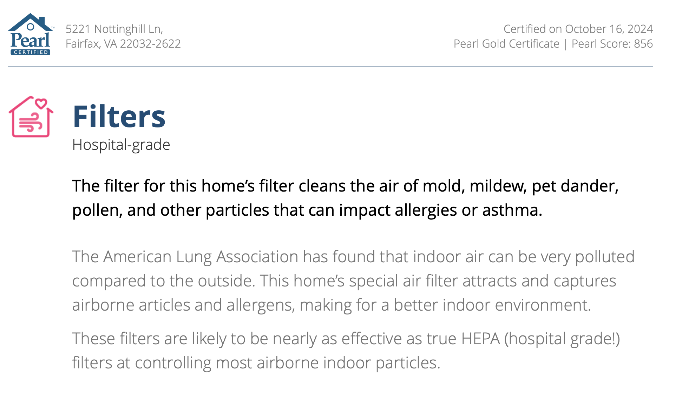
Pearl Report:
Features and Benefits
Pearl Marketing Package
CONFIDENTIAL ©2021
Notes:
Co-branded certification reports highlight high efficiency features in the home, explain those features in terms of benefits, and also provide an engagement guide for homeowners, contractors, real estate agents and appraisers
Certifications come from several streams: contractors, builders, agents, manufacturers but mainly contractors today
80% of our certifications come from data integrations
Also have the ability to certify solar installations

Slide 19
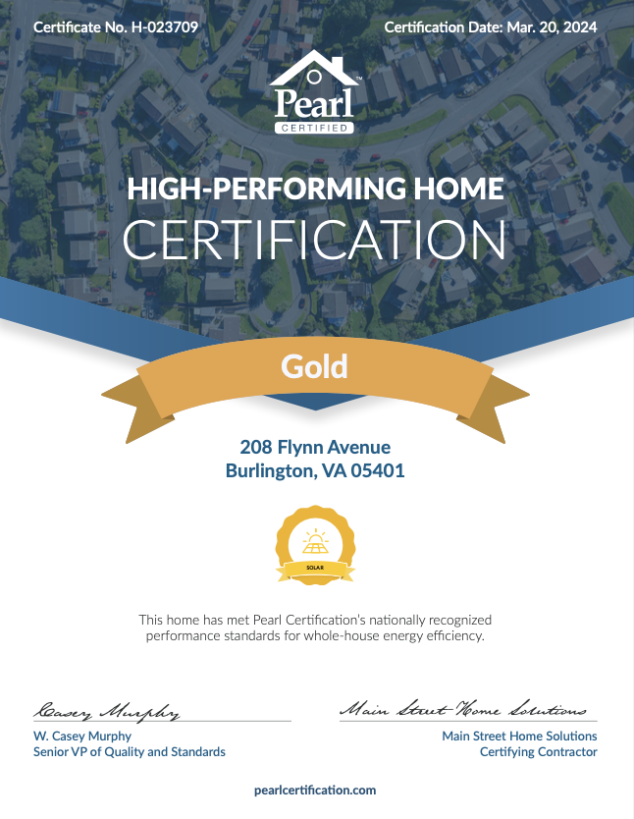
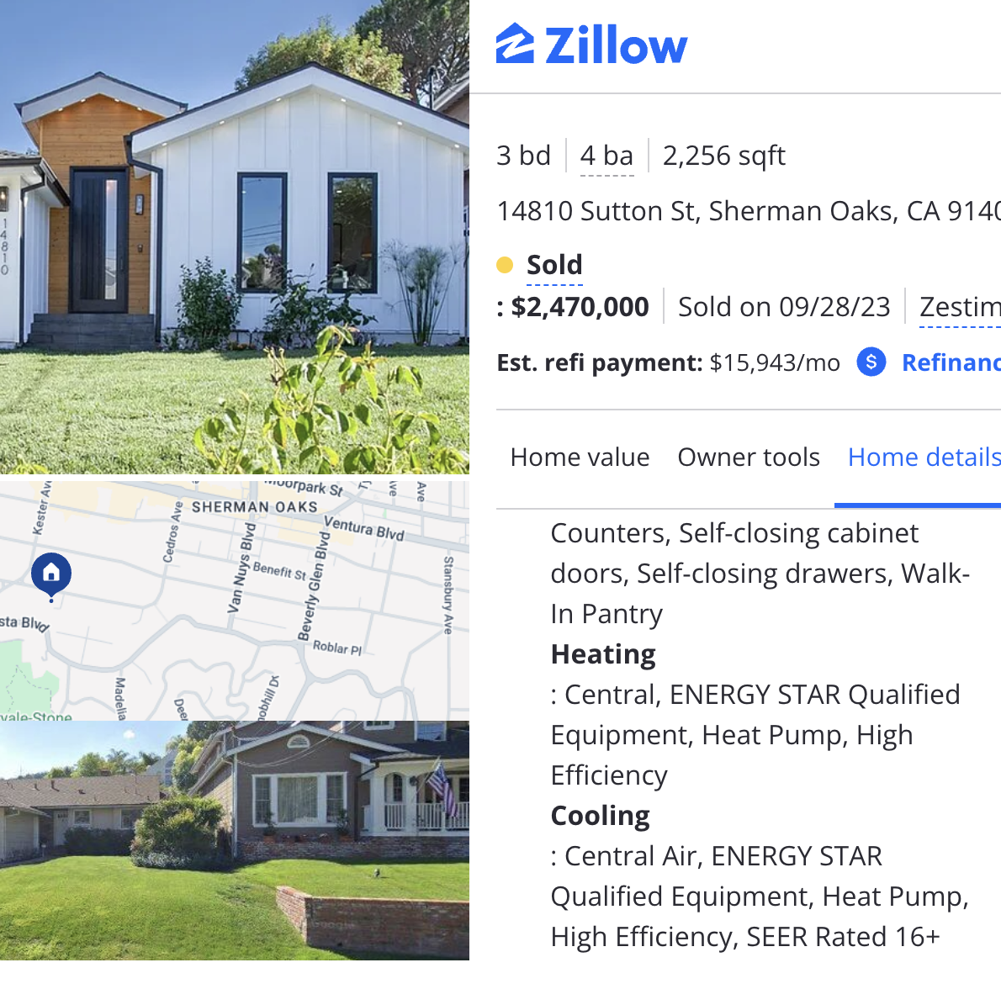
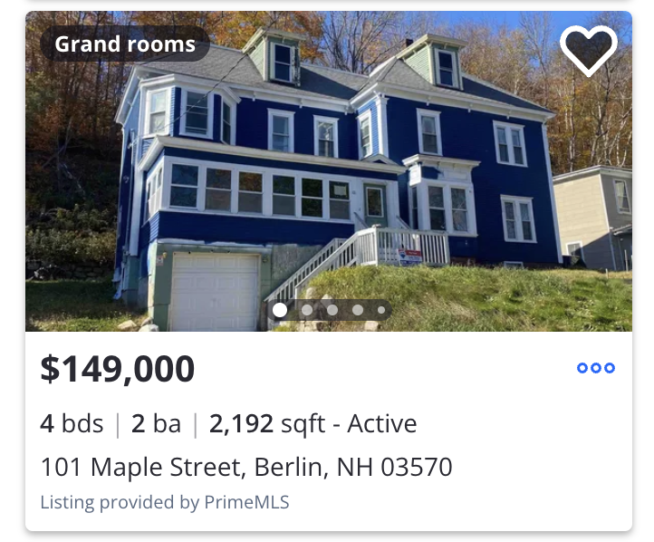
Making the HERS rating visible
This is a high performing home
Agent signs listing agreement
Agent inputs listing data into MLS and receives notification
Listing populated with Pearl and RESNET data automatically
Agent can order a Pearl Report with HERS Rating, and incorporate it into listing marketing

Slide 20
Real estate sector engagement
Negotiating data integrations with ten large MLS’s covering 25% of U.S. listings
Other real estate technology partnerships signed / in development
Developed on-demand materials for agents: offered via association and brokerage relationships, as well as through agent portal (The Spark)
Approved and delivered Continuing Education classes for state Realtor associations
Partnership with NAR to offer course tailored for IRA programs
Achieved RESO Common Format certification from the industry’s data standards organization

Slide 21
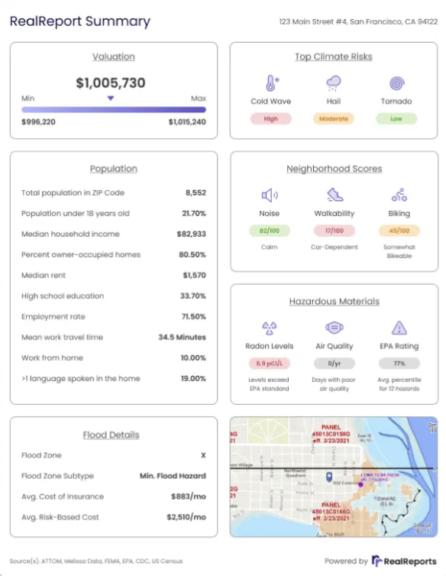
Real Reports
Shows presence of HERS rating / Pearl certification
Prompt agent to order certification report
Partnerships:
San Francisco MLS
Park City Board of Realtors (UT)
Prime MLS (NH)
Bridge MLS (Bay Area)
Southwest MLS (NM)
Hive MLS (NC Coastline)
The Keyes Company (SW Florida brokerage)
Baird & Warner (IL Brokerage)

Slide 22
New Rental Owner-Investor Initiative
Notes:
· Slide 3 – Pearl was founded…
o Pearl was founded to transform the market for high-performing homes
o We are a 3rd party certification services provider that certifies new and existing single family and multifamily homes
o Our co-founders and many of our staff lived through the ARRA days and saw that once the money dried up, so too did homeowner and contractor interest in energy efficiency
§ Pearl is unique in that we are able to tie the efficiency features of a home directly to home value in the form of equity

Slide 23
Rental Investor-Owner Opportunity Slide
2% of SF rental stock nationwide owned by professional investors (1k units or more)
Concentration of ownership of investor-owned SF homes:
32 investors own 450k SF homes
5 investors own 300k
Concentration in some markets
25% in Atlanta
21% in Jacksonville
18% in Charlotte
Institutional buyers focused on less expensive end of the market

Slide 24
RESNET-Pearl Offering for Rental Investor-Owners
For owners of rental portfolios who want to make improvements for both financial and ESG reasons
RESNET-Pearl services provided
Electrification workscopes
Rater verification of improvements
Pearl Report with:
RESNET HERS Index
Carbon Index and/or
HERS20
ENERGY STAR Home Upgrade (if desired)

Slide 25
Benefits for investor-owners
Benefits:
Position company to take advantage of utility/local government electrification rebates
Lower operating costs / improved cash flow
Marketing tools to enhance rental process
Higher sales price
Increased equity supports refinance
Access to better financial products
Metric for investor/stockholder sustainability reporting
Association with ENERGY STAR brand

Slide 26
Workscope
Upgrade packages tailored to:
Owner’s priorities, e.g. cost savings and/or electrification and/or zero emissions
Owner’s budget
Customer type
Housing type
Climate zone
RESNET / Pearl can ensure that scopes include prioritized items, e.g. duct sealing

Slide 27
Post-installation rating and certification
Document improvements to position properties for rental, financing, and sale
HERS Index: shows home’s energy efficiency and energy savings
HERS H20 Rating: shows home’s water efficiency and water savings
HERS Carbon Savings
Pearl Report:
Showcases features and benefits for owner, buyer, and/or renters
Includes filled out Appraisal Institute Green & Energy Efficient Addendum
Estimates home’s increased equity value
Includes marketing materials for agents to use at time of sale
(Potentially) ENERGY STAR Home Upgrade

Slide 28
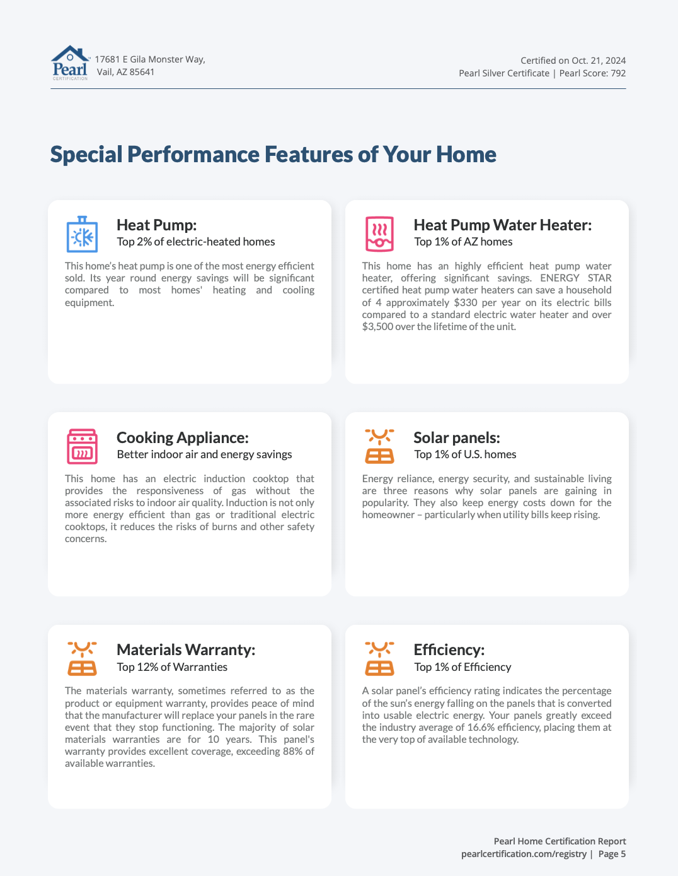
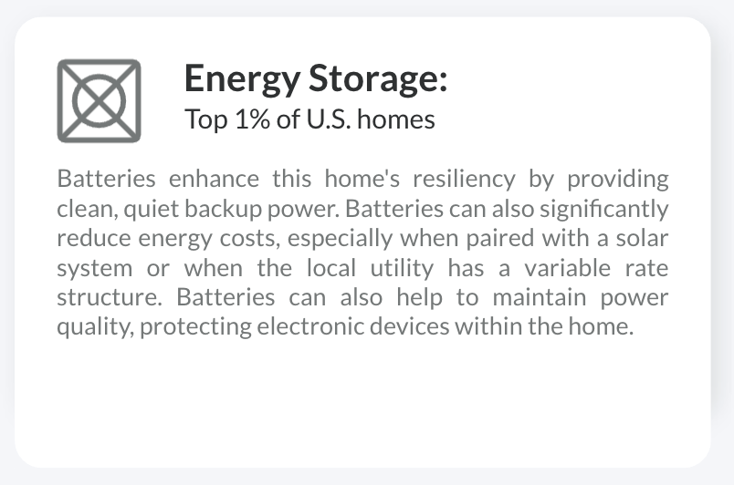
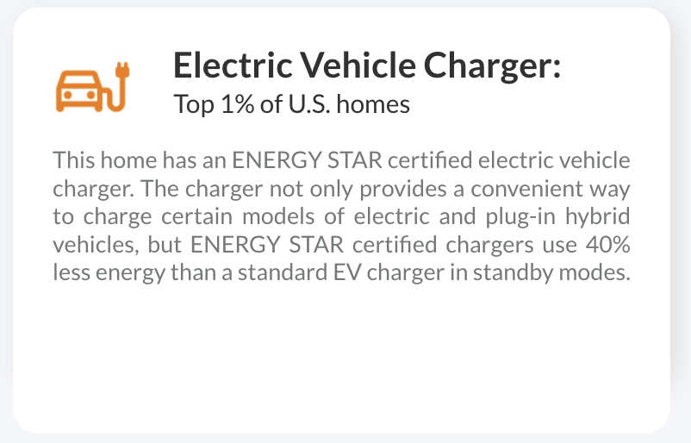
The Pearl Report: Features to Benefits
CONFIDENTIAL ©2021
Notes:
Co-branded certification reports highlight high efficiency features in the home, explain those features in terms of benefits, and also provide an engagement guide for homeowners, contractors, real estate agents and appraisers
Certifications come from several streams: contractors, builders, agents, manufacturers but mainly contractors today
80% of our certifications come from data integrations
Also have the ability to certify solar installations

Slide 29
The Pearl Report: Energy Dashboard
CONFIDENTIAL ©2021
Notes:
Co-branded certification reports highlight high efficiency features in the home, explain those features in terms of benefits, and also provide an engagement guide for homeowners, contractors, real estate agents and appraisers
Certifications come from several streams: contractors, builders, agents, manufacturers but mainly contractors today
80% of our certifications come from data integrations
Also have the ability to certify solar installations

Slide 30
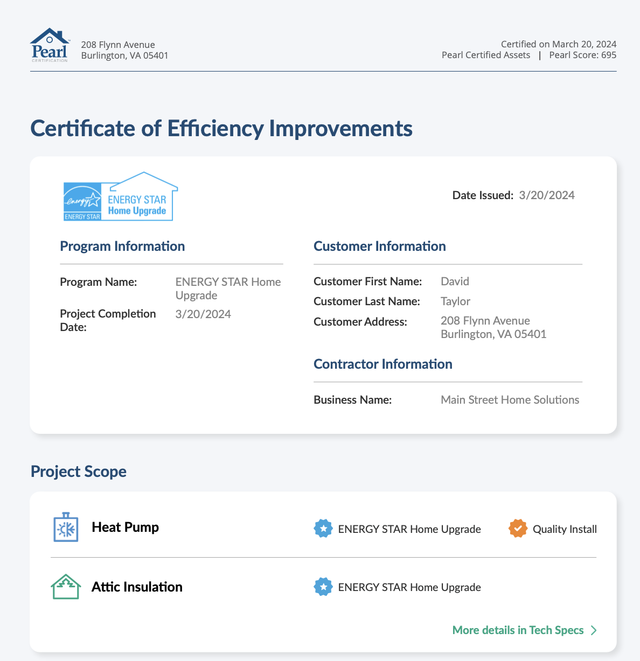
ENERGY STAR Home Upgrade
CONFIDENTIAL ©2021
Notes:
Co-branded certification reports highlight high efficiency features in the home, explain those features in terms of benefits, and also provide an engagement guide for homeowners, contractors, real estate agents and appraisers
Certifications come from several streams: contractors, builders, agents, manufacturers but mainly contractors today
80% of our certifications come from data integrations
Also have the ability to certify solar installations

Slide 31
Robin LeBaron
President & Co-Founder
646.416.2650
robin@pearlcertification.com
Notes:
We hope you’ll join us. Thank you.

