Slide 1

Energy Rating Index Performance Path
Speaker Name
Speaker Affiliation
Notes:
This presentation will cover the Energy Rating Index Performance Path found in the 2015 IECC

Slide 2
Goals of the Concept
Increase compliance for residential energy codes
Increase building energy savings through increased compliance
Complement existing performance-based residential efficiency programs
Create cost-effective retrofit and new build strategies to exceed minimum code requirements
Notes:
The goals of the ERI are to:
Increase compliance for residential energy codes
Increase building energy savings through increased compliance
Complement existing performance-based residential efficiency programs
Create cost-effective retrofit and new build strategies to exceed minimum code requirements

Slide 3
Overview of the ERI Performance Path
Notes:
What is the ERI Performance Path?

Slide 4
ERI Performance Path
Additional option for IECC compliance
Target ERI score is met through a wide range of performance options
Requires builders to achieve the mandatory code requirements of the 2015 IECC and comply with minimum insulation and window envelope performance requirements of the 2009 IECC
Mandatory Requirements
2015 IECC provisions including:
  Section R402.4 Air Leakage
  Section R403 Systems
  Section R403.5 Service Hot Water Systems
  Section R404 Electrical Power and Lighting Systems
Building Envelope requirements of the 2009 IECC
Notes:
The Energy Rating Index (ERI) performance path gives builders yet another option for complying with the International Energy Conservation Code (IECC). In addition to the prescriptive and performance paths of previous versions of the IECC, builders now have the option of meeting a target ERI score through a wide range of performance options to demonstrate compliance. The ERI performance path also requires builders to achieve the mandatory code requirements of the IECC, including water heating piping provisions, and comply with the minimum insulation and window envelope performance requirements of the 2009 IECC.

Slide 5
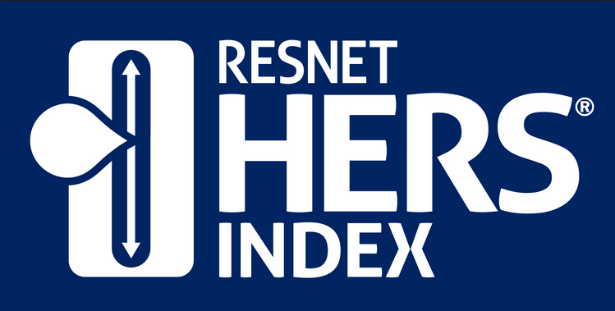
States and jurisdictions can specify which qualifying ERI method they will use
RESNET HERS Index is the existing compliance ERI method
Is nationally recognized
Based on ANSI RESNET Standard 301-2014
To date, over 1.5 million homes have been rated in the US under the RESNET standards
Notes:
The ERI performance path allows states and jurisdictions to specify which qualifying ERI method it will use.
RESNET’s Home Energy Rating System (HERS) index, based on ANSI RESNET Standard 301-2014, is the existing compliant ERI method and is nationally recognized for inspecting and calculating a home's energy performance. To date, over 1.5 million homes have been rated in the U.S. under the RESNET standards and in 2013, half of all new homes were rated and issued a HERS Index Score.

Slide 6
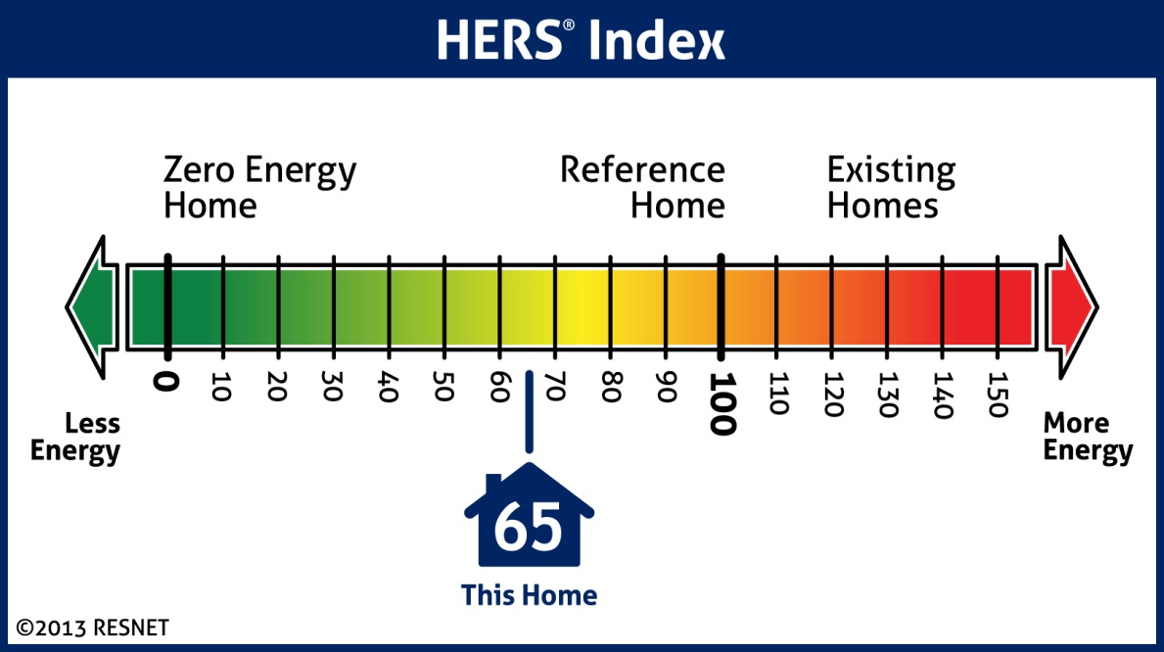
What is a HERS Index and Score?
A Zero Net Energy home scores a HERS Index of 0
A scoring system established by RESNET based off of the 2006 IECC
The scale is based on a 100 – 0 index
A home based on the 2006 IECC scores a HERS Index of 100
A score of 0 is equivalent to a net zero home
Notes:
HERS Index is a scoring system established by RESNET that is based on the 2006 IECC. The scale is a 0-100 index in which a score of 100 reflects a home built to the 2006 IECC and a score of 0 is equivalent to a net zero home.

Slide 7
2015 IECC Target ERI Scores
The ERI score is defined as a numerical score where 100 is equivalent to the 2006 IECC and 0 is equivalent to a net-zero home. Each integer value on the scale represents a one percent change in the total energy use of the rated design relative to the total energy use of the ERI reference design.
2015 IECC Target ERI by Climate Zone
Climate Zones 1-2: 52
Climate Zone 3: 51
Climate Zone 4: 54
Climate Zone 5: 55
Climate Zones 6: 54
Climate Zones 7-8: 53
Notes:
The ERI score is defined as a numerical score where 100 is equivalent to the 2006 IECC and 0 is equivalent to a net-zero home. Each integer value on the scale represents a one percent change in the total energy use of the rated design relative to the total energy use of the ERI reference design.
The ERI scores required in the 2015 IECC, as shown here, were determined using a modeling method in each of the climate zones and are based on values represented in the IECC
The scores required under the ERI performance path are based on an analysis performed by the Florida Solar Energy Center of HERS index scores for homes in 16 cities distributed throughout the climate zones. The homes used in the analysis were one-story 2000 ft² and two-story 2400 ft² homes built using the 2012 IECC envelope and air leakage requirements and state-of-the-shelf high-efficiency HVAC and water heating equipment. Alternately, the ERI scores are obtainable by reducing energy use by an additional 10% compared to a home with the 2012 envelope and duct systems and assuming best-case orientation and architecture of prototype homes. The homes were modeled for the 2006, 2009 and 2012 IECC which provided a range of HERS Index scores by climate zone.

Slide 8

What is included in an Energy Rating?
Energy ratings are based on a number of variables including the type and efficiency of each of the following:
  Equipment
  Appliance upgrades
  Exterior walls (both above and below grade)
  Floors over unconditioned spaces
  (such as garages or crawlspaces)
  Ceilings and roofs
  Attics, foundations and crawlspaces
  Windows and doors, vents and ductwork
  HVAC and water heating systems
  Air leakage of the home
  Leakage in the heating and cooling distribution system
Notes:
Energy ratings are based on a number of variables including the type and efficiency of each of the following:
Equipment
Appliance upgrades
Exterior walls (both above and below grade)
Floors over unconditioned spaces (such as garages or crawlspaces)
Ceilings and roofs
Attics, foundations and crawlspaces
Windows and doors, vents and ductwork
HVAC and water heating systems
Air leakage of the home
Leakage in the heating and cooling distribution system

Slide 9
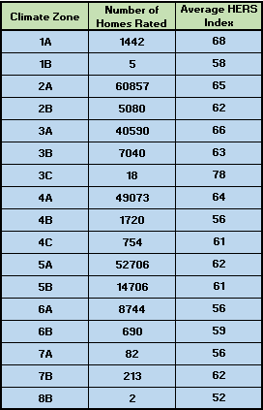
Average HERS Index by Climate Zones
March 2012 – March 2014
Over 240,000 homes between 8 climate zones have been rated using the HERS Index and have a weighted average score of 63.55.
Notes:
The table shown here depicts the average HERS index rating for each climate zone based on the number of homes receiving HERS ratings from March 2012 to March 2014.
Over 240,000 homes between 8 climate zones have been rated using the HERS Index and have a weighted average score of 63.55.

Slide 10
Benefits of the Energy Rating Index Score Option
Notes:
Using the ERI performance path for compliance with the IECC has several benefits, including more flexibility in complying with code, decreased emissions, lower building costs, reduced jurisdictional manpower, utility bill savings, increased resale value and market competition.

Slide 11
Benefits of the Energy Rating Index Score Option
From a Builder’s Perspective
Lower First Costs
Increased Flexibility in Compliance
From a Consumer’s Perspective
Building Innovation
Utility Bill Savings
Resale Value
Comparison Shopping for Beyond Code Minimum Homes
Notes:
Builder Perspective
Lower First Costs
The ERI performance path allows builders flexibility in achieving the ERI performance goal of the 2015 IECC rather than following the prescriptive approach. The greater flexibility allows builders to select the most cost effective efficiency measures that perform the best for each home. Leading Builders of America (LBA) estimates that a level of energy performance that would have cost $3,000 extra using the prescriptive approach of the IECC would cost only $1,300 with the ERI performance path, including the cost of the HERS rating. NRDC estimates that the extra costs of the down payment for the more energy-efficient home will pay back in net monthly savings in just over six months. Increased flexibility for builders also means lower construction costs, lower costs to the buyer and continual improvement in energy efficiency.
Consumer Perspective
Utility Bill Savings
The ERI performance path provides substantial reductions in utility bills—about $468 a year for a typical house compared to the 2012 IECC. As such, energy efficient homes following the ERI performance path are more affordable since the monthly utility bill savings more than pay for the increase in mortgage payments.
In addition, ERI scores will be provided to the buyer, creating stronger markets for beyond-code homes by clearly demonstrating lower operating costs and providing guidance to the occupant on what utility bills should be.
Resale Value
The ERI score of a home will be included on the energy label that is required by the IECC and can be used to market the efficiency of the home. In addition, many markets around the US are including HERS scores on real estate MLS listings.
Energy labels and inclusion in the MLS allow builders and homeowners to effectively demonstrate the extra value of energy efficient components and utility bill savings to the next buyer for a better selling price.
The Institute for Market Transformation and the University of North Carolina also found a correlation between HERS ratings and mortgage loan foreclosure. The risk of defaulting on a mortgage was found to be 32% lower on HERS rated homes and reduced correspondingly with lower HERS index scores.

Slide 12
Cost Effectiveness of Using the ERI to Comply with the 2015 IECC
Annual savings of the 2015 IECC ERI performance path, averaged across climate zones, is $468
A study by the Florida Solar Energy Center compared homes configured to comply with the ERI performance path provisions of the 2015 IECC to homes configured to comply with the 2012 IECC.
Life-cycle cost savings, averaged across climate zones, is $12,784 for the 2015 IECC ERI performance path
The study found that in all cases, compliance with the ERI performance path of the 2015 IECC is cost-effective
Notes:
RESNET contracted with the Florida Solar Energy Center to conduct cost-effectiveness analysis of new homes configured to comply with the ERI performance path provisions of the 2015 IECC compared to homes configured to comply with the 2012 IECC. The analysis was conducted across all IECC Climate Zones with national averages weighted using new home construction starts.
The study found that in all cases, compliance with the ERI performance path of the 2015 IECC is cost-effective.
Annual savings of the 2015 IECC ERI performance path, averaged across climate zones, is $468.
Life-cycle cost savings, averaged across climate zones, is $12,784 for the 2015 IECC ERI performance path.
The Savings-to-investment ratio (SIR), averaged across climate zones, is 1.69
The Net Present Value (NPV) averaged across climate zones, is $5,219

Slide 13
2015 IECC Improvement Costs
Incremental improvement costs of improving 2012 IECC homes to comply with 2015 IECC ERI criteria were determined using methodology for evaluating cost effectiveness of retrofits for DOE’s Building America program
Most Common Efficiency Improvements
100% High-Efficiency Lighting
Higher Efficiency Heating, Cooling and Water Heating Equipment
Duct Systems Inspected and Tested to Meet Improved Performance
Enhanced Envelope Efficiencies
Energy Star Refrigerators, Dishwashers and Clothes Washers
Notes:
The incremental cost of improving the 2012 IECC SRD homes to comply with the 2015 IECC ERI performance path criteria was determined using the methodology used to evaluate the cost effectiveness of retrofits for the U.S. Department of Energy’s Building America program. In most cases, improvement costs used in the analysis parallel those available from the National Renewable Energy Laboratory’s (NREL) National Residential Efficiency Measure Database.
The most common efficiency improvements employed in this study comprised 100% high-efficiency lighting, higher efficiency heating, cooling and water heating equipment, interior, leak-free duct systems, enhanced envelope efficiencies and energy star refrigerators, dishwashers and clothes washer.

Slide 14
Economic Analysis
Life-Cycle-Cost Analysis
Based on 30 year life-cycle-cost analysis
Section 4.6 of ANSI/RESNET 301-2014
Economic Parameters
25% income tax rate
4% property tax rate
Includes replacement costs and maintenance fraction
Property assessment ratio of 80%
Most recently published energy prices
Notes:
Economic analysis is based on a 30 year life-cycle-cost analysis using the methodology specified by Section 4.6, ANSI/RESNET 301-2014. The economic parameter values published on the RESNET web site for 2014 as augmented by an effective income tax rate of 25%, a property tax rate of 4% and a property assessment ratio of 80% were used in the analysis.
The life-cycle-cost analysis includes replacement costs (escalated at the general inflation rate) for measures lasting less than the full analysis period (standard residential mortgage period of 30 years in this case). For example, HVAC equipment, with an assumed service life of 15 years, would be replaced in year 16 and high efficiency CFL lighting, with an assumed service life of 5 years, would be replaced five times during the analysis period. Where incremental maintenance is required, a maintenance fraction is also included in the analysis.
Energy prices used in the analysis are the most recently published (2012) average annual U.S. prices for residential electricity and residential natural gas as provided by the U.S. Energy Information Administration. The prices used are $0.1177/kWh of electricity consumption and $1.045/therm of natural gas consumption. Energy prices are not varied in the analysis by location.

Slide 15
Case Studies
Notes:
Nationwide, seven states have incorporated a HERS Index Score option into their residential building energy codes thus far: Arkansas, Colorado, Idaho, Kansas, Massachusetts, New York and New Mexico. The HERS programs in these states and jurisdictions serve as examples of the successful implementation of an ERI performance requirement. For a complete list of jurisdictions that have incorporated the RESNET HERS Index Score into their building energy codes, see http://www.resnet.us/professional/main/Hers_index_and_energy_codes.

Slide 16

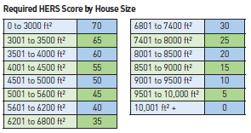
City of Santa Fe
Residential Green Building Code
Homes 3,000ft² or less required to achieve HERS score of 70 or less
HERS scores for homes greater than 3,000 ft² tiered based on home size
Required HERS scores built on levels set in National Green Building Code
Applies to all new single family homes, attached and detached
Notes:
New Mexico also adopted the HERS Index statewide as a compliance option to the 2009 IECC and several jurisdictions are now requiring new residential construction to receive a HERS rating. The City of Santa Fe, for example, requires HERS ratings for all residential construction as part of the Santa Fe Residential Green Building Code.
The program began in 2006 when Santa Fe mandated that all new residential construction receive a HERS rating. The initial program did not require homes to achieve a particular score and it wasn’t until January 1, 2008, that all new residential single family homes were required to meet specific target HERS scores as outlined in the green code.
Santa Fe’s HERS index threshold was built on the levels set in the National Green Builder Standard and is based on the size of the home being rated. Homes that are 3,000 square feet or less are required to achieve a HERS Index of 70 or better. The required scores are then tiered based on square footage, with homes greater than 10,000 square feet required to have a HERS rating of 0 or better.
The HERS requirement in the Santa Fe’s green code applies to all new single-family units, both attached and detached, including guest houses.
To date, over 900 homes have been HERS rated under the requirement to achieve a HERS rating of 70 or better.
It is estimated that the initial first cost increase of a home built to a HERS score of 70 is 2-4% over a home that was not building to the HERS requirements.

Slide 17
How does a home in Santa Fe receive a HERS score?
Preliminary HERS based on building plans is submitted with residential checklist to obtain building permit
Final HERS prepared once home is nearly complete and assumptions in preliminary HERS have been verified
HERS scores determined by certified HERS rater that has completed RESNET training and Santa Fe training courses
Notes:
Residential HERS scores are determined by a certified HERS rater that has completed training through a RESNET Accredited Rater Training Provider as well as a number of additional training courses developed by Santa Fe Community College and required by the building department, including a thermal bypass course and an advanced RemRate class that covers energy code components specific to New Mexico, such as trombe walls and adobe. In addition, HERS raters must correctly perform a blower door and duct blaster test as part of the required field test.
Homes receive a HERS score in two phases. A preliminary HERS index is prepared based on the building plans and is submitted along with Santa Fe’s residential checklist to obtain a building permit. A final HERS rating is prepared once the home is nearly complete and all assumptions in the preliminary HERS index have been verified. The final HERS index score must be submitted before a Certificate of Occupancy can be issued.

Slide 18
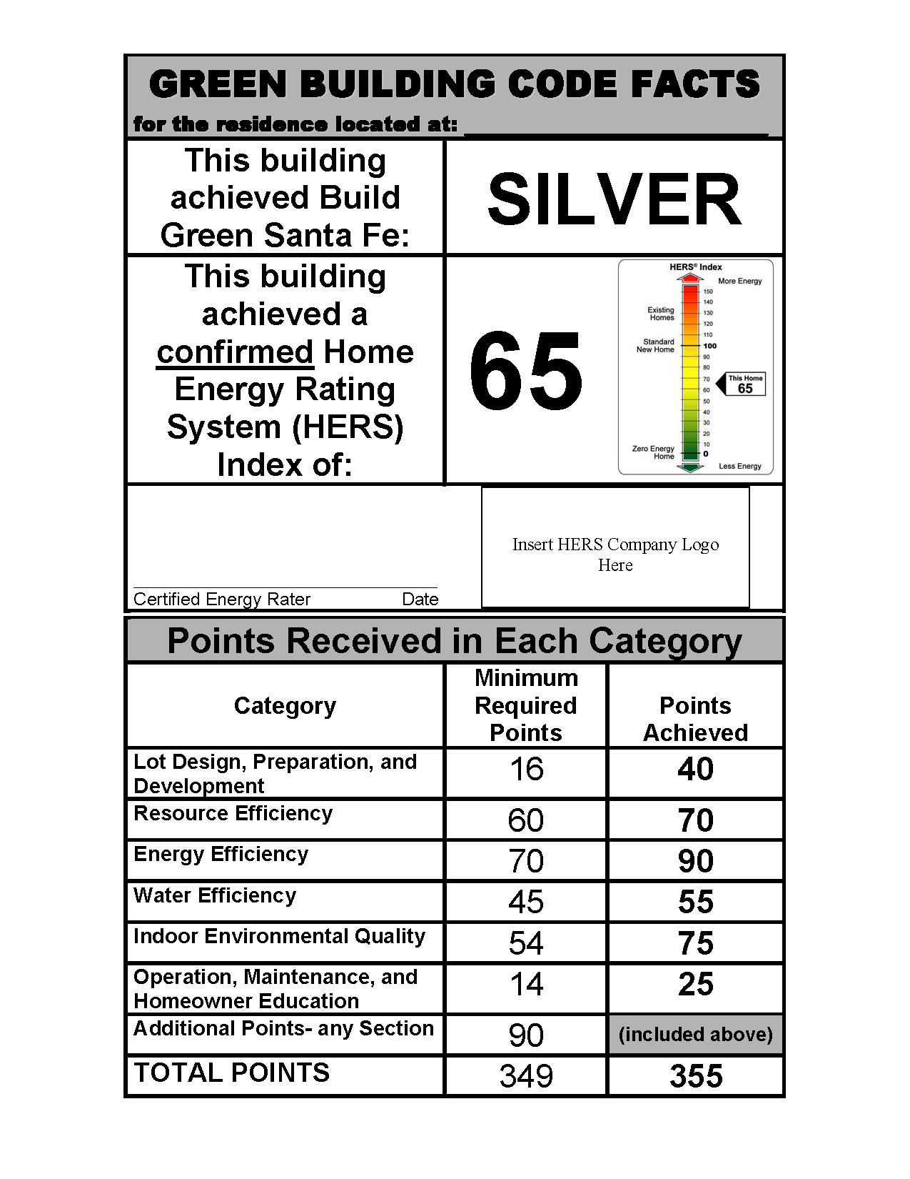
A report that reflects the final HERS score is posted in the window of the rated home prior to the issuance of a Certificate of Occupancy and may only be removed by the first occupant
Notes:
A report, similar to the shown here, that reflects the final HERS score is posted in the window of the rated home prior to the issuance of a Certificate of Occupancy and may only be removed by the first occupant.

Slide 19
Santa Fe Best Practices
Requiring that all new construction receive a HERS rating during the initial stages of the program familiarized builders with the process of obtaining a target HERS score.
No initial HERS score allowed builders to learn through trial and error how to achieve low ratings Building department personnel were sent to HERS trainings to ensure awareness of the program.
The program is set up to focus primarily on elements of the building envelope.
Building inspectors and HERS raters work together to achieve maximum efficiency in new residential construction.
HERS raters also work closely with one another to ensure consistency and credibility within the Santa Fe HERS community.
Additional training required for HERS raters to ensure quality assurance is maintained
Best practices have led to:
A realistic set of scores for the jurisdiction
An increase in quality of construction
Construction practices that reflect unique needs of the city
An increase in support for the program from the building community
Competition among builders
An increased in use of energy efficient products and technologies
Notes:
Santa Fe’s inventive approach to incorporating the HERS index into a mandatory green building code has fostered a number of best practices for other cities and jurisdictions to follow. Requiring that all new construction receive a HERS rating during the initial stages of the program worked well to familiarize builders with the process of obtaining a target HERS score. Since there was initially no set HERS score, builders could learn through trial and error how to achieve low ratings and Santa Fe could establish a realistic set of scores for the jurisdiction based on feedback from the builders. Additionally, the City of Santa Fe sent building department personnel to HERS trainings to ensure awareness of the program. As a result, the building community throughout Santa Fe understands and supports the local HERS program.
The HERS program in Santa Fe is set up to focus primarily on elements of the building envelope. As such, builders are more aware of the role the building envelope has in efficiency. Construction practices reflect an emphasis on air barriers and other elements included on the required Thermal Bypass Checklist. The quality of construction has increased as well. The HERS program has encouraged competition amongst builders; many builders challenge themselves and others to score the lowest HERS rating for each home size. The competitive environment has encouraged the use of new energy efficient products and technologies.
Furthermore, building inspectors and HERS raters work together to achieve maximum efficiency in new residential construction. Building inspectors are required to inspect for compliance with provisions of the Santa Fe Residential Green Code that are also included as part of a HERS rating. Although building inspectors are not focused solely on the energy efficiency portion of the code, this allows for a second set of eyes on building components such as insulation and air sealing. HERS raters also work closely with one another to ensure consistency and credibility within the Santa Fe HERS community.
The City of Santa Fe has had great success with implementing the HERS index into the residential energy code. However, the city has had to overcome a number of roadblocks as well. Since the credibility of raters is often an issue with HERS programs, Santa Fe requires additional training for HERS raters to ensure quality assurance is maintained. The city has also struggled with having an adequate number of HERS raters to keep up with the growing demand for new homes.

Slide 20
Resources

Slide 21

RESNET
Gather HERS information
Identify states and jurisdictions using HERS Index
Find a local RESNET HERS rater
www.resnet.us
www.hersindex.com
Notes:
RESNET is the leading resource for collecting HERS Index information, identifying states and jurisdictions using the HERS Index and finding a local RESNET HERS rater.
Visit either resnet.us or hersindex.com for more information.

Slide 22
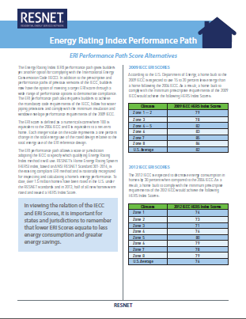
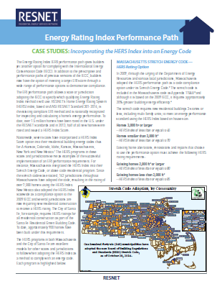
Energy Rating Index Fact Sheets
Six informational fact sheets are available
Overview of the ERI Performance Path in the 2015 IECC
Benefits of the Energy Rating Index Score Option
Frequently Asked Questions
Cost Effectiveness of Using the ERI to Comply with the 2015 IECC
Implementation Guidelines for the ERI Performance Path
ERI Performance Path Score Alternatives
Case Studies: Incorporating the HERS Index into an Energy Code
Notes:
In addition, BMG was contracted by RESNET to develop a series of informational factsheets to raise awareness for and answer questions regarding the ERI performance path of the IECC.
The fact sheets include:
Overview of the ERI Performance Path in the 2015 IECC
Benefits of the Energy Rating Index Score Option
Frequently Asked Questions
Cost Effectiveness of Using the ERI to Comply with the 2015 IECC
Implementation Guidelines for the ERI Performance Path
ERI Performance Path Score Alternatives
Case Studies: Incorporating the HERS Index into an Energy Code

Slide 23
Questions?

