Slide 1

Energy Rating Index Performance Path
Speaker Name
Speaker Affiliation
Notes:
This presentation will cover the Energy Rating Index Performance Path found in the 2015 IECC

Slide 2
Goals of the Concept
Increase compliance for residential energy codes
Increase building energy savings through increased compliance
Complement existing performance-based residential efficiency programs
Create cost-effective retrofit and new build strategies to exceed minimum code requirements
Notes:
The goals of the ERI are to:
Increase compliance for residential energy codes
Increase building energy savings through increased compliance
Complement existing performance-based residential efficiency programs
Create cost-effective retrofit and new build strategies to exceed minimum code requirements

Slide 3
Overview of the ERI Performance Path
Notes:
What is the ERI Performance Path?

Slide 4
ERI Performance Path
Additional option for IECC compliance
Target ERI score is met through a wide range of performance options
Requires builders to achieve the mandatory code requirements of the 2015 IECC and comply with minimum insulation and window envelope performance requirements of the 2009 IECC
Mandatory Requirements
2015 IECC provisions including:
  Section R402.4 Air Leakage
  Section R403 Systems
  Section R403.5 Service Hot Water Systems
  Section R404 Electrical Power and Lighting Systems
Building Envelope requirements of the 2009 IECC
Notes:
The Energy Rating Index (ERI) performance path gives builders yet another option for complying with the International Energy Conservation Code (IECC). In addition to the prescriptive and performance paths of previous versions of the IECC, builders now have the option of meeting a target ERI score through a wide range of performance options to demonstrate compliance. The ERI performance path also requires builders to achieve the mandatory code requirements of the IECC, including water heating piping provisions, and comply with the minimum insulation and window envelope performance requirements of the 2009 IECC.

Slide 5
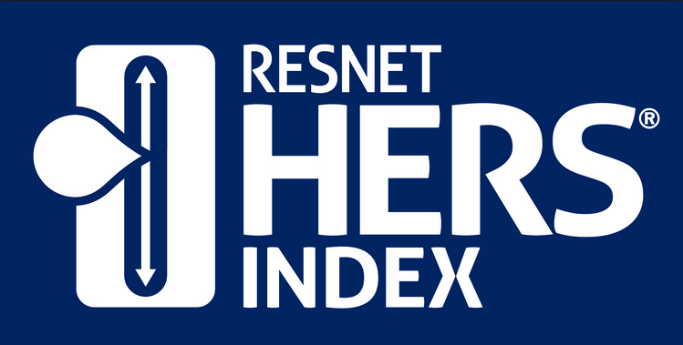
States and jurisdictions can specify which qualifying ERI method they will use
RESNET HERS Index is the existing compliance ERI method
Is nationally recognized
Based on ANSI RESNET Standard 301-2014
To date, over 1.5 million homes have been rated in the US under the RESNET standards
Notes:
The ERI performance path allows states and jurisdictions to specify which qualifying ERI method it will use.
RESNET’s Home Energy Rating System (HERS) index, based on ANSI RESNET Standard 301-2014, is the existing compliant ERI method and is nationally recognized for inspecting and calculating a home's energy performance. To date, over 1.5 million homes have been rated in the U.S. under the RESNET standards and in 2013, half of all new homes were rated and issued a HERS Index Score.

Slide 6
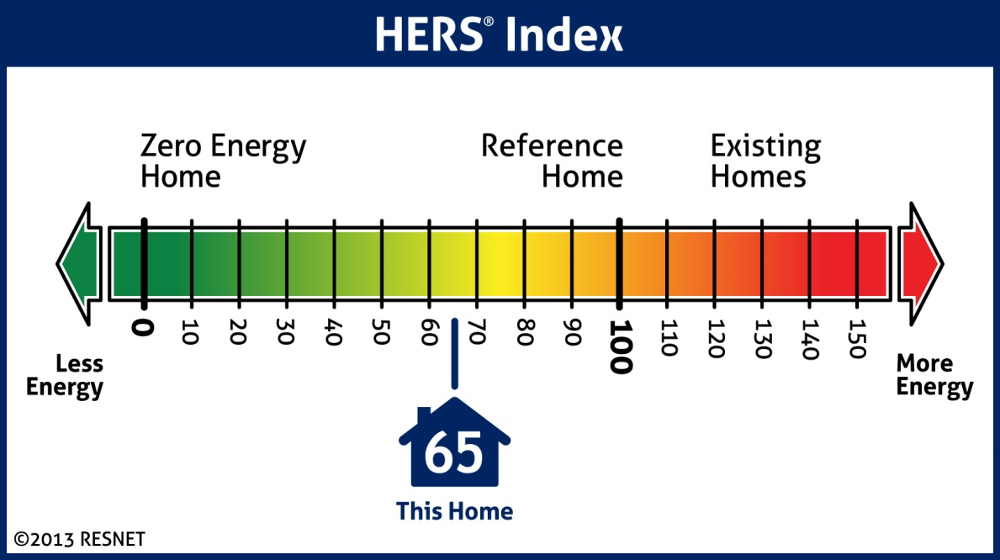
What is a HERS Index and Score?
A Zero Net Energy home scores a HERS Index of 0
A scoring system established by RESNET based off of the 2006 IECC
The scale is based on a 100 – 0 index
A home based on the 2006 IECC scores a HERS Index of 100
A score of 0 is equivalent to a net zero home
Notes:
HERS Index is a scoring system established by RESNET that is based on the 2006 IECC. The scale is a 0-100 index in which a score of 100 reflects a home built to the 2006 IECC and a score of 0 is equivalent to a net zero home.

Slide 7
2015 IECC Target ERI Scores
The ERI score is defined as a numerical score where 100 is equivalent to the 2006 IECC and 0 is equivalent to a net-zero home. Each integer value on the scale represents a one percent change in the total energy use of the rated design relative to the total energy use of the ERI reference design.
2015 IECC Target ERI by Climate Zone
Climate Zones 1-2: 52
Climate Zone 3: 51
Climate Zone 4: 54
Climate Zone 5: 55
Climate Zones 6: 54
Climate Zones 7-8: 53
Notes:
The ERI score is defined as a numerical score where 100 is equivalent to the 2006 IECC and 0 is equivalent to a net-zero home. Each integer value on the scale represents a one percent change in the total energy use of the rated design relative to the total energy use of the ERI reference design.
The ERI scores required in the 2015 IECC, as shown here, were determined using a modeling method in each of the climate zones and are based on values represented in the IECC
The scores required under the ERI performance path are based on an analysis performed by the Florida Solar Energy Center of HERS index scores for homes in 16 cities distributed throughout the climate zones. The homes used in the analysis were one-story 2000 ft² and two-story 2400 ft² homes built using the 2012 IECC envelope and air leakage requirements and state-of-the-shelf high-efficiency HVAC and water heating equipment. Alternately, the ERI scores are obtainable by reducing energy use by an additional 10% compared to a home with the 2012 envelope and duct systems and assuming best-case orientation and architecture of prototype homes. The homes were modeled for the 2006, 2009 and 2012 IECC which provided a range of HERS Index scores by climate zone.

Slide 8

What is included in an Energy Rating?
Energy ratings are based on a number of variables including the type and efficiency of each of the following:
  Equipment
  Appliance upgrades
  Exterior walls (both above and below grade)
  Floors over unconditioned spaces
  (such as garages or crawlspaces)
  Ceilings and roofs
  Attics, foundations and crawlspaces
  Windows and doors, vents and ductwork
  HVAC and water heating systems
  Air leakage of the home
  Leakage in the heating and cooling distribution system
Notes:
Energy ratings are based on a number of variables including the type and efficiency of each of the following:
Equipment
Appliance upgrades
Exterior walls (both above and below grade)
Floors over unconditioned spaces (such as garages or crawlspaces)
Ceilings and roofs
Attics, foundations and crawlspaces
Windows and doors, vents and ductwork
HVAC and water heating systems
Air leakage of the home
Leakage in the heating and cooling distribution system

Slide 9
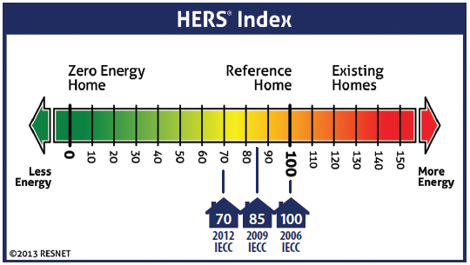
A Comparison of HERS Index Scores and Energy Codes - Basic
2015 IECC target ERI scores range from 51 – 55 based on climate zone
How does the ERI Performance Path Compare?
2009 IECC
2012 IECC
Other Standards
*HERS Index chart represents estimates for the 2006, 2009 and 2012 IECC
Notes:
2015 IECC target ERI scores range from 51 – 55 based on climate zone
How does the ERI Performance Path compare to the 2009 IECC?
According to the U.S. Department of Energy, a home built to the 2009 IECC is expected to use 15 to 20 percent less energy than a home following the 2006 IECC. As a result, a home built to comply with the minimum prescriptive requirements of the 2009 IECC would achieve a HERS score of approximately 85.
How does the ERI Performance Path compare to the 2012 IECC?
The 2012 IECC is expected to decrease energy consumption in homes by 30 percent when compared to the 2006 IECC. As a result, a home built to comply with the minimum prescriptive requirements of the 2012 IECC would achieve a HERS score of approximately 70.
How does the ERI Performance Path compare to other standards?
A study performed by the Leading Builders of America and the National Association of Home Builders Research Center found the corresponding HERS index scores for Energy STAR, a level of 50% beyond the 2006 IECC and a level 60% beyond the 2006 IECC to be 70, 56, and 47, respectively.

Slide 10
Who is Using the HERS Index?
To date, jurisdictions in seven states have incorporated a HERS Index Score option into their residential code:
Arkansas
Colorado
Idaho
Kansas
New Mexico
New York
Massachusetts
Notes:
Across the nation, state and local governments are adding a HERS Index Score target as a performance compliance option to their building energy code. To date, code jurisdictions in the states of Arkansas, Colorado, Idaho, Kansas, New Mexico, New York and Massachusetts have incorporated a HERS Index Score option into their residential energy codes.
A comprehensive list of jurisdictions that have incorporated a HERS Index Score into their energy code can be found on the RESNET website ( http://resnet.us/professional/main/Hers_index_and_energy_codes)

Slide 11
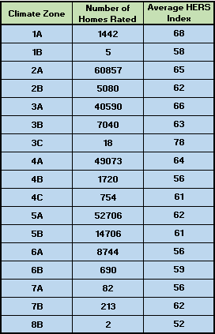
Average HERS Index by Climate Zones
March 2012 – March 2014
Over 240,000 homes between 8 climate zones have been rated using the HERS Index and have a weighted average score of 63.55.
Notes:
The table shown here depicts the average HERS index rating for each climate zone based on the number of homes receiving HERS ratings from March 2012 to March 2014.
Over 240,000 homes between 8 climate zones have been rated using the HERS Index and have a weighted average score of 63.55.

Slide 12
Benefits of the Energy Rating Index Score Option
Notes:
Using the ERI performance path for compliance with the IECC has several benefits, including more flexibility in complying with code, decreased emissions, lower building costs, reduced jurisdictional manpower, utility bill savings, increased resale value and market competition.

Slide 13
Benefits of the Energy Rating Index Score Option
From a Builder’s Perspective
Lower First Costs
Increased Flexibility in Compliance
From a Consumer’s Perspective
Building Innovation
Utility Bill Savings
Resale Value
Comparison Shopping for Beyond Code Minimum Homes
Notes:
Builder Perspective
Lower First Costs
The ERI performance path allows builders flexibility in achieving the ERI performance goal of the 2015 IECC rather than following the prescriptive approach. The greater flexibility allows builders to select the most cost effective efficiency measures that perform the best for each home. Leading Builders of America (LBA) estimates that a level of energy performance that would have cost $3,000 extra using the prescriptive approach of the IECC would cost only $1,300 with the ERI performance path, including the cost of the HERS rating. NRDC estimates that the extra costs of the down payment for the more energy-efficient home will pay back in net monthly savings in just over six months. Increased flexibility for builders also means lower construction costs, lower costs to the buyer and continual improvement in energy efficiency.
Consumer Perspective
Utility Bill Savings
The ERI performance path provides substantial reductions in utility bills—about $468 a year for a typical house compared to the 2012 IECC. As such, energy efficient homes following the ERI performance path are more affordable since the monthly utility bill savings more than pay for the increase in mortgage payments.
In addition, ERI scores will be provided to the buyer, creating stronger markets for beyond-code homes by clearly demonstrating lower operating costs and providing guidance to the occupant on what utility bills should be.
Resale Value
The ERI score of a home will be included on the energy label that is required by the IECC and can be used to market the efficiency of the home. In addition, many markets around the US are including HERS scores on real estate MLS listings.
Energy labels and inclusion in the MLS allow builders and homeowners to effectively demonstrate the extra value of energy efficient components and utility bill savings to the next buyer for a better selling price.
The Institute for Market Transformation and the University of North Carolina also found a correlation between HERS ratings and mortgage loan foreclosure. The risk of defaulting on a mortgage was found to be 32% lower on HERS rated homes and reduced correspondingly with lower HERS index scores.

Slide 14

From a Code Official’s Perspective
Reduction in Compliance Verification Time
Building Performance
From an Environmental Perspective
Quality Assurance
Decreased Emissions
From a Code Jurisdiction’s Perspective
Reduced Energy Bills
Certification Testing to Obtain Final HERS Score
3rd Party Certified Inspections Demonstrating Compliance
Improved Review and Approval Process and Time
National Standard based on US DOE/US EPA Best Practices
Ability to Adopt/Promote Whole House Performance Standards
Cleanenergy.org
Notes:
From a Code Official’s Perspective
Reduction in Compliance Verification Time
The ERI performance path requires verification by an approved third party as well as the use of an industry standard efficiency report to demonstrate compliance. By using a qualified third party, jurisdictions will reduce the manpower needed to conduct inspections. In addition, the compliance report could be utilized by the code official to verify compliance in lieu of or in addition to their own inspections and documentation, reducing jurisdiction manpower requirements to review energy and compliance documents as well.
Quality Assurance
The HERS index, a qualified ERI method, is built on elaborate quality control and quality assurance. HERS raters are certified by RESNET after they have taken training courses and have passed field and online tests. RESENT requires HERS raters to have continual professional education and periodic recertification; HERS raters must also demonstrate compliance with ethical standards. At least 1% of every rater’s output each year must be rechecked by an independent rater, and the two ratings must agree within 3 ERI/HERS points. In addition, it is recommended that all HERS raters take the residential IECC certification exam.
Building Performance
An increase in compliance boosts an increase in building energy savings. The ERI approach provides a platform that focuses both on the assessment of the quality of installation as well as building performance.
From an Environmental Perspective
Decreased Emissions
The Natural Resources Defense Council (NRDC) estimates that the ERI performance path will cut energy bills and greenhouse gas emissions by 20 percent compared to the 2012 IECC and by 40 percent compared to the 2006 IECC if adopted nationwide. The ERI performance path in the 2015 IECC will accumulate to a national cost savings of over $100 billion by 2030 compared to the 2006 IECC. Cumulative greenhouse gas emissions reduction will be over 560 metric tons carbon dioxide, or the equivalent to the emissions produced by 158 coal-fired power plants.

Slide 15


From the Market’s Perspective
Market Competition and Innovation
Integrated Market
Increased Sales
Future Programs
Generate Job Opportunities
Nwwindandsolar.com
Notes:
Market’s Perspective
Market Competition and Innovation. The added flexibility of the ERI performance path drives innovation and encourages competition in the energy efficient product and service industries, further lowering the cost of efficiency and increasing potential for future cost-effective efficiency improvements. Competition in the product and service industry will foster continual improvements in products and advances in building technology, creating new jobs, new businesses and additional energy savings down the road. The ERI approach also encourages innovation and competition amongst builders. Homeowners are interested in the most energy efficiency for the lowest cost; builders will combine performance options with creativity to compete with one another to demonstrate the lowest HERS scores to home buyers.
Integrated Market. Rather than insulation manufacturers competing solely with one another and with window manufacturers for UA tradeoffs, the ERI performance path opens the competition to HVAC equipment vendors, white goods producers, plumbing fixture manufacturers, lighting product manufacturers, solar water heater producers, solar PV firms, energy recovery ventilator producers and others.
Increased Sales and Job Opportunities. Energy efficiency will become less expensive as more builders buy efficient components and those selling high-efficiency products will see an increase in sales as well. As these businesses sell more, they also generate more jobs.
Future Programs. The ERI performance path complements performance-based residential efficiency programs by providing a “shell” for existing residential energy code and above code programs to fit. It also provides a format for the development of future energy programs, including those designed for net zero energy. The ERI approach provides a platform to move the code toward building zero energy homes by allowing trade-offs and credit for regulated and unregulated loads.

Slide 16
Cost Effectiveness of Using the ERI to Comply with the 2015 IECC
Annual savings of the 2015 IECC ERI performance path, averaged across climate zones, is $468
A study by the Florida Solar Energy Center compared homes configured to comply with the ERI performance path provisions of the 2015 IECC to homes configured to comply with the 2012 IECC.
Life-cycle cost savings, averaged across climate zones, is $12,784 for the 2015 IECC ERI performance path
The study found that in all cases, compliance with the ERI performance path of the 2015 IECC is cost-effective
Notes:
RESNET contracted with the Florida Solar Energy Center to conduct cost-effectiveness analysis of new homes configured to comply with the ERI performance path provisions of the 2015 IECC compared to homes configured to comply with the 2012 IECC. The analysis was conducted across all IECC Climate Zones with national averages weighted using new home construction starts.
The study found that in all cases, compliance with the ERI performance path of the 2015 IECC is cost-effective.
Annual savings of the 2015 IECC ERI performance path, averaged across climate zones, is $468.
Life-cycle cost savings, averaged across climate zones, is $12,784 for the 2015 IECC ERI performance path.
The Savings-to-investment ratio (SIR), averaged across climate zones, is 1.69
The Net Present Value (NPV) averaged across climate zones, is $5,219

Slide 17
Energy Rating Index Implementation Guidelines
Notes:
The Implementation Guidelines for the ERI Performance Path are provided for the successful implementation of the ERI approach within a jurisdiction.
.

Slide 18

The process includes:
Initial analysis and energy rating of the proposed home
Review for compliance with the energy code
The inspection and testing of energy using features in the home to ensure that they perform as proposed
Completing a final energy rating of the home once completed
The ERI compliance path, implemented through the HERS rating process, provides independent, third-party analysis and review of the energy using features of a house.
The thoroughness of the HERS rating process reduces the need for the jurisdiction to conduct plan review and specific inspections focused on compliance with the energy code
Notes:
The ERI compliance path, implemented through the HERS rating process, provides independent, third-party analysis and review of the energy using features of a house that includes:
An initial analysis and preliminary energy rating of the proposed home prior to submitting for permit
Review for compliance with the energy code
On-site inspection of energy features in the home
A final energy rating of the home once construction is completed
A home complying with the ERI path demonstrates compliance with the IECC. The thoroughness of the HERS rating process reduces the need for the jurisdiction to conduct plan review and specific inspections focused on compliance with the energy code. Jurisdictions are encouraged to participate in the rating process as an observer to better understand how the ERI approach, as implemented through a HERS rating, demonstrates compliance with the energy code.

Slide 19
Qualified HERS Rater
Objective
Competent
Ethical
Experienced
Professional
Notes:
A RESNET HERS rater that provides energy code plan review and inspection verification for a jurisdiction falls under the category of a Special Inspector as defined in Chapter 17, Special Inspections and Tests, of the ICC International Building Code (IBC). The recommended guidelines follow specific provisions within Chapter 17 that are applicable to the ERI and HERS rating process to ensure compliance with the IECC.
The HERS rater should be objective and competent for the work performed.
The HERS rater should also disclose possible conflicts of interest so that objectivity can be confirmed. RESNET HERS Raters follow the Rating and Home Energy Survey Code of Ethics that stresses the obligation of a home energy rater/auditor to present accurate and unbiased information on energy performance in a professional manner, and disclose any potential conflicts of interest. http://www.resnet.us/professional/standards/ethics

Slide 20
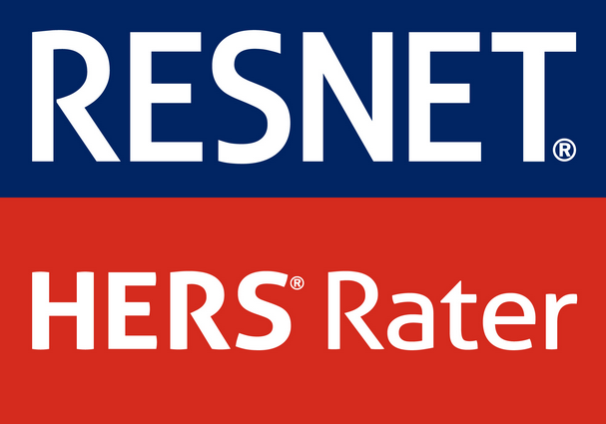

HERS Rater Certifications
HERS Raters must be experienced and educated in conducting, supervising and evaluating a HERS rating
The following RESNET HERS certifications demonstrate competency in this field:
Home Energy Rater Certification
Rating Field Inspector Certification (can only provide the infield testing and inspection but not certified to provide an ERI)
It is recommended that HERS Raters demonstrate knowledge of the provisions of the IECC by holding the ICC IECC Residential Energy Inspector/Plan Examiner certification
energyefficientillinois.com
Notes:
The HERS Rater should provide information to demonstrate that they are experienced and educated in conducting, supervising and evaluating a HERS rating. Certifications should be provided to demonstrate that they meet the intent of this requirement. The following RESNET HERS certifications demonstrate competency in this field:
Home Energy Rater Certification
Rating Field Inspector Certification (can only provide the infield testing and inspection but are not certified to provide an ERI)
Qualifications for each certification level is found in the Mortgage Industry National Home Energy Rating Systems Standard
The HERS rater should also demonstrate their knowledge of the residential provisions of the IECC. This is accomplished by holding the ICC IECC Residential Energy Inspector/Plan Examiner certification. In addition, the HERS rater must have knowledge of any state or local jurisdiction amendments to the IECC.

Slide 21

Documentation and Reporting Requirements
The Approved Rating Software Tool that is defined in ANSI/RESNET 301-2014 will generate reports and must have the following information:
Property location, including city, state, zip code, street address or community/subdivision name and lot number and Plan Name for the rated home
Name and contact information (phone number and email address) of the Certified Rater conducting the rating
Name, mailing address and telephone number of the Approved Rating Quality Assurance (Q/A) Provider under whose auspices the Rater is certified
Date the Rating was conducted
Name of the Approved Software Rating Tool (including version number) used to determine the Rating
In addition, the rating report must have the following statement in no less than 10 point font:
“The Home Energy Rating Standard Disclosure for this home is available from the Rating Provider.”
As required by the IBC, records should be kept of all inspections and provided to the building official upon request.
Notes:
As required by the IBC, records should be kept of all inspections and should be provided to the building official upon request.
The Approved Rating Software Tool that is defined in ANSI/RESNET 301-20143(301-2014) will generate reports and must have the following information:
Property location, including city, state, zip code, street address or community/subdivision name and lot number and Plan Name for the Rating
Name and contact information (phone number and email address) of the Certified Rater conducting the rating
Name, mailing address and telephone number of the Approved Rating Quality Assurance (Q/A) Provider under whose auspices the Rater is certified
Date the Rating was conducted
Name of the Approved Software Rating Tool (including version number) used to determine the Rating
In addition, the rating report must have the following statement in no less than 10 point font:
“The Home Energy Rating Standard Disclosure for this home is available from the Rating Provider.”

Slide 22
Documentation and Reporting Requirements Cont.
Home Ratings
Projected Rating
Confirmed Rating
Sampled Rating
Mandatory Requirements
Provide documentation that 2015 IECC requirements have been met:
Building Envelope
HVAC
Water Heating
Lighting
Provide documentation that building envelope meets the minimum insulation and glazing requirements as defined in the 2009 IECC
Notes:
Home Ratings
Documentation should be submitted to the building official for the following ratings:
Projected Rating: This rating shall be determined from the building plans that accounts for construction specifications, planned location and orientation of the home. Guidelines for generating the projected ratings are included in ANSI/RESNET 301-2014. Guidelines are also available for generating ratings for multifamily (3 stories and less) buildings in the RESNET Guidelines for Multifamily Energy Ratings. The projected rating should be provided as part of the plan submittal for permit. The HERS rating must be equal to or less than the maximum ERI referenced in the IECC.
Confirmed Rating: This rating shall be determined from field verified values. The HERS Rating from the confirmed rating must be equal to or less than the maximum ERI referenced in the IECC. The confirmed rating will be provided to the building official prior to issuance of the certificate of occupancy.
Sampled Rating (Option): Chapter 6 of the Mortgage Industry National Home Energy Rating Systems Standards outline a process by which homes can be rated using a sample testing and inspection process. This formal process has been in place since 2008 and is recognized by the US Environmental Protection Agency, US Department of Energy, and Internal Revenue Service. Raters working with a RESNET Accredited Sampling Provider are eligible to oversee and conduct a sampling process that follows Chapter 6.
Mandatory Requirements.
Documentation must be provided to the building official demonstrating that the mandatory requirements contained in the residential provisions of the 2015 IECC have been met. This includes meeting the minimum requirements of the building envelope, heating and cooling, water heating and lighting systems. Documentation must also be provided that demonstrates that the building envelope meets the minimum insulation and glazing requirements as defined in the 2009 IECC.

Slide 23
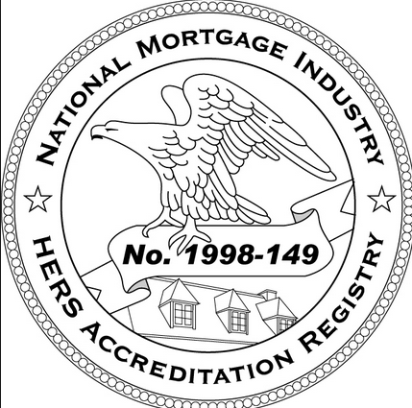
Quality Assurance Review for Accredited Providers
One home, or 10% of each HERS Rater’s annual total of homes, whichever is greater, must be reviewed by a Quality Assurance Designee
Homeowners should be informed that their home may be selected for a QA review and building officials should be notified of review
Notes:
The Mortgage Industry National Home Energy Rating Systems Standard includes the requirements for a quality assurance review that must be conducted by a QA Designee. The QA Designee must not be involved in any part of the rating or inspection on the home. The greater of one (1) home or ten percent (10%) of each Rater’s annual total of homes must be reviewed.
The building official should require that documentation be provided to the homeowners that states their house may be selected for a quality assurance review to ensure that the home meets the minimum requirements of the rating process. The building official should be notified by the HERS Rater when a home is selected for a quality assurance review and also receive a copy of the quality assurance report.

Slide 24
Case Studies
Notes:
Nationwide, seven states have incorporated a HERS Index Score option into their residential building energy codes thus far: Arkansas, Colorado, Idaho, Kansas, Massachusetts, New York and New Mexico. The HERS programs in these states and jurisdictions serve as examples of the successful implementation of an ERI performance requirement. For a complete list of jurisdictions that have incorporated the RESNET HERS Index Score into their building energy codes, see http://www.resnet.us/professional/main/Hers_index_and_energy_codes.

Slide 25

Massachusetts
Stretch Energy Code
Included in MA code as Appendix 115AA
Based on 2009 IECC but requires 20% greater efficiency
HERS performance path compliance option
Notes:
In 2009, through the urging of the Department of Energy Resources and various local jurisdictions, Massachusetts adopted the HERS performance path as a code compliance option under its Stretch Energy Code, or above code residential program. The stretch code is included in the Massachusetts code as Appendix 115AA and although it is based on the 2009 IECC, it requires approximately 20% greater building energy efficiency.
Since the stretch code was enacted, 142 jurisdictions throughout Massachusetts have adopted the code, resulting in the rating of over 7,000 homes using the HERS Index.
As of July 1, 2014, the standard “non-stretch” provisions of the Massachusetts’ energy code will be based on the 2012 IECC. The stretch code will continue to be based on the 2009 IECC with amendments until the stretch code is updated.

Slide 26
Required HERS Index scores based on house size
New residential buildings 3-stories or less, including multi-family units
Homes 3,000 ft² or larger
HERS Index of less than or equal to 65
Homes less than 3,000 ft²
HERS Index of less than or equal to 70
Existing home alterations, renovations and repairs that choose to use the performance option must achieve the following HERS rating requirements:
Existing homes 2,000 ft² or larger HERS Index of less than or equal to 80
Existing homes less than 2,000 ft² HERS Index of less than or equal to 85
Notes:
The stretch code requires new residential buildings 3-stories or less, including multi-family units, to meet an energy performance standard using the HERS Index based on house size:
Homes 3,000 ft² or larger – HERS Index of less than or equal to 65
Homes smaller than 3,000 ft² – HERS Index of less than or equal to 70
Existing home alterations, renovations and repairs that choose to use the performance option must achieve the following HERS rating requirements:
Existing homes 2,000 ft² or larger – HERS Index of less than or equal to 80
Existing homes less than 2,000 ft² – HERS Index of less than or equal to 85

Slide 27
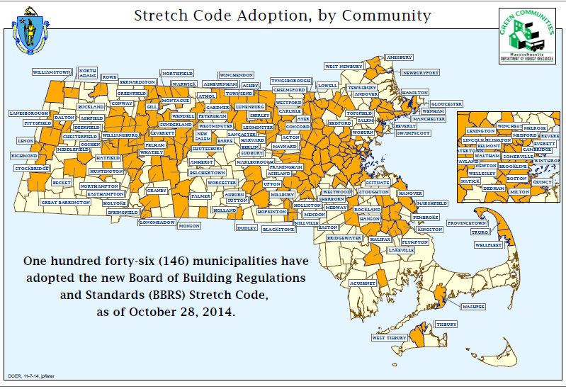
Notes:
The stretch code has been widely accepted throughout Massachusetts. Jurisdictions may choose to enforce the base code or adopt the stretch code as the mandatory energy code. To date, 142 jurisdictions have adopted the stretch code, resulting in the rating of over 7,000 homes using the HERS Index. The average score of all of the homes is currently 59, just five points below the national average.
Utilities are also encouraging the adoption of the stretch code. Initially, the Department of Energy Resources provided full support, including training and education, for the HERS program. However, due to the success and widespread adoption of the stretch code, utilities are now leading training programs and providing education to building officials and decision makers throughout the state.

Slide 28

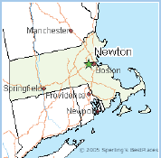
City of Newton, MA
First jurisdiction in MA to adopt HERS Stretch Code as part of Code
To date, over 230 homes rated
Since the beginning of the program
61% of homes rated received HERS scores better than state average
72% of homes rated received HERS scores better than national average
Notes:
The city of Newton was the first jurisdiction in Massachusetts to adopt the HERS stretch code as a part of its energy code. Leading by example, the city has been highly successful in incorporating the code; to date, over 230 homes have been HERS rated under the stretch code.
Newton’s HERS stretch code is mandatory and was shepherded in by a building commissioner who emphasized the importance of such a program. As such, there were very few issues with its inception and implementation.
According to a local building official, the success of Newton’s stretch code can be attributed to the decision to adopt the code in its entirety at the very start of the statewide program. By appealing to the sense of civic duty, as well as the enthusiasm regarding the stretch code in the town leadership, Newton was in an excellent position to act as the leader within Massachusetts.
For projects that either require or opt into the HERS performance path, local HERS raters have stepped up and have taken the lead in performing HERS audits, both alleviating some of the workload in the building department as well as maintaining the high level of standards Newton homeowners have come to expect.
Due to the aggressive nature of the program, over 61% of the homes rated since the beginning of the program have received HERS scores better than the state average. Furthermore, over 72% of the homes rated have scored better than the national HERS average.

Slide 29
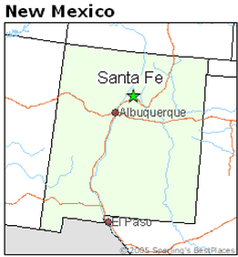
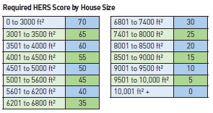
City of Santa Fe
Residential Green Building Code
Homes 3,000ft² or less required to achieve HERS score of 70 or less
HERS scores for homes greater than 3,000 ft² tiered based on home size
Required HERS scores built on levels set in National Green Building Code
Applies to all new single family homes, attached and detached
Notes:
New Mexico also adopted the HERS Index statewide as a compliance option to the 2009 IECC and several jurisdictions are now requiring new residential construction to receive a HERS rating. The City of Santa Fe, for example, requires HERS ratings for all residential construction as part of the Santa Fe Residential Green Building Code.
The program began in 2006 when Santa Fe mandated that all new residential construction receive a HERS rating. The initial program did not require homes to achieve a particular score and it wasn’t until January 1, 2008, that all new residential single family homes were required to meet specific target HERS scores as outlined in the green code.
Santa Fe’s HERS index threshold was built on the levels set in the National Green Builder Standard and is based on the size of the home being rated. Homes that are 3,000 square feet or less are required to achieve a HERS Index of 70 or better. The required scores are then tiered based on square footage, with homes greater than 10,000 square feet required to have a HERS rating of 0 or better.
The HERS requirement in the Santa Fe’s green code applies to all new single-family units, both attached and detached, including guest houses.
To date, over 900 homes have been HERS rated under the requirement to achieve a HERS rating of 70 or better.
It is estimated that the initial first cost increase of a home built to a HERS score of 70 is 2-4% over a home that was not building to the HERS requirements.

Slide 30
How does a home in Santa Fe receive a HERS score?
Preliminary HERS based on building plans is submitted with residential checklist to obtain building permit
Final HERS prepared once home is nearly complete and assumptions in preliminary HERS have been verified
HERS scores determined by certified HERS rater that has completed RESNET training and Santa Fe training courses
Notes:
Residential HERS scores are determined by a certified HERS rater that has completed training through a RESNET Accredited Rater Training Provider as well as a number of additional training courses developed by Santa Fe Community College and required by the building department, including a thermal bypass course and an advanced RemRate class that covers energy code components specific to New Mexico, such as trombe walls and adobe. In addition, HERS raters must correctly perform a blower door and duct blaster test as part of the required field test.
Homes receive a HERS score in two phases. A preliminary HERS index is prepared based on the building plans and is submitted along with Santa Fe’s residential checklist to obtain a building permit. A final HERS rating is prepared once the home is nearly complete and all assumptions in the preliminary HERS index have been verified. The final HERS index score must be submitted before a Certificate of Occupancy can be issued.

Slide 31
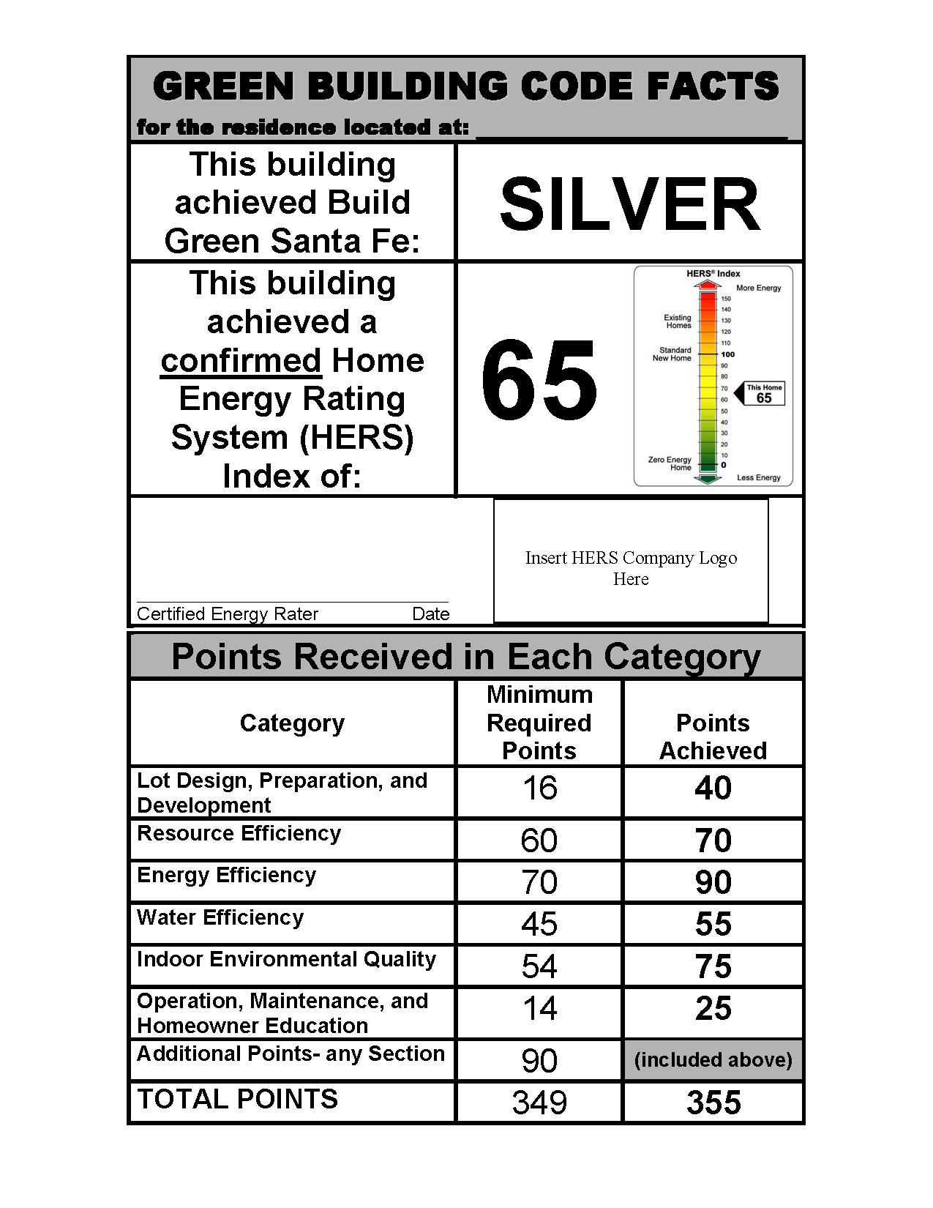
A report that reflects the final HERS score is posted in the window of the rated home prior to the issuance of a Certificate of Occupancy and may only be removed by the first occupant
Notes:
A report, similar to the shown here, that reflects the final HERS score is posted in the window of the rated home prior to the issuance of a Certificate of Occupancy and may only be removed by the first occupant.

Slide 32
Santa Fe Best Practices
Requiring that all new construction receive a HERS rating during the initial stages of the program familiarized builders with the process of obtaining a target HERS score.
No initial HERS score allowed builders to learn through trial and error how to achieve low ratings Building department personnel were sent to HERS trainings to ensure awareness of the program.
The program is set up to focus primarily on elements of the building envelope.
Building inspectors and HERS raters work together to achieve maximum efficiency in new residential construction.
HERS raters also work closely with one another to ensure consistency and credibility within the Santa Fe HERS community.
Additional training required for HERS raters to ensure quality assurance is maintained
Best practices have led to:
A realistic set of scores for the jurisdiction
An increase in quality of construction
Construction practices that reflect unique needs of the city
An increase in support for the program from the building community
Competition among builders
An increased in use of energy efficient products and technologies
Notes:
Santa Fe’s inventive approach to incorporating the HERS index into a mandatory green building code has fostered a number of best practices for other cities and jurisdictions to follow. Requiring that all new construction receive a HERS rating during the initial stages of the program worked well to familiarize builders with the process of obtaining a target HERS score. Since there was initially no set HERS score, builders could learn through trial and error how to achieve low ratings and Santa Fe could establish a realistic set of scores for the jurisdiction based on feedback from the builders. Additionally, the City of Santa Fe sent building department personnel to HERS trainings to ensure awareness of the program. As a result, the building community throughout Santa Fe understands and supports the local HERS program.
The HERS program in Santa Fe is set up to focus primarily on elements of the building envelope. As such, builders are more aware of the role the building envelope has in efficiency. Construction practices reflect an emphasis on air barriers and other elements included on the required Thermal Bypass Checklist. The quality of construction has increased as well. The HERS program has encouraged competition amongst builders; many builders challenge themselves and others to score the lowest HERS rating for each home size. The competitive environment has encouraged the use of new energy efficient products and technologies.
Furthermore, building inspectors and HERS raters work together to achieve maximum efficiency in new residential construction. Building inspectors are required to inspect for compliance with provisions of the Santa Fe Residential Green Code that are also included as part of a HERS rating. Although building inspectors are not focused solely on the energy efficiency portion of the code, this allows for a second set of eyes on building components such as insulation and air sealing. HERS raters also work closely with one another to ensure consistency and credibility within the Santa Fe HERS community.
The City of Santa Fe has had great success with implementing the HERS index into the residential energy code. However, the city has had to overcome a number of roadblocks as well. Since the credibility of raters is often an issue with HERS programs, Santa Fe requires additional training for HERS raters to ensure quality assurance is maintained. The city has also struggled with having an adequate number of HERS raters to keep up with the growing demand for new homes.

Slide 33
Resources

Slide 34

RESNET
Gather HERS information
Identify states and jurisdictions using HERS Index
Find a local RESNET HERS rater
www.resnet.us
www.hersindex.com
Notes:
RESNET is the leading resource for collecting HERS Index information, identifying states and jurisdictions using the HERS Index and finding a local RESNET HERS rater.
Visit either resnet.us or hersindex.com for more information.

Slide 35
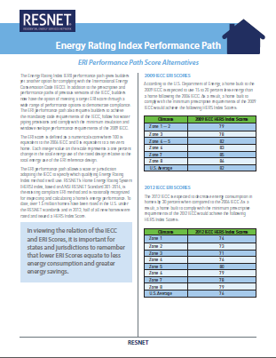
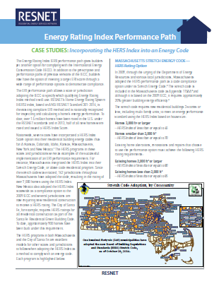
Energy Rating Index Fact Sheets
Six informational fact sheets are available
Overview of the ERI Performance Path in the 2015 IECC
Benefits of the Energy Rating Index Score Option
Frequently Asked Questions
Cost Effectiveness of Using the ERI to Comply with the 2015 IECC
Implementation Guidelines for the ERI Performance Path
ERI Performance Path Score Alternatives
Case Studies: Incorporating the HERS Index into an Energy Code
Notes:
In addition, BMG was contracted by RESNET to develop a series of informational factsheets to raise awareness for and answer questions regarding the ERI performance path of the IECC.
The fact sheets include:
Overview of the ERI Performance Path in the 2015 IECC
Benefits of the Energy Rating Index Score Option
Frequently Asked Questions
Cost Effectiveness of Using the ERI to Comply with the 2015 IECC
Implementation Guidelines for the ERI Performance Path
ERI Performance Path Score Alternatives
Case Studies: Incorporating the HERS Index into an Energy Code

Slide 36
Questions?

