Slide 1
SDC 200, 300, 900 & 1600
An Overview of the Standards Development Committees (SDC)
Sharla Riead, Chair of SDC 200 Gayathri Vijayakumar, Chair of SDC 300
John Hensley, Chair of SDC 900
Anna Kelly, Chair of SDC 1600

Slide 2
SDC 200
Education, Training, and Certification
Sharla Riead EnergySmart Institute, Lead Instructor

Slide 3
Members
Chair: Sharla Riead, EnergySmart Institute
Users
Users
Mary English, Metropolitan Energy Center
Jesse Krivolavek, Millennial Impact Six
Doug McCleery, MaGrann Associates
Mark Schroer, Habitat for Humanity, Retired
The RESNET Standards Development Committee 200 is responsible to oversee RESNET’s education, training assessment and certification standards and amending the standards.
Builders, Government &
Private Sector Programs
Producers
Producers
Robert Cantrell, Strand AE
Tei Kucharski, Florida Solar Energy Center
Eurihea Speciale, Building Efficiency Resources
Training Providers,
HERS Raters,
QADs
General Interest
General Interest
Rod Buchalter, RenewABILITY Energy Inc.
Olga Cano, HUD Public & Indian Housing Office
Robert Lipkins PhD, Consulting Psychometrician
Zak Shadid, EPA ENERGY STAR Residential
Advocates, Educational
Institutions, Government
Entities

Slide 4
Work Item
Responsibilities:
Training Provider
Rating QA Provider
Graded Field Evaluation
Probationary Ratings
Probationary Models
Interpretation Request
Graded Field Evaluation is not an Examination
2024 Achievements
Editorial Updates
Editorial changes to MINHERS Chapter 2
HERS Modeler
HVAC Grading
General Clarification
Typos/Spelling/Etc.

Slide 5
2025 Plans
RESNET RFI Credentialing Changes
Training Content and Delivery Standards
RESNET Practical Simulation instead of RESCAZ Simulation, Building Science and RESNET Knowledge
Quality and oversight of training content, delivery, and Proctoring
HERS Modeler Credentialing Changes
Certification under Multiple Providers
Standards for Professional Development
Impacts to Chapter 1 & 9 as well

Slide 6
THANK YOU

Slide 7
SDC 300
Inspections, Testing, and Calculations of Energy Ratings
Gayathri Vijayakumar, Chair of SDC300 Steven Winter Associates, Principal Mechanical Engineer

Slide 8
Members
Chair: Gayathri Vijayakumar, Steven Winter Associates, Inc.
Users
Brian Shanks, Beazer Homes
Charlie Haack, NAIMA
Edwin Hensley, Habitat for Humanity
Robby Schwarz, Build Tank
The RESNET Standards Development Committee 300 is responsible to oversee RESNET’s technical standards related to the inspections, testing, and calculations that impact an energy rating and amending those standards.
Users
Builders, Government &
Private Sector Programs
Producers
Josh Spence, PEG
Gayathri Vijayakumar, SWA
Kelly Parker, Guaranteed Watt Savers
Thiel Butner, Pando Alliance
Terry Clausing, Drysdale & Associates
Producers
Training Providers,
HERS Raters,
QADs
General Interest
General Interest
Advocates, Educational
Institutions, Government
Entities
Dean Gamble, EPA ENERGY STAR Residential
Ian Finlayson, Mass. Dept of Energy Resources
Jason Toves, ICC
Rob Salcido, PNNL
Philip Fairey, Florida Solar Energy Center

Slide 9
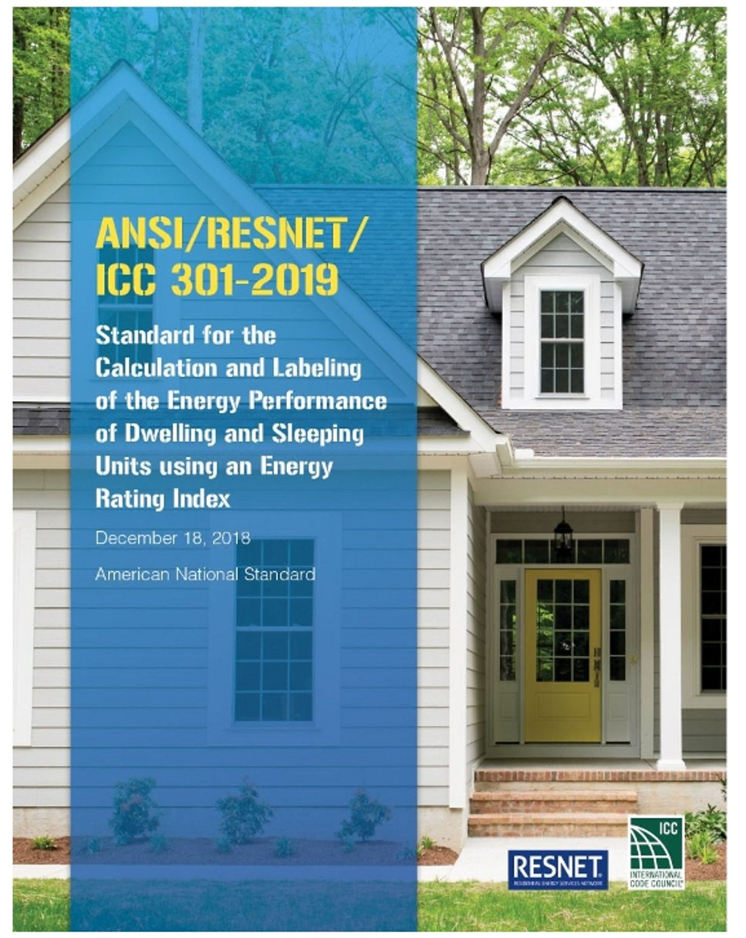
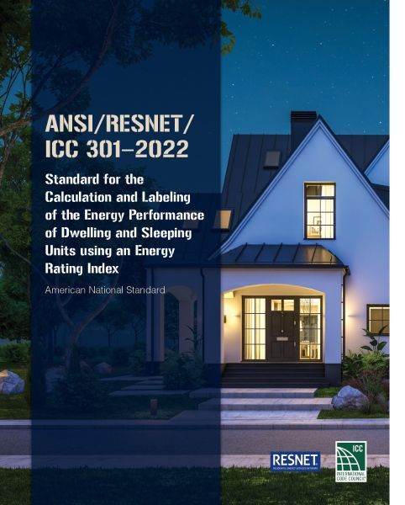
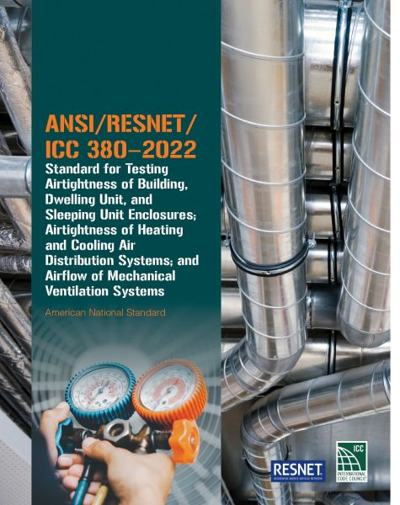
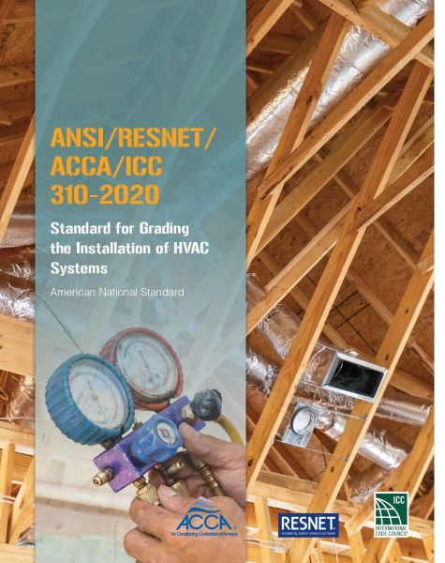

Slide 10
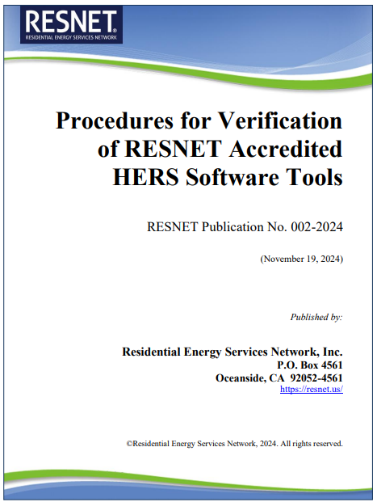
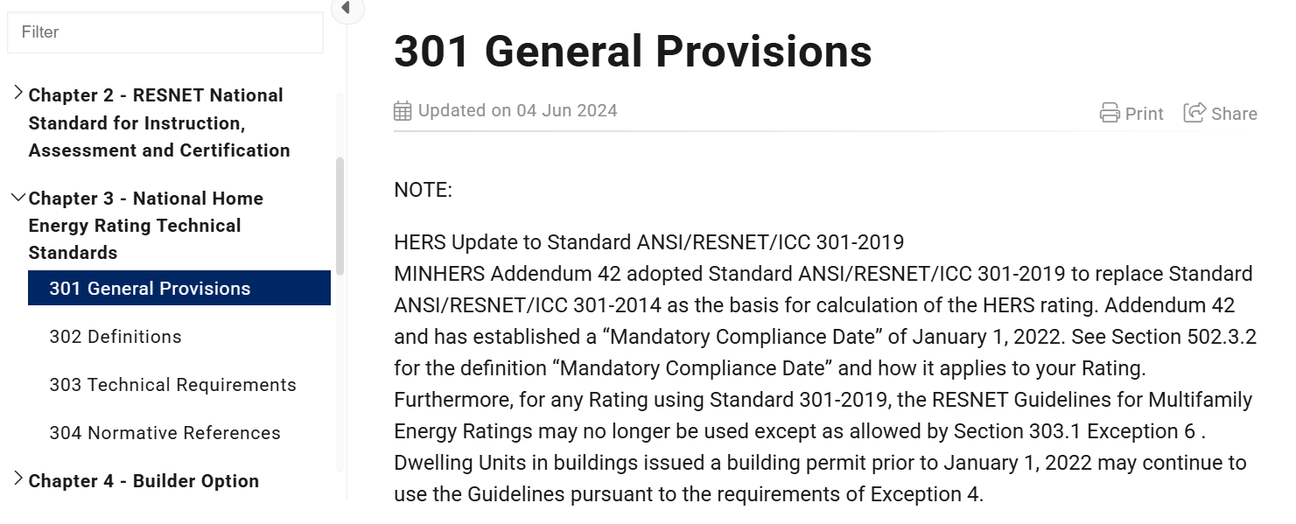
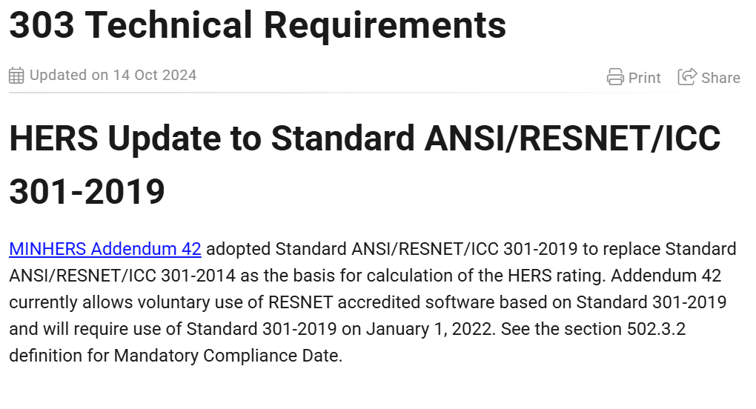

Slide 11
Developing ANSI 301-2022
Addendum A
Addendum B
Addendum C
Addendum D
Interpretations
New changes
Public Comments

Slide 12
RESNET Adopts ANSI 301-2022 in July
Addendum A
Addendum B
Addendum C
Addendum D ?
Addendum E
MINHERS
Addenda

Slide 13
Changes in ANSI 301-2022
If solar or other renewable energy on-site is being modeled in the rating:
Raters will need to document the status of the Renewable Energy Certificate (REC)
Retired, retained, sold/transferred, none associated, unknown
A Minimum Rated Feature has been added for Onsite Battery Storage which will affect the ERI calculation and will require Raters to determine and record the following:
Storage type
Maximum kW charging/discharging rates
Usable kWh capacity
Round-trip efficiency

Slide 14
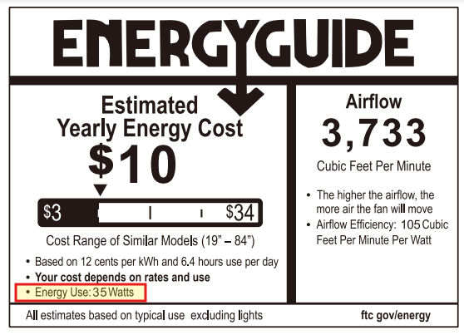
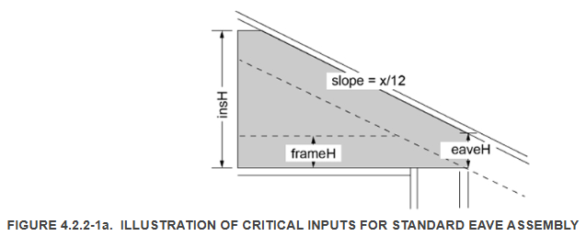
Changes in ANSI 301-2022
When modeling the home/building, Raters will be required to:
Enter the “Energy Use” Watts from the Energy Guide Label for ceiling fans, instead of LCFSW
Model the venting strategy for clothes dryers
Vented or Ventless
Document the orientation of exterior walls
Document the roof shape
Flat, sloped/shed, hip and gable
Document roof eave geometry

Slide 15
Changes in ANSI 301-2022
For homes or dwelling units with Central Fan Integrated Supply (CFIS) Systems that provide ‘Dwelling Unit Mechanical Ventilation’, rules are now in the Standard for how to model them.
Raters must document the following:
How outdoor air is controlled: mechanical damper or other flow control
Primary blower fan control strategy: runs on a fixed timer interval or runs during heating and cooling operations
Strategy for meeting any remainder of a ventilation target: supplemental system, blower fan
Blower fan model number
Raters must test the following:
The ventilation airflows of each fan for each operational mode used by the system

Slide 16
Changes in ANSI 301-2022
Other HVAC updates and changes:
For forced air distribution systems, Raters must now model the duct area (or use default)
For untested duct systems, can use DLTO default of 4 cfm per 100 ft² of CFA if 100% inside CSV, no building cavities used as ducts, and ducts not located in assemblies adjacent to exterior/USV
For untested ductless systems, to use default DSE of 1.0, must be less than 10ft AND in CSV.
Dwelling unit mechanical ventilation system controls, continuous or programmed/intermittent, must be documented by the Rater, along with photos of the system itself
For ratings with through-wall AC & PTAC units, Raters shall model the portion of the wall assembly occupied by the AC unit separately, using an R-value of 2 or less
Formal inclusion of SEER2 and HSPF2 ratings, including conversion factors

Slide 17
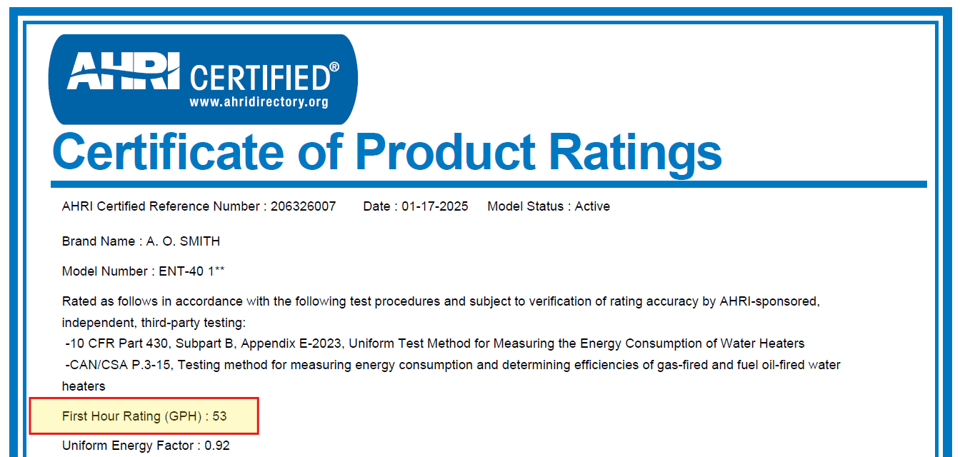
Changes in ANSI 301-2022
DHW updates and changes:
When using UEF for hot water equipment efficiency, Raters must also obtain first-hour rating (GPH)
Slight changes to on-site protocol when verifying hot water distribution systems
Low-flow fixtures
Pipe insulation
Pipe length

Slide 18
Changes in ANSI 380-2022
Clarifications and Refinement of existing practice:
Definitions to better align with RESNET 301 and 310
Infiltration Volume definition, set-up, and test method with respect to Attics, Crawlspaces, Basements and Mechanical Rooms
Infiltration, Duct Leakage, and Ventilation test set-ups with respect to mechanical openings
Dwelling unit infiltration test set-up with respect to adjacent conditioned spaces including dwelling units (which shall be opened for the test unless access is not permitted)

Slide 19
Changes in ANSI 380-2022
Expansions to existing practice:
Passive resistance devices can now be used for ventilation systems with multiple inlet terminals provided there is a passive resistance device simultaneously measuring every inlet
Ventilation test equipment now includes sections for vane anemometers, hot wire anemometers, and non-averaging velocity pressure probes
Inlet and outlet airflows may now be measured using a vane anemometer
Hot wire anemometers, and non-averaging velocity pressure probes may be used for mid-stream ventilation air flow measurements

Slide 20
THANK YOU

Slide 21
SDC 900
MINHERS
Chapter 1, 6 and 9
Key Updates
John Hensley Vice President, Quality Assurance & Training
Building Performance Solutions, LLC.

Slide 22
Chapter 1 - Addendum 67
Key Updates
Comment period ended 01/10/2025 and returned to committee for resolutions.
102.1 Criteria for Rating Quality Assurance Providers
102.1.1.1.3.1
Updates on when the QA Checklist must be used. The scoring of the QA Checklist. Recording of the QA Checklist, and the applicable data requirements as specified in the ANSI & MINHERS Standards.
102.1.1.1.3.1.1
Rating Providers must use the RESNET QA application to complete all QA reviews (File & Field).
102.1.1.1.3.1.2
Prior written approval from RESNET must be received before any alternative formats can be used for the QA Review and/or QA Review Checklist.
RESNET National Standards for Home Energy Ratings

Slide 23
Chapter 1 - Addendum 67
Key Updates – Continued…
Comment period ended 01/10/2025 and returned to committee for resolutions.
102.1 Criteria for Rating Quality Assurance Providers
102.1.3.2
Providers must confirm any use of accredited software tool will not alter previously uploaded HERS or HERSH20 Ratings consistent with section 102.1.10
102.2.2.9.2.1 Updates the Conflict-of-Interest Disclosure
RESNET National Standards for Home Energy Ratings

Slide 24
Chapter 6 – Sampled Ratings
Key Updates
Addendum 46 Update – Standards for Sampled Ratings
Approved: October 17, 2024
Mandatory (Backdated): July 1, 2024
Transition period: January 1, 2024, to July 1, 2024
Interim Addendum 78i – Addressing sunset of Sampling
Establishes a sunset date for sampled ratings of single-family homes.
Approved: October 17, 2024
Mandatory: January 1, 2025
RESNET National Standards for Sampled Ratings

Slide 25
Chapter 9 - Addendum 75
Major Updates
903 Quality Assurance Review of Accredited Providers
903.1.2
Ongoing Review of Rating Quality Assurance Provider QA Activities and Enhanced Quality Assurance REVIEWS Monitoring Of QA Providers - multiple changes as the organization transitions to electronic submission of all records to the registry.
All calculation formats match the most current version
All applicable review items match the most current version
All data fields are mapped correctly for transmission and storage to RESNET Buildings Registry
Multiple update to section 903. Procedures, cleaned up language, disciplinary actions and appeals process
RESNET National Standards for Quality Assurance

Slide 26
Chapter 9 - Addendum 75
Major Updates – continued…
904 Quality Assurance Requirements for Providers
904.3.2
HERS Rater Quality Assurance – requirements of the use of the RESNET QA checklist and the requirement of all records to be uploaded to the Registry.
904.3.3.3.5.1
“Remote QA” Procedures and eligibility – a large section of updated language for file & field QA.
904.4
Rating Quality Assurance Provider responsibility accuracy of records and registry information.
RESNET National Standards for Quality Assurance

Slide 27
Chapter 9 - Addendum 75
Major Updates – continued…
908 Ethics & Consumer Complaints
908.1
Ethics and Appeals Committee make up of the committee Chair and membership.
909 Ethics & Appeals Complaints
Updates to how the complaint is filed to how the complaint is investigated.
910 Provider Accreditation and Renewal Process
Updates were made throughout the entire section – Probation, Suspension, and Revocation of Accreditation of Providers.
Appendix B: Definitions Added
In-field Field QA, QA Evaluation Period, and Certification Period
RESNET National Standards for Quality Assurance

Slide 28
Special thank you to the team!
Chairman: John Hensley, Building Performance Solutions, LLC
Vice Chairman: Emelie Cuppernell-Glitch, Performance Systems Development
Members:
Michael Arblaster, Harmony Home Energy
Cristen Burrell, Arizona Public Service
David Choo, CalCERTS
Phil Crone, Leading Builders of America
Leo Jansen, Energy Efficient Homes Midwest
Dean Potter, K. Hovnanian Homes
Elliot Seibert, U.S. Environmental Protection Agency
Jerrica Stacey, ICC
Frank Swol, EAM Associates, Inc
SDC 900

Slide 29
Thank you!
John Hensley, Building Performance Solutions, LLC
Address
Number
Email
1934 Old Gallows Rd. Suite 350
Vienna, Virginia 22182
571-234-6030
JohnH@BPSconsultant.com

Slide 30
SDC 1600 Update
Calculating CO2e Emissions on Metered Data for Ratings
Anna Kelly SBW Consulting, Director of Innovation and Strategy
Notes:
What we’re going to do is introduce this new standard, why we developed it, and where we are in the process.

Slide 31
Goal
Standardize calculating CO2e emissions from metered data
Scope
SDC 1600
The Purpose
Long-run marginal emissions in building performance
Context
Addresses a growing demand for accurate carbon assessments

Slide 32
SDC 1600 Membership
Anna Kelly
David Goldstein
Chair
David Goldstein (Chair, until October 2024
In loving memory of David Goldstein, whose leadership and dedication inspired us all.
Members:
• Jonathan Arnold, Arnold Development Group
• Michael Browne, Advanced Building Analysis, LLC
• Steve Byers, EnergyLogic
• Philip Fairey, FSEC
• Asa Foss, U.S. Environmental Protection Agency
• Leo Jansen, Energy Efficient Homes Midwest
• Brendan O’Brien, American Gas Association
• Roland Risser, Former Deputy Assistant Secretary for Renewable Power, U.S. Department of Energy
• Craig Sinnamon, Power TakeOff

Slide 33
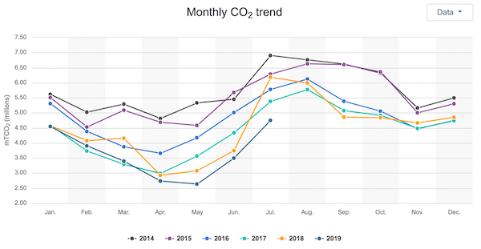
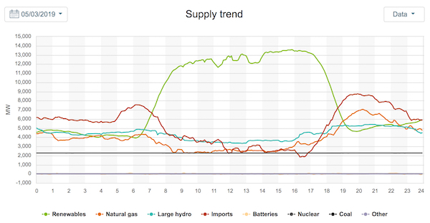
Average Emissions
“On a cool, sunny afternoon in May, average emissions were 284 lbs/MWh, and marginal emissions were 1,012 lbs, MWh”
Marginal Emissions
Sherry Listgarten, Palo Alto Online
Notes:
On a cool but sunny Friday afternoon, May 3 2019 at 1:27pm, average emissions were a low 284 lbs/MWh, but marginal emissions were a sky-high 1012 lbs/MWh.

Slide 34
Why now?
2009
2015
2025
13 Million Meters
65 Million Meters
120 Million Meters
ARRA passed – Investment in smart meters begins.
45% deployed. Utilities overcome data constraints.
Load balancing, grid management, and carbon.
Notes:
Building professionals require accurate, up-to-date ways to calculate carbon impacts
Evolving energy sources and regional variations necessitate a framework that factors in marginal emissions
Supports industry goals for net-zero and carbon-conscious design

Slide 35
Status
Drafting
Discussing
Finalizing and Balloting
Publication
Notes:
Committee and Task Groups formed to draft standard language
Meetings held to refine technical aspects and gather input from experts2
Integration of NREL Cambium data to accurately represent regional emissions factors3
Ongoing reviews to balance consistency with existing RESNET protocols
Key Milestones
Early conceptual drafts developed and reviewed
Discussion on forecasting periods—evaluating shorter vs. longer look-ahead windows
Resolving data sourcing questions around grid fuel mix and future projections
Anticipated TimelineNear-term: Finalizing draft text and balloting within SDC
Mid-term: Public comment period and resolution of stakeholder feedback
Long-term: Publication of the new standard and integration with other RESNET tools

Slide 36
THANK YOU

