Slide 1
Setting The Standard Straight!
Understanding ANSI/ACCA/RESNET Standard 310
Chris Hughes
Bill Graber

Slide 2
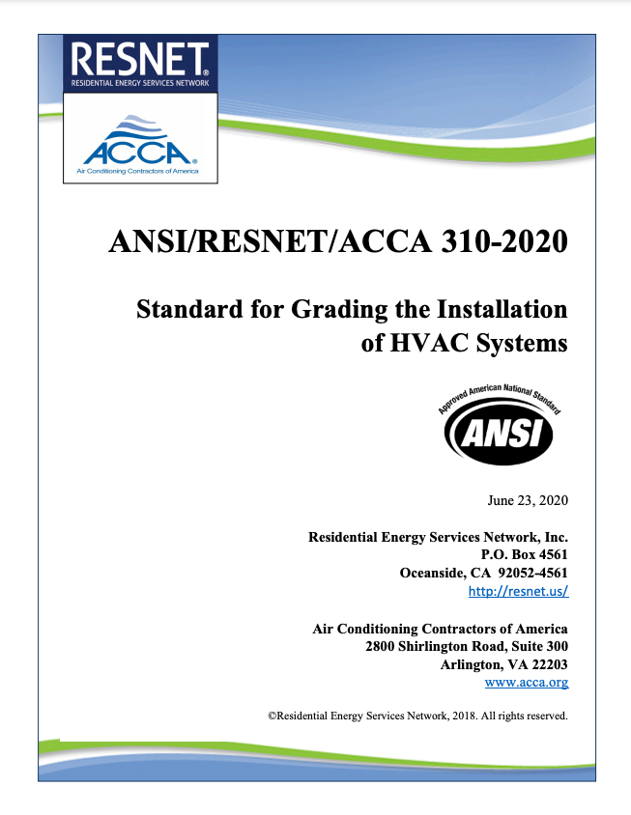
Standard 310
A Step-By-Step HVAC Grading Process

Slide 3
Standard 310
A Step-By-Step HVAC Grading Process

Slide 4
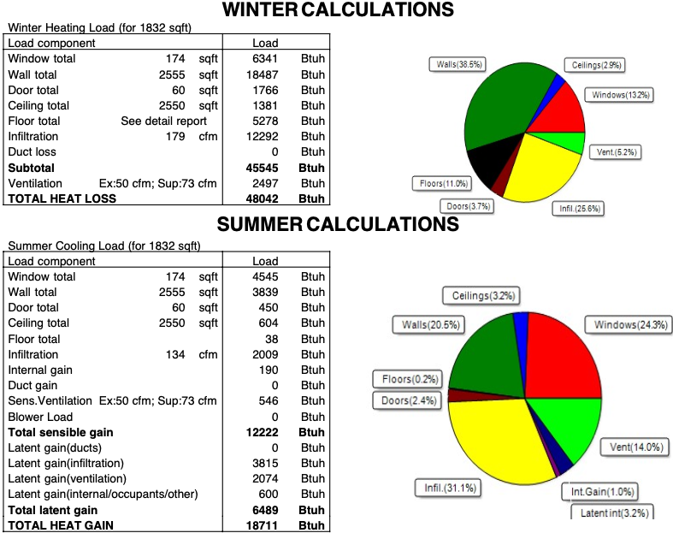
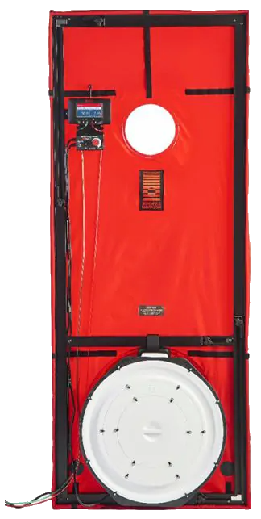
Design Review
Infiltration
Orientation
U-Value
ETC.

Slide 5
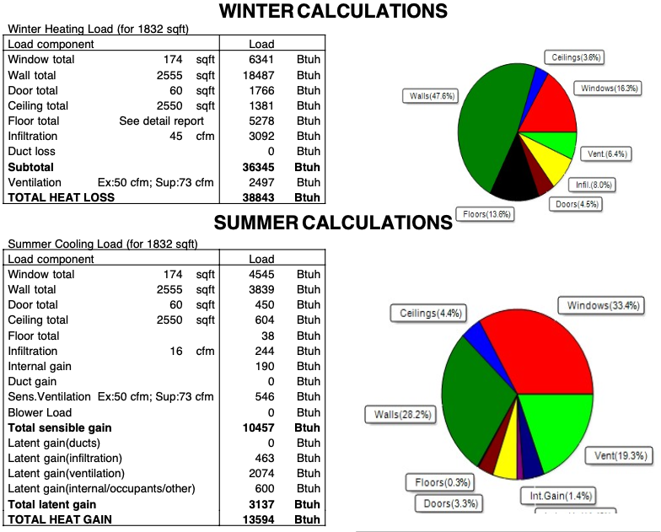
Design Review – Why It Matters
Loose SHR = 0.65
Tight SHR = 0.77
Infiltration Reduction
Heating = 9,199 BTU/h (19%)
Cooling = 5,117 BTU/h (27%)
(Sensible = 1,765)
(Latent = 3,352)

Slide 6
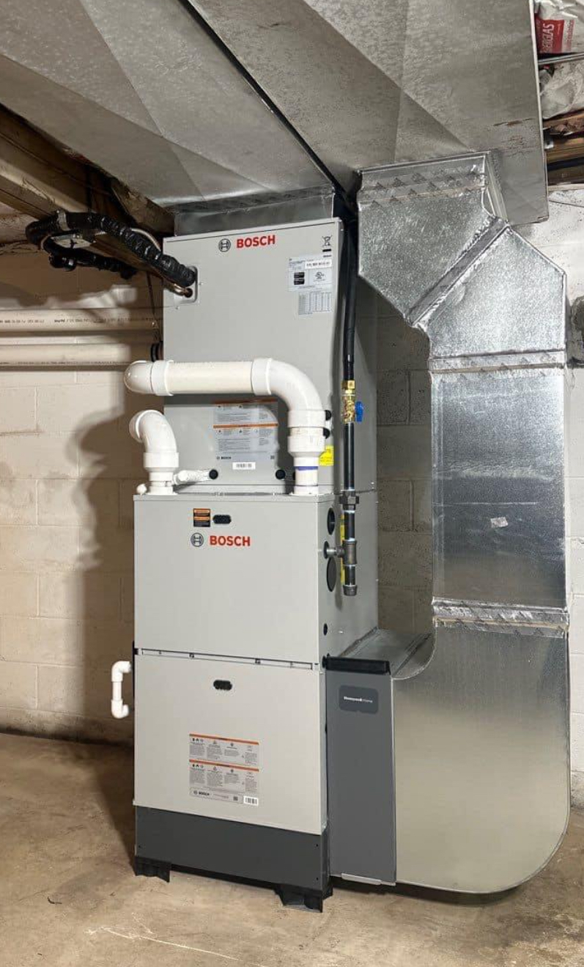
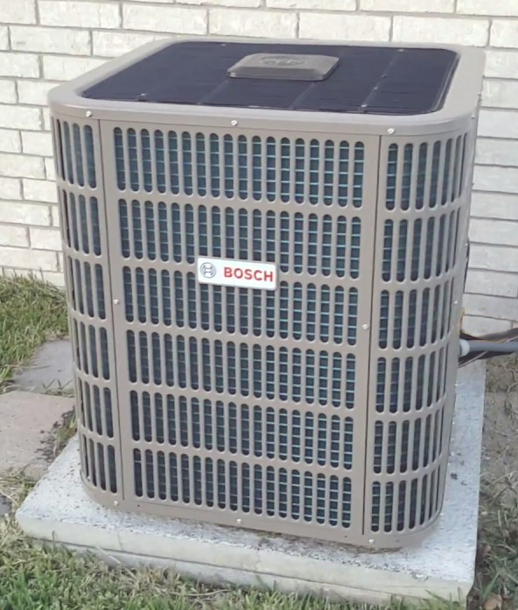
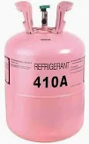
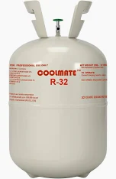
Design Review – Very Important Takeaway!
4. Task 1: Evaluation of the Design.
3
4.2.5.3.2. The equipment manufacturer(s) and model number(s)¹⁵.
15 (Informative Note) For equipment types that include both an evaporator/fan-coil and a condenser, include the manufacturer and model number for both components.
2
1
A2L
Refrigerant is here!

Slide 7
Standard 310
A Step-By-Step HVAC Grading Process

Slide 8
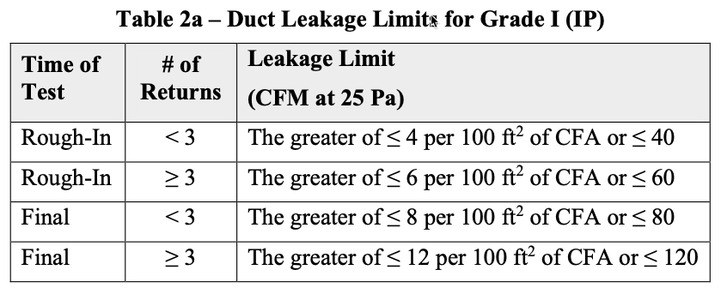
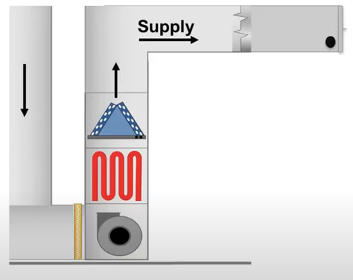
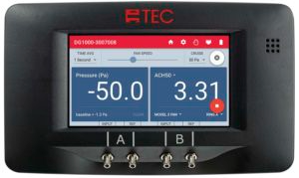
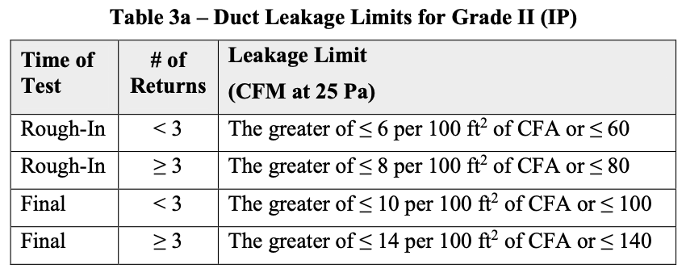
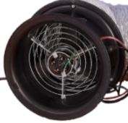
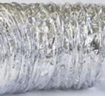
Total Duct Leakage – What Is It?
Tables from Standard 310
-25.0
50.0
-25Pa
Test Pressure

Slide 9
Florida Case Study
Time To Measure The Leaks
A Duct Blaster or Blower Door test is needed at this time
In this case, the Tech had a blower door
Blower Door Results
3230 CFM50
9.4 ACH50
Notes:
To measure the leakage one can, apply the use of the DuctBlaster or Blower door test to find the leakage. These methods will be explained in detail further in the class.
For now, we are going to give you the CFM leakage answer which was measured at 380 CFM.

Slide 10
Florida Case Study Summary
384 CFM leak
1400 CFM
1016 CFM
384 CFM of Duct Leakage To Vented Attic (Outside)
384 CFM comes into the house through leaks
Notes:
Adding the duct leakage amount to the natural infiltration amount tells us theat we have 384 CFM of infiltration to deal with rather than the Manual J predicted infiltration load of 102 CFM.

Slide 11
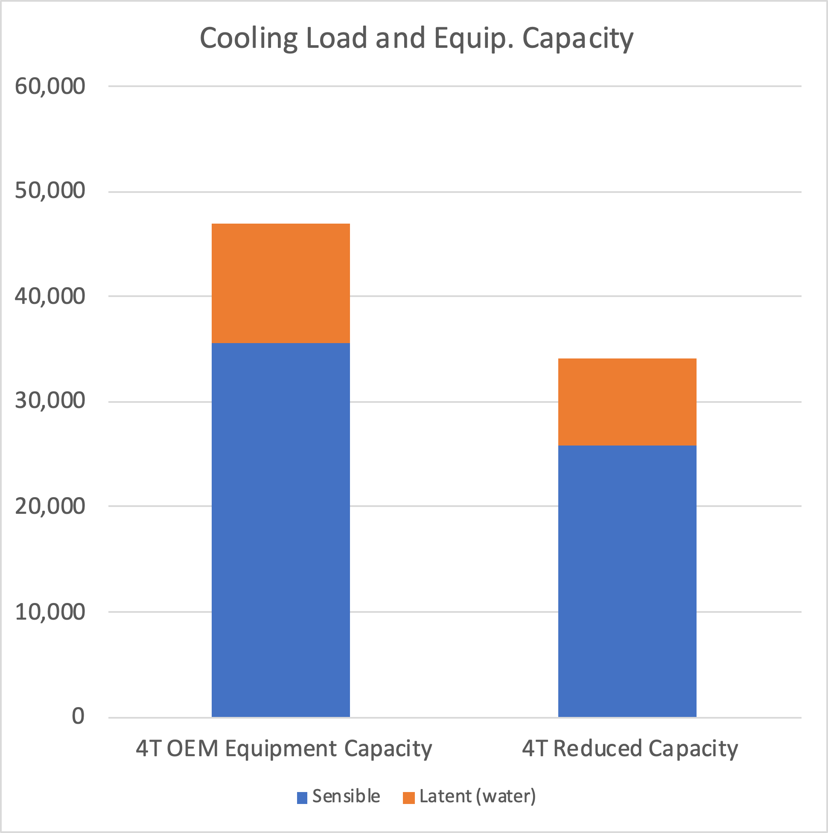
¼ of the capacity is lost out the attic!
Because of 384 CFM Leakage
Notes:
This slide shows a capacity reduction feeding the home due to the conditioned air not reaching its proper location.
¼ or 25% is lost out the attic – we can’t use that to cool the house anymore.

Slide 12
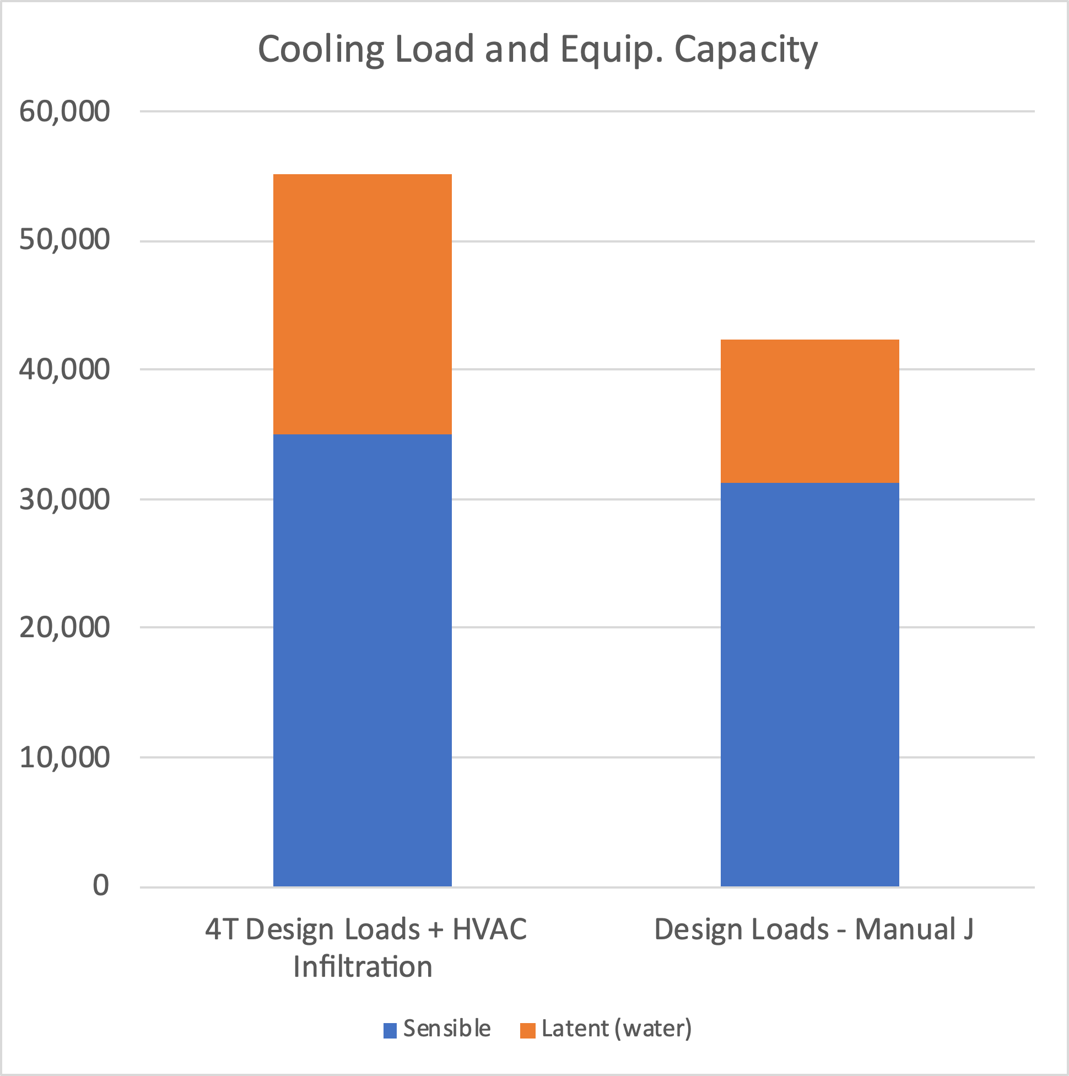
Also: The house sucks… in hot humid air!
Because of 384 CFM Extra Infiltration
Notes:
Notice the increase of latent capacity on the house, this is largely because of the type of air that is coming into the home. This extra load is full of humidity.

Slide 13
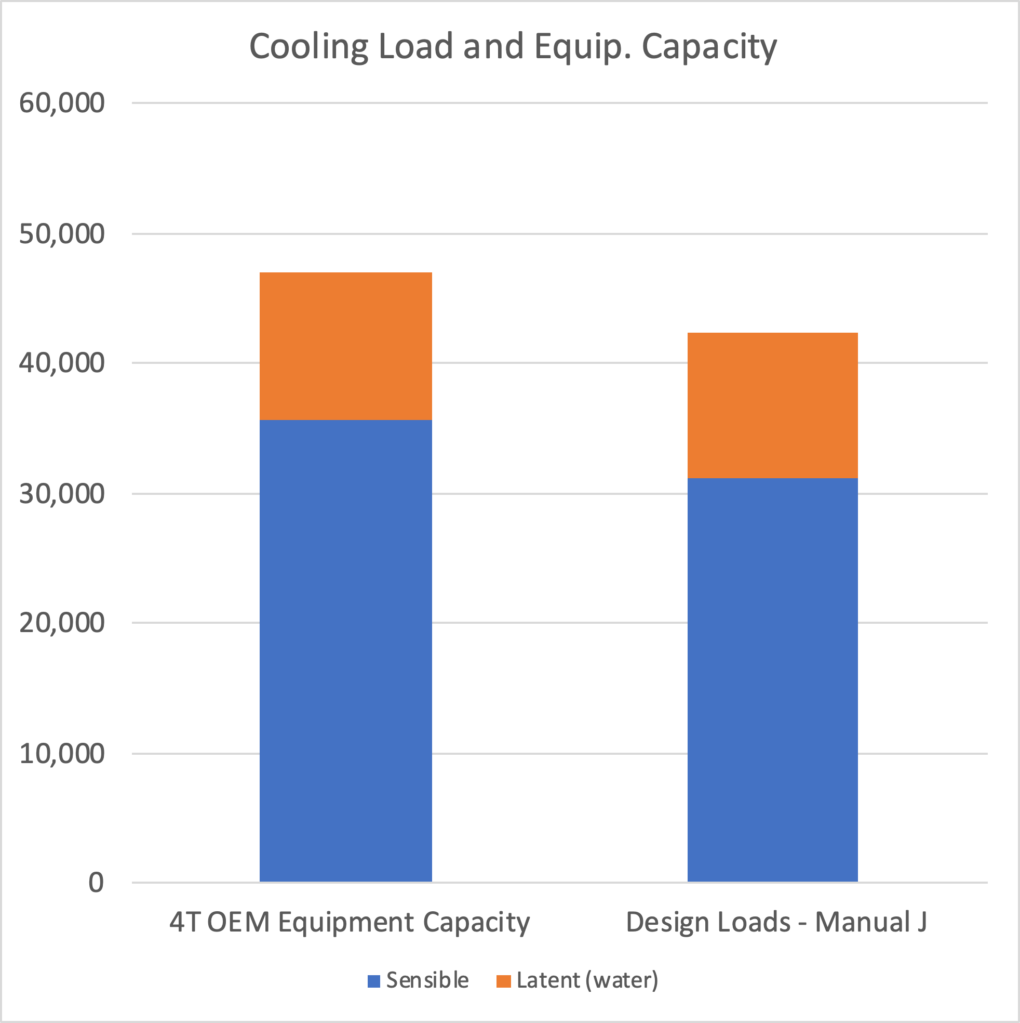
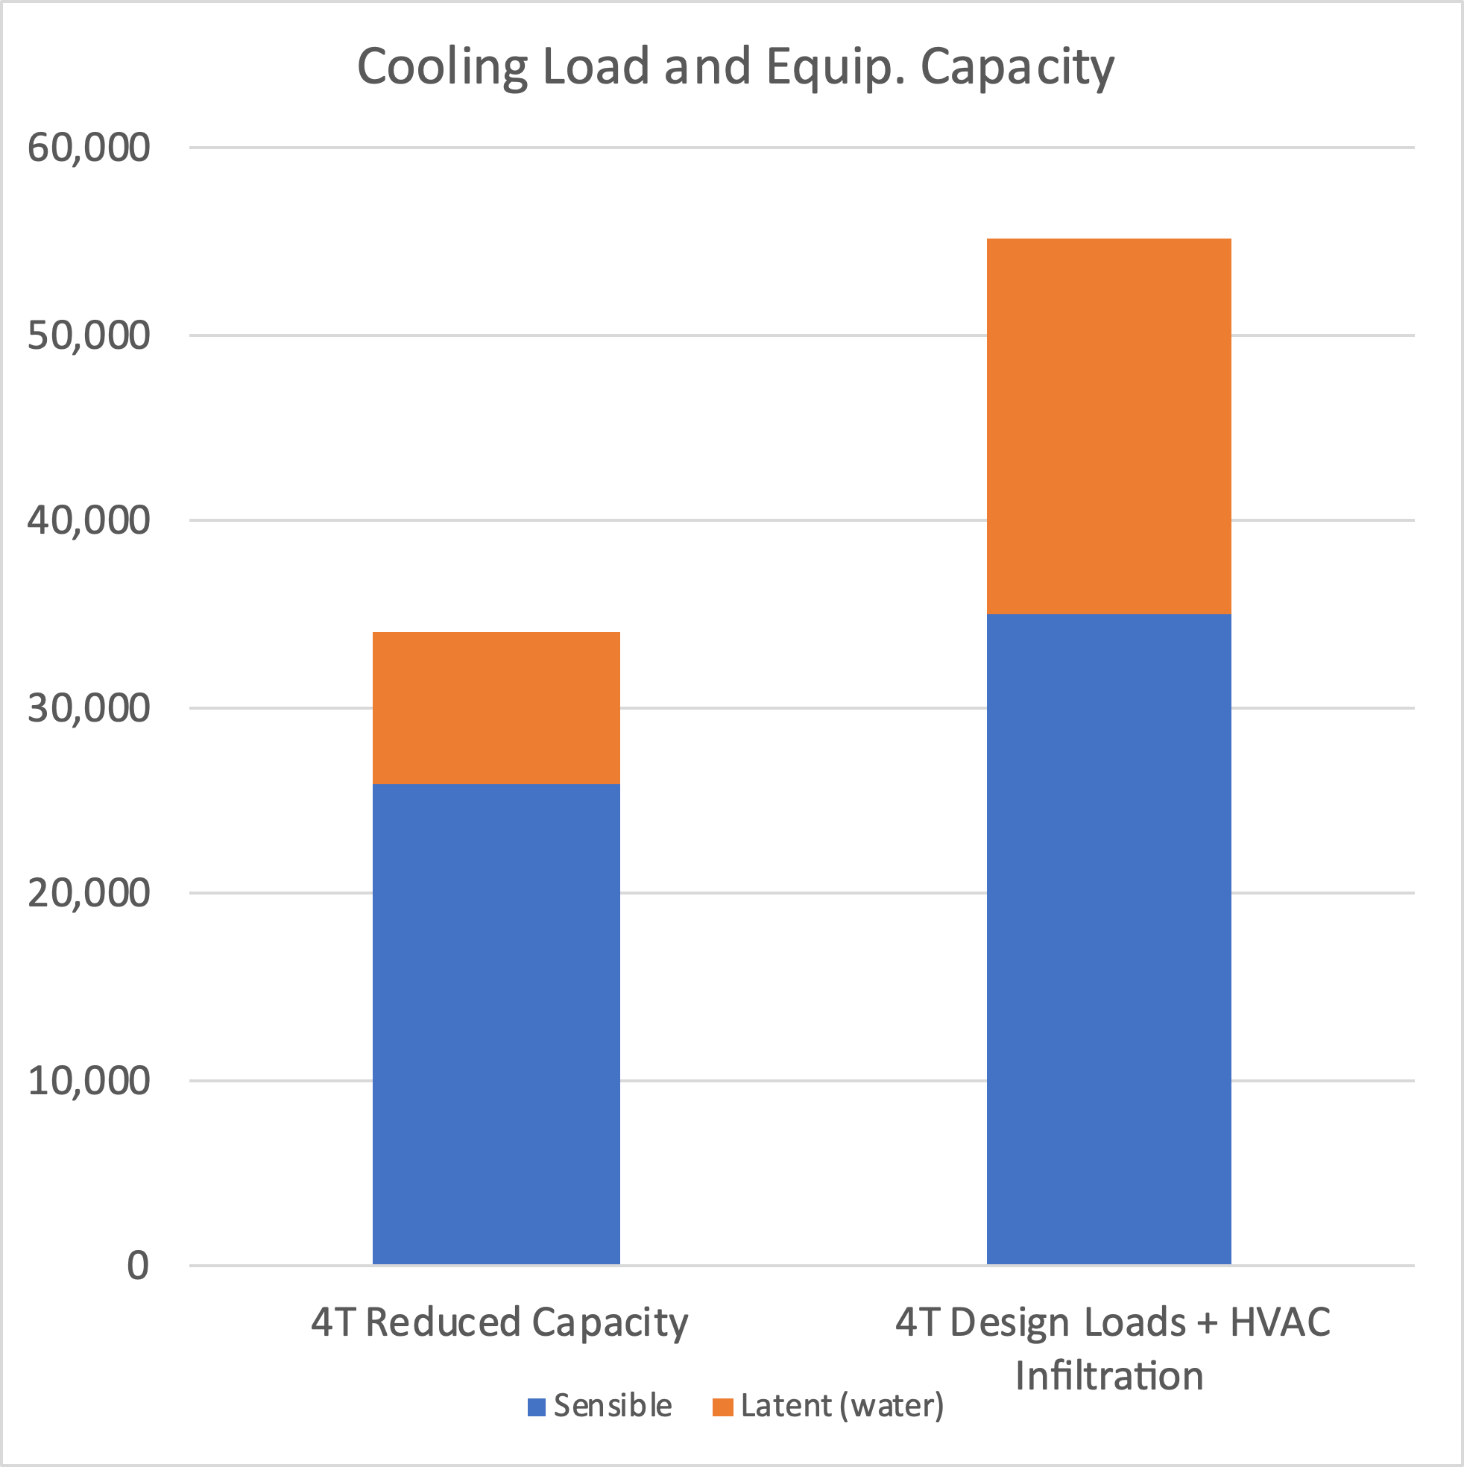
Is Leaking 380 CFM a Big Deal – YES, It IS!
102%
41%
*Before
114%
74%
Notes:
Obviously, we have a reduced capacity of the air conditioner.
With the house now sucking in hot humid air we also have an increased load that the AC can not handle.
Now we can see what is affecting this customer’s comfort.

Slide 14
Standard 310
A Step-By-Step HVAC Grading Process

Slide 15
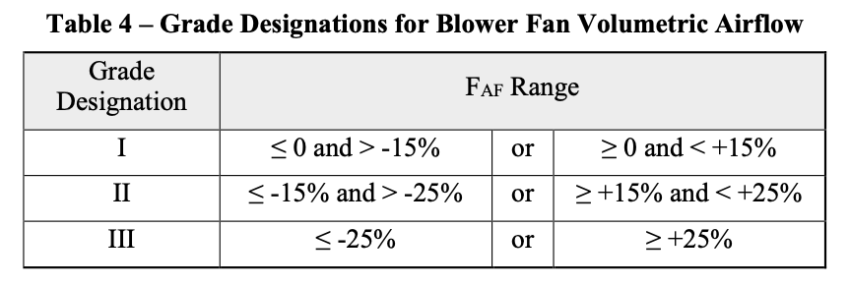
Blower Fan Airflow – What Is It?
*15 Minutes of run time
100% Capacity = Wet Indoor Coil
“Design” Fan Speed
*

Slide 16
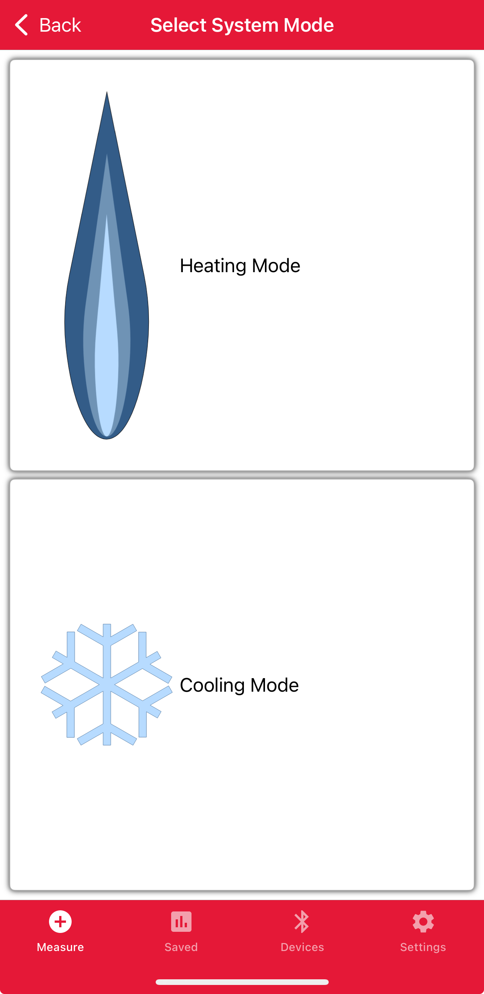
1400 CFM
1200 CFM

Slide 17
The Soap Box Speech!
Water Removal capacity
At 465 CFM/ton
.81 SHR = 6120 BTU/h = 6.1 pints/hr
At 360 CFM/ton
.71 SHR = 9570 BTU/h = 9.5 pints/hr
*Based On Goodman Equipment

Slide 18
Fun Fact Reference!
1 pint of water in the vapor state takes up about an average size bedroom at design conditions
1,472 Cu. ft. Or
~175 Sq. ft.
=
Design 75⁰ F 50%RH

Slide 19
Standard 310
A Step-By-Step HVAC Grading Process

Slide 20
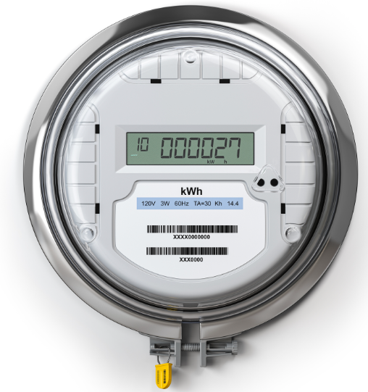
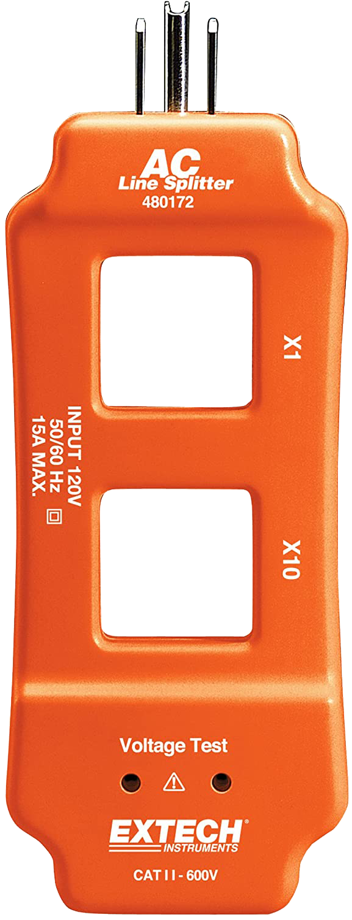
Blower Fan Watt Draw – What Is It?
4
Grade III
Blower Fan Watt Draw
Grade I or II
Plug-In Watt Meter
Clamp-On Watt Meter
House Utility Meter

Slide 21
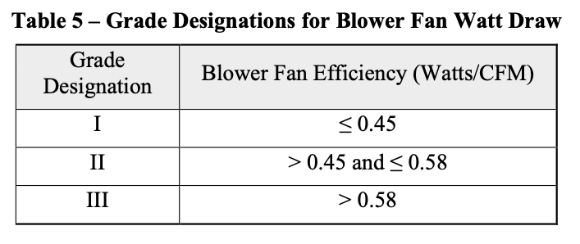
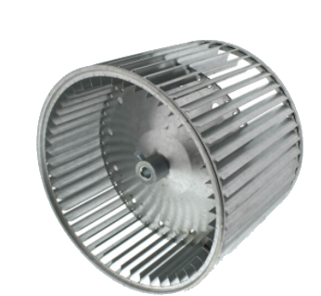
Blower Fan Watt Draw – Where It Matters
Watts
CFM

Slide 22
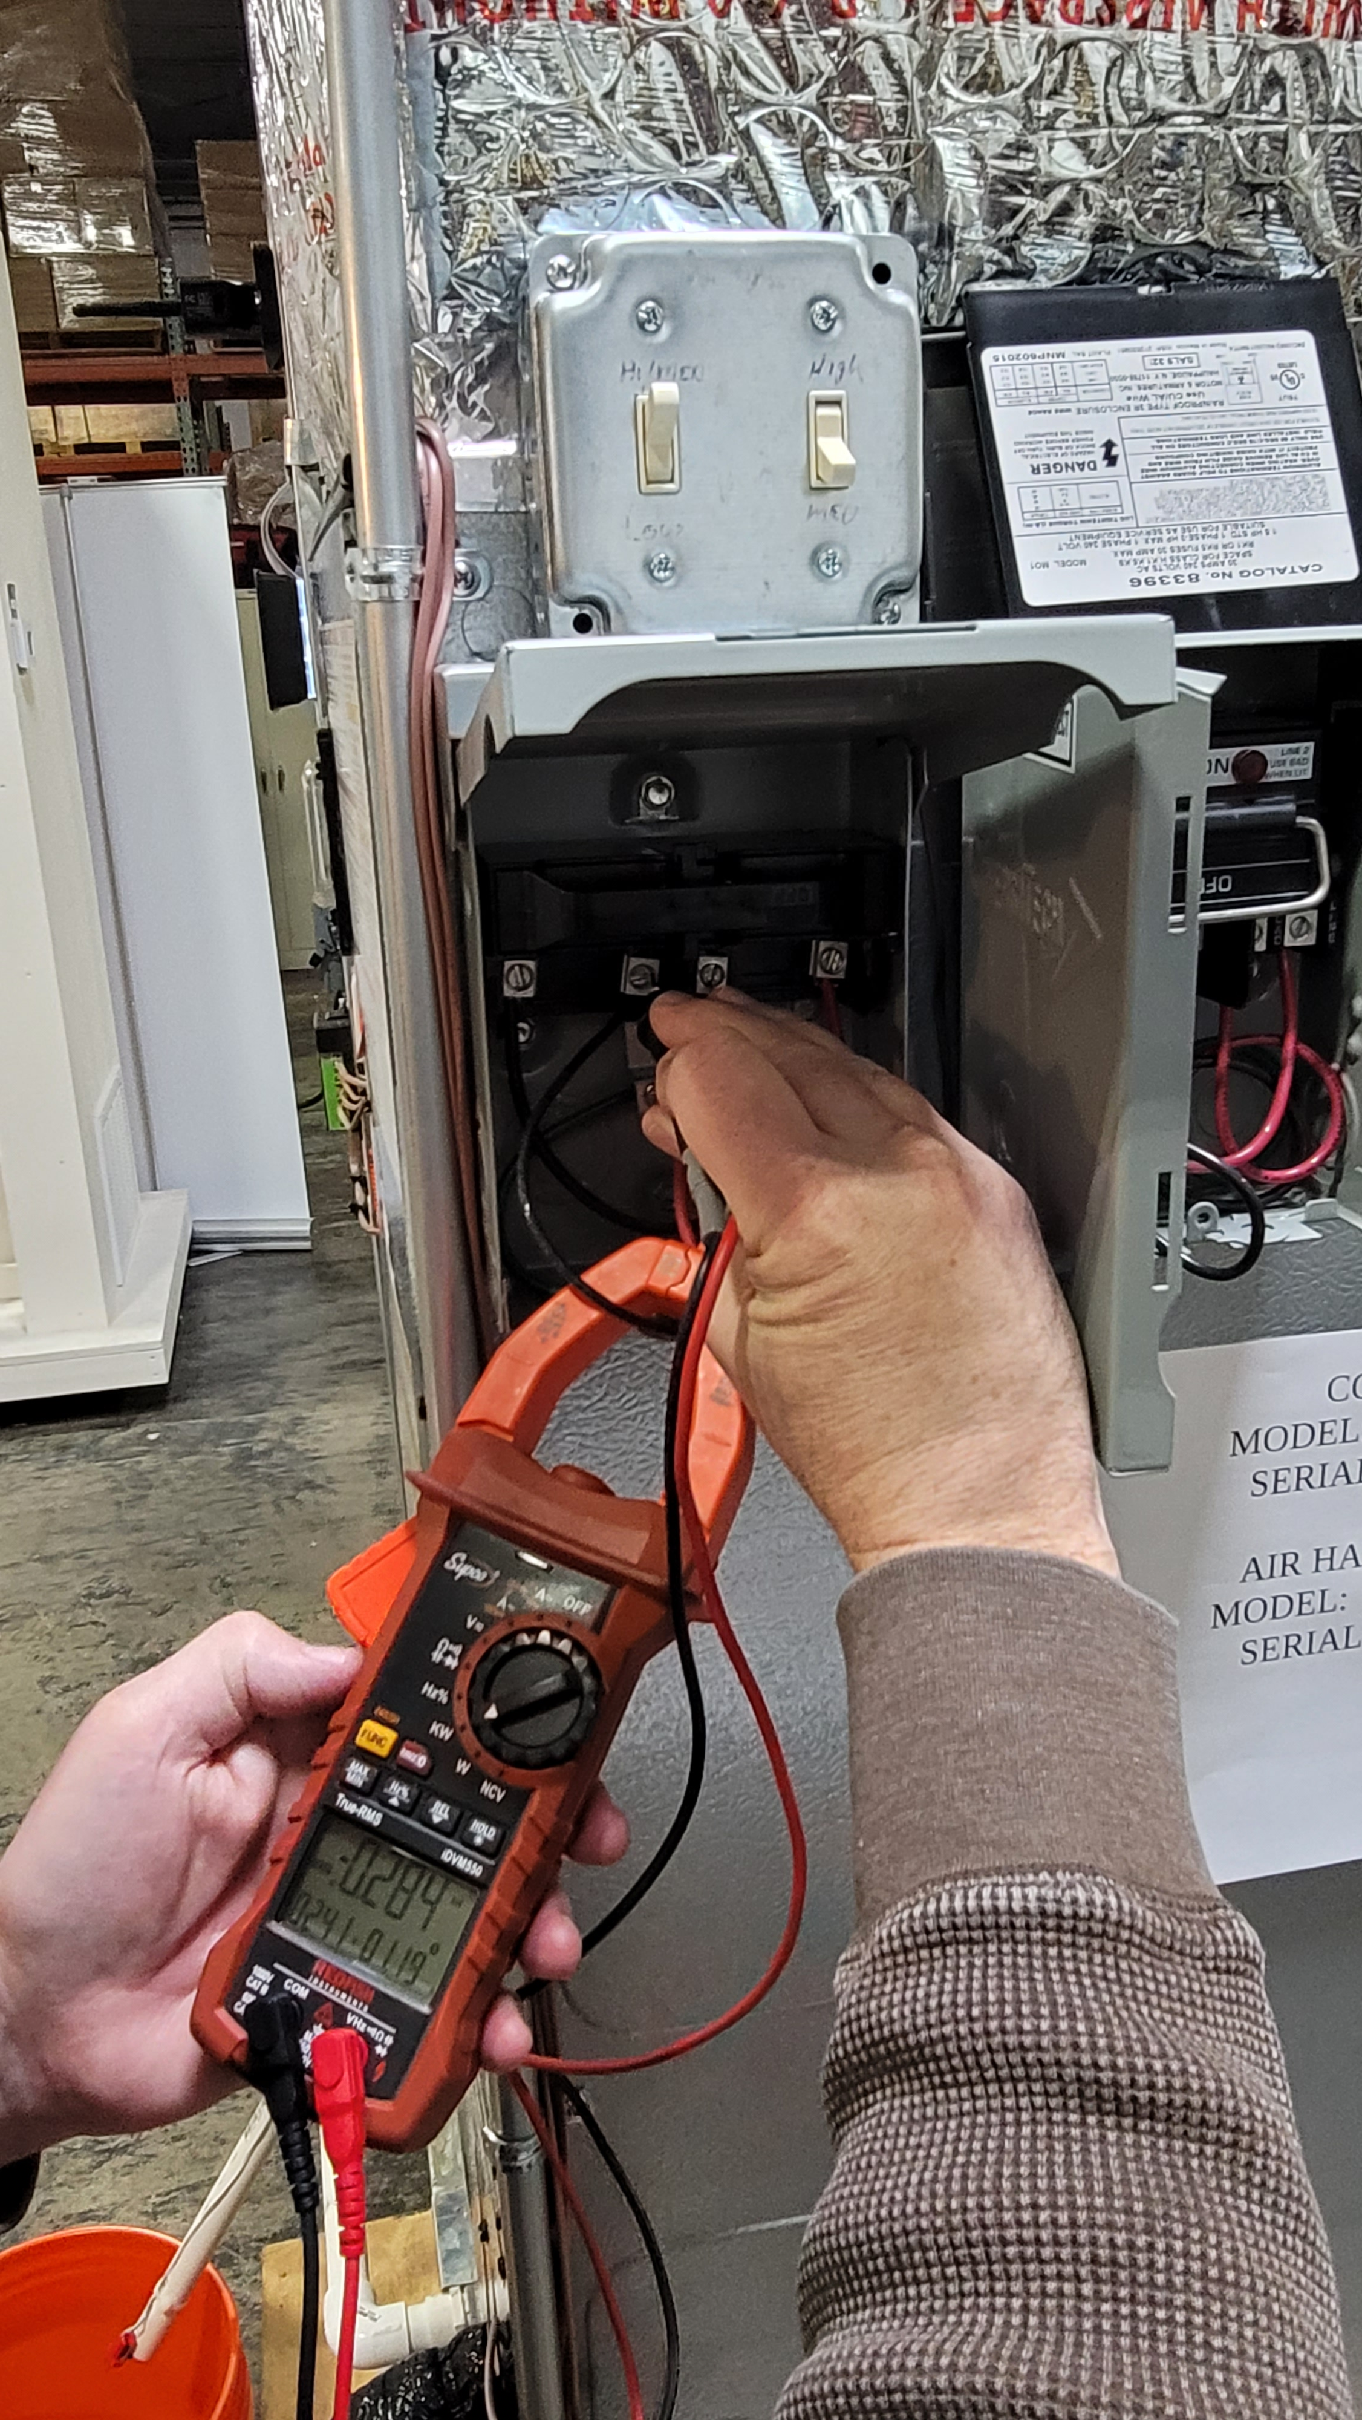
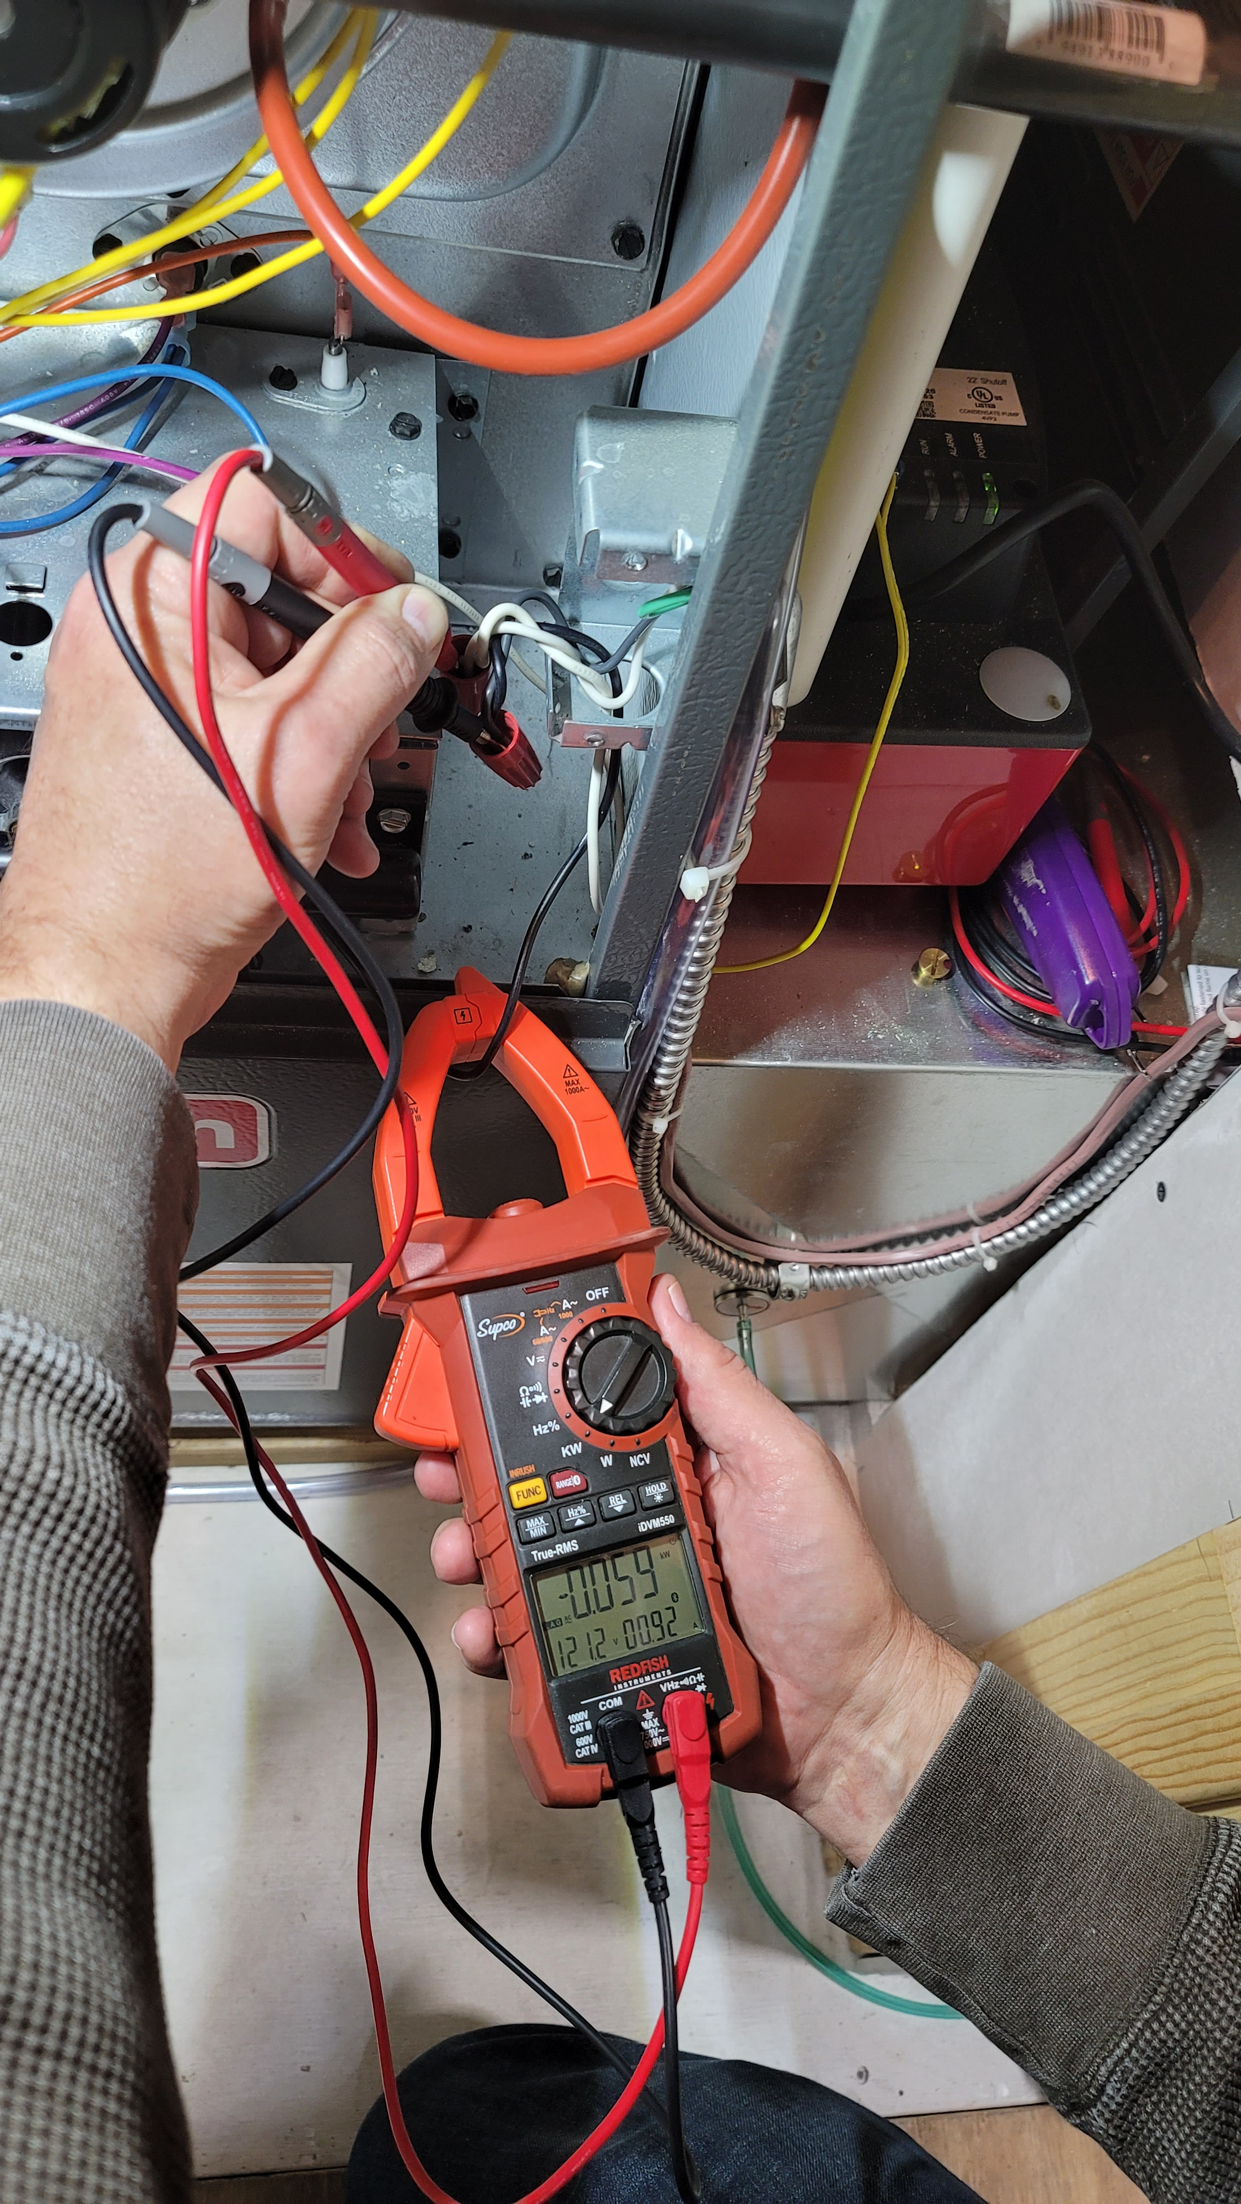
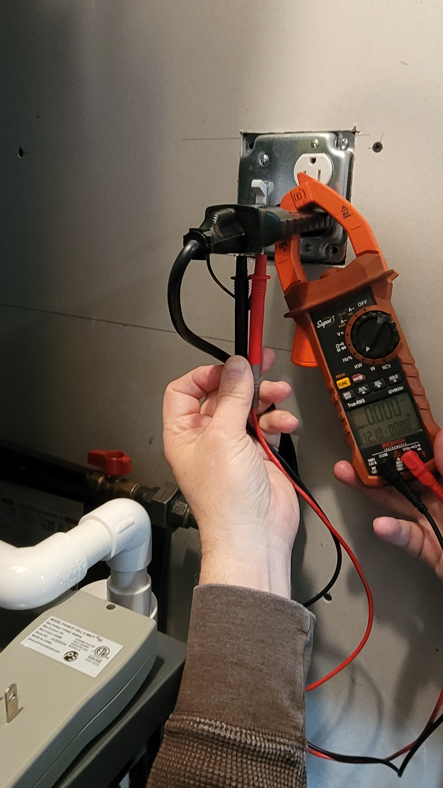
Blower Fan Watt Draw – How Do We Do It?
Note: Hot Wire & Ground Wire
At the Service Disconnect
At the Forced-Air HVAC System
At the Forced-Air HVAC System

Slide 23
Standard 310
A Step-By-Step HVAC Grading Process

Slide 24
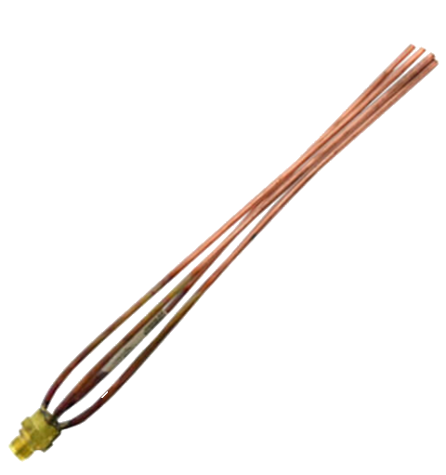
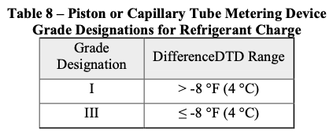
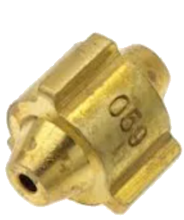
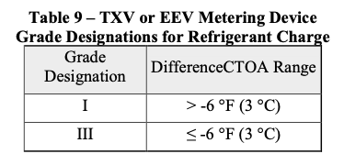
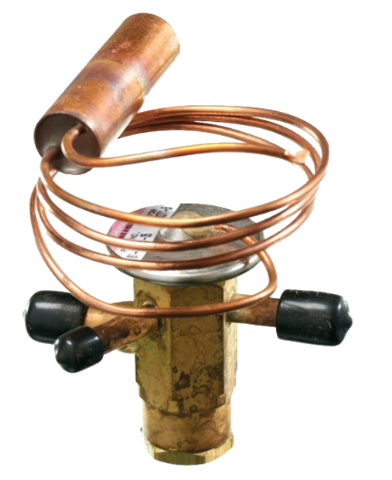
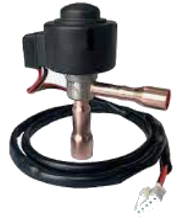
Refrigerant Charge – Where It Matters
Orifice or piston
Capillary Tube
Electronic Expansion Valve
(EEV)
Thermostatic Expansion Valve
(TXV)

Slide 25
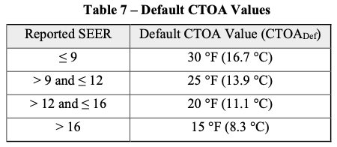
Non-Invasive Refrigerant Charge – The Math
Difference DTD (Design Temperature Difference)
DDTD = Suction Line Temp Target – Suction Line Temp Measured
DifferenceDTD Range
SLTT = Return Air Dry Bulb – DTD + Target Superheat (manufacturer)
DTD = Return Air Dry Bulb – Saturated Suction Temperature
Difference CTOA (Condensing Temperature Over Ambient)
DCTOA = Liquid Line Temp Target – Liquid Line Temp Measured
DifferenceCTOA Range
LLTT = Outdoor Dry Bulb + CTOA – Target Subcooling (manufacturer)

Slide 26
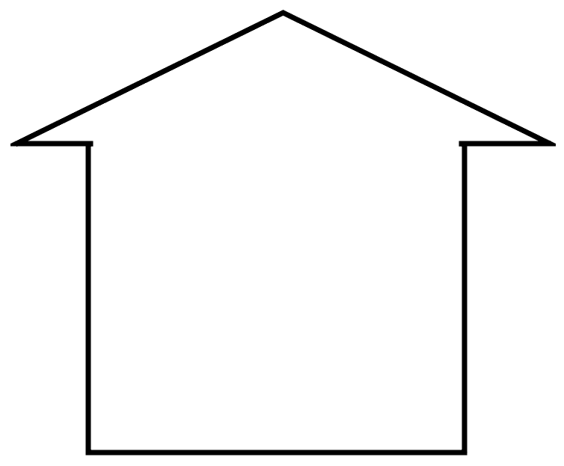
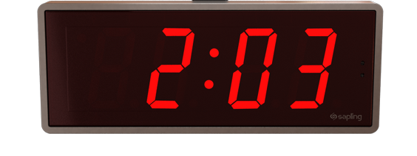
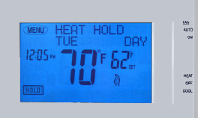
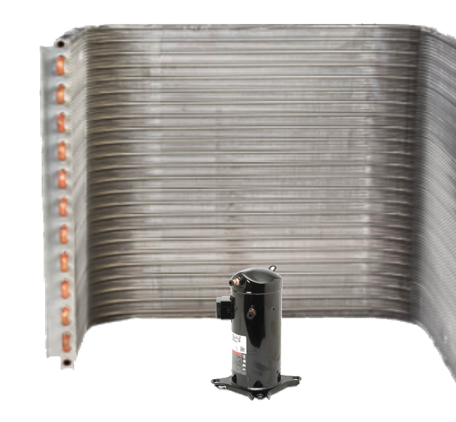
Non-Invasive Refrigerant Charge – What Do I Need To Know?
1. Ambient Dry Bulb Outdoor
2. Return Air Dry Bulb Indoor
3. Return Air Wet Bulb Indoor
4. HVAC Suction & Liquid line Temps.
5:00
115⁰ F
50% RH
What do you mean 75⁰ F is comfortable!
80⁰ F
>50% RH
70⁰ F to 75^{0 F} (Depending on SEER)
50% RH
70⁰ F
>50% RH

Slide 27
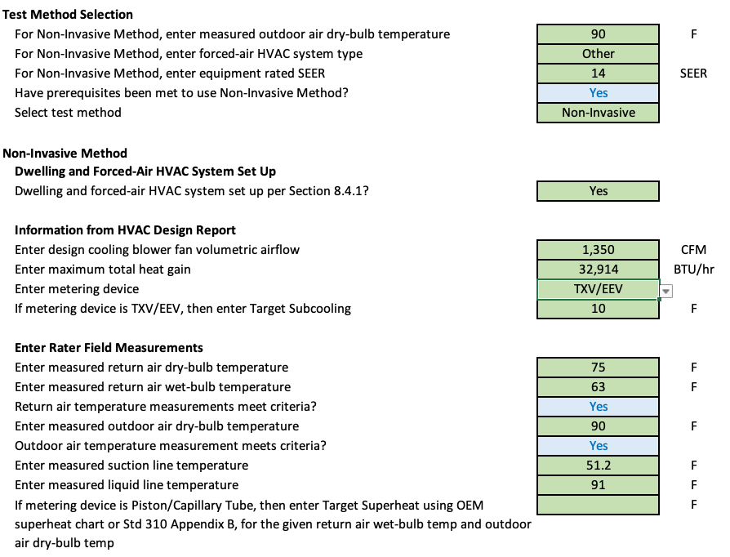
Non-Invasive Refrigerant Charge – Grade I

Slide 28
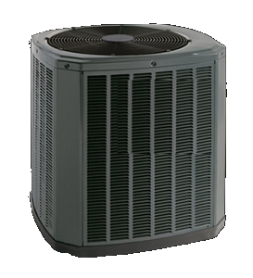
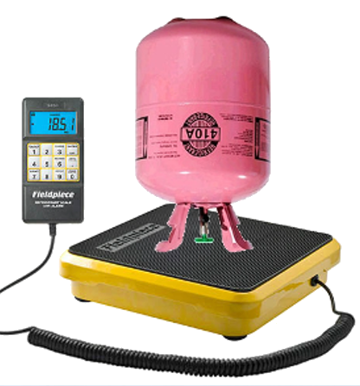
Refrigerant Charge – Option 2
Weigh in Verification

Slide 29
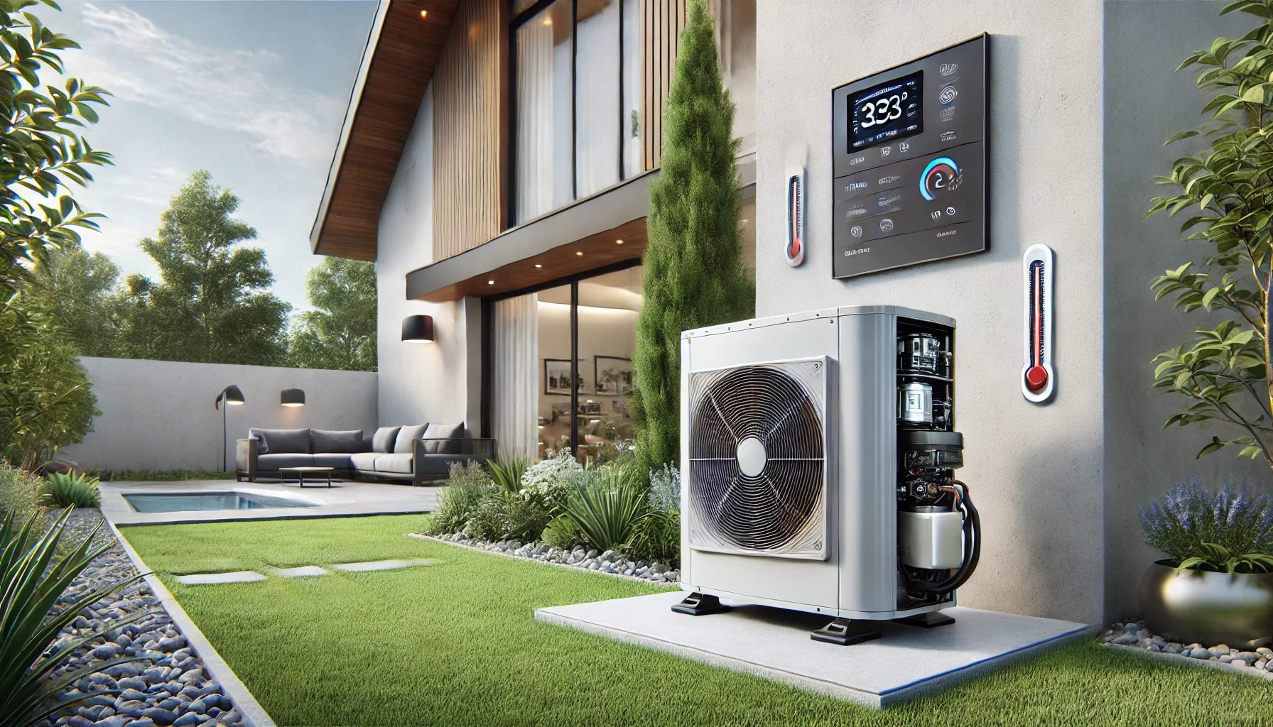
Pillars
Of Inverter Systems
Equipment Info
Equipment Requirements
Pic of Bryan Orr rolling his eyes about having to connect customer phone to wifi thermostat.
Relate that to having to commission a system with controls.
Commissioning Details
Startup Instructions

Slide 30
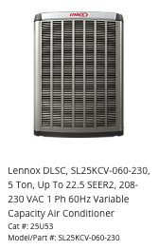
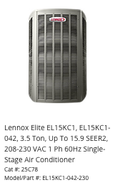
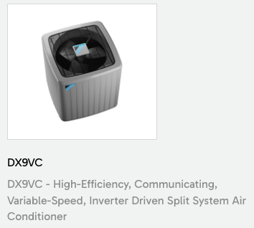
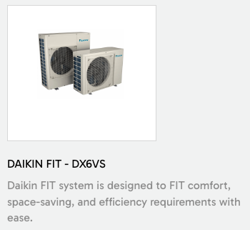
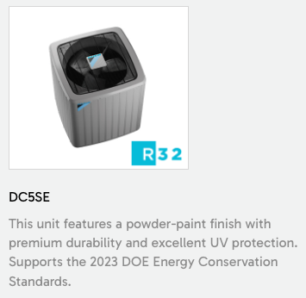
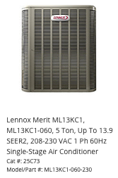
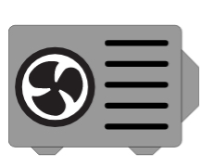
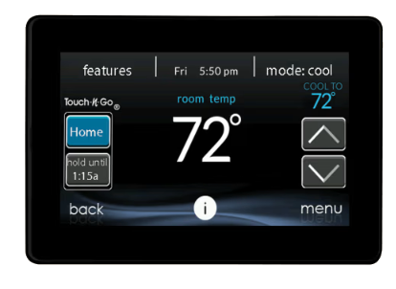
EQUIPMENT INFO
Brand
ETC.
Line
Tonnage
Control
App
Controlled

Slide 31
Pillars
Of Inverter Systems
Equipment Info
Equipment Requirements
Pic of Bryan Orr rolling his eyes about having to connect customer phone to wifi thermostat.
Relate that to having to commission a system with controls.
Commissioning Details
Startup Instructions

Slide 32
EQUIPMENT REQUIREMENTS
Outdoor Temperature
Indoor Temperature
Wall Control/App/Display
*Charge Mode
App
Controlled

Slide 33
Pillars
Of Inverter Systems
Equipment Info
Equipment Requirements
Pic of Bryan Orr rolling his eyes about having to connect customer phone to wifi thermostat.
Relate that to having to commission a system with controls.
Commissioning Details
Startup Instructions

Slide 34
COMMISSIONING DETAILS
Factory Charge
Charging Method (Subcooling)
Fix Ty’s last name
Subcool Target/Tolerance
Wait Time

Slide 35
Pillars
Of Inverter Systems
Equipment Info
Equipment Requirements
Pic of Bryan Orr rolling his eyes about having to connect customer phone to wifi thermostat.
Relate that to having to commission a system with controls.
Commissioning Details
Startup Instructions

Slide 36
Inverter System Start Up Instructions
Activating Charge Mode
Step 1
Step 2
Step 3
100%
App
Controlled
100%

Slide 37
How many times have you been told to consult the OEM only to find out you didn’t find what you needed.

Slide 38
OEM Commissioning Data
How about some better instructions…

Slide 39
OEM Commissioning Data
Once conditions are favorable. Okaayy...

Slide 40
OEM Commissioning Data
Sound, sure that’s a good place for compressor RPM data.
I should not have to go to sound power level to be the only place to find compressor max RPM.

Slide 41
OEM Commissioning Data
Why is the outdoor unit my identifier? How will I know when it ramps down?

Slide 42
OEM Commissioning Data
Expensive thermostat, yet I must resort to the outdoor unit for running capacity?

Slide 43
Why don’t we just play one game. TOGETHER!
I mean, it does make sense…
Who let this guy on the court!

Slide 44
Commissioning Instructions For Inverters!
Available In The TEC SMART CALCULATORS App
FREE RESOURCE!

Slide 45
Commissioning Instructions For Inverters!
Where Do I Find It?
Available In The TEC SMART CALCULATORS App
2
1

Slide 46
Start up Instructions
Accessing Charge Mode
There were only two brands we could find confident capacity verification instructions for so that the equipment could be tested with third-party tools!
Capacity Verification
WHY?

Slide 47
Start up Instructions
Accessing Charge Mode
Ask your dealer about
Compressor Hertz or RPS Data.
Capacity Verification
Examples:
2 ton = 46 Hertz
3 ton = 66 Hertz
4 ton = 54 Hertz
5 ton = 60 Hertz
*Notice the hertz are different for each tonnage. Different compressor, different charts!

