Slide 1
Spray Foam Used in Unvented Attics
Keith Grzybowski Huntsman Building Solutions, Engineering Manager

Slide 2
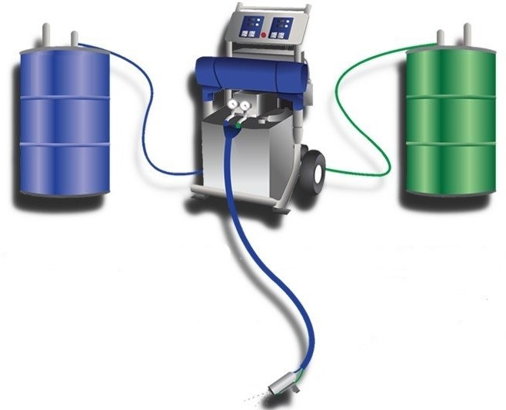
What is Spray Polyurethane Foam (SPF)
Two Component System
Applied as a Liquid
Expands in Place
Air Barrier (Air Impermeable)
Will Not Support Mold Growth
Environmentally Responsible
Energy Efficiency
Zero Ozone Depletion
Low Embodied Carbon
A
B
Notes:
A-Side (ISO) - MDI
B-Side (resin) mixture of polyols – manufacturer specific
Contractor manufactures the actual spray foam insulation on the jobsite
It’s initially applied as a liquid that rapidly expands to provide a continuous air seal by filling all the gaps, cracks, and voids

Slide 3
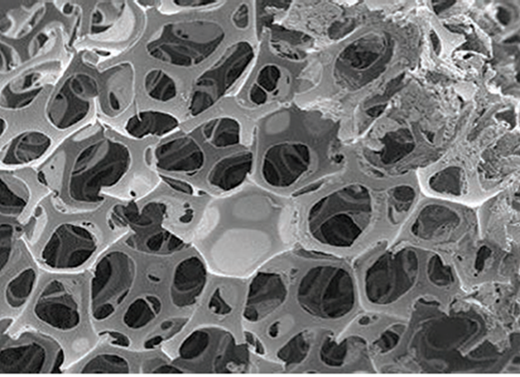
Open-Cell SPF
Low Density Open-Cell:
Spray-in-Place Insulation & Air Barrier
0.5 – 0.75 lbs./ft³
R-3.5 - 4.5 per inch
Vapor Semi-Permeable (Open)
5 - 15 Perms
Flexible
Drains water through
Water Blown
GWP: 0
3
Notes:
Interior use only. Can be used residentially/commercially

Slide 4
Key Advantages of Open-Cell SPF
Flexible, maintains an air seal during movement/shifting of the building over time
Semi-vapor permeable supports bi-directional drying of assemblies
Soft texture and open cell structure allows for greater sound abatement vs. a hard rigid foam
100:1 Expansion Ratio - (99% air) requires less material, reduced environmental impact, less expensive - $/R-value
4

Slide 5
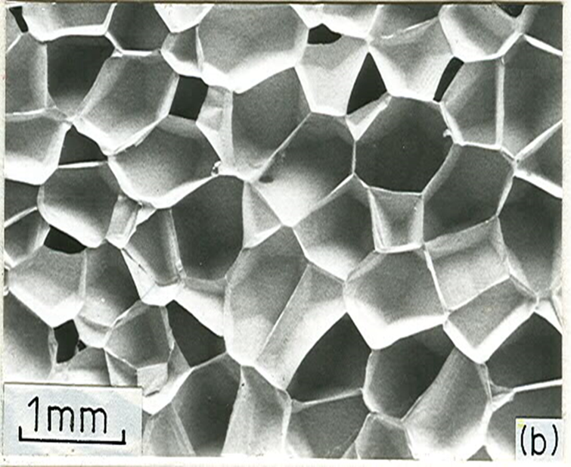
Closed-Cell SPF
Medium Density Closed-Cell:
Spray-in-place Insulation & Air Barrier
2 lbs./ft³
R- 6.0 -7.4 per inch
Low Vapor Permeance < 1 Perm
Class II Vapor Retarder
Rigid
Does Not Sustain Mold
Rejects Bulk Water
Synthetic Blowing Agent
HFO - Zero ODP, GWP: 1
5
Notes:
Typically expands 30 – 40 times its size
HFO Mandated Jan 1 2025

Slide 6
Key Advantages of Closed-Cell SPF
Higher R-Value per inch - Limited spaces
Can be used in CZ 5 and above without an additional vapor retarder product
Class II Vapor Retarder (< 1 perm ) required in Cold Climates
Resiliency
Higher tensile strength - Rigid composition adds wall racking strength
Increased Wind Uplift for roof assemblies
FEMA Class 5 rated product
Renewable and Recycled Content
6

Slide 7
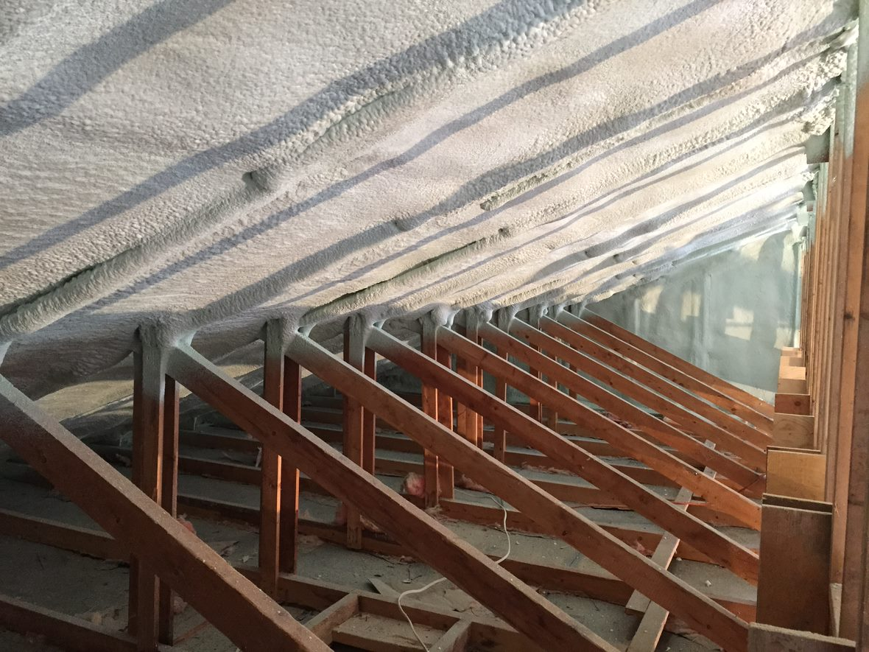
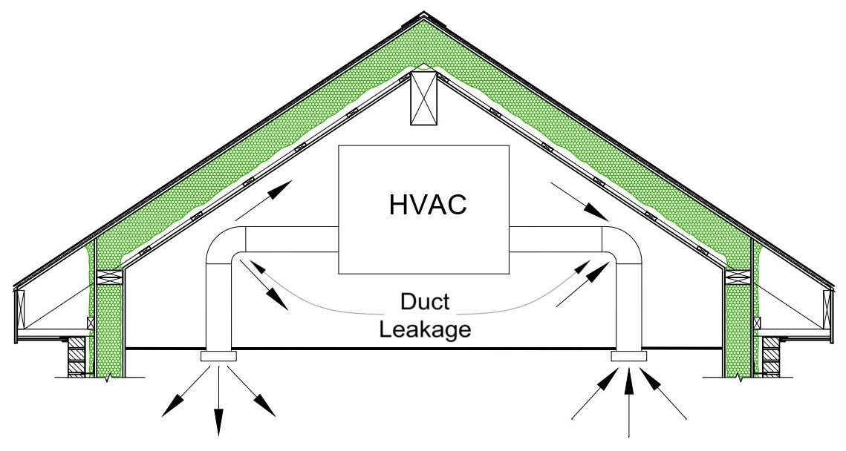
Unvented Attics
7
Notes:
IRC Section R806.5 – Introduced 2009
IBC Section 1202.3 – Introduced 2015
There are provisions for air impermeable, air permeable and hybrid assemblies.

Slide 8
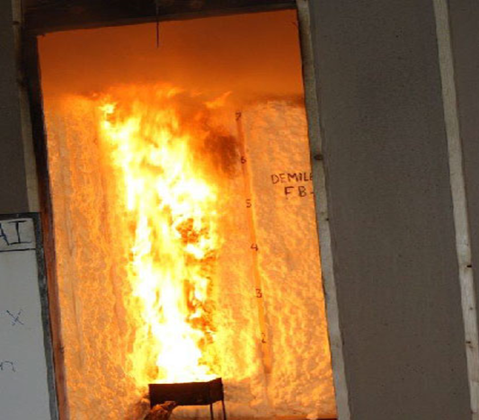
Code Requirements
Flame Spread and Smoke Developed Index
<75 and <450
15-minute Thermal Barrier
½” Gypsum or 23/32” Wood Structural Panel
Attics and Crawl Spaces
Only require an Ignition Barrier Protection Required
Foam Left Exposed in Attic
Specific Spray Foam Products must be Tested
Alternate Thermal Barrier Assemblies (Intumescent Coatings)
No Storage permitted, Only to Service Utilities, Air is Not Circulated to Other Parts of Building
AC377 Appendix X or End-Use Configuration
Min/Max Thickness
Must be 3rd Party Verified
8
Notes:
In general spray foam needs to be separated from the interior of a building by a 15-minute thermal barrier
TB Prescriptively ½” gypsum or 23/32” Wood structural panels
IB Prescriptively 1.5” mineral wool, ¼” WSP, 3/8” particleboard, ¼” hardboard, 3/8” gypsum, 0.016” steel sheet metal, 1.5” cellulose, ¼” fiber cement panel
Alternate thermal barrier assemblies (intumescent Coatings) tested in accordance with NFPA 286, FM 4880 or UL 1040

Slide 9
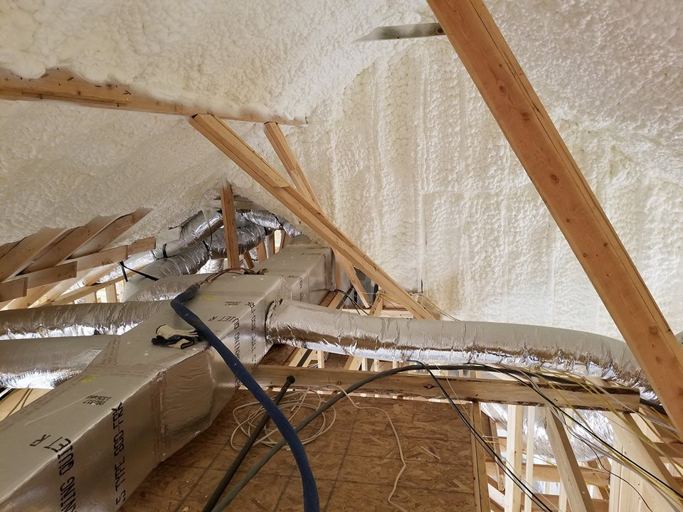
Advantages
Tighter Building Envelope
HVAC Equipment and Ducts in Conditioned Space
Cathedral Ceilings and Flat Roofs
Resiliency
Retrofits
9
Notes:
Seals typically the leakiest part of the house

Slide 10
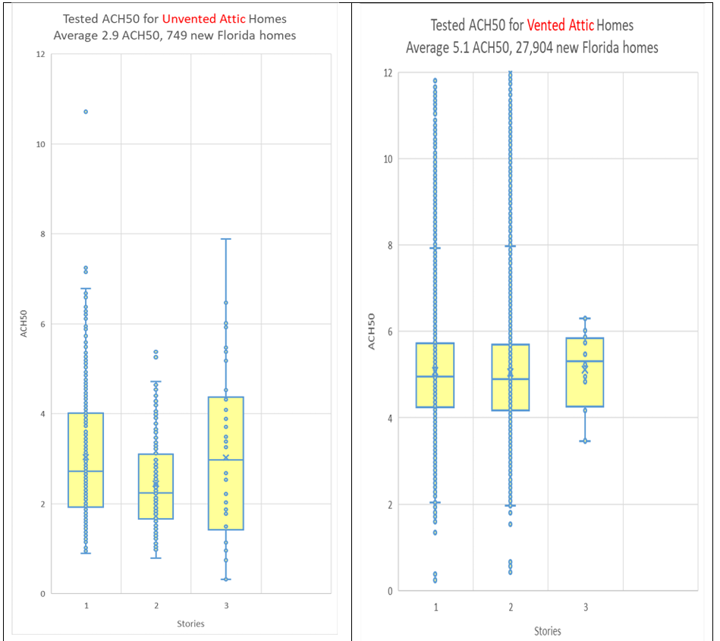
Building Envelope
Tighter Building Envelope
Spray Foam is both Insulating and Air Sealing the Structure
No Longer Need to Seal Attic Floor Penetrations
Can Lights, Exhaust Fans, etc.
Eliminate Certain Accessory Products
Soffit/Ridge Vents, Radiant Sheathing, etc.)
10
Notes:
Airtightness levels of Energy rated Florida homes constructed in 2020 to October 20, 2024
Median values at centerline
Box is 25% - 75% range of values
Vents serv a purpose, but are weak points for unwanted intrusion (water, pollutants, etc.)

Slide 11
Conditioned Attic
Continuous Air Seal
Moving the Thermal Boundary to the Roofline
Creates a Conditioned Attic Space
No Insulation or Class I Vapor Retarder at the Ceiling Level
Allows Attic and Living Space to Passively Communicate
HVAC Equipment in Attic Space
Run More Efficiently
Longer Lifespan
Eliminate HVAC Closets
Typical Vapor Retarder in cold climates
Attic Space
Keep Conditioned Air In
Allow Air and Moisture to communicate between the two spaces.
Living Space
11
Notes:
-Conditioned Space (IECC) – An area, room or space that is enclosed within the building thermal envelope and that is directly heated or cooled or indirectly heated or cooled. Spaces are indirectly heated or cooled where they communicate through openings with conditioned spaces, where they are separated from conditioned spaces by uninsulated walls, floors or ceilings, or where they contain uninsulated ducts, piping or other sources of heating or cooling.
-Attic temperature typically +/- 10F from living space temperature
-HVAC equipment running more efficiently, longer lifespan

Slide 12
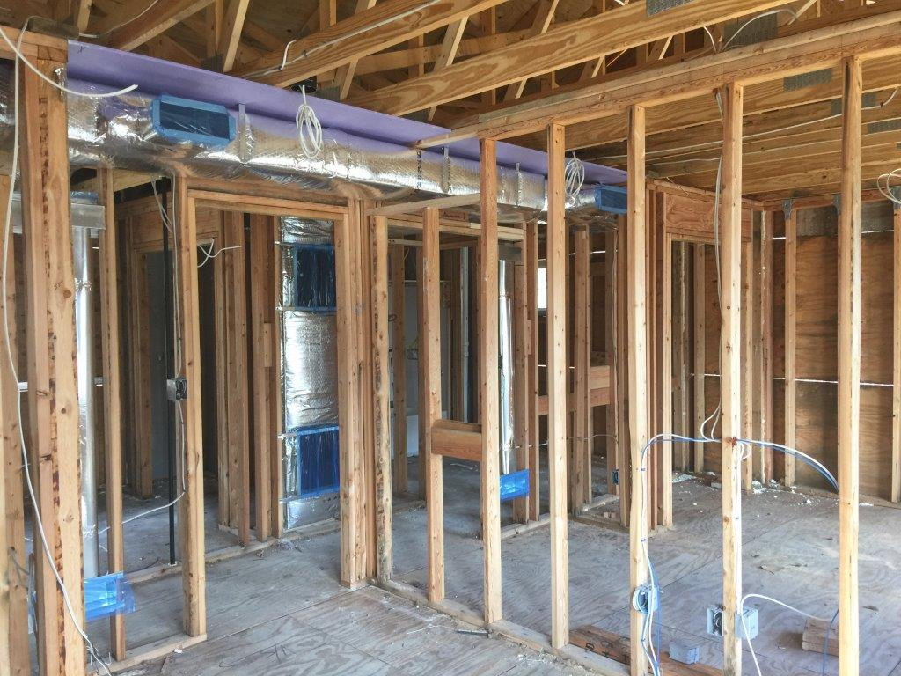
Ducts in Conditioned Space
Duct Leakage is no Longer Lost Directly Outside
Duct Insulation in no Longer Required
Ease of Construction
Eliminate Chases in Attic Floors
Difficulties with Deeply Buried Ducts
12
Notes:
Ducts in conditioned space becoming more prevalent (ES, ZERH)
Duct leakage ranges can be excessive
Duct Testing is not always required
Duct insulation was in major shortage in 2020/2021
Added square footage and design flexibility with moving HVAC equipment into the attic
Ducts in dropped ceiling in photo

Slide 13
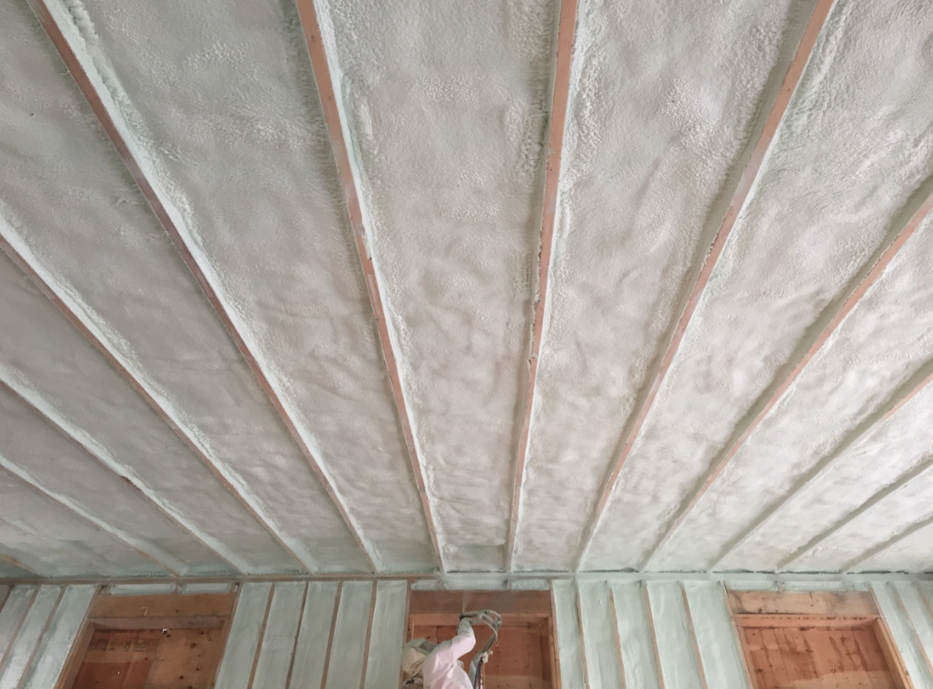
Cathedral Ceilings
Limited Space
Meet Increasing R-Value Requirements
Eliminates Poor Ventilation
Air Flow Through Insulation
13
Notes:
No cross ventilation in cathedral roofs
Low slope roofs have poor ventilation (no stack effect)
Up to an R60 in 8” of closed-cell spray foam

Slide 14
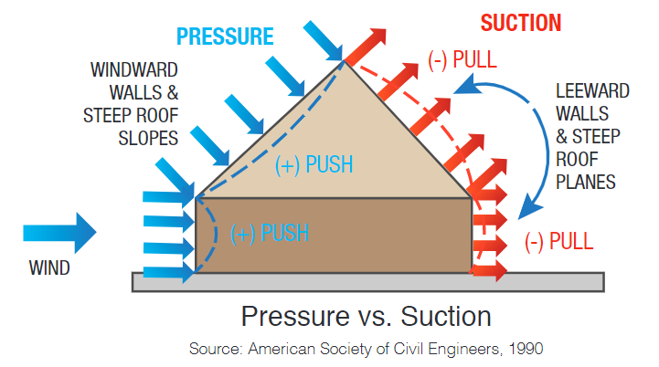
Resiliency
Increase Uplift Resistance with Spray Foamed Roof Decks
Eliminate Soffit/Vent Openings
Water Infiltration
Fire Embers / Smoke
Pests
14
Notes:
During hurricanes there are 3 main causes of damage: storm surge (flooding), damage from rain and wind damage.
Wind is listed as the highest cause for property damage/loss.
Wind uplift is a naturally occurring vacuum created in strong wind events. Results in rapid and sustained pressure forces on the roof.
WUI Code has special requirements for attic vents. Specialty vents that prevent intrusion of flames or embers $$$

Slide 15
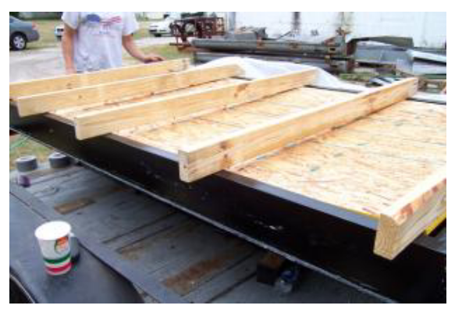
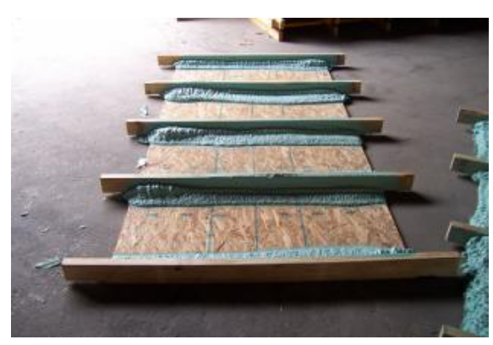
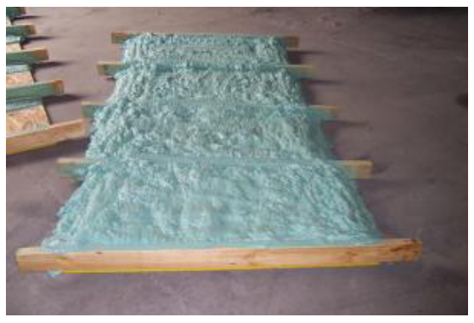
Wind Uplift
15
Notes:
Testing information from SPFA 2008 test study.
Spray foam “adhesive” used as a fillet can add up to 2x the strength to the roof deck/truss attachment. 3” full-cavity fill can add 3x.
FEMA P-804 – Wind Retrofit for Residential Buildings:
Multiple guidelines for how to add cost effective wind-retrofit projects to mitigate damages from wind events.
3 Project Types: Roof and Wall Coverings, openings (windows/doors), Load Path Connections.
SPF prescriptively listed as a roof deck “adhesive”
SPF Minimum design uplift pressure of 110psf (TAS 202)

Slide 16
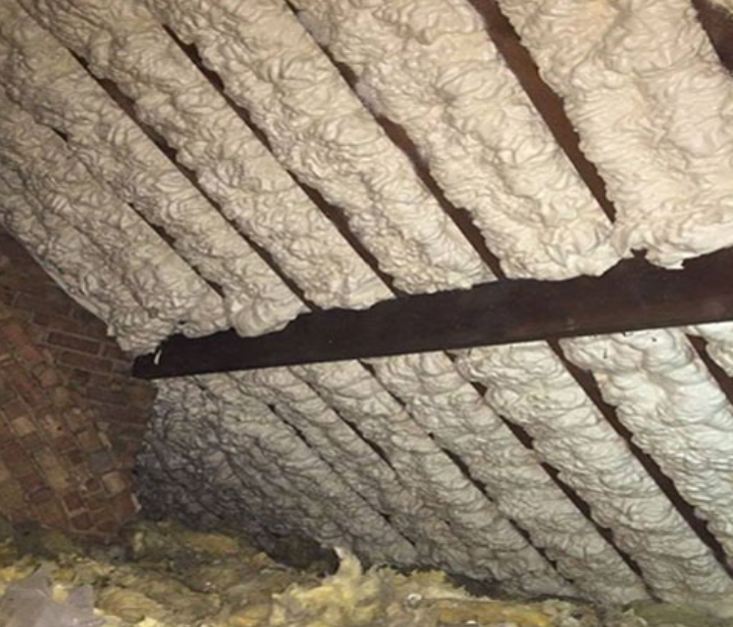
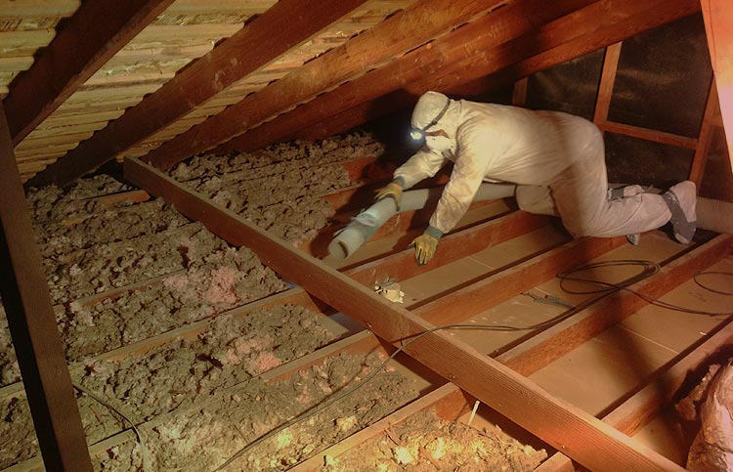
Retrofit Applications
Easiest Way to Substantially Upgrade Thermal Envelope
Increase insulation and add air sealing
Eliminate Moisture problems
It is important to remove the existing insulation in order to avoid creating an area for potential issues.
To reduce odors and improve indoor air quality
The existing insulation is full of dust and debris. Leaving those contaminates in a sealed attic may cause odor problems. Improvement to indoor air quality with less contaminates in the air.
Allow Air and Moisture to communicate between the two spaces.
16

Slide 17
Life Cycle Analysis
EPD | Embodied Carbon (1 m²) | Yearly Carbon Emission Reductions through energy savings | GWP Payback Period | Lifetime Carbon Savings | Return on Invested Carbon
HFO Industry | 4.16 kg | 1556 kg CO2/year | 7-8 years | >104 tCO2 | 8x
Open-Cell SPF | 1.65 kg | 1556 kg CO2/year | 2-3 years | >112 tCO2 | 14x
After offsetting its higher embodied carbon vs fiberglass, it then decarbonizes buildings throughout their lifetime.
SPF insulation offers the best Return on Invested Carbon in the market.
17
Notes:
Industry EPD comparing spray foam to fiberglass
75 year lifespan

Slide 18
THANK YOU
Questions?

Slide 19
Huntsman Building Solutions
Address
Number
Email
3315 E. Division St.
Arlington, TX 76011
214-930-1470
kgrzybowski@huntsmanbuilds.com

